Slide 1
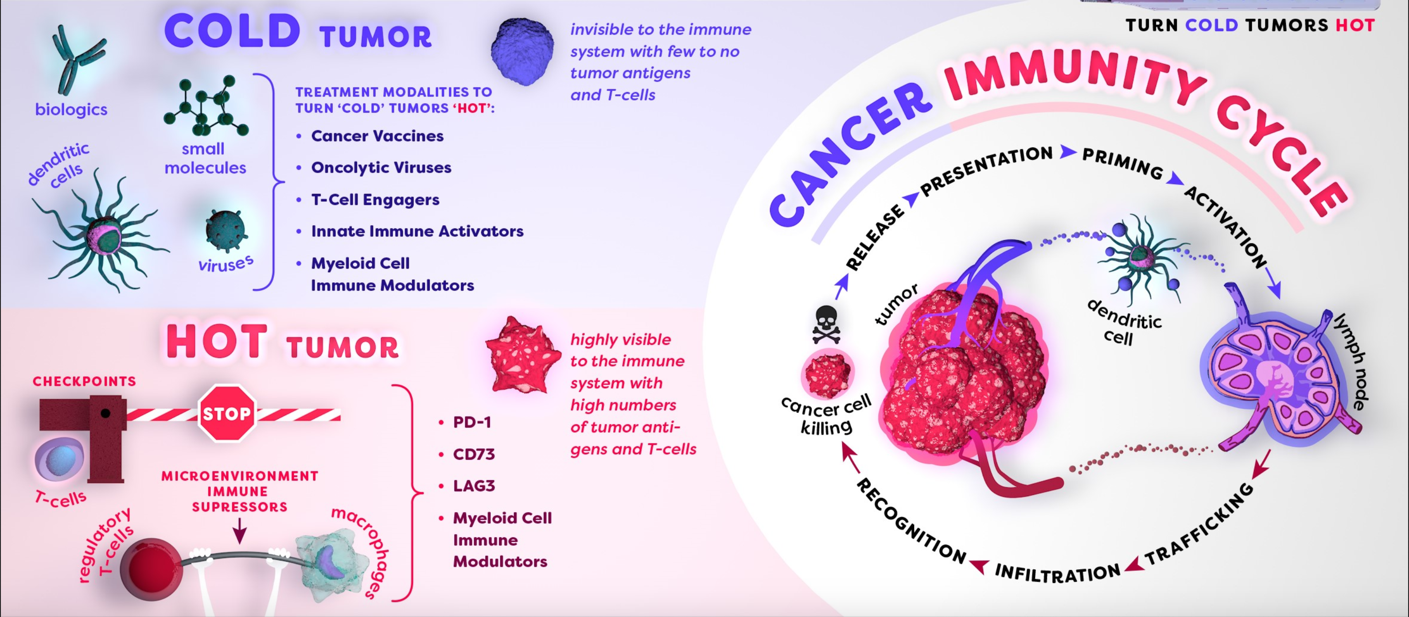
Tumour immunology, microenvironment and therapeutic avenues
Dr. Jamie Morrison (Associate Professor)
Uppsala University
Department of Pharmaceutical Biosciences
jamie.morrison@farmbio.uu.se

Slide 2
Learning Objectives
Understand the role of immune cells in tumour development (both primary and secondary tumours).
How cellular and humoral responses are important for immune surveillance of tumours.
How tumours evade immune surveillance.
Gain insight into the use of checkpoint inhibitors to improve the survival prognosis in cancer patients.

Slide 3
Useful resources
Janssen LM, Ramsay EE, Logsdon CD, et al. The immune system in cancer metastasis: friend or foe? Journal for ImmunoTherapy of Cancer 2017;5:79. doi: 10.1186/s40425-017-0283-9 – (PDF in Studium, https://jitc.bmj.com/content/5/1/79)
Tumour immunology and immunotherapy - https://www.youtube.com/watch?v=K09xzIQ8zsg
IMMUNOTHERAPY: The Path to a Cancer Cure - https://www.youtube.com/watch?v=UbFjiWOBErA

Slide 4
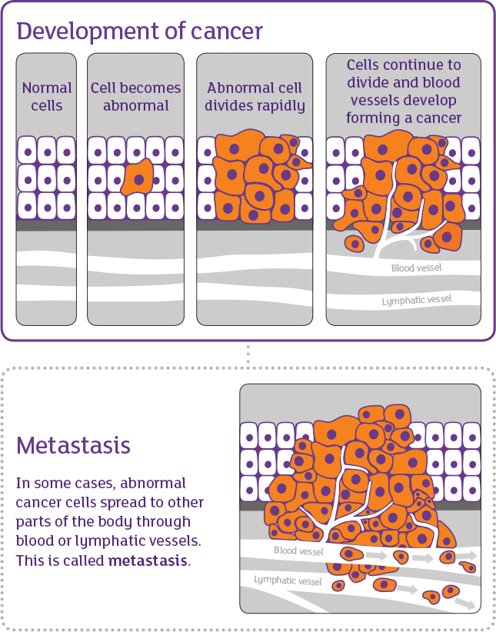
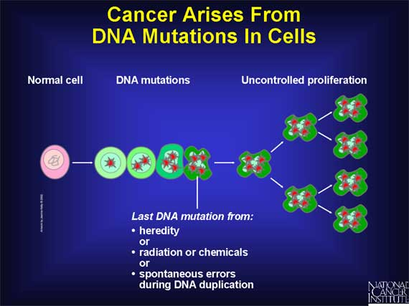
What is cancer?
https://www.web-books.com/ON/B0/E18R1818/09MB18.html
https://www.cancer.nsw.gov.au/about-cancer/cancer-basics/what-is-cancer

Slide 5
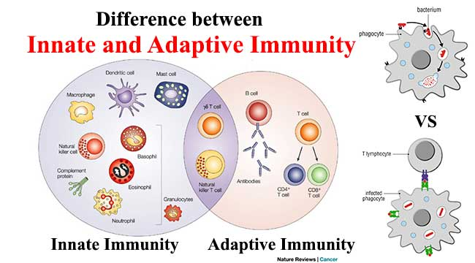

Slide 6
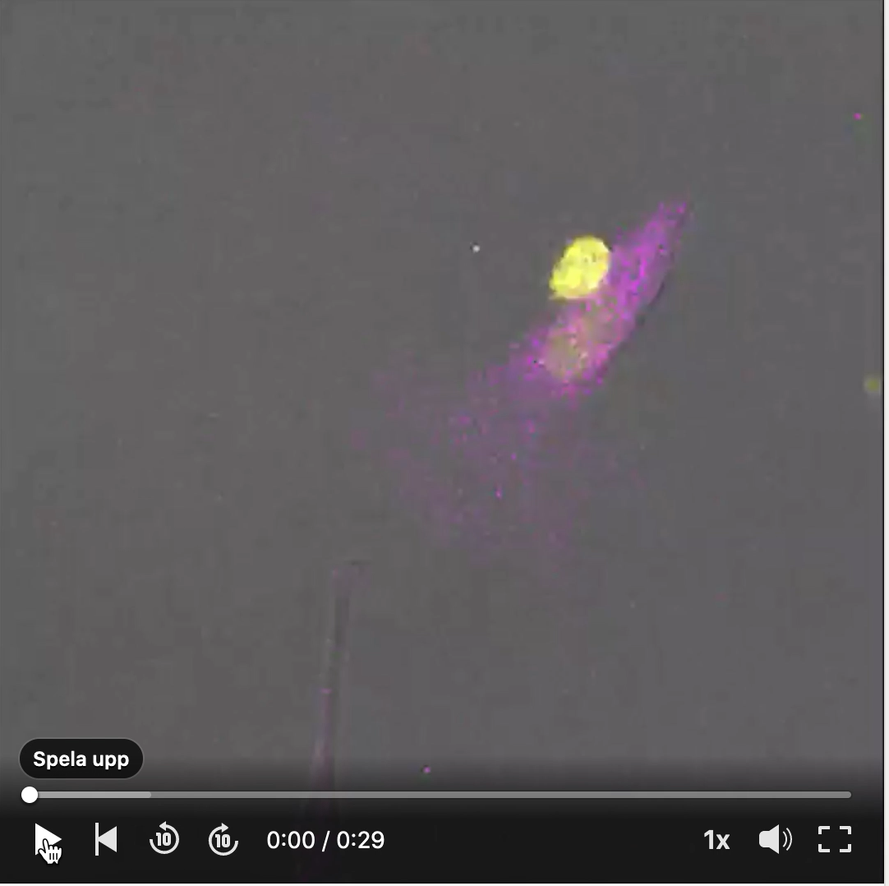
Courtesy of Jeroen Slaats (Radboud Institute for Molecular Life Sciences, Holland)

Slide 7
How is a tumour cell recognized by immune cells?
Does a tumour cell differ from our own tissue?
If so, how does it differ?
What type of immune response can be effective against tumour cells?

Slide 8
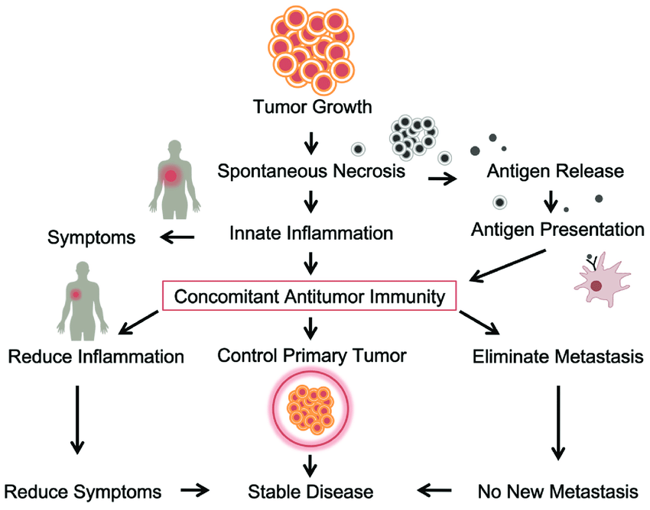

Slide 9
T cells are important for Concomitant Immunity

Slide 10
The importance of co-stimulation for T cell activation

Slide 11
T cells “help” each other

Slide 12
Cellular and humoral responses

Slide 13
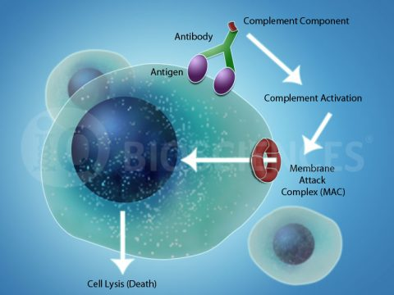
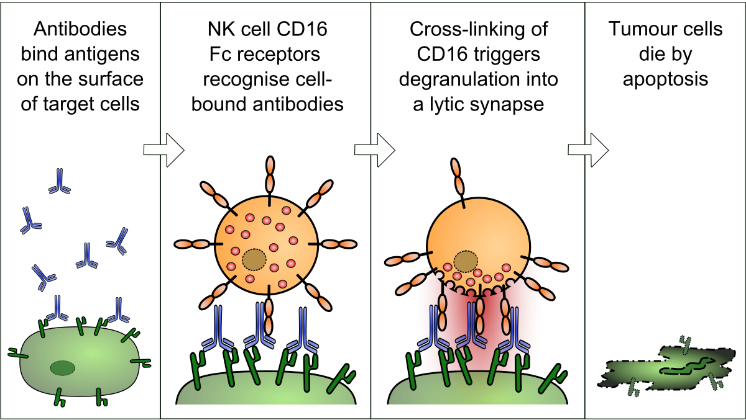
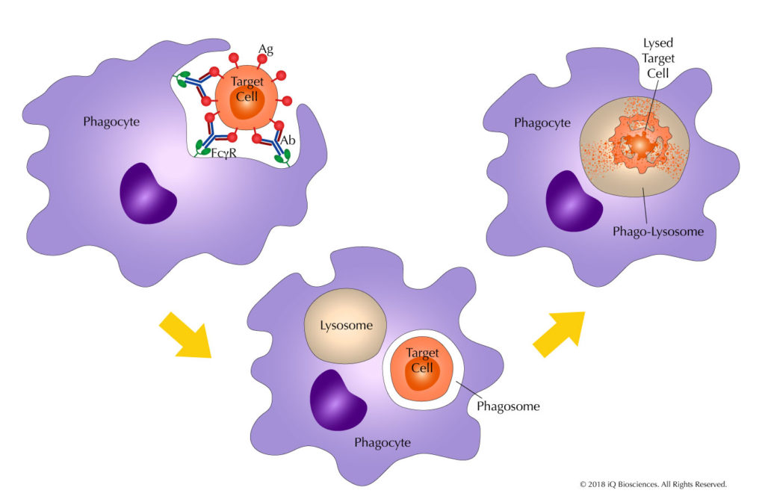
Complement-dependent Cytotoxicity (CDC)
How does the humoral response remove pathogens and tumour cells?
Antibody-dependent Cellular Cytotoxicity (ADCC)
Antibody-dependent Cellular Phagocytosis (ADCP)

Slide 14
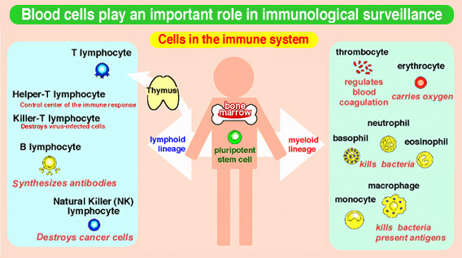
Can “Immune Surveillance” guard against tumour formation?
What evidence do we have for that this exists?
What immune cells are involved in immune surveillance?
How do drugs today work to aid immune surveillance?

Slide 15
Immune surveillance - tumours

Slide 16
Tumour antigens

Slide 17
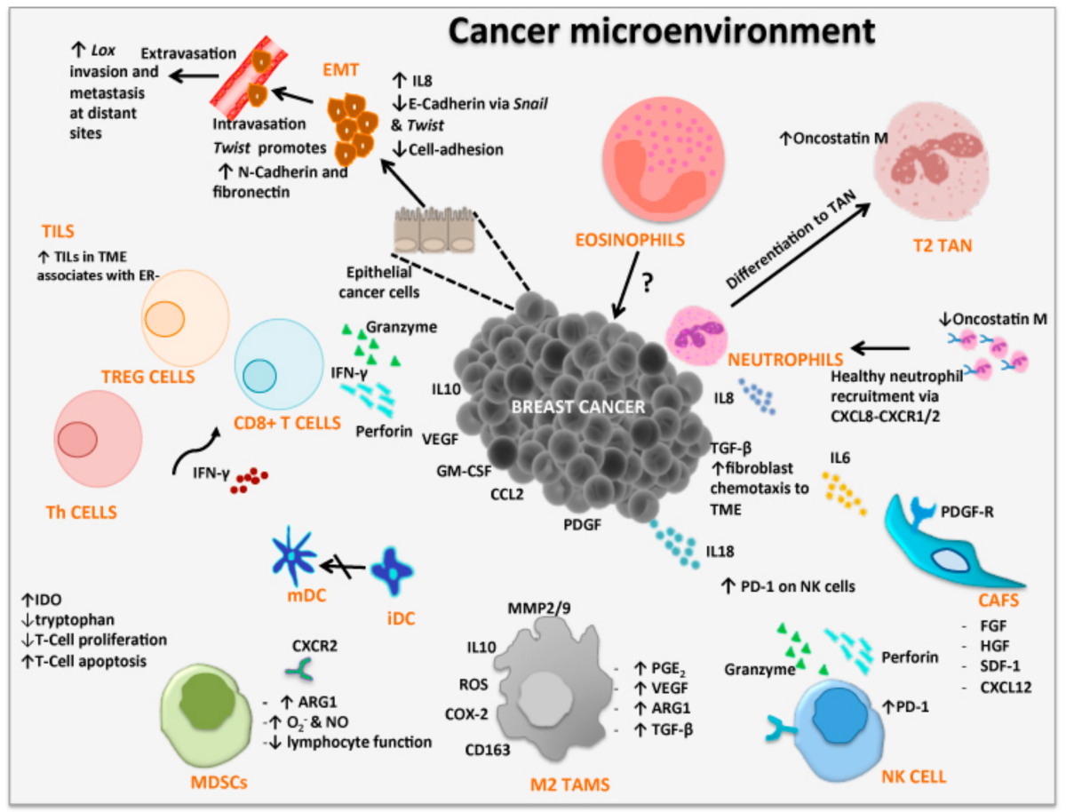
Are there immune cell infiltrates of special importance when it comes to improving the chance of survival?

Slide 18
T lymphocyte infiltration into the tumour is key to a successful and durable anti-tumour response

Slide 19
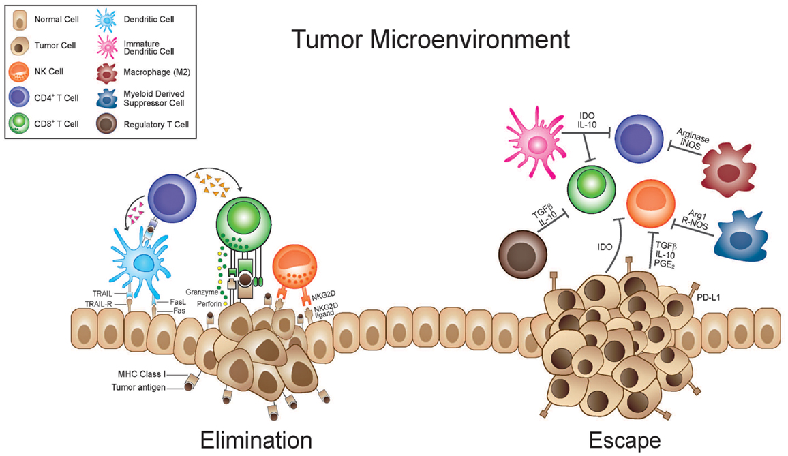
How is an immune response against a tumour induced?

Slide 20


Slide 21
Evasion of Immune responses against Tumours

Slide 22
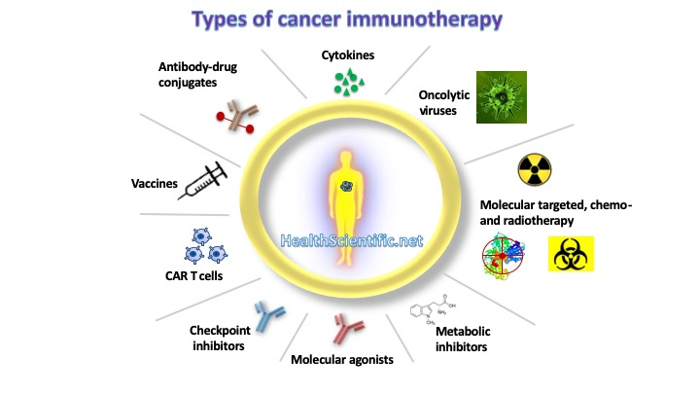
Specific and non-specific immunotherapies
There are two main categories of immunostimulants:
Specific immunostimulants provide antigenic specificity in immune response, such as vaccines or any antigen.
Non-specific immunostimulants act irrespective of antigenic specificity to augment immune response of other antigens or stimulate components of the immune system without antigenic specificity, such as adjuvants and non-specific immunostimulators.

Slide 23
Cancer Immunotherapies in use today

Slide 24
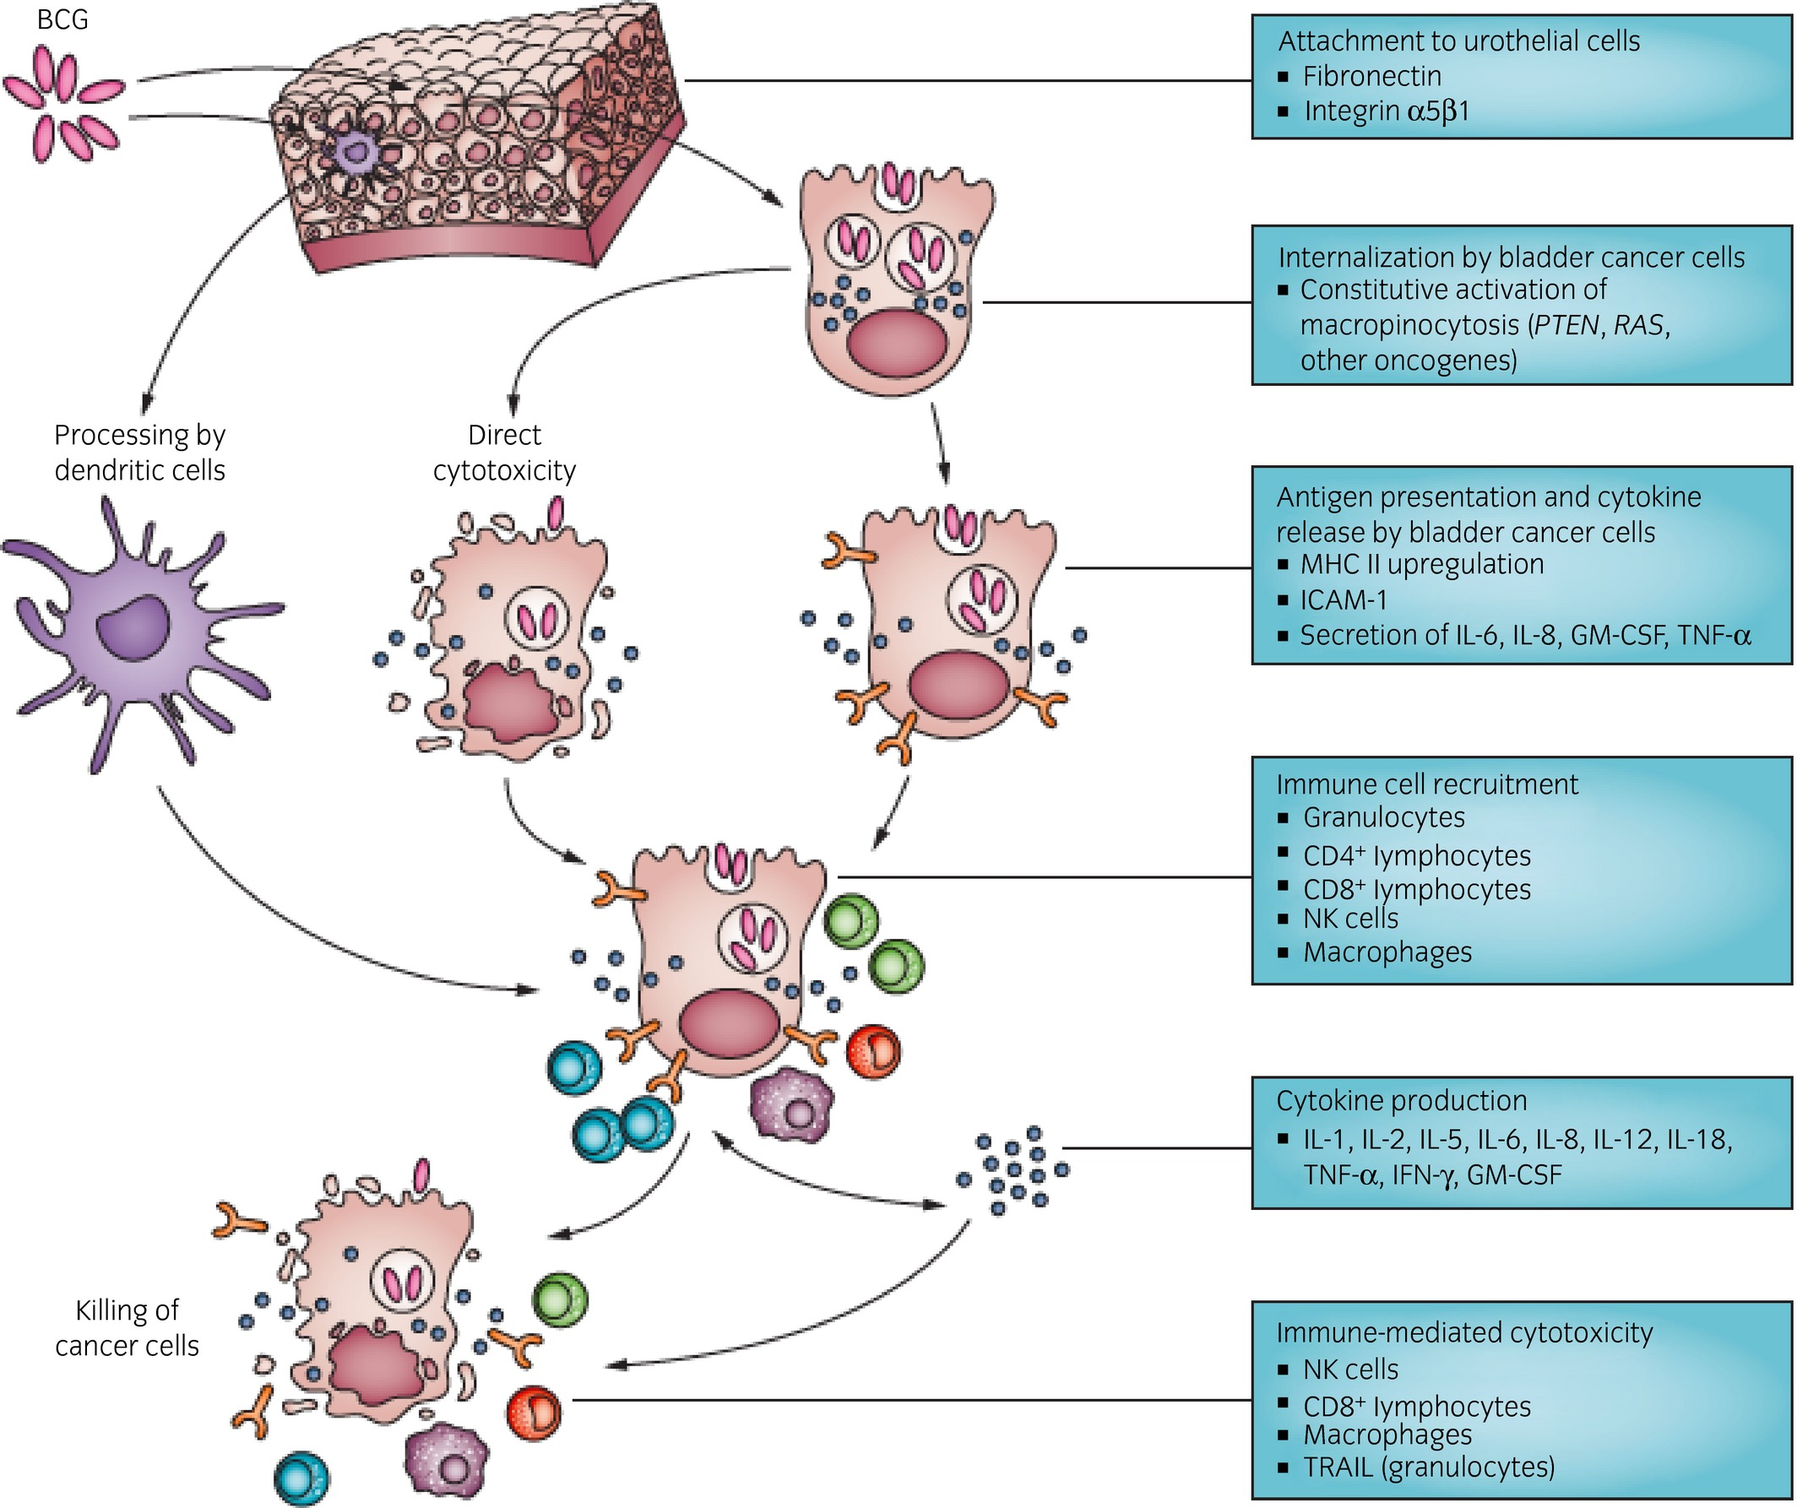
Non-specific immunotherapy in bladder cancer since 1970

Slide 25
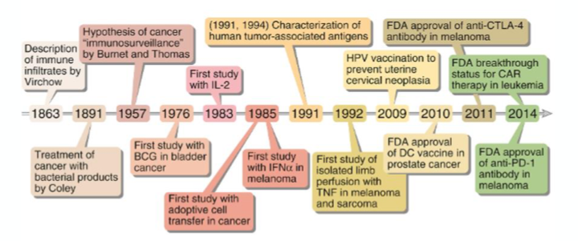
History of cancer immunotherapy

Slide 26
Division of cancer immunotherapy into two branches

Slide 27
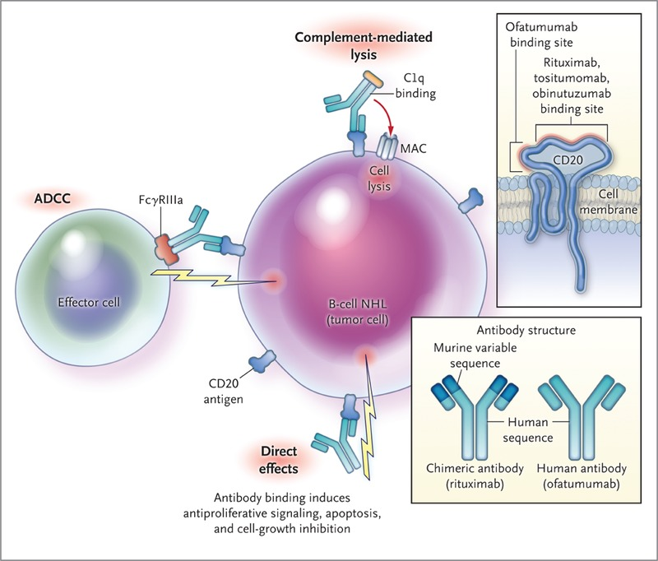
Passive immunotherapy of cancer
Antibody therapy

Slide 28
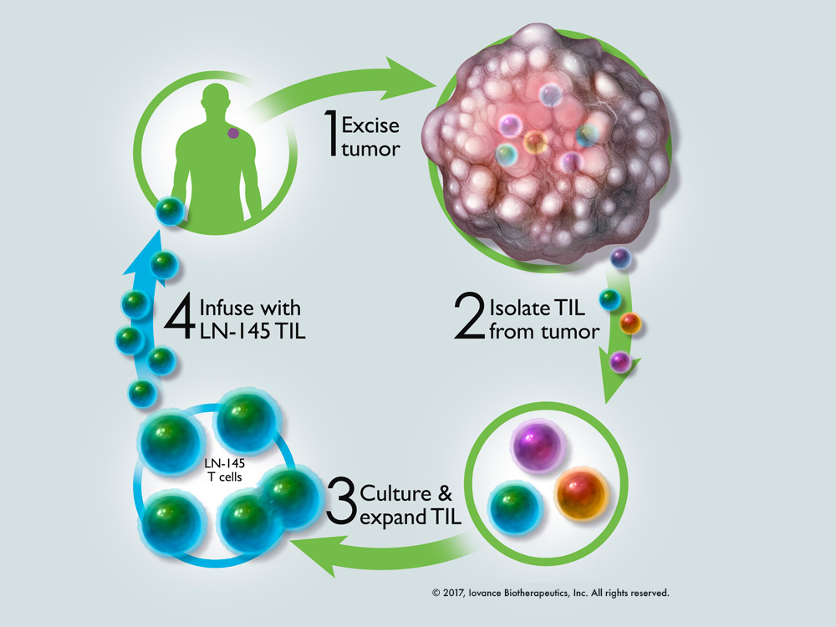
Passive immunotherapy of cancer
Poll 1
Adoptive cellular therapy (tumour infiltration lymphocytes (TILs)

Slide 29
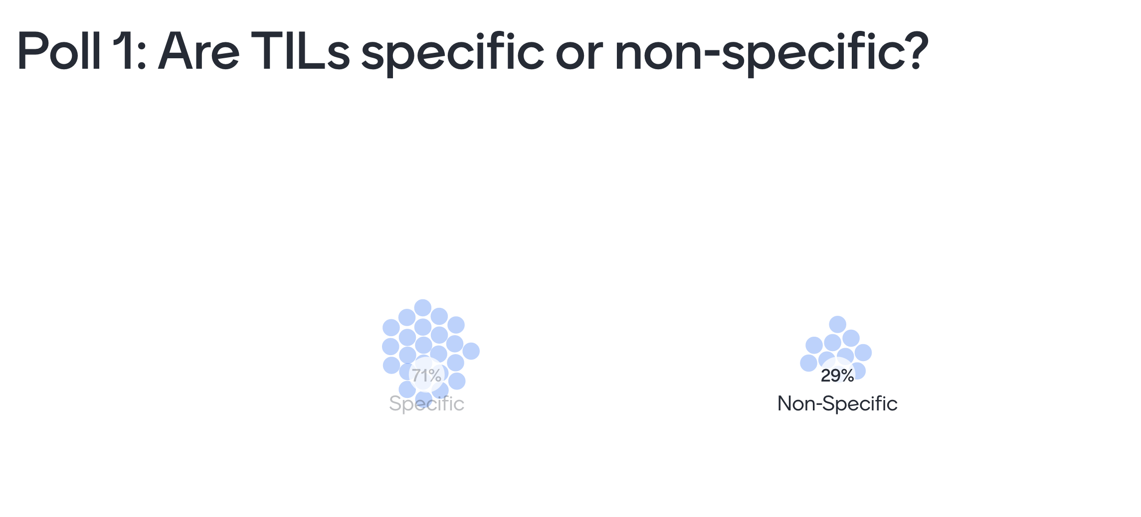

Slide 30
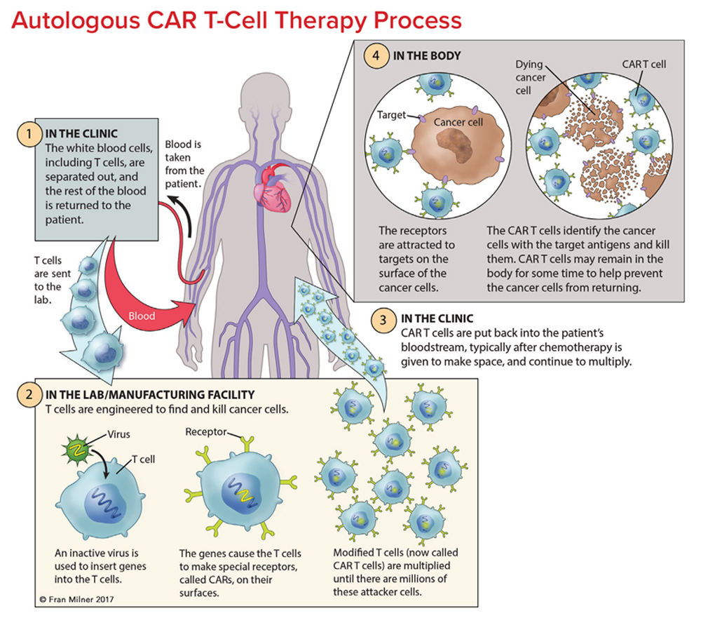
Passive immunotherapy of cancer
Chimeric antigen receptor (T cells) – CAR-T
Poll 2

Slide 31
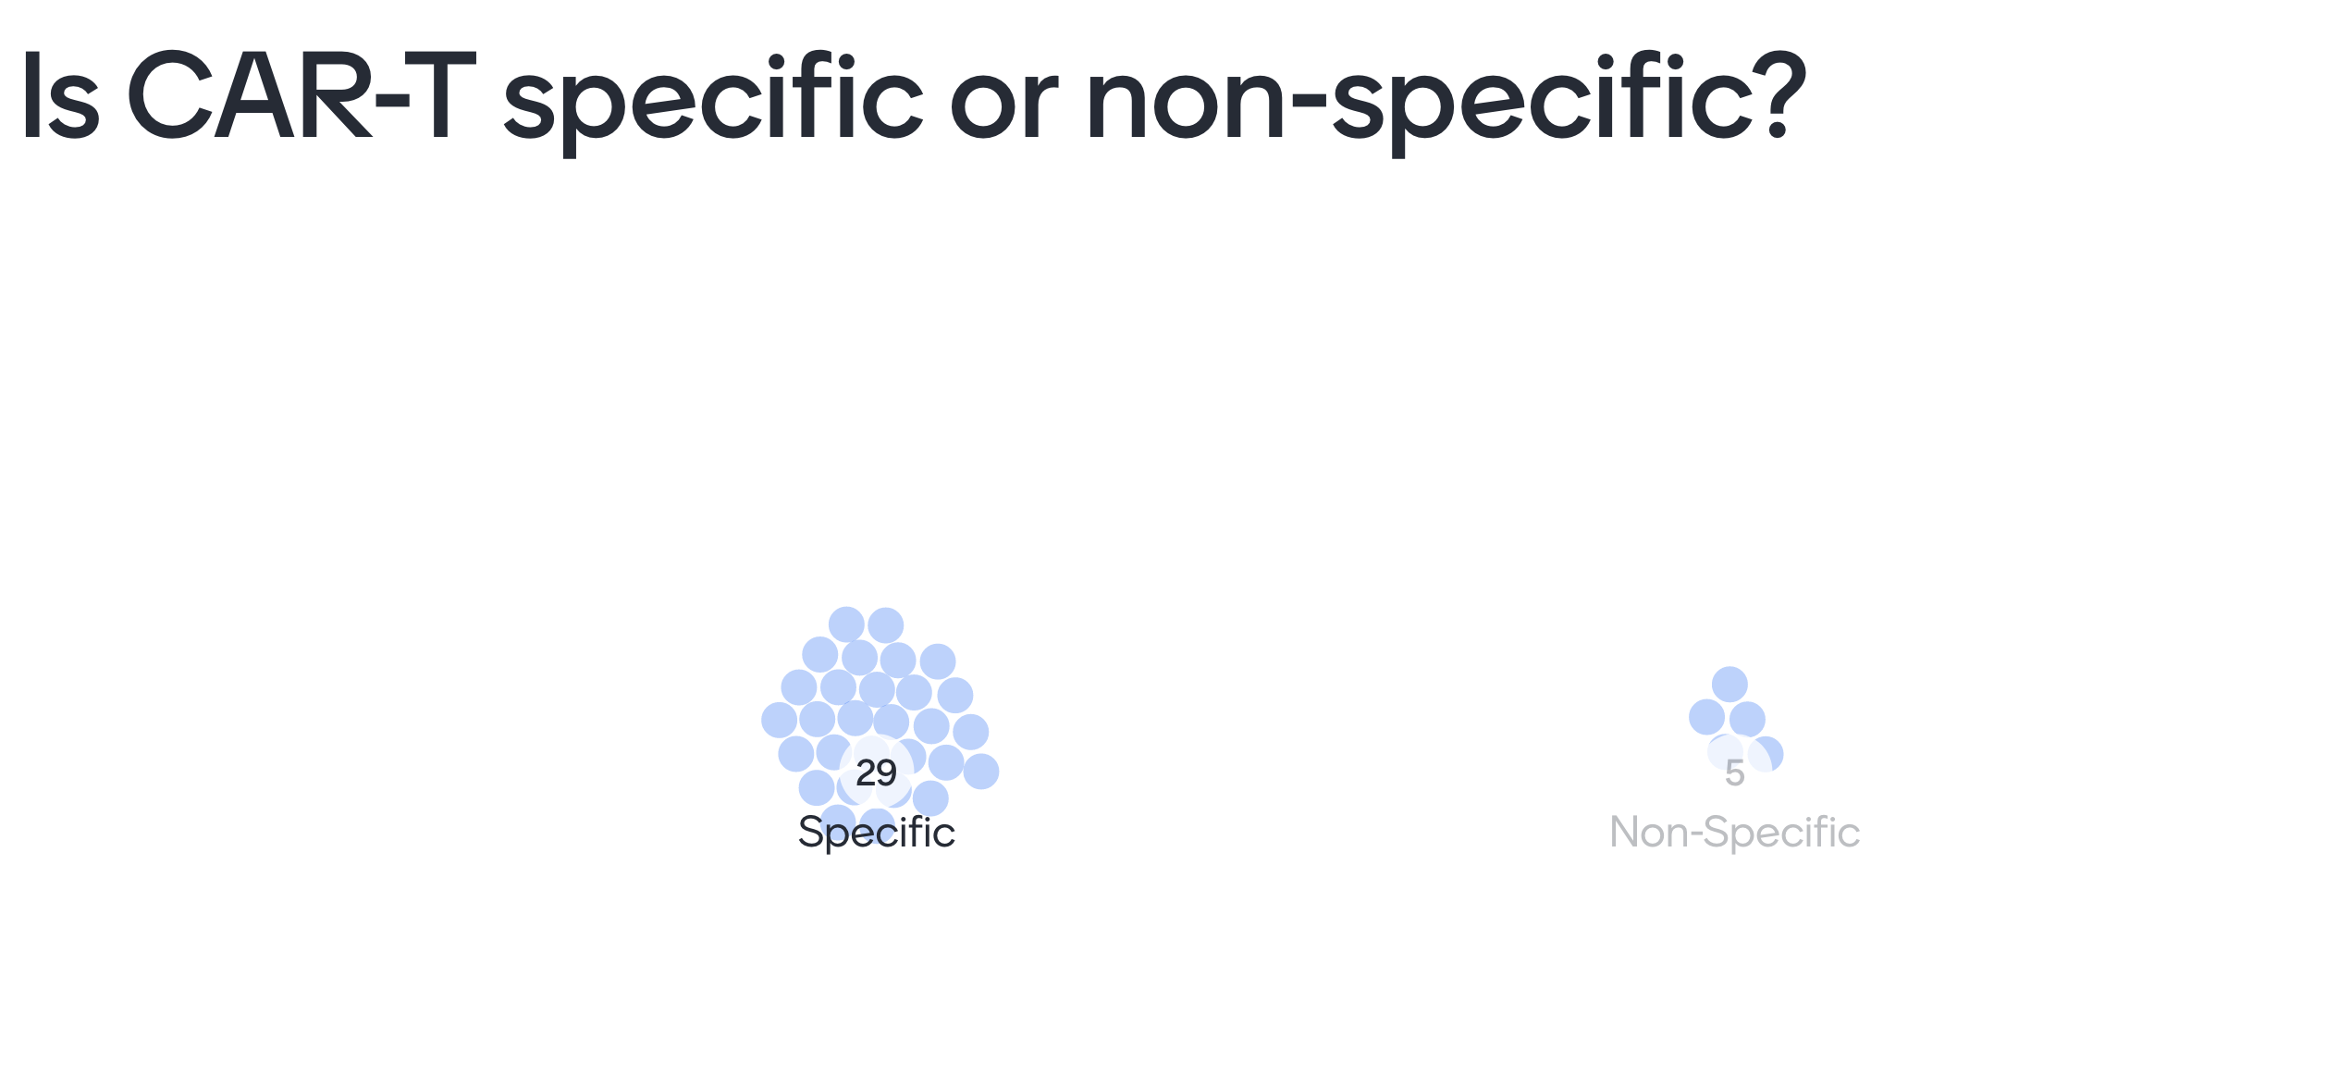

Slide 32
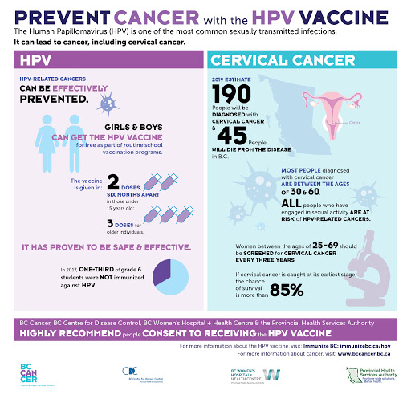
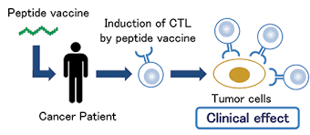
Stimulation of the host anti-tumour immune response
Prophylactic vaccination
Therapeutic vaccination
What is the difference?
Poll 3

Slide 33
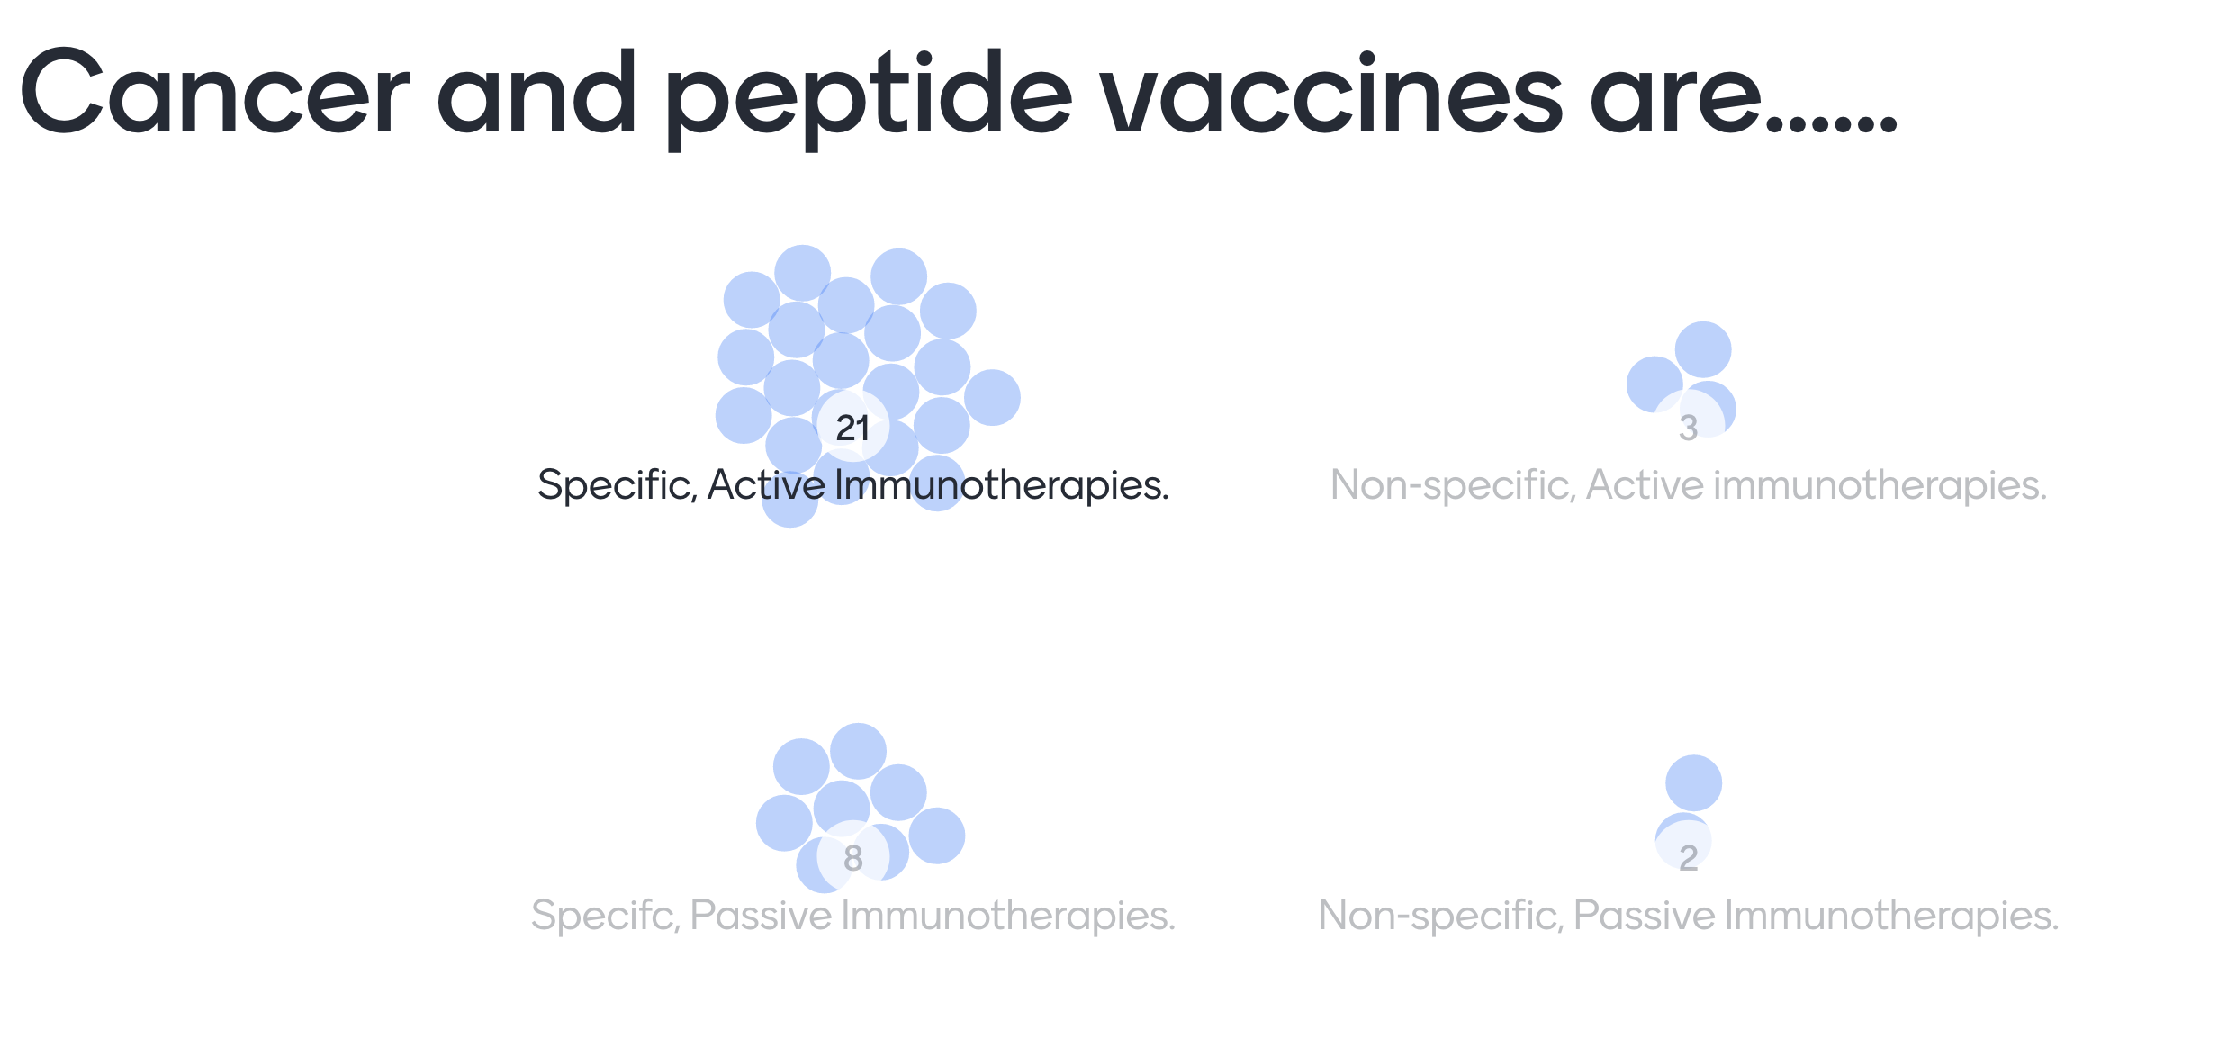

Slide 34
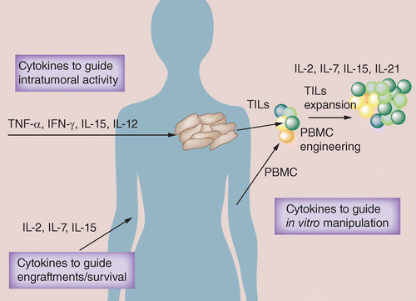
Stimulation of the host anti-tumour immune response
Cytokine Therapies

Slide 35
Stimulation of the host anti-tumour immune response

Slide 36
Checkpoint inhibitors – a game changer
Increasing immune responses through release of the breaks “checkpoint inhibitors”: Antibodies that can block the interaction between a receptor and a ligand.
Target: CTLA-4
– Antibody block of CTLA4 on a T cell will allow for proper co- stimulation to occur.
– CTLA-4 targeting antibodies can also remove T regulatory cells in the tumour through ADCP (antibody dependent cellular phagocytosis).
Target: PD-1 or PD-L1
– Remove the interaction between PD1 (T cell) and PDL1 (tumour) to increase anti-tumour responses.
B7 family of ligands and CD28-family of receptors
Poll 4

Slide 37
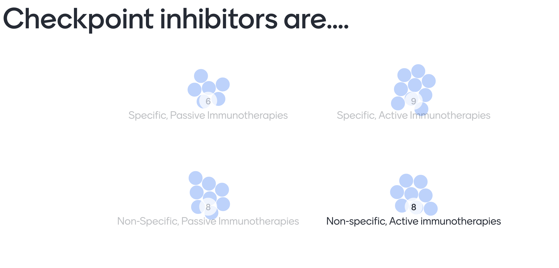

Slide 39
FDA approval landscape of CPIs
CTLA-4 Human IgG1 Mab
PD-1 Human IgG4 Mab
CTLA-4 Human IgG1 Mab/PD-1 Human IgG4 Mab
PD-1 Humanised IgG4 Mab
PD-L1 Humanised IgG1 Mab
PD-L1 Human IgG1_{K} Mab
PD-L1 Human IgG1 Mab

Slide 40
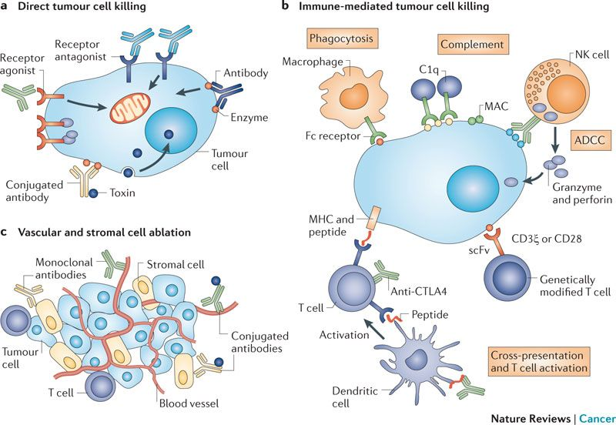
Monoclonal antibodies have a wide variety of ways to modulate anti-tumour immunity
http://edelweisspublications.com/keyword/28/913/Antibody-therapy

Slide 41
Ways to use monoclonal antibodies as drugs that can affect immune responses against a tumour

Slide 42
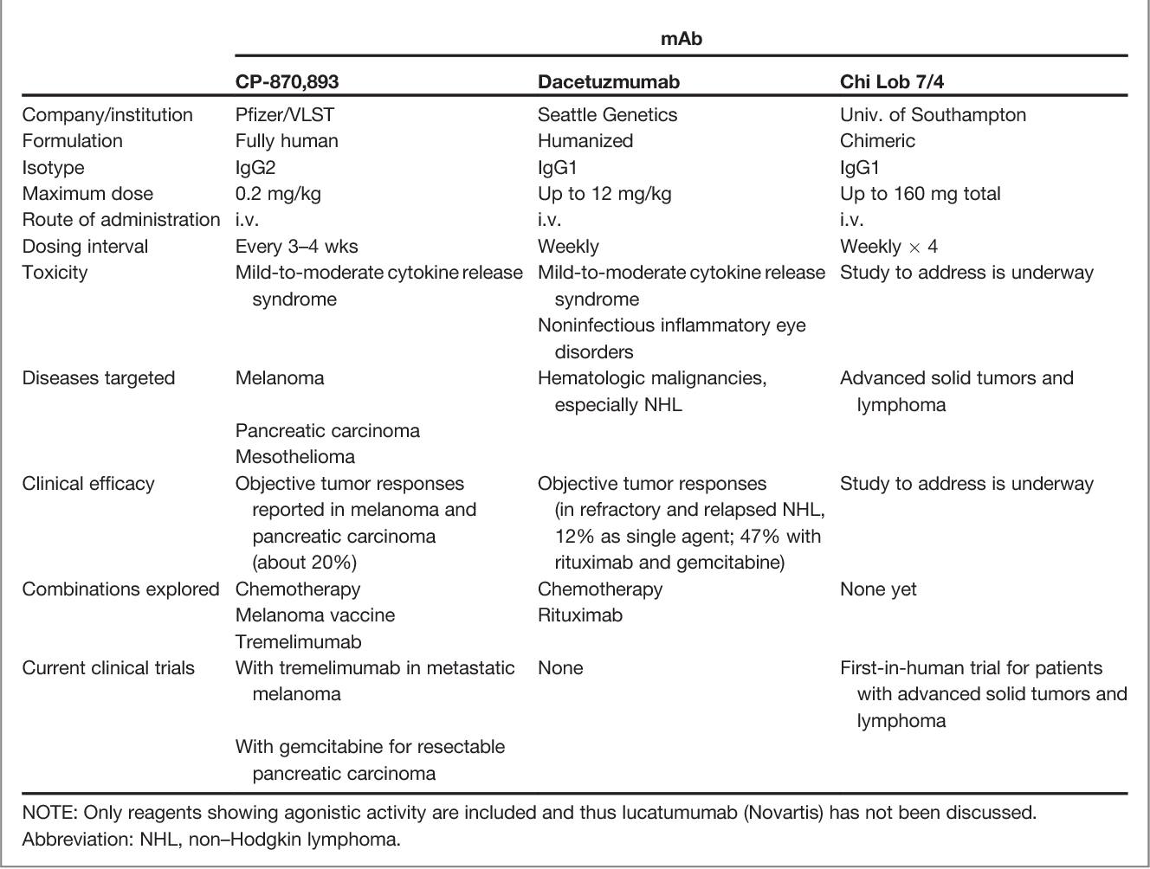
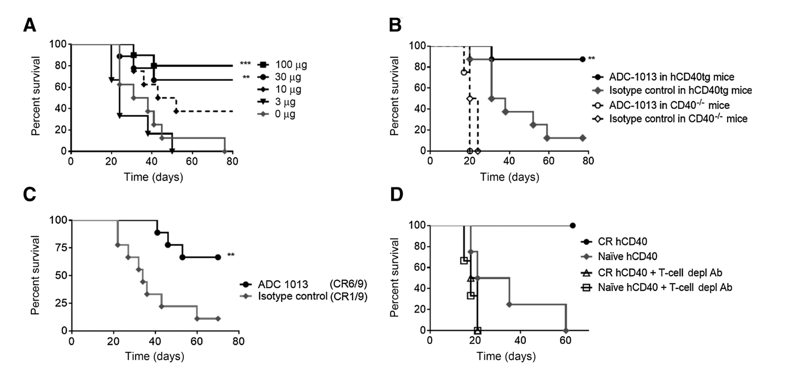
Anti-CD40 antibodies in clinical trials
Sara M. Mangsbo et al. Clin Cancer Res 2015;21:1115-1126
Vonderheide, R., & Glennie, M. (2013). Agonistic CD40 Antibodies and Cancer Therapy. Clinical Cancer Research, 19, 1035 - 1043.

Slide 43
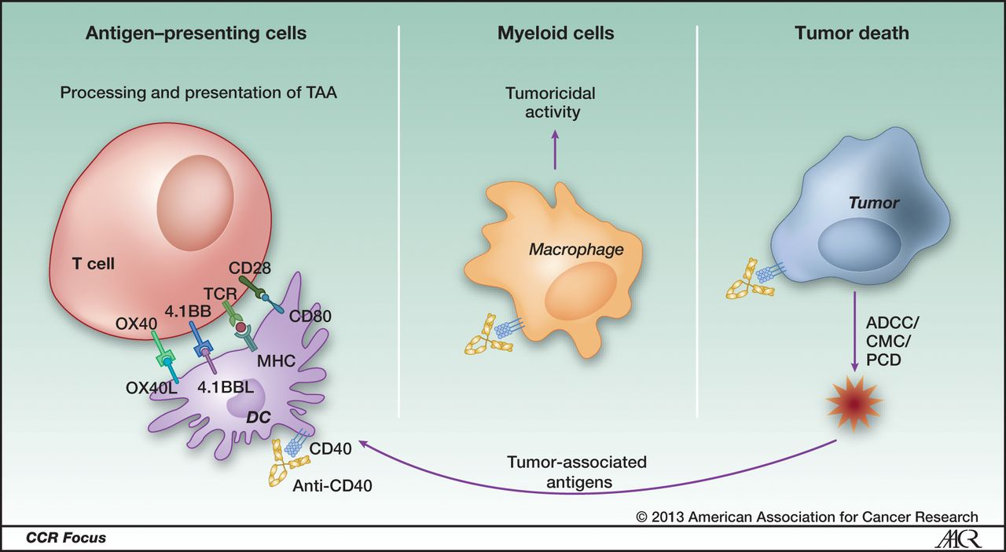
Potential mechanisms of action of agonistic CD40 mAb on various immune effectors
Roxana S. Dronca, and Haidong Dong Clin Cancer Res 2015;21:944-946

Slide 44
Conclusions
Antigen-presentation and co-stimulation is key to induce proper anti-tumour responses.
Cytotoxic T cells, NK cells and macrophages can kill tumour cells.
The tumour can hamper immune responses by tampering with the antigen presentation machinery and by recruiting suppressive immune cells.
Monoclonal antibodies do not only target the tumour, they can target immune cells and thereby modulate immune responses against a tumour.
Other strategies in immunotherapy of cancer can be therapeutic vaccination, CAR T cells and oncolytic viruses.

