Slide 1
Introduction: Ph d course Management, Organisation and ICT
Professor Jan Löwstedt, SBU , Stockholm university
Associate Professor Jan Lindvall, Department of Business Studies, Uppsala university

Slide 2
Agenda
Welcome! Professor Jan Löwstedt
Short presentations
Purpose – intention- with the course (JaLi. Why and How?).
Setting the Scene: Jan Löwstedt ”Organisation/Work (”socio”) & Technology (”materiality”) ”.
Discussions – Q & A (JaLi) articles. Focus on ”Deep reading

Slide 3
Motives for our course 1. Relevance! ”A multi-level approach”
(Hu)Man or/& Machine. Automation, AI, Digitalisation (”virtulisation”). ”Augmented reality” /Metaverse? Web 3.0?
For Society? Growth, Productivity, Employment, (In)equality? Blockchain, decentralised finance? New laws?/GDPR, Digital Markets Act?
For Organisations? New Business Models (e,g Platform Companies: Market Power) – new ways to organise/structuring, new roles, routines, rules… Competition? EU?
For Individuals? New competence, new skills? Skilling – Deskilling?

Slide 4
Motives for our course 2
Still a ”under-researched” area (c.f. Orlikowski & Scott, 2008; Bailey & Barley, 2020) ?
Management/organisation/institutional and Informatics: One to abstract, one to specific?. (Orlikowski & Barley, 2001).
The research school: MIT

Slide 5
Ambition – Purpose (”…the identification of a purpose is the initial step in the capability life cycle”, Eggers & Kaplan, 2013, p.308).
Five seminars – to create ”Trading zones”, with articles as ”Boundary objects”. By that contribute to leverage -”create affordance?”- your own research.
Experience – shared understanding – important, to create and develop capabilities/competence.
Communication - conversation – dialogue: ambition, relational/interactive.

Slide 6
How we (plan) to do it
A number of themes, in five meetings.
”Cognition” and ICT
Coordination/integration and communication
Decision-making and knowledge.
Memory – organizational and technological.
Power and change.

Slide 7
Cognition – information, knowledge important! Logics!
”March and Simon (1958) proposed that organizations can be understood as cognitive phenomena that derive from, and in turn influence, the mental models, frames-of-references, and routinized knowledge structures of their participants. In its emphasis on knowledge representations as the basis for organizing…”
Porac, et al, 2003, ”Interorganizational Cognition and Interpretation”.

Slide 8
In general…Organizations, March & Simon, 1958/1993.
”This book is about the theory of formal organizations. Organizations are systems of coordinated action among individuals and groups whose preferences, information, interests, or knowledge differ. Organization theories describe the delicate conversion of conflict into cooperation, the mobilization of resources, and the coordination of effort that facilitate the joint survival of an organization and its members.”
March & Simon (1958/1993), Organizations, p. 2

Slide 9
Part 2

Slide 10
Is – can – philosophy be important?
Ontology – ”how the ”World” – reality – is”.
Epistemology – ”how to gain knowledge”?

Slide 11
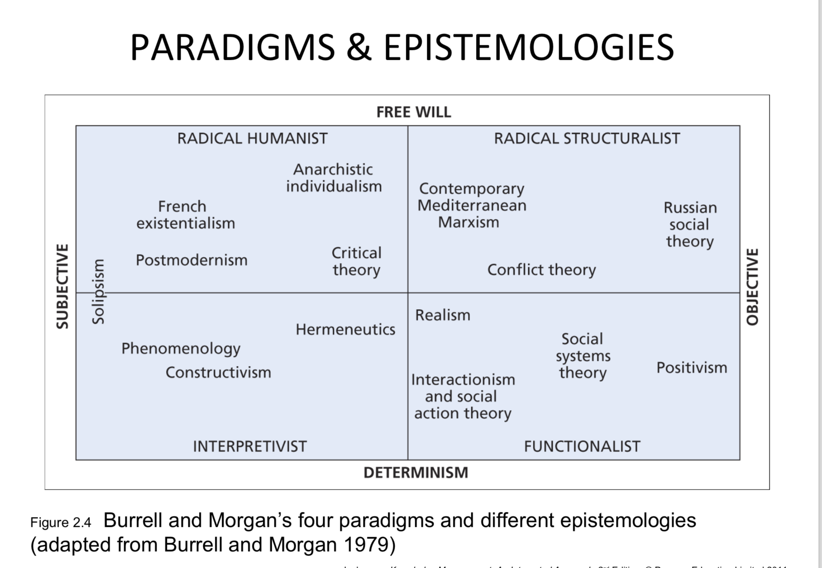
Epistemology

Slide 12
Technology – ”computer”- in theory
Absent presence; exogenous force (one variable);emergent – social – process; entanglement in practice -sociomateriality (Orlikowski, 2010)
Contingency theory. Technology as exogenous force Deterministic. Without history and social settings (Barley, 1986)
Structur or Actor? Structuration theory (Giddens, Orlikowski), ANT (Latour) Strauture and Actor! Agency – intentions?
Sociomateriality. Technology in a context, history and social situation matters! Agency- voluntaristic.
Materiality matters! Affordance. Mechanisms

Slide 13
Materiality1: Which tools… and legacy!
1950s. Mainframes, automate manual work. Centralisation. ”Standardisation” HW & SW ”boundled”.
1980s. PC. Generation, manipulation, presentation of digital data. Decentralisation- variations. HW & SW unboundled. New ”programs”, new applications.
1990s. Internet. A common grammar/”rules” (IP). Integration (horisontal/vertikal). Open Source.
2010s Cognitive Computing. Artificiell Intelligence (AI): ”Software is eating the world”. Algoritms.

Slide 14
Materiality 2 – ”Tools”.
Database – RDBM. For memory, search and manipulation.
Enterprise systems (ERP): For integration, automation.
BI and analytics. Decision making, attention, ”pattern recognition”.
Cloud computing. Technology as service, mobility.
IoT – Internet of Things. Connections, integration. New standards?
AI, Machine Learning – Algorithms. Automation, Predictions
The Social Machine. ”Life”, emotions, games…”

