Slide 1
Organizational Learning an Knowledge
Jan Löwstedt May 2022

Slide 2
Organizational learning and knowledge -What makes companies competitive?
Resource –based view of the firm (Penrose 1959)
Knowledge economy (Drucker 1969)
Organizational learning (Argyris&Schön 1978), - ’How organizations learn and unlearn’ (Hedberg 1981)
Kunskapsföretaget (Sveiby&Risling 1986)
Learning by the Knowledge Intensive Firm - KIF (Starbuck 1992)
Exploration and exploitatation (March 1991)
What’s your stategy for managing knowledge? (Hansen, Nohira & Tierney 1999) - personification or codification
Human vs. Structural capital (=intelectual capital Edvinsson 1997)

Slide 3
Knowledge and learning in organizations
Individual
Organizational
Technological

Slide 4
Individual
Collective
A
B
General
Specific
C
D
Fig.: Knowledge and learning in organizations

Slide 5
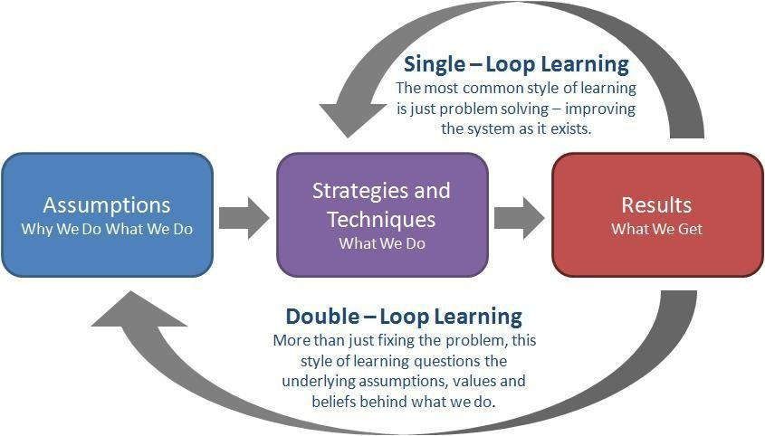
Organizational learning
Adaptive processes in organization aimed at preserving and developing (sustainable) performance over time
Problem solving vs challenging underlying assumptions (Argyris&Schön 1978)

Slide 6
Organizational learning - an organizational perspective
Organizations develop routines and capablities to adapt to changing (dynamic) environments( Nelson&Winter, 1982, Teece 1986, Penrose 1959) – a capability theory perspective
Balancing adaptive processes for exploration and exploitation for innovations (March 1991) – a managerial perspective
Knowledge Work - Knowledge in an organization is a set of practices (Newell 2015, Sveiby&Risling 1986, Starbuck 1992) – a knowledge in practice perspektive
Knowledge / knowing in organizationas is situated, relational and activity based (Lave & Wenger 1991, Löwstedt&Stymne 2002) – a social learning perpective

Slide 7
Organizational learning – Knowledge management perspective (individualistic)
Organizational knowledge - creating, storing, sharing in KM-systems
What’s your stategy for managing knowledge? (Hansen, Nohira & Tierney 1999) - personification or codification
Learning among organizational members (rational choice, bounded rationality)
Knowledge creation (Senge 1990 Nonaka 1991) - New knowledge is developed by individuals and groups , organizations play a critical role in articulating and amplifying that knowledge

Slide 8
Many organizational learning theories are technology blind
Adaptation, change competitve advantage is the outcome - org. learning theory/models exclude technology/IT as the means
What is the role of information technology in balancing adaptive processes for exploration and exploitation for innovation and organizational performance?
K M perspective?
Capability perspective?
Management perspective
Social learning perspectve

Slide 9
Exploration and Exploitation (March 1991)
Exploitation is the refinement and extention existing competences - the return ar positive and predictive
Exploration is in its essence experimentation with new alternativs - the returns are uncertain, distant and often negative
Space between learning and realization of returns is generally greater in exploration
Balancing short and long turn is affected by the distributions of costs and benefits and ecological interaction
Organization tends to substitute exploration by exploation to increase reliability of performance rather than the mean over time

