Slide 1
Doctoral Course Management, Organisation, ICT.
Meeting 3, May 2, 2022.
Decision - Learning
Jan Lindvall

Slide 2
Agenda (approx)
10.15-10.30 Introduction. Short presentation – ”situate” BI/BA. Automate (ERP/”API”;RPA) & Informate (BI/BA).
10.30 – Focus: Learning, Knowledge (”Informate”) March; Exploration & Exploitation in Organizational Learning. Jan Löwstedt.
11.15- 12.00 Small group discussion: Focus Kellog et al. & Arnott et al (2017) ”Patterns of Business …”
13.00 – 14.15 Our three main articles.
14.15-15.00 Three other…

Slide 3
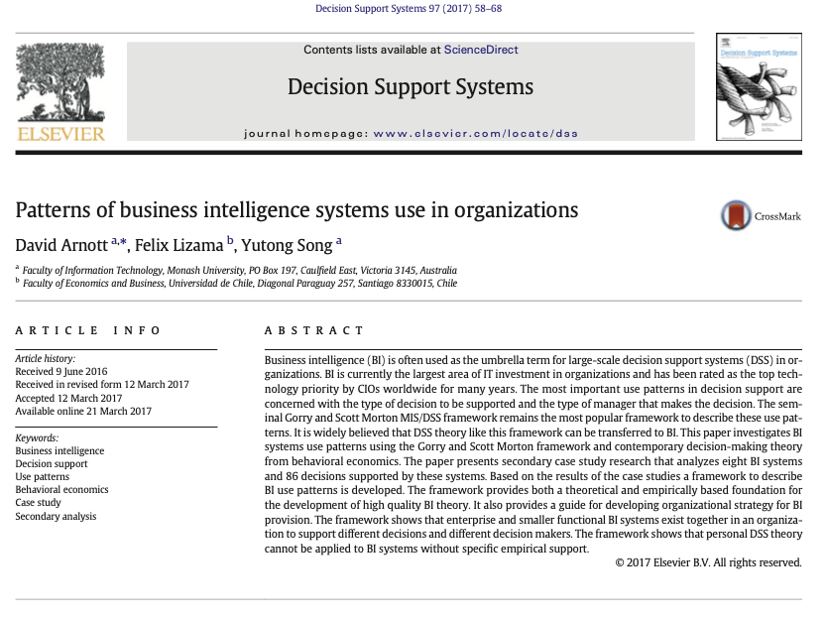
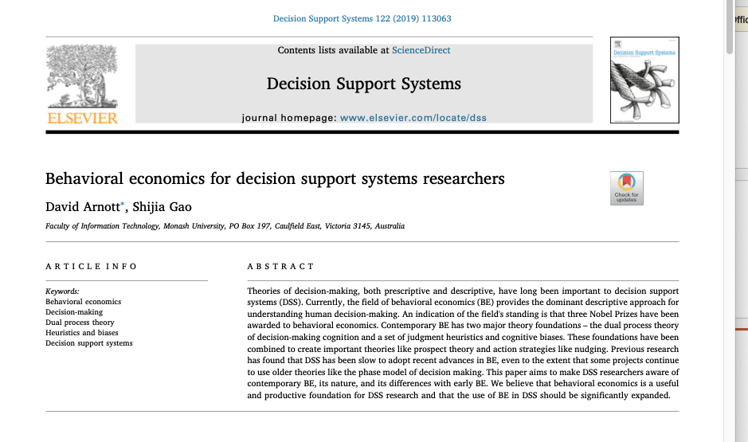
Decision making (process?)
Theories- Ideas (”Socio”, Social”)
Tools - Materiality

Slide 4
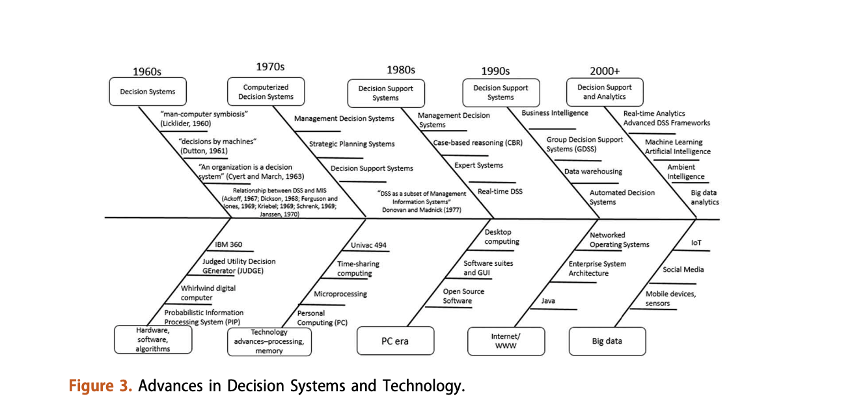
Materiality: Tools- history. Power et al (2019)

Slide 5
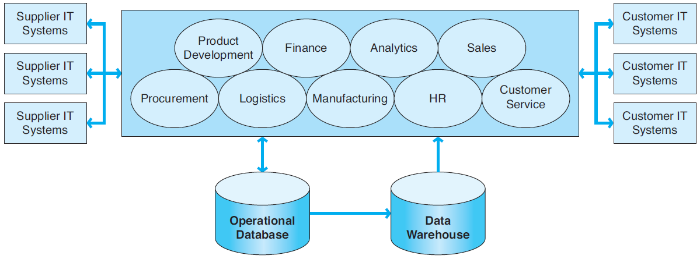
ERP systems: AUTOMATE Integration. Transactional Data
EDI, Internet EDI, or extranets are used to connect a company’s ERP system to the IT systems of its suppliers and customers.
Exhibit 6-2
An ERP II System
SO 3 Current ERP system characteristics

Slide 6
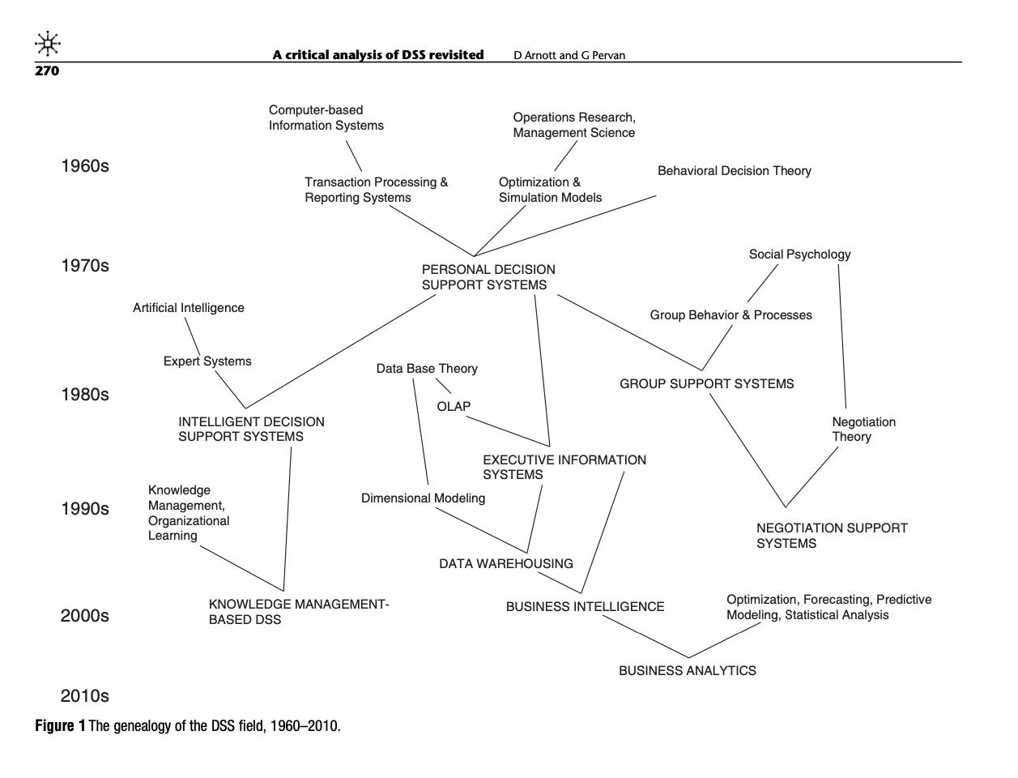
Materiality: Tools – history/Legacy. Functionality & Use (”Design & Use”).

Slide 7
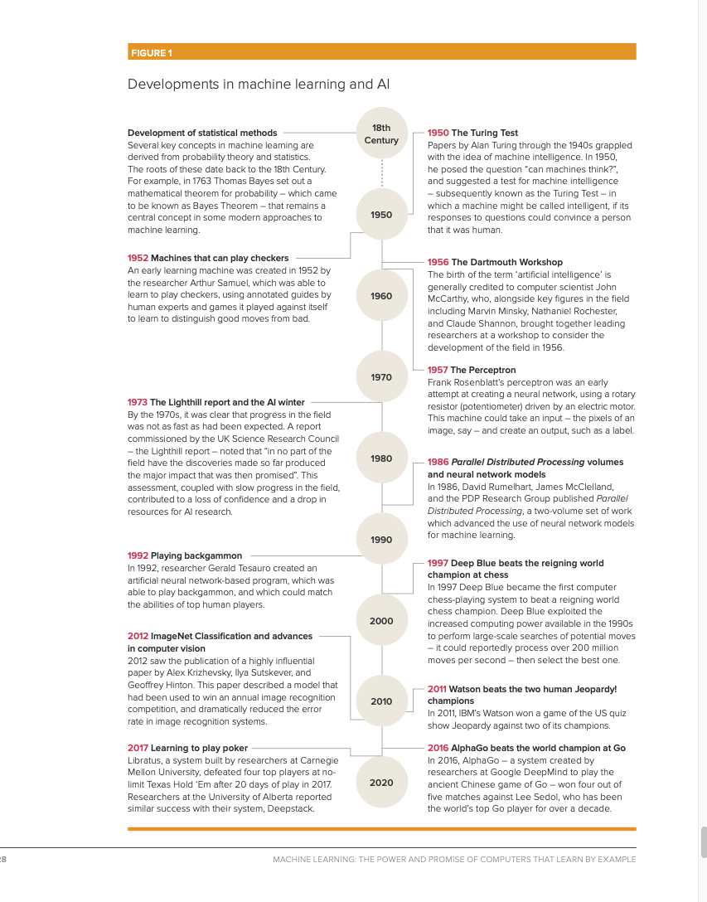
The AI – environment/ development?Royal Society

Slide 8
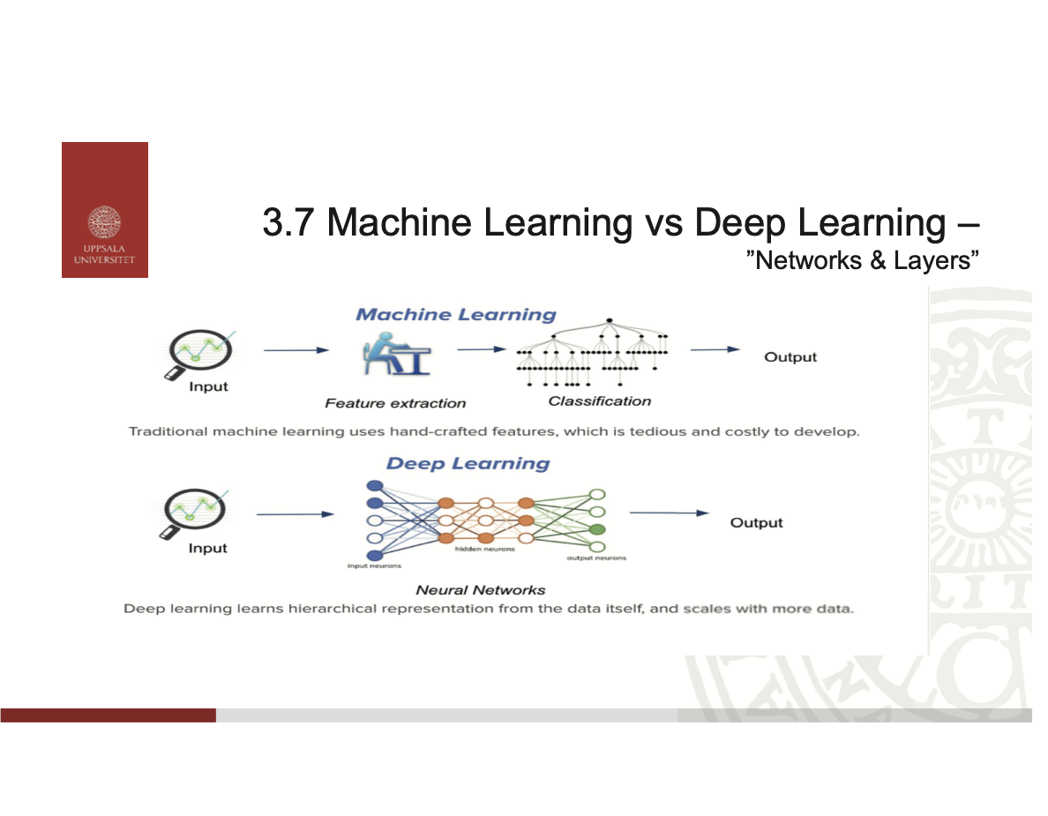
”Learning”

Slide 9
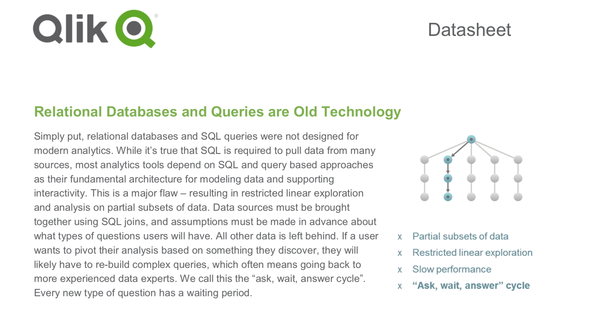
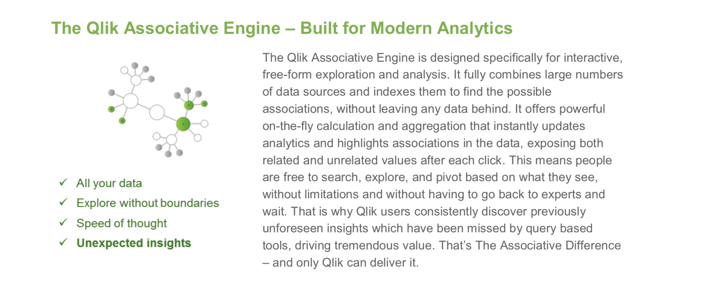
Analytics – old (RDBM; Query) and new. According to Qlik!

Slide 10
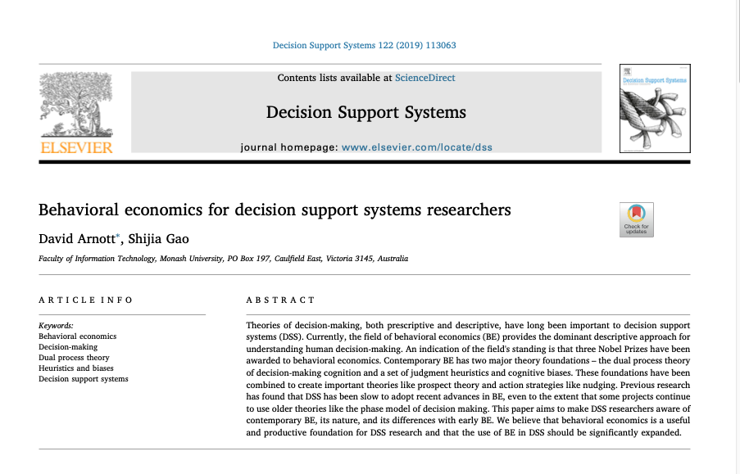
Ideas about decision

Slide 11
Ideas: Tradition vs Alternative (Behavioral Economics)
Tradition – von Neumann & Morgenstern
”Alternative” Behavioral Economics & Others
(Expected) Utility theory
One person, one point of time, one dimension. Perception & Preferences given.
Rational Choice – ”Game Theory”, ”Prisoners Dilemma”.
”Desktop” – prescriptive/normative, axioms
Prospect Theory
”Person & Situation”: ”Social”, history.
Behavioral Economics: System 1 & System 2.
Frames/framing: framing, naming, relating.
Experiments – Laboratory
Klein – intuition, naturalistic decision making
Gigerenzer – evolutionary approach

Slide 12
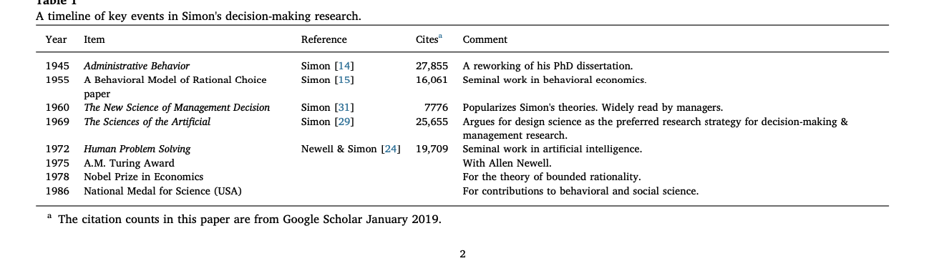
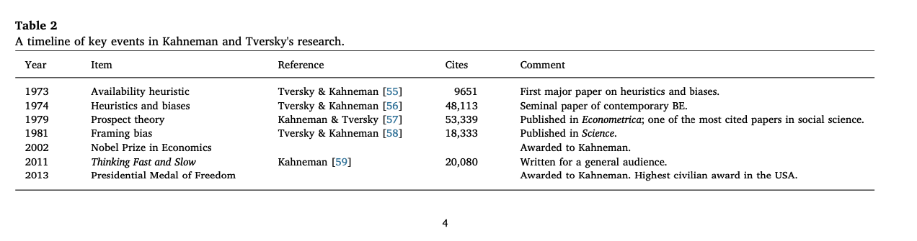
Behavioral Decision
Herbert Simon
Daniel Kahneman

Slide 13
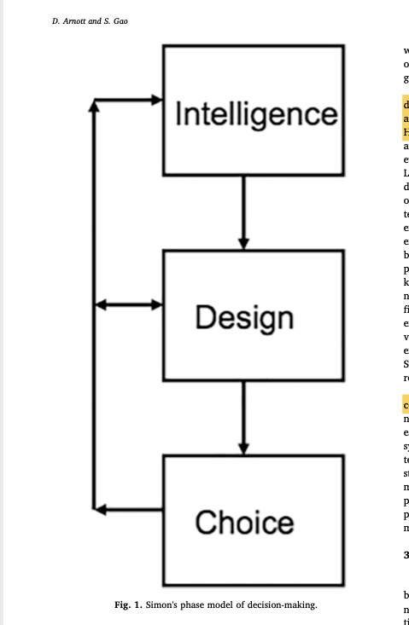
Herbert Simon
Herbert Simons contribution, according to Arnott & Gao, 2019
Simon´s phase model
Bounded Rationality.
The phase model of decision-making.
”Intelligence, which is taken from the military concept, involves “searching the environment for conditions calling for decision” ([31], p. 2) as well as collecting data about a potential decision. Design entails “inventing, developing, and analyzing possible courses of action”, and choice involves “selecting a particular course of action from those available”
Decision structuredness. Program & Non-programmed

Slide 14
Central Assumptions/Concepts in Decision Theory/Making and Organisational Design (e.g. Design Science; Nudging).
Uncertainty (unclear causality/”relations”) & Risk (”identified relations”).
Choice/s (Logic of consequences) vs. Judgement (Logic of Appropriateness).
Causality (cause & effect) & Correlation.
Linearity vs Non-Linearity (Exponential growth; Power Laws).

Slide 15
Some aspects…
Individual (”egoism”) vs Social/Group (”Altruism”; ”Wisdom of Crowds”).
Programmed vs Non-programmed decision (c.f. Strategic- Tactic- Operative).
Facts (cognition) vs Values (emotions, ”affects”).
Logic of Consequences (”efficiency”; calculation; means/ends) & Logic of Appropriateness (legitimacy; ”fair”).

Slide 16
Person & Situation (”SocialPsycology”): The Situation
Complexity leads to uncertainty leads to use of heuristics – can lead to cognitive mistakes.
Complexity: difficult to identify causality (cause and effect). Interdependencies, non-linearity.
Uncertainty: difficult to calulate risk.
Heurstics: Rule of thumb
Cognitive mistakes/biases: ”Systematic”. Often related to System 1 thinking.

Slide 17
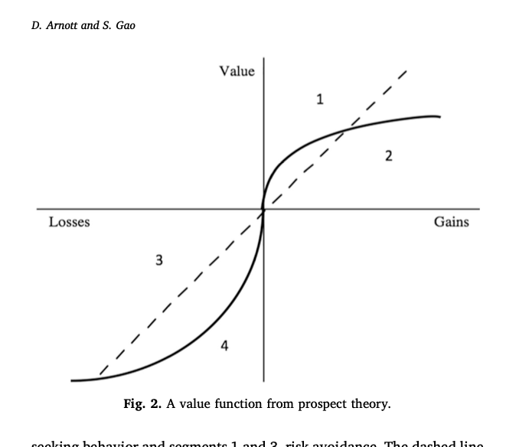
Different situations – different decisions, different actions!
Expected utility vs Prospect Theory
Changes from a baseline
”People think about life in terms of changes, not levels. They can be changes from the status quo or changes from what was expected, but whatever form they take, it is changes that make us happy or miserable”.
Thaler (2015, p.32) Misbehaving
Framing (and naming) is important!

Slide 18
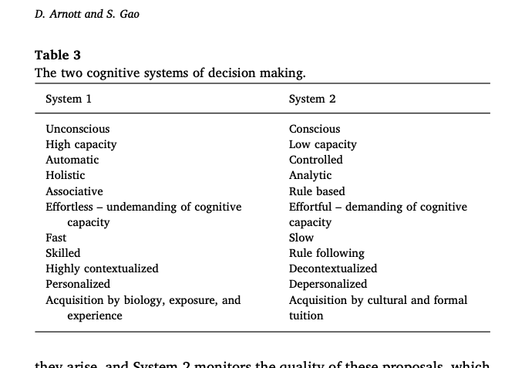
Kahneman – System 1 (Fast) & System 2 (Slow)

Slide 19
General heuristics/biases
The availability heuristic: you use what you remember. The importance of memory.
The representative heuristic: signals/traits that correspond with previously formed stereotypes
The confirmation heuristic: search and collects data (use selective data) when testing ideas/hypotheses.
The affect heuristic: follow a emotional evaluation before an analytcal.
Bazerman & Moore (2013, p 7) Judgement in Managerial Decision Making
I

Slide 20
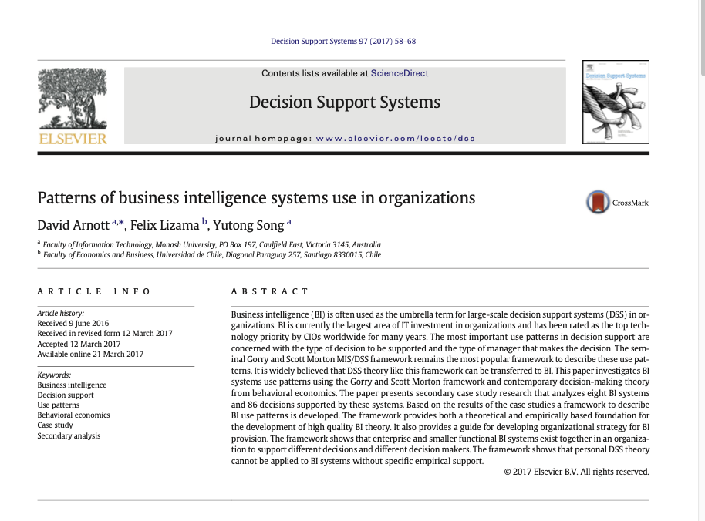
Use of BI

Slide 21
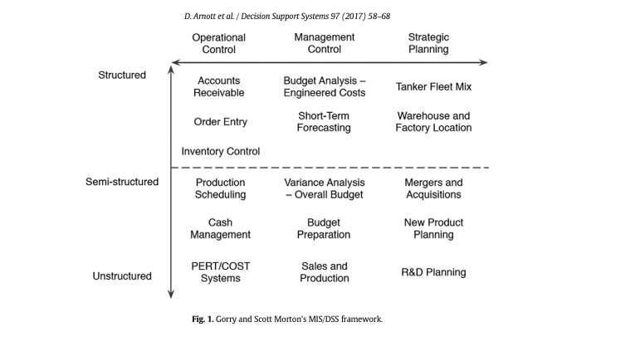
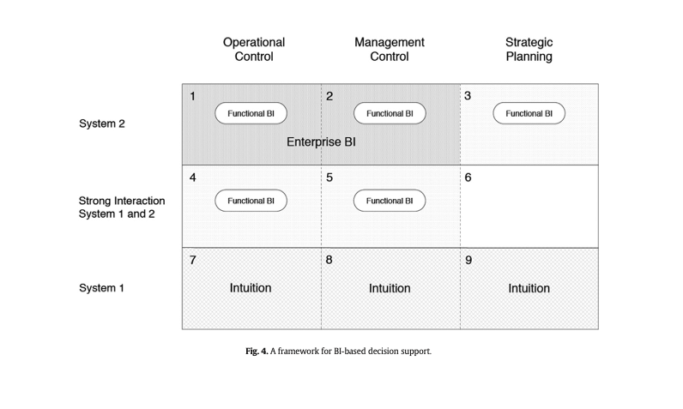
Patterns of BI-use
Generic IS Framework
Result: BI-based

Slide 22
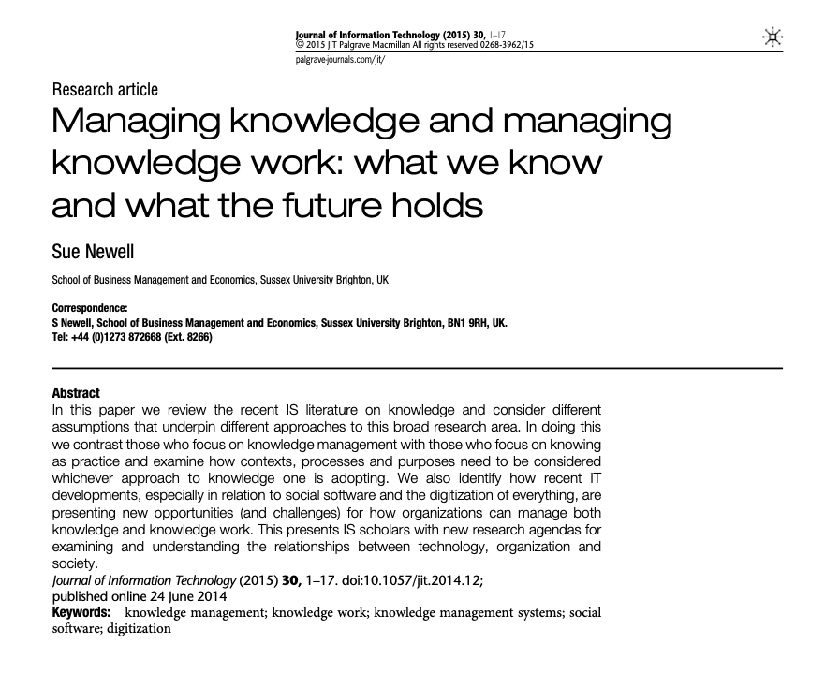
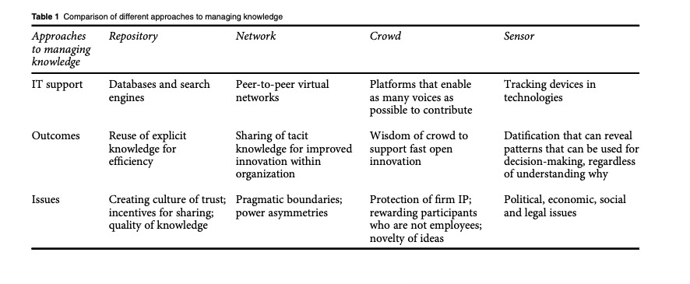
Knowledge Worker
A need of managing a new resource – knowledge!
Different Approaches to KM

Slide 23
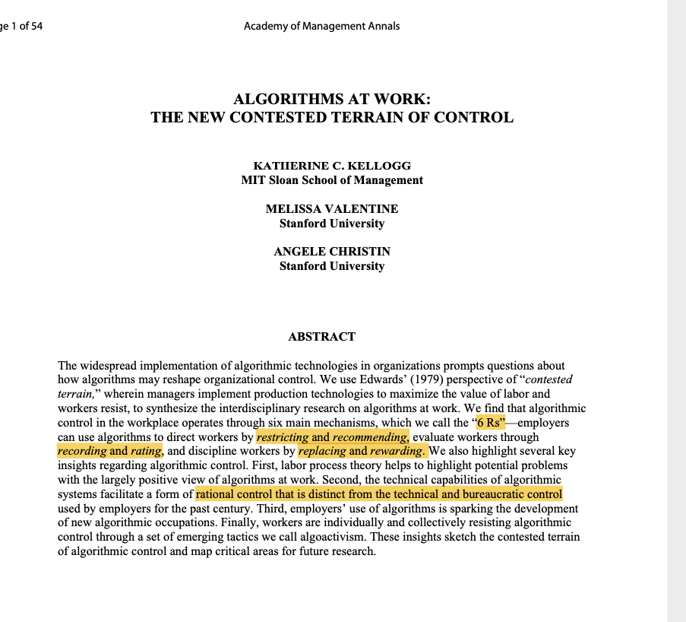
”Contested Terrain”: Maximation of Labor Value & Workers Resistance. Conflict

Slide 24
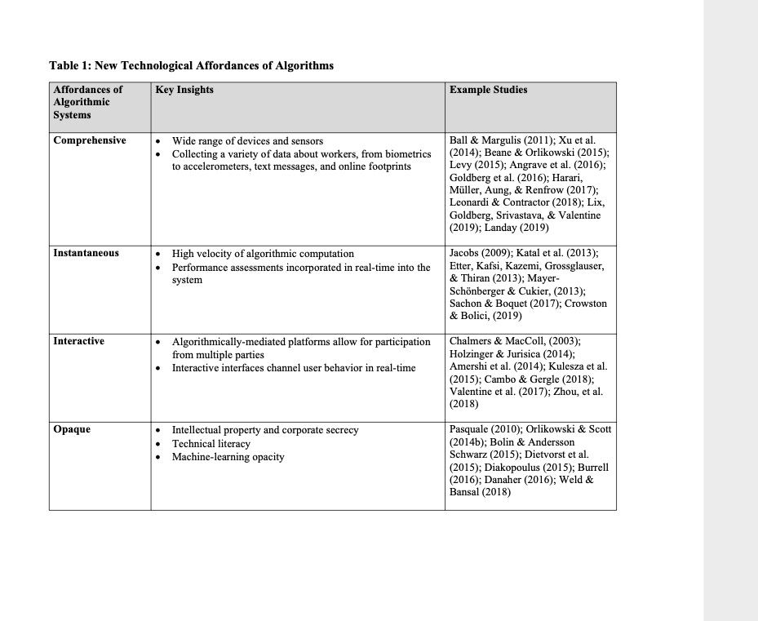
What can algorithms do? Algorithms & affordance

Slide 25
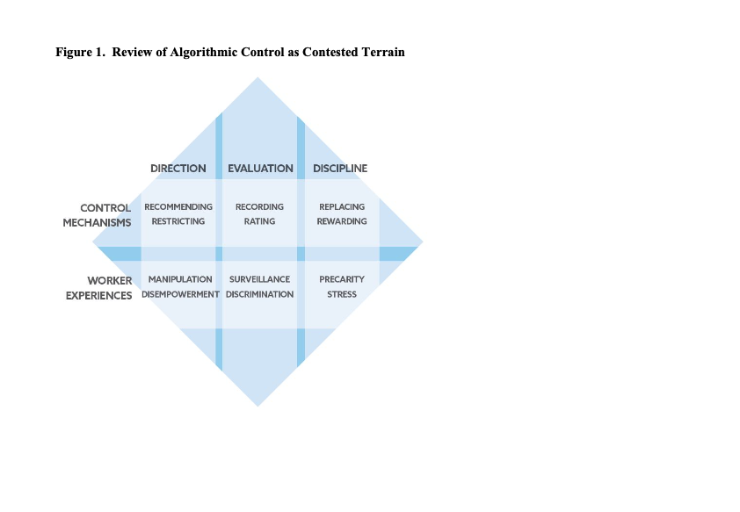
Result – how do employees experience use of algorithms?

Slide 26
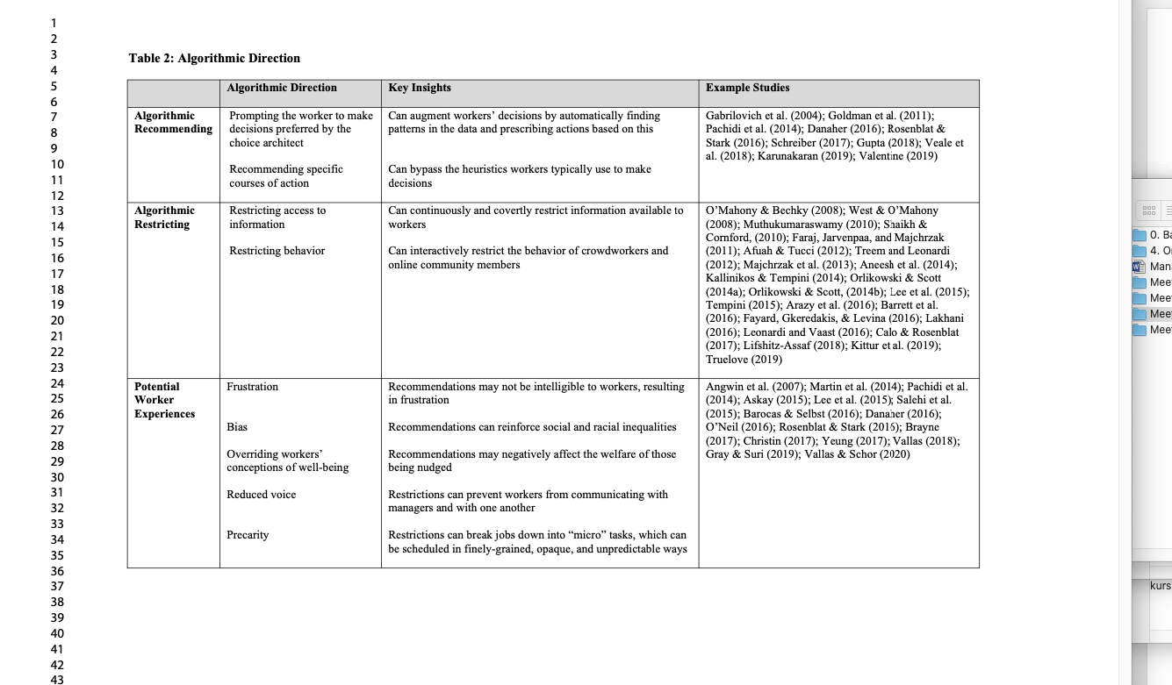
DIRECTING: Recommending & Restricting

Slide 27
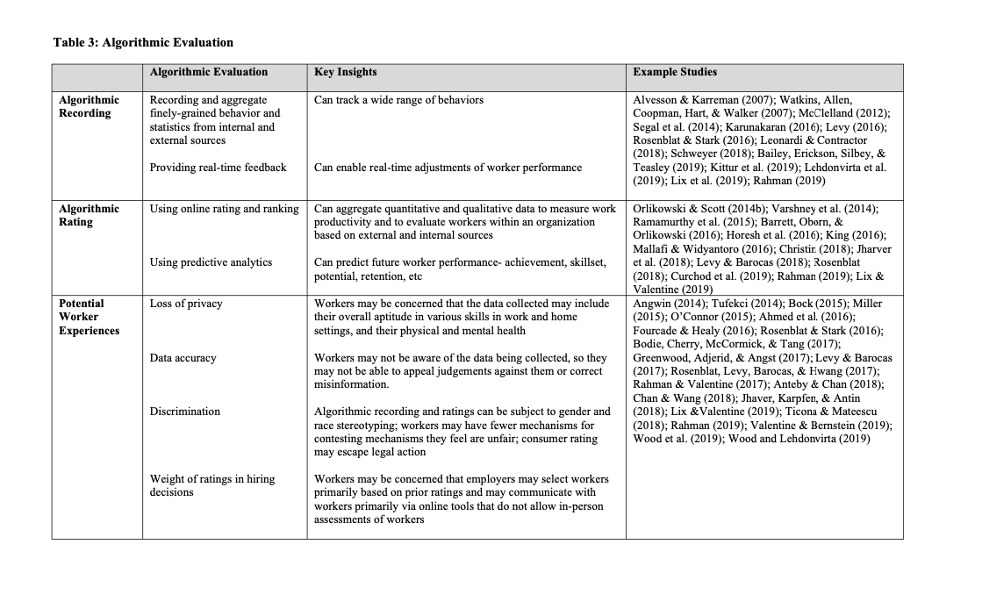
EVALUATING: Recording & Rating

Slide 28
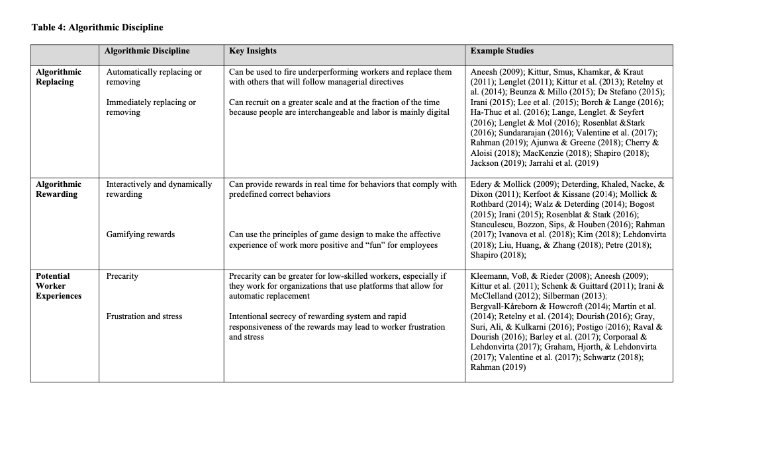
DISCIPLINE: Replacing & Rewarding

