Slide 1
Organizational Memory, Routines and Technology
Management, Organization and ICT
Ph.D. course 22 05 18

Slide 2
Collective and organizational memory
”Collective ways of acting and thinking that have a reality outside the individuals who, at every moment of time, conforme to it” (Durkheim,1895)
If an organization is to learn anything, then the distribution of its memory, the accuracy of the memory, and the conditions under which the memory is treated as a constraint become crucial characteristics of organizing” (Weick ,1979:202)
Locus of org. memory: cognitiv maps, iterpretative schema, organizational frame of reference, etc

Slide 3
Memory
”the faculty of retaining and recaling things past” (American Heritage Dictionary, 1969)
Core concept in information-processing theories: Organizations as information processing systems (Galbraith 1977)
The Thinking organization (Sims&Gioia 1986)
Organizal Memory (Walsh & Ungson 1991)

Slide 4
Organization memory
Embodied in SOP (March&Simon 1958)
Structural artifacts (e.g roles) (Starbuck&Hedberg 1977)
Organizational learning (Argyrsis&Schön 1978)
Individual or the upper echolon of the organization or organization (Hambrick& Manson 1984)
Is comprised of cause maps, strategic orientation and SOP (Hall 1984)

Slide 5
Routines and Resourses in Capability theory
Research on dynamic capabilities theory aims to explain how organizations to survive or even achieve competitive advantage by adjusting firm assets in response to changing environments (Helfat & Winter, 2011; Teece, 2007).
Dynamic capabilities are generally considered “the capacity of an organization to purposefully create, extend, or modify its resource base” (Helfat et al., 2007: 1)
The conceptual argument that tangible resources available ‘‘off the shelf’’, being available to all competitors, do not play a role in sustained resource- or capabilities-based competitive advantage (Peteraf, 1993; Teece et al., 1997).
Since tangible resources are recognized as indispensable aspects of the context in which organizational activities take place neglecting these resources means bypassing a potentially important factor when accounting for how routines develop (D’Adderio, 2011).

Slide 6
The innovative organization project
This study uses an explorative approach and qualitative data from product development in two world-leading Nordic firms to study tangible antecedents of organizational capabilities development. Point of departure:
Capabilities theory is concerned with how firms develop organizational capabilities to improve firm competitiveness prioritizes intangible resources as antecedents of capabilities…
… and has largely left tangible resources as antecedents unstudied, thereby neglecting potentially important insight into how capabilities develop.

Slide 7
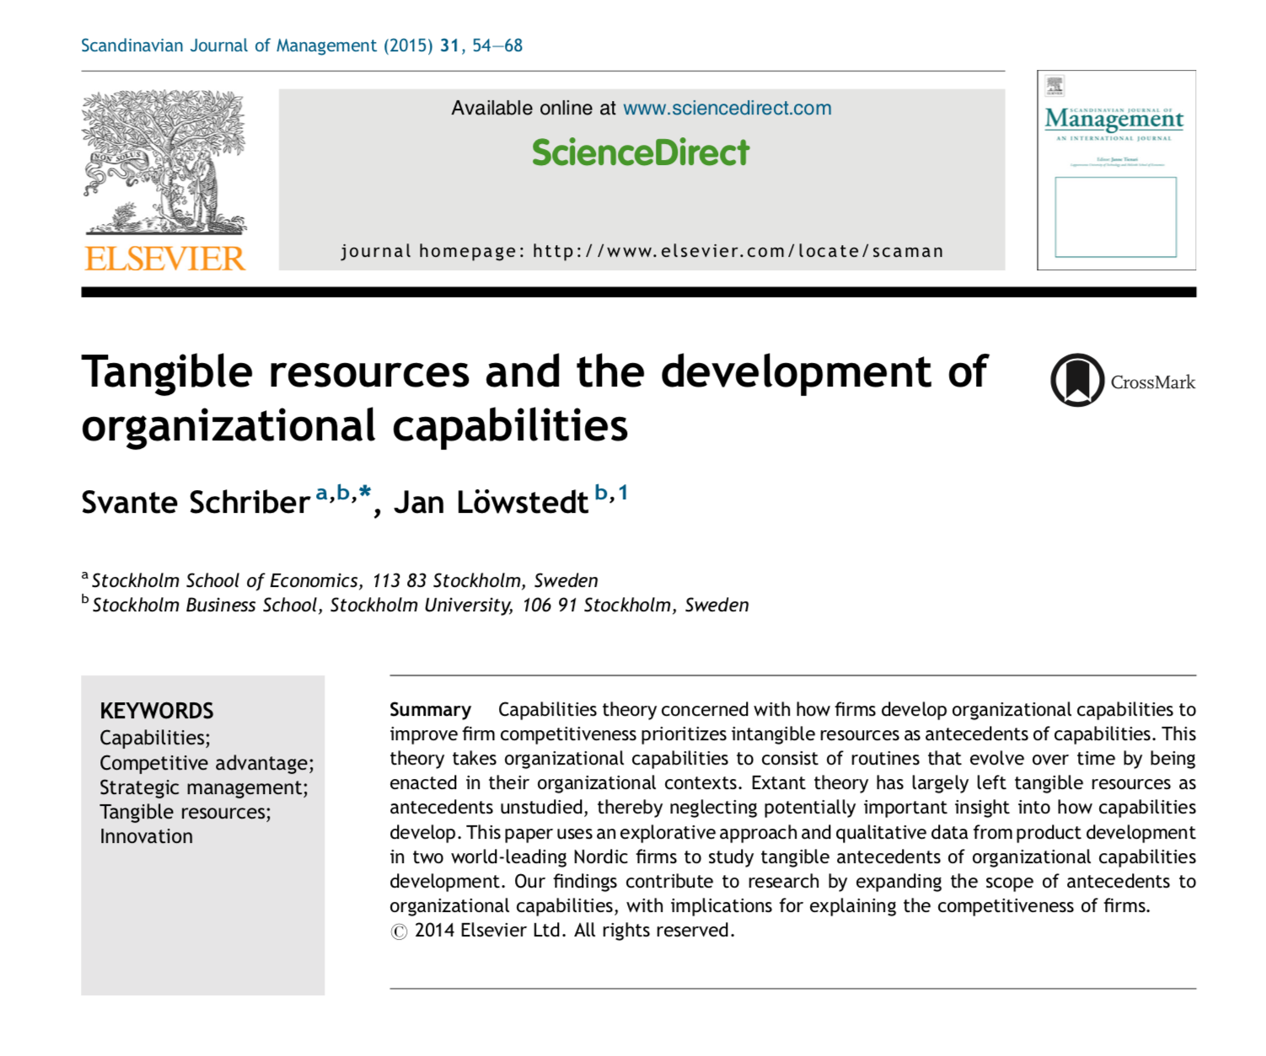

Slide 8
Innovative product development in two cases
Idea generation
Idea validation
Knowledge integration
Knowledge development

Slide 9
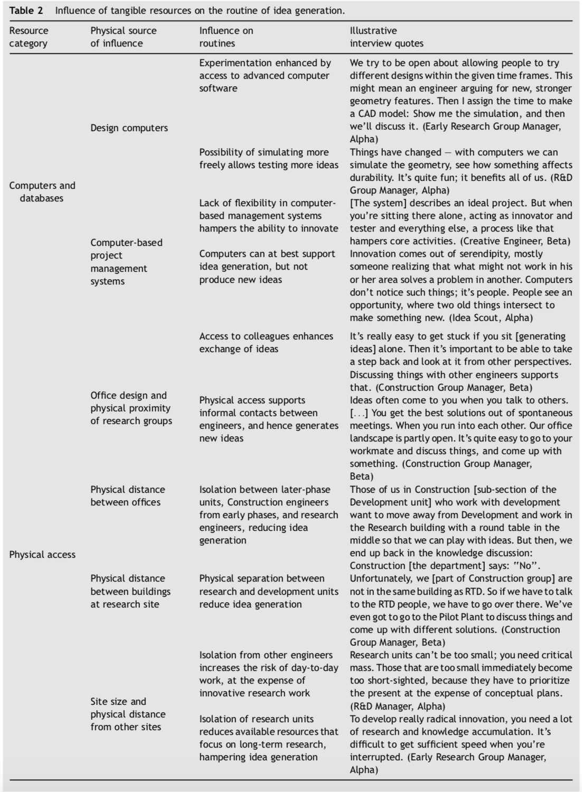

Slide 13
Development of Dynamic capabilities (competitive adantage)
Resources – routines – capabilities
Interplay between tangible and intangible resources:
Idea generation
Idea validation
Knowledge integration
Knowledge development
Dynamic capability – orchestration of resources into routines

