Slide 1
The Role and Tolls &Techniques of a CFO/Controller
Lecture 1. Introduction: Corporate Governance & Management Control
Jan Lindvall
January 16, 2023

Slide 2
Agenda
Welcome!
Why this course?
Corporate Governance System/s
Course Presentation
Three generic models: CG – MCS – Data Processing

Slide 3

Our track – MAC – a journey in the direction of…

Slide 4
…a special focus on the controller/CFO.
“We shall refer to the person who is responsible for designing and operating the management control system as the controller. Actually, in many organizations the title of this person is chief financial officer (CFO).”
Anthony & Govindarajan, 2007, Management Control Systems, p. 110.

Slide 5
Governance
"Corporate governance and management control systems (MCSs) are inextricably linked. A corporate governance focus is slightly broader than an MCSs focus. An MCSs focus takes the perspective of top management and asks what can be done to ensure the proper behaviors of employees in the organization. The corporate governance focus is on controlling the behaviors of top management (the so- called C-suite executives) and also, although less directly, those of all the firm's other employees. The links between corporate governance and MCSs are obvious. Changes in corporate governance mechanisms and practices will usually have direct and immediate effects on MCS practices and their effectiveness".
Merchant & Van der Stede (2017, s. 273). Management Control Systems.

Slide 6
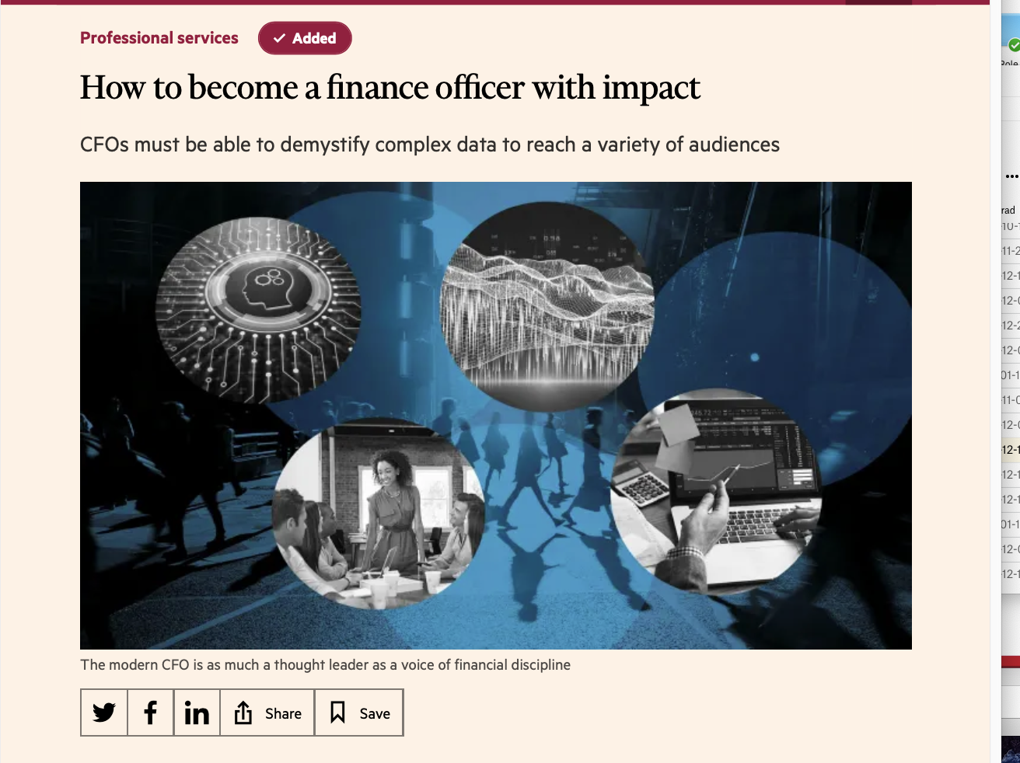
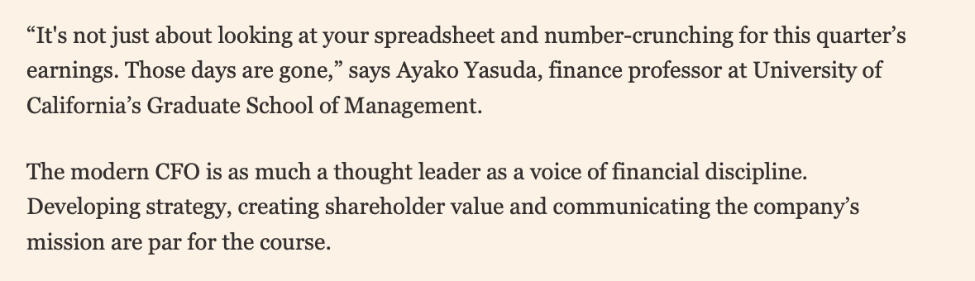
CFO development (ambition)– from bean counter to business partner
Financial Times december 14, 2020

Slide 7
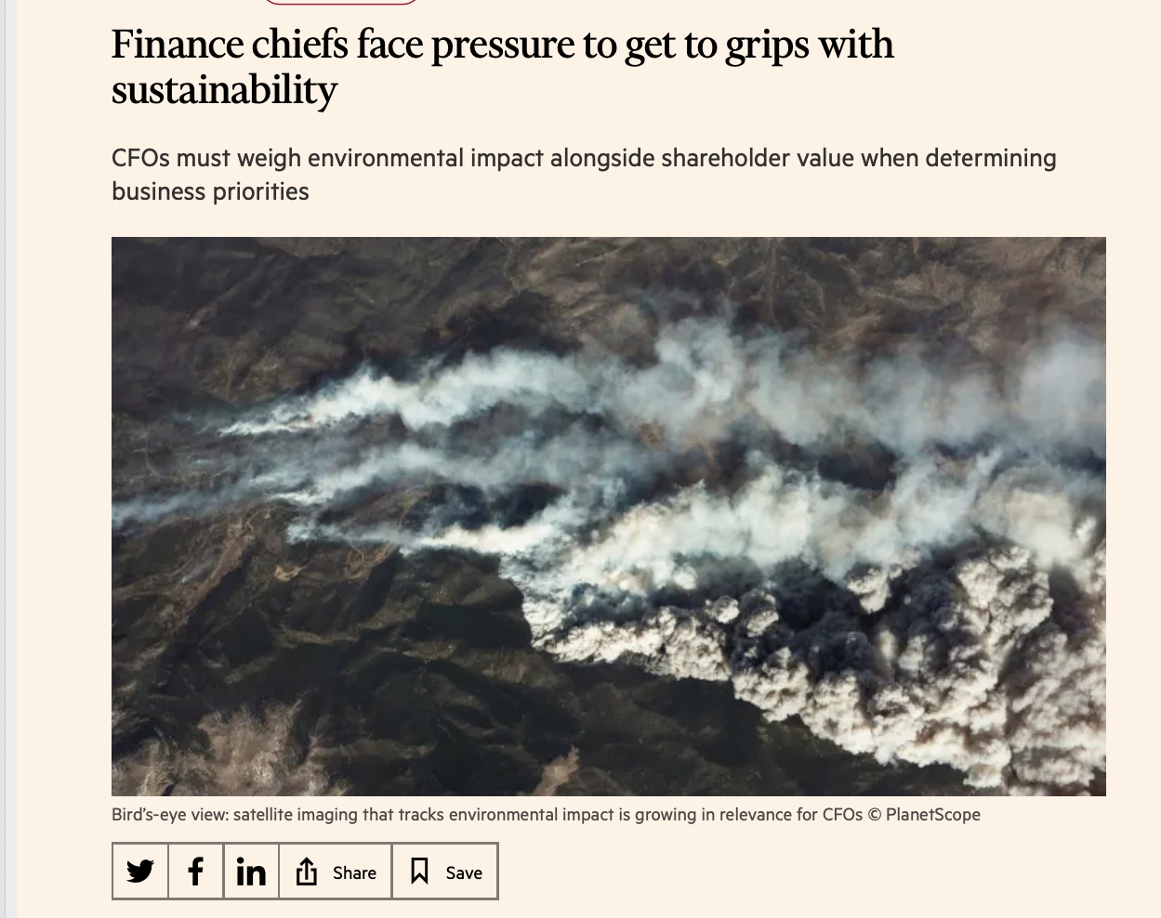
New topic/s …ESG!

Slide 8
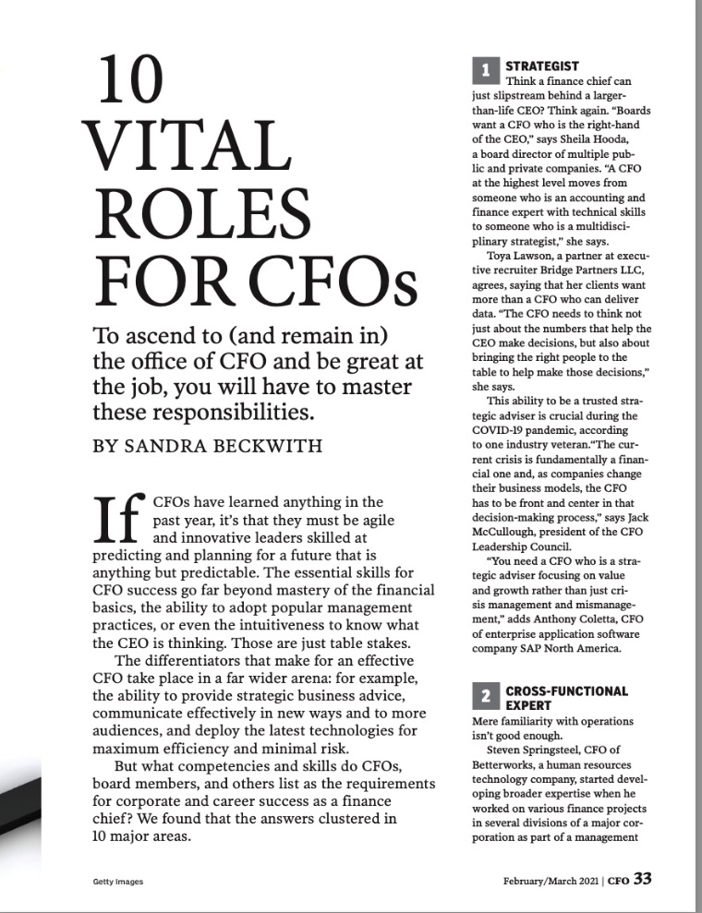
A New Role…

Slide 9
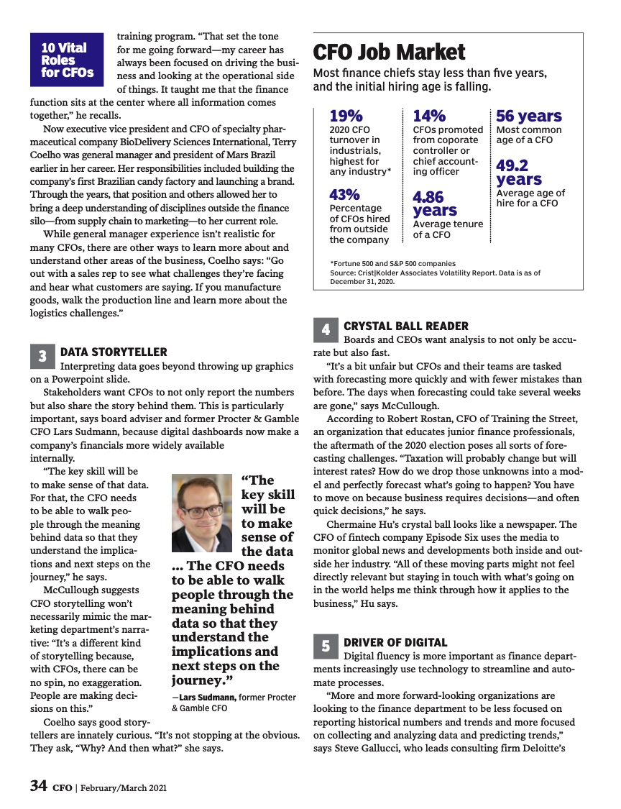
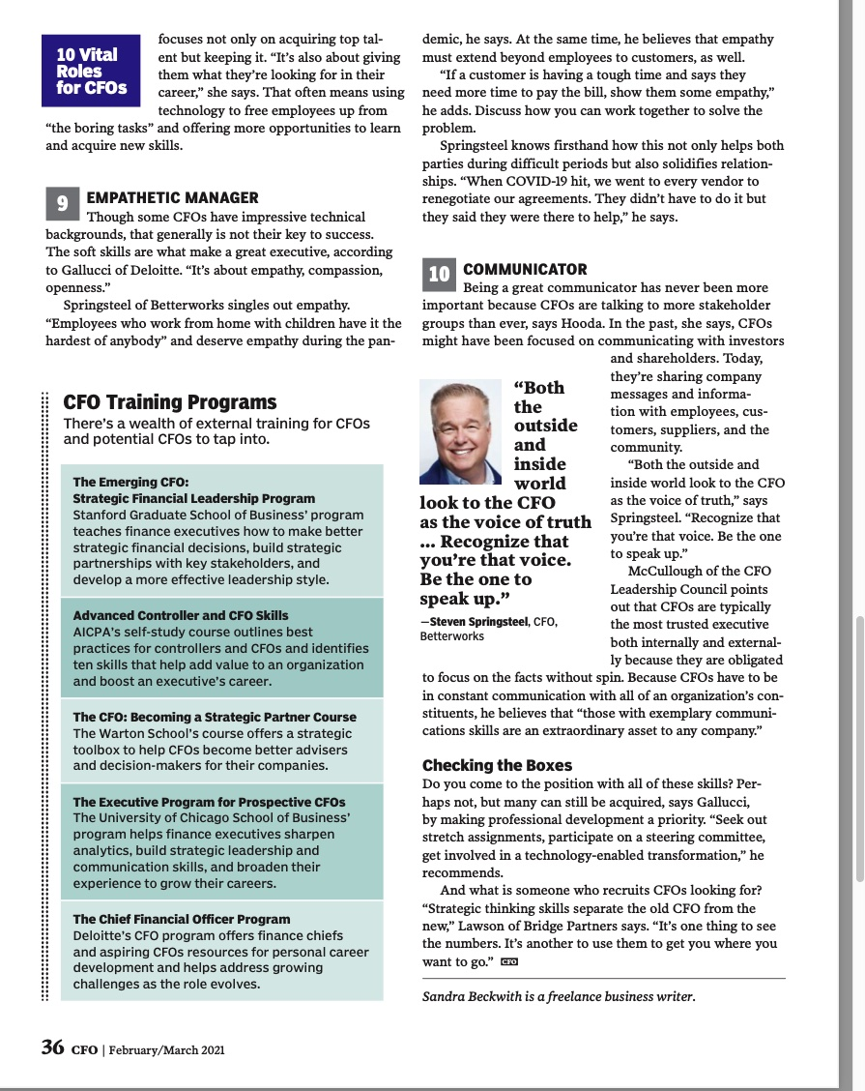
…need for new competences and skills

Slide 10
Concepts and Logics: Accounting is the language of business!
”A firm’s financial statement are like an optical lens. If you know how to look through them you can more clearly see what is going on at the firm”
Revsine, et al, Financial Reporting and Analysis.

Slide 11

From Shareholders to stakeholders: Strategy-Structure – SystemH:Purpose-People –Process.
Purpose- People - Processes
”Rethink” business
Law & Regulations
Ownership & Governance
Mesurement & Performance
Finance & Investment

Slide 12
Four Pillars - and models - for Corporate Control
Growth – Income Statement
Profit & Profitability – Income Statment & Balance Sheet.
Sustainability
Risk – Operational & Financial

Slide 13
Introduction: week 3: GOVERNANCE/Ownership
16/1 15.15-17 F1, H425: Introduction: ESG
17/1 15.15-17 F2, B153: Governance: Owners & Swedish Corporate Governance System
18/1 F3, 13.15-15 B153: Private Equity – important owners with specific management competence?

Slide 14
Introduction: Week 4 BALANCE SHEET MANAGEMENT
23/1 F4, B153, 14.15-16: Capital Allocation: Capex/Intangibles
24/1 F5, A114, 14.15-16 : Debt and debt policy. Shifting policies/ shifting metrics
25/1 Seminar 1: Case: Alleima & CFO (a spinoff from Sandvik).
26/1 F6, B115, 13.15-15. Strategic Pillars and Key Performance indicators: KPI

Slide 15
Week 5: Digital Tools
30/1 F7, B153 14.15-16: IT Governance and IT-strategy: Romney Ch 10, 18
31/1 F8, A144, 14.15-16: Data base, Data warehouse and datalakes Romney Ch 1, 4 & 14
2/2 F9, H2, 10-12: ERP-systems Romney et al Ch 2, 3, Examples: 15, 16

Slide 16
Week 6: Digital Tools & Digital Solutions.
6/2 F10, 13-15-15, H425: BI/BA Romney ch 5, 6, 7 ex 14 & 17
7/2 F11, 15.15-17 H425 System Implementation & Cloud Romney ch 19 & 24
8/2 F12; H425,15.15-17 Cyber Security
9/2 Seminar 2 10-12 13-15 BI/BA
(10/2 13.15-15 B115 EXTRA TIME)

Slide 17
Week 7: Summary & ”exams”
13/2 A114 13.15-15 Summary
14/2 Seminar 3: PM
16/2 H2 13-15 “Dugga” - concept test

Slide 18
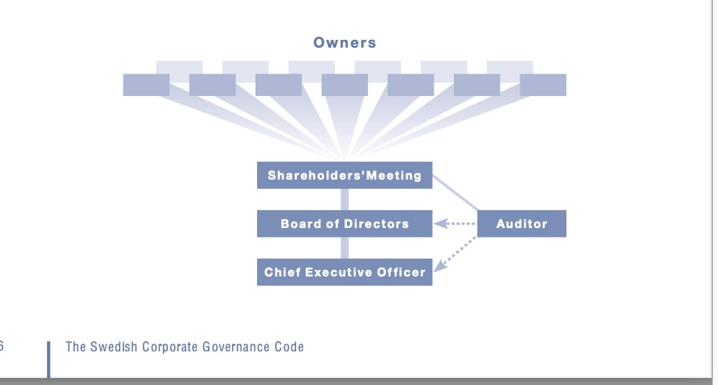
Governance System

Slide 19
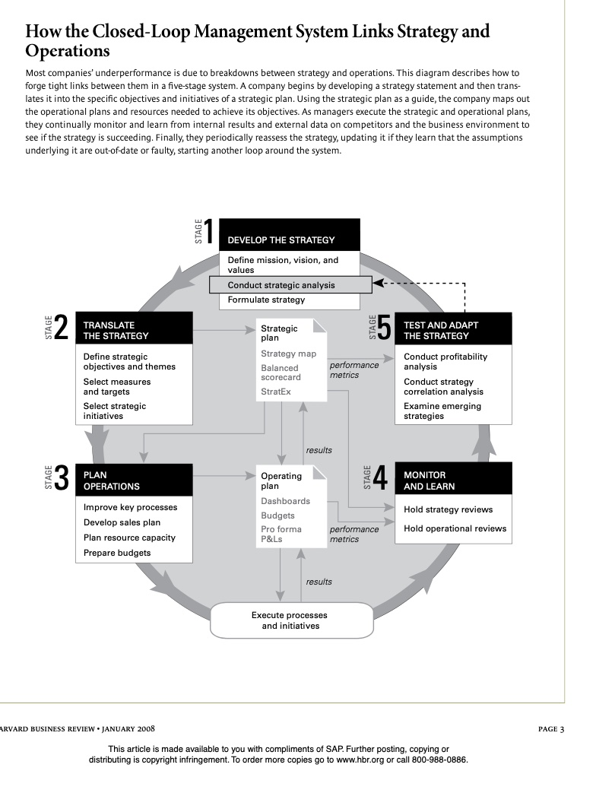
Management Control Systems

Slide 20
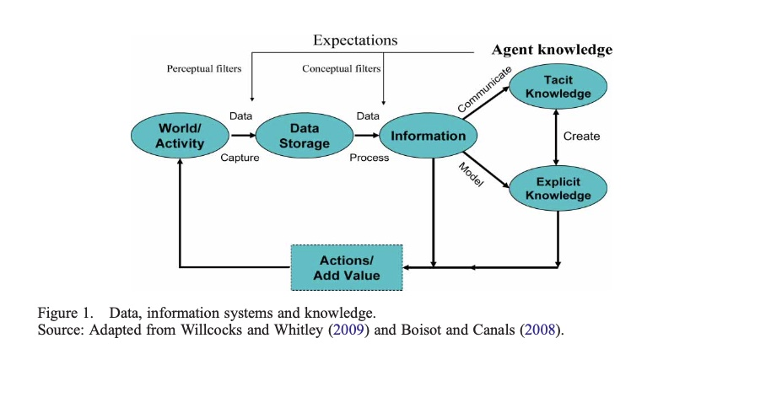
Data Processing

Slide 21
Pedagogical idea
Our lectures
Part 1: Teacher presentation (45 minutes)
Part 2: Q & A: Two things (questions) that interest you/bother you related to our reading (mainly our deep reading).

Slide 22
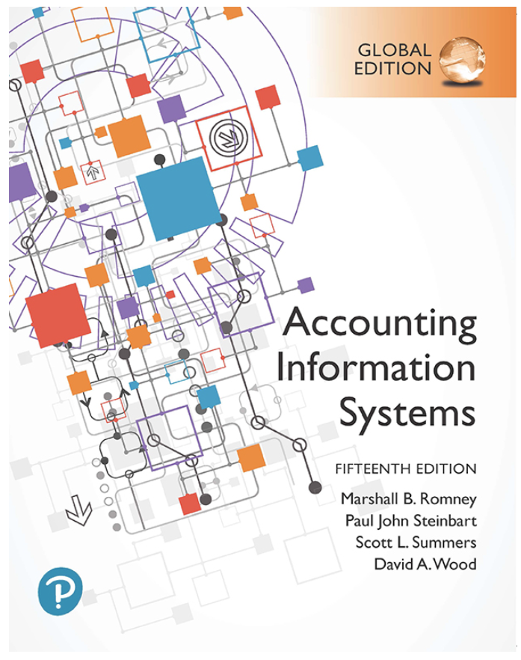

Our Literature

Slide 23
Course Materials | Pearson

Slide 24
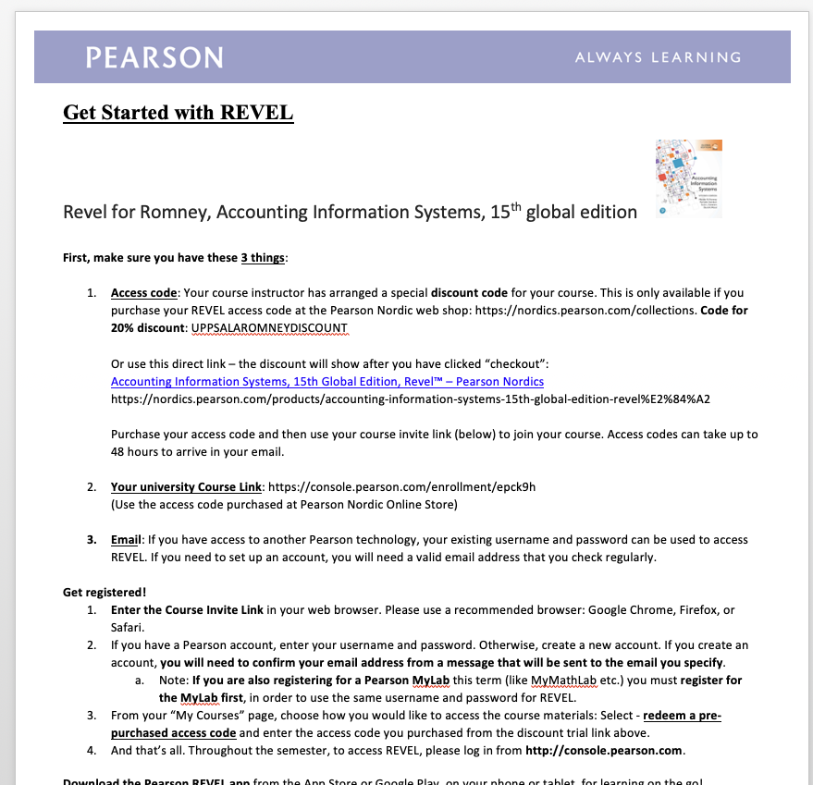
How to buy…

Slide 25
Examination
The course will be examined by:
Active participation, two seminars (40%, G/U).
One ”paper” (incl seminar), according to specific instruction (1-2 students). (40%, VG/ G/ U).
One individual (”small”) exam – ”concept test” (20%, VG/G/ U.
All activities will be taken into consideration in the summarised grade.

