Slide 1
The Role, Tools & Techniques of a CFO/Controller
Lecture 2. Corporate Governance: Different owners/stakeholders – different goals/target/metrics.
Jan Lindvall
January 17, 2023

Slide 2
Agenda
Shareholders vs Stakeholders?
Different (countries) owners – different (situations) goals.
The Problem?
Swedish Corporate Governance
Exampel: Ericsson

Slide 3
Dominant idea: Shareholder orientation
”Capital Market” (finance important; stock market, IPO:s. new financial instruments).
Cash is king! ”Profit is an opinion. Cash is a fact”!
”Profit/net income”- balance (retained earnings) or dividends? A financial goals – how much?
Foucus – Core competence, ”Free cash flow”
Time horizon: quarterly performance: short terminism.
New rules: e.g. impariment test, Goodwill (”writeoffs”).
New metrics: RoI (ROCE ), vs Economic Value Added (EVA). Accounting (e.g. EPS) vs Share Price. EBIT/DA!

Slide 4
From shareholder orientation to Purpose Driven Company
The ownership of corporations is currently associated with shareholdings. That is a mistake and leads to an inappropriately restrictive conception of ownership. Instead, ownership should primarily be related to the formulation and implementation of corporate purpose. There are many forms of ownership that are associated with this including individual, family, institutional, employee, cooperative, mutual and public ownership, depending on the nature of corporate purposes. This points to the importance of diversity of ownership and the responsibilities as well as rights that go with it.
The second lever is corporate governance. At present this is primarily linked to the alignment of managerial interests with those of shareholders. Again, this is a mistake. Corporate governance is the means by which corporate purposes are implemented by management in the organisation, and the appropriate values and culture are adopted. The particular form that corporate governance takes will therefore be specific to the nature of the firm’s corporate purposes and the particular requirements to deliver them.

Slide 5
Purpose driven company
”Corporate purpose is the reason a corporation is created and exists, what it seeks to do and what it aspires to become. It reflects the contribution it wishes to make in furthering the interests of its customers, communities and societies and is the basis on which relations of trust are created in business.”
Mayer, 2018, Reforming Business for the 21st Century. p. 16
”Corporate purpose is distinct from the consequential implications for the corporation's profitability and shareholder returns. The purpose of corporations is not to produce profits. The purpose of corporations is to produce profitable solutions for the problems of people and planet. In the process it produces profits, but profits are not per se the purpose of corporations.”
Mayer, 2018, Reforming Business for the 21st Century. p. 16

Slide 6
Different owners – different goals – different metrics?
Dispersed ownership vs dominant owner?
Private (”Family”) & Public (”Listed”).
Many or Few owners? Power?
Active - Passive owners? Voice- Exit
Majority /control owners. Active. Long term.
”Institutions”: e.g Pension Funds, Sovereign Wealth Funds (cash rich, long term, ”Passive”?).
Index funds. Passive.
Private equity (PE)/ hedge funds: Active, shorter time horizon (for ”exit”).

Slide 7
Different owners - examples
Investor, Industrivärden, Lundberg.
AP-funds (national pension funds). Sovereign (state owned) funds; Norges Bank Investment Management.
Vanguard, BlackRock (index)
PE: Blackstone, EQT
Cevian

Slide 8
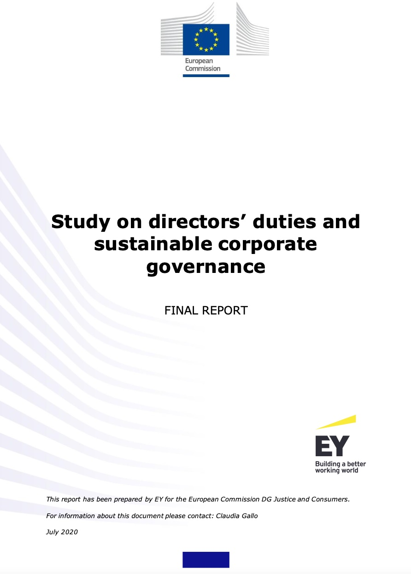
The Problem according to EU

Slide 9
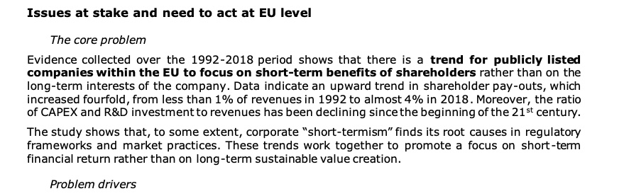
The Core Problem: short-term; CAPEX & R&D

Slide 10
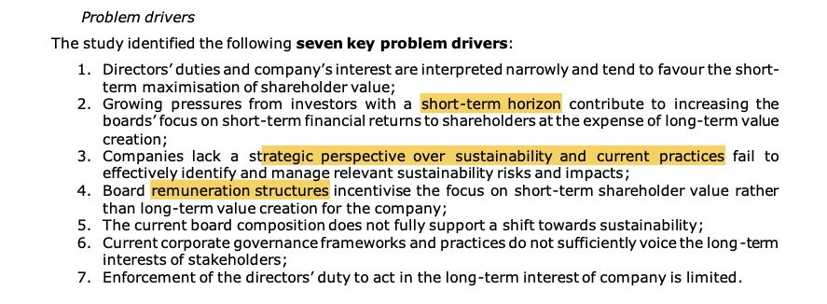
Number of Governance Problems

Slide 11
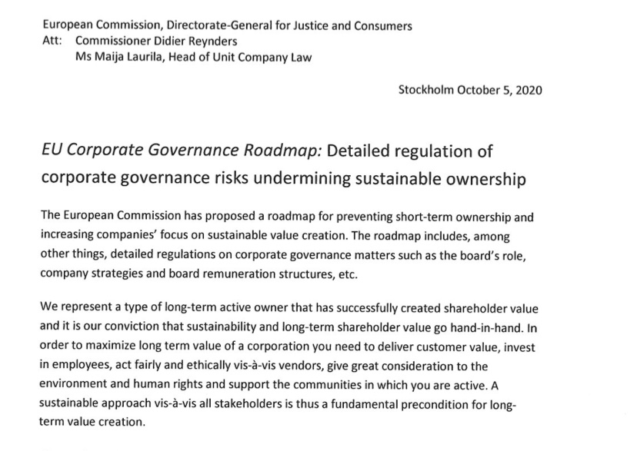
The Response: Swedish active owners

Slide 12
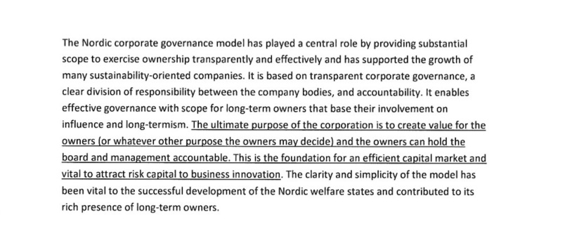
WHY not Short-terminism? The Nordic Corporate Governance Model!

Slide 13
”The Nordic” Corporate Governance
Strong General Meeting Powers
Shares with multiple voting rights
Strong minority protection
Effective individual shareholder rights
Non- executive boards
Use of Board Committees
Auditors appointed by and accountable to the shareholders
Active Governance Role of Major Shareholders

Slide 14
Background – Swedish Corporate Governance
Law or Self-regulation?
2004: Swedish Code of Corporate Governance. Self – Regulation under the Principle ”Comply or Explain”.
Committees: nomination -, (AGM), renumeration- ; audit-.

Slide 15
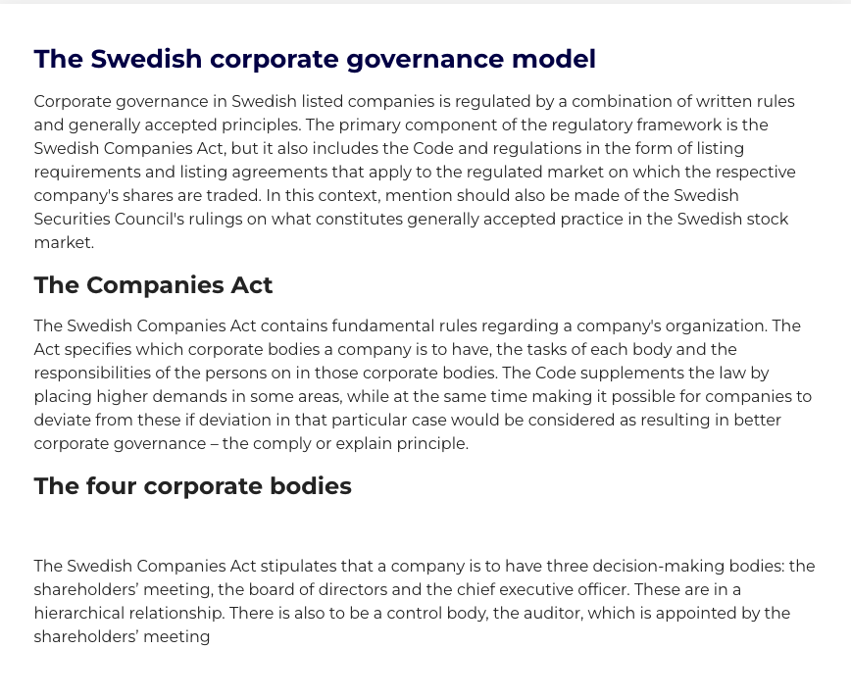
The Swedish CG Model: rules (laws) and principles

Slide 16
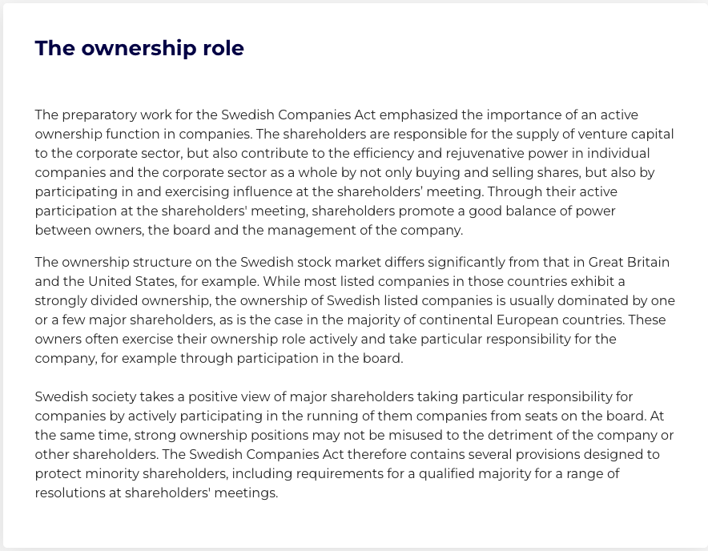
Active owners!

Slide 17
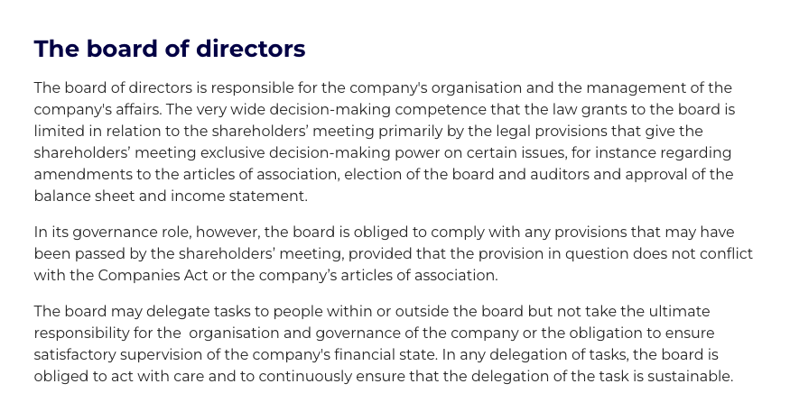
The Board – important!

Slide 18
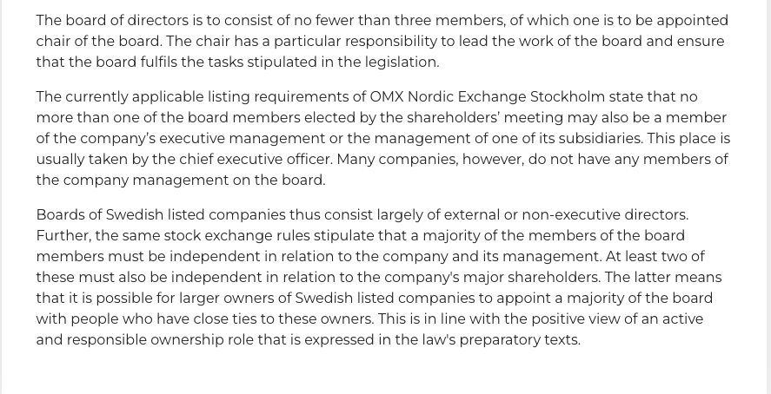
The Board and the company management: a two-tier system

Slide 19
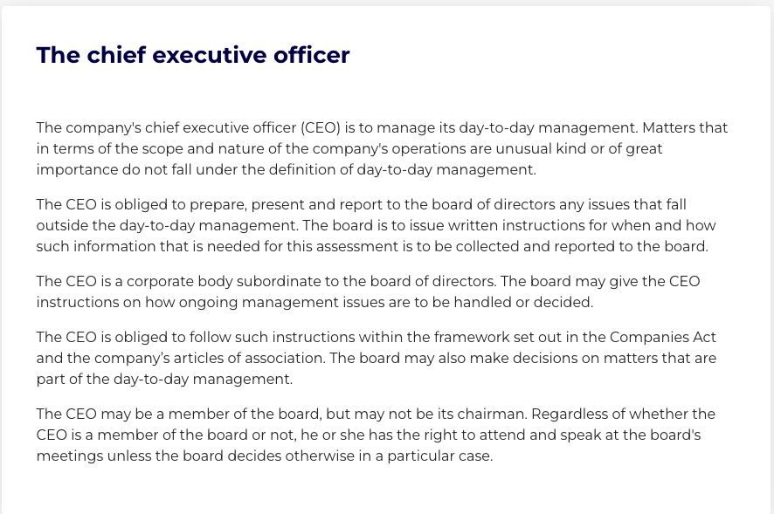
CEO - responsible for the MCS (with CFO).

Slide 20
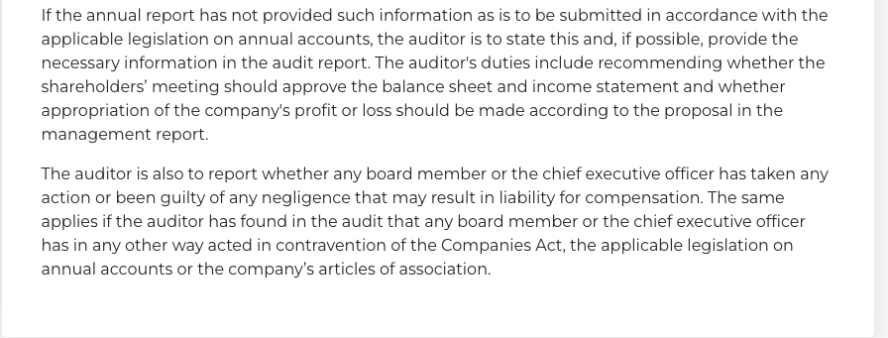
Annual report - so important

Slide 21
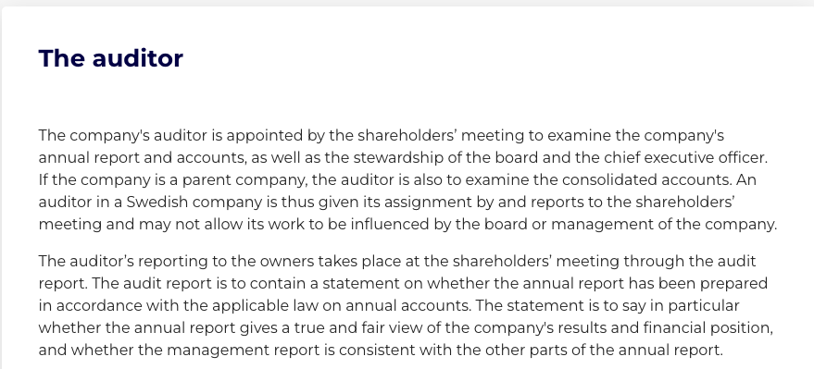
Auditing – för whom?

Slide 22

CGR

Slide 23
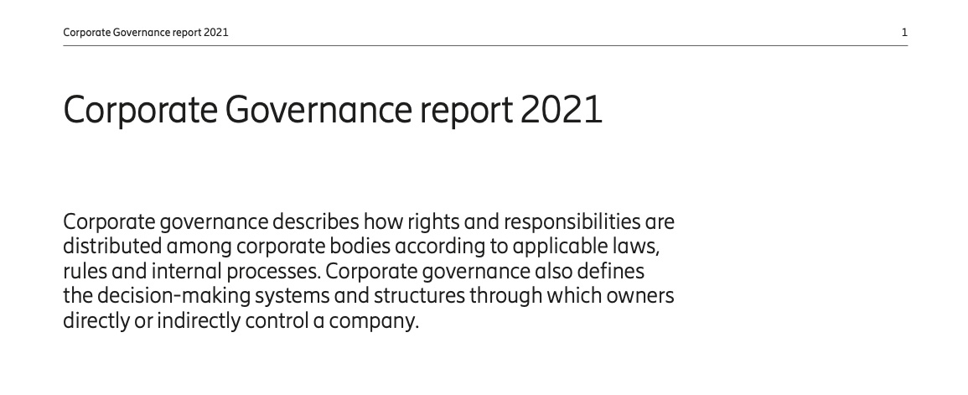
Ericsson: ”rights and responsibilities”

Slide 24
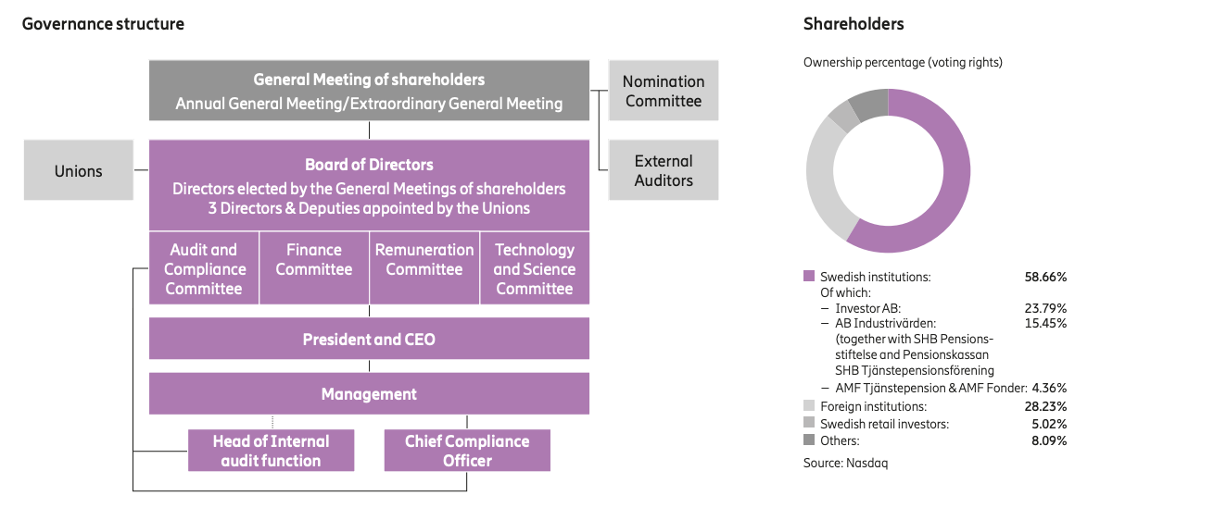
Ericsson: Governance Structure

Slide 25
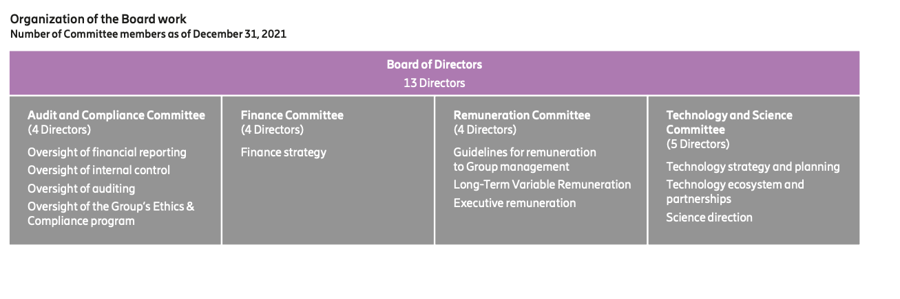
Ericsson Committees

Slide 26
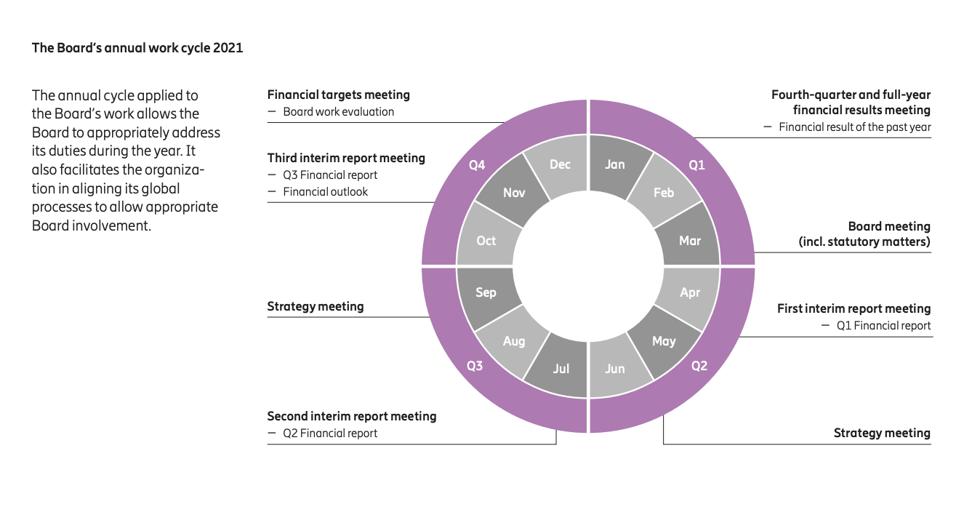
Board: work cycle & Strategy

Slide 27
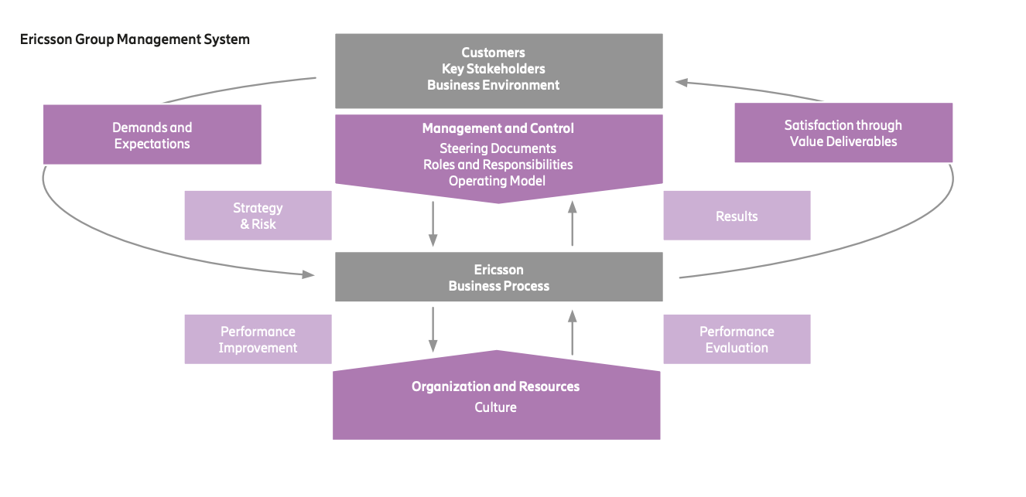
Management System

Slide 28
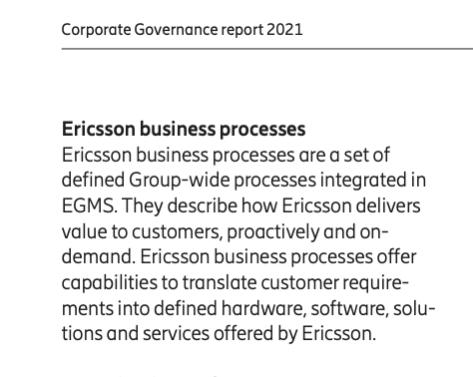
Processes: important concept!

Slide 29
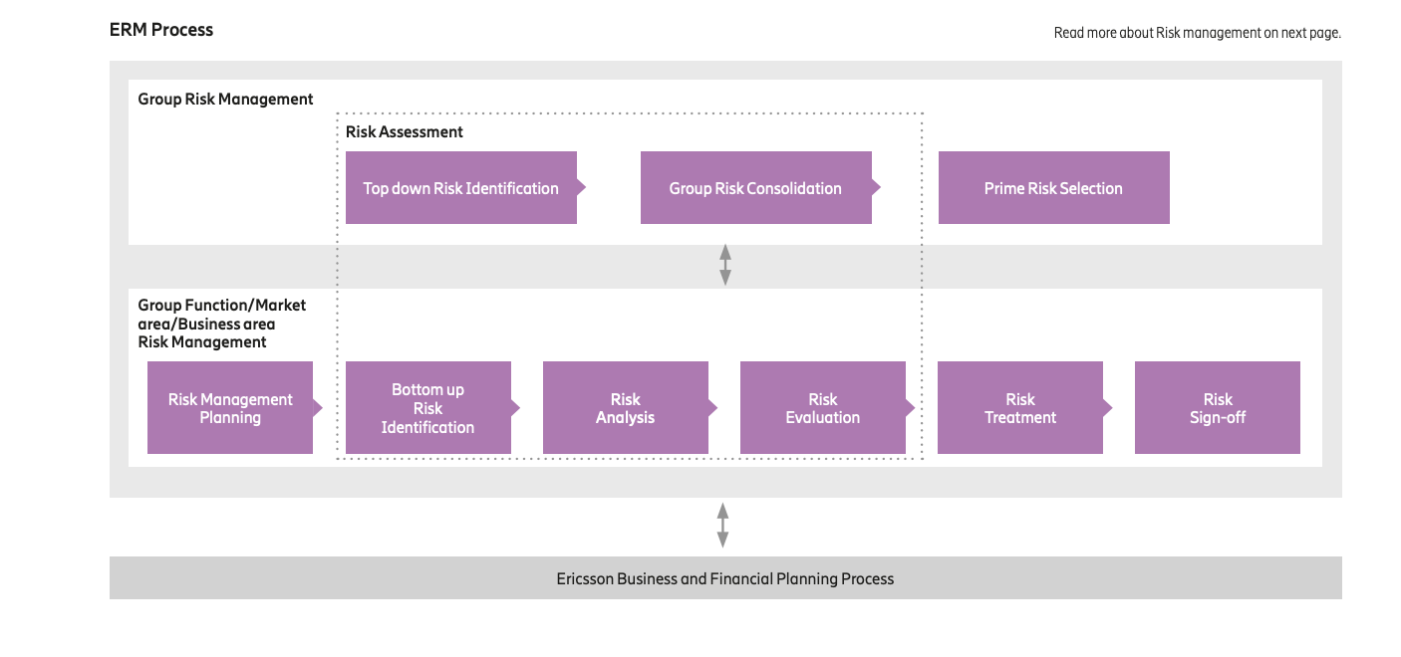
One important Process: Risk Process. ERM

Slide 30
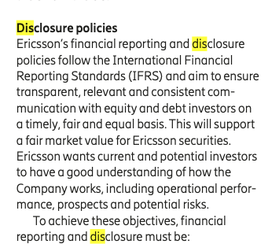
The importance of Financial Reporting

Slide 31
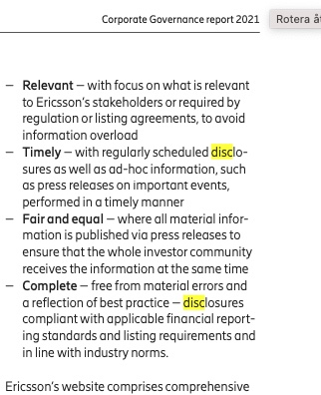
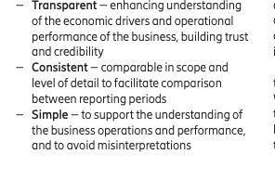
Criteria for good Financial Reporting

Slide 32
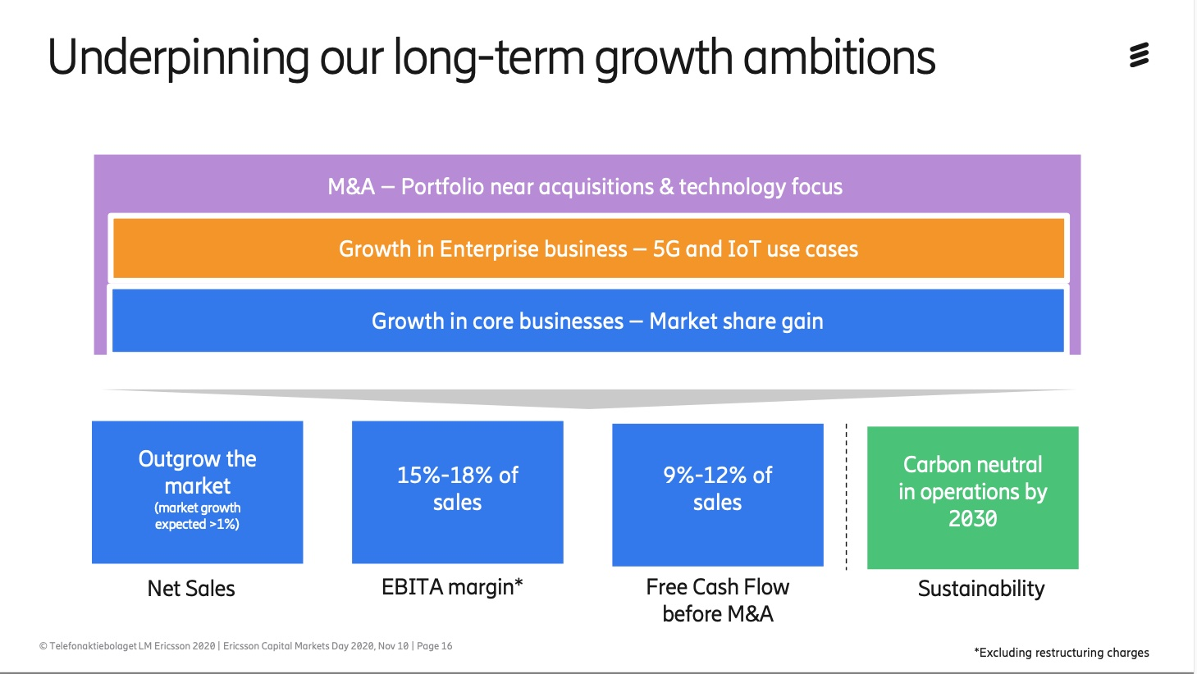
Ericsson: Goals

Slide 33
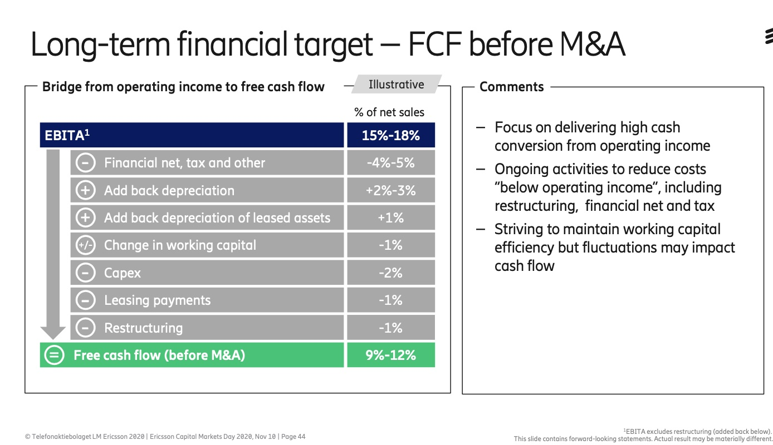
Financial Target

Slide 34
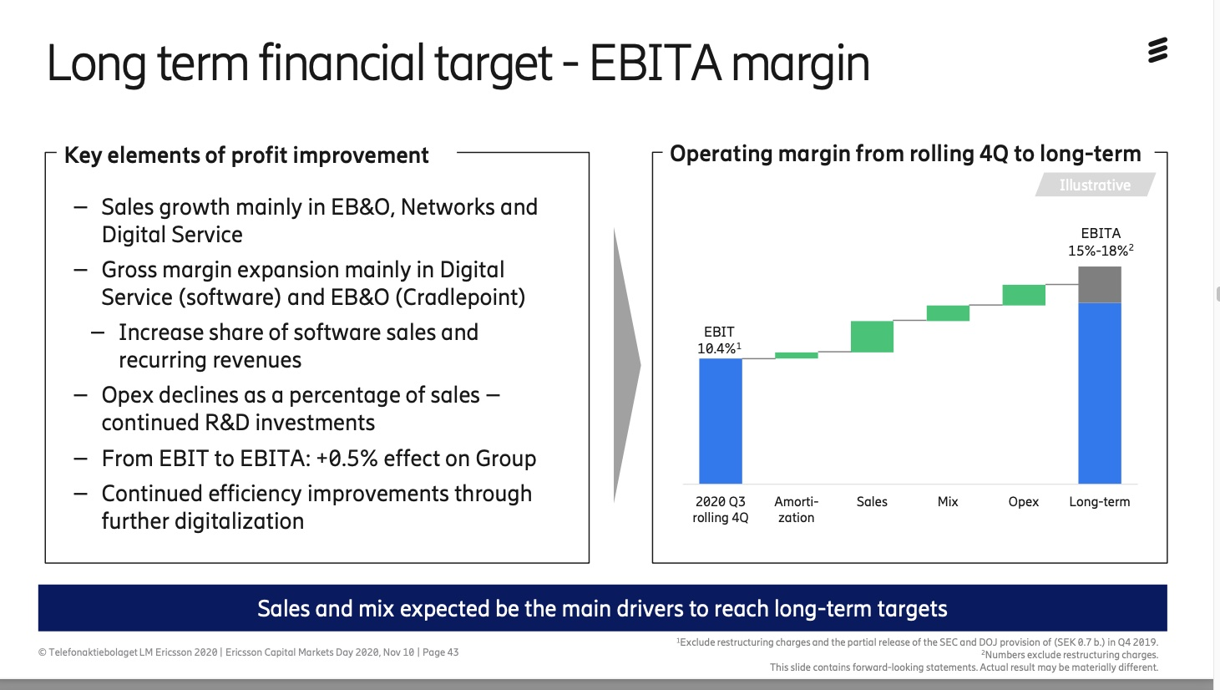
EBITA

Slide 35
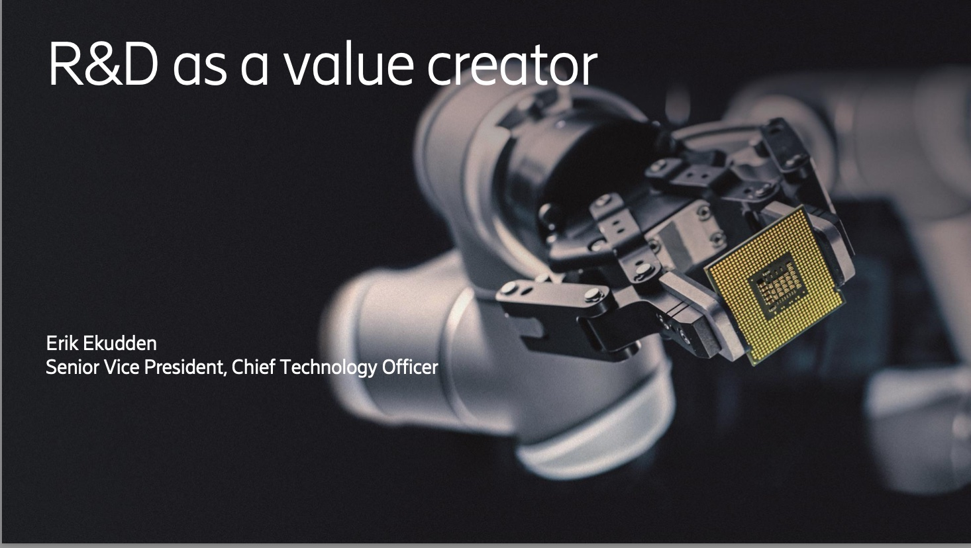

Slide 36
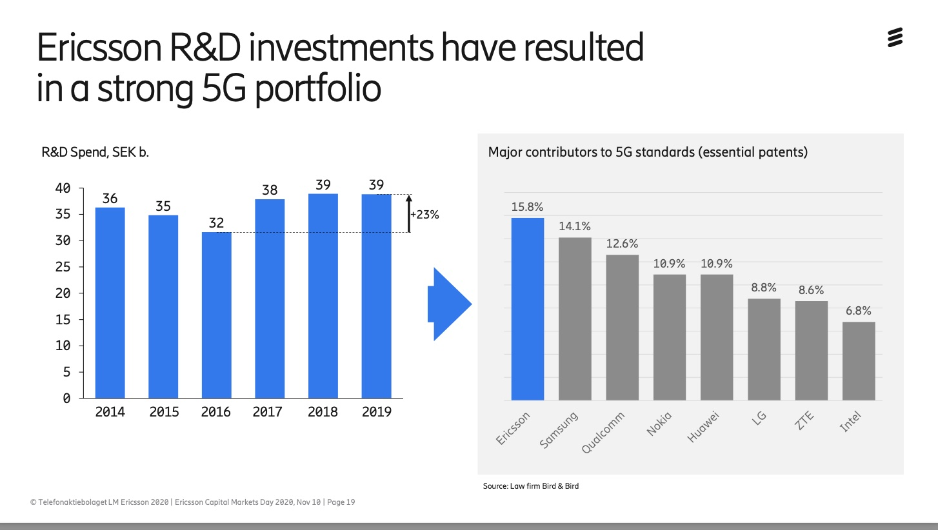
R&D Important

Slide 37

CMD 2022

Slide 38
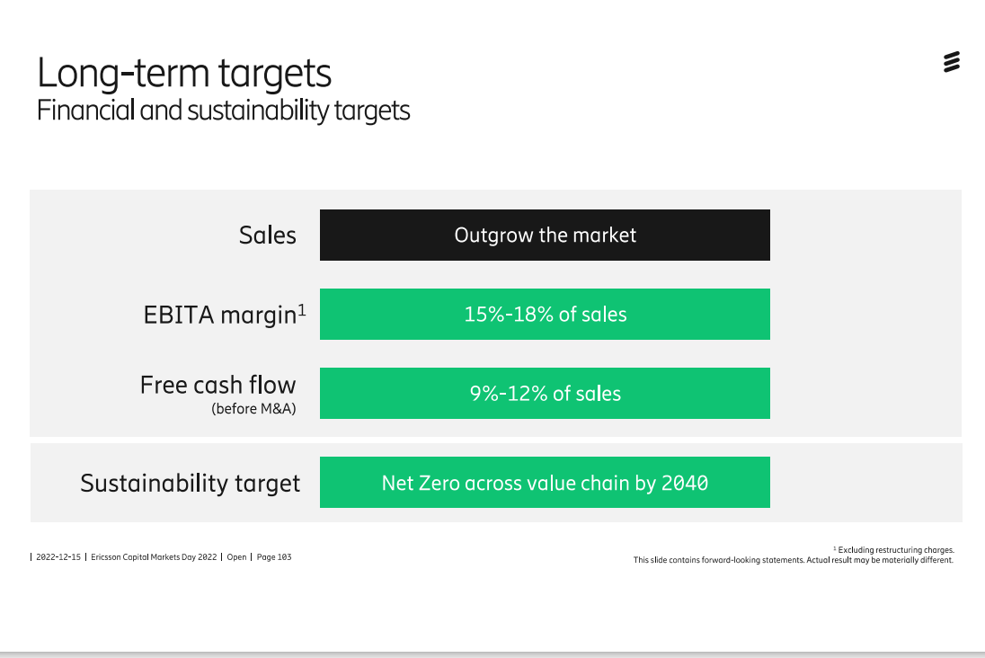
Long-Term Targets

Slide 39
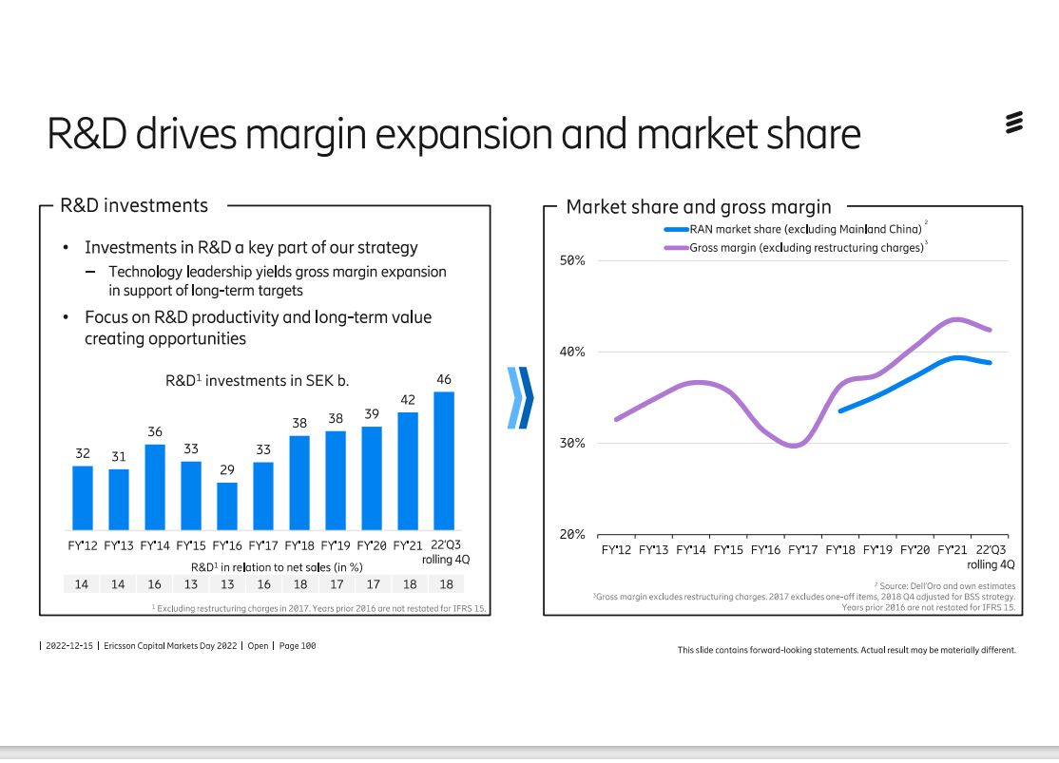
R&D important!

Slide 40
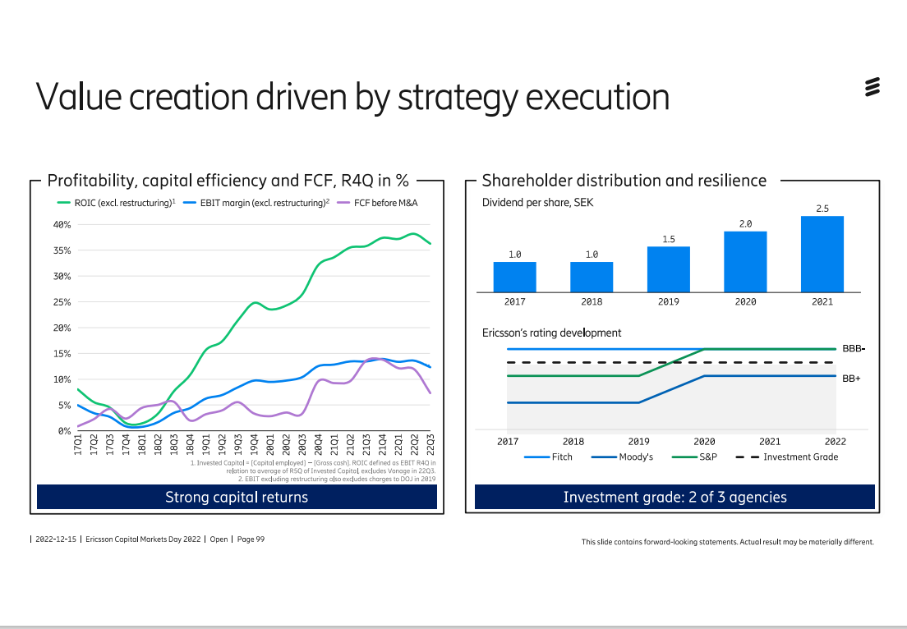
Value & Strategy

Slide 41
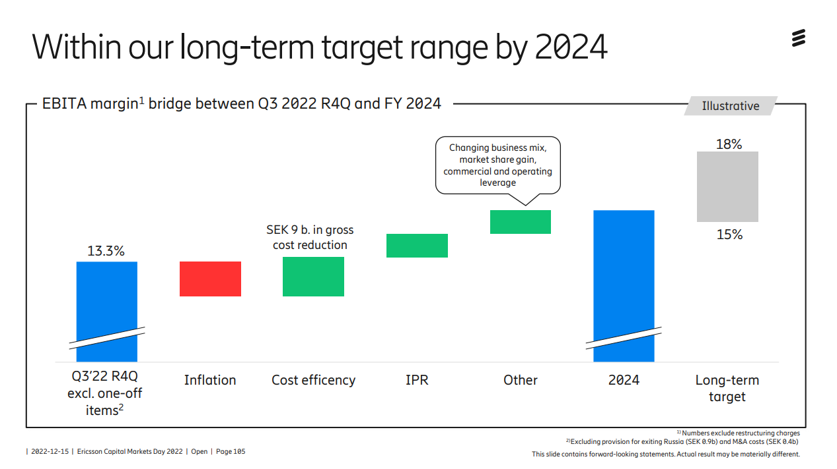
How to reach…

Slide 42
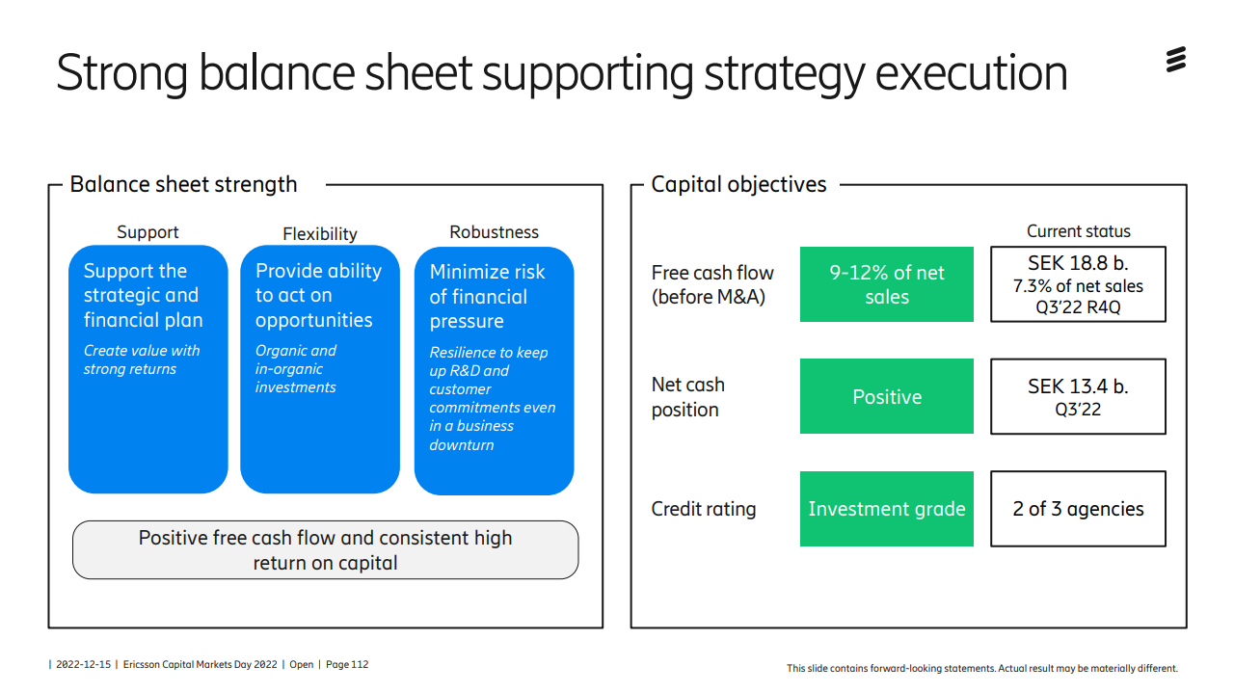
Balance Sheet Important!

Slide 43
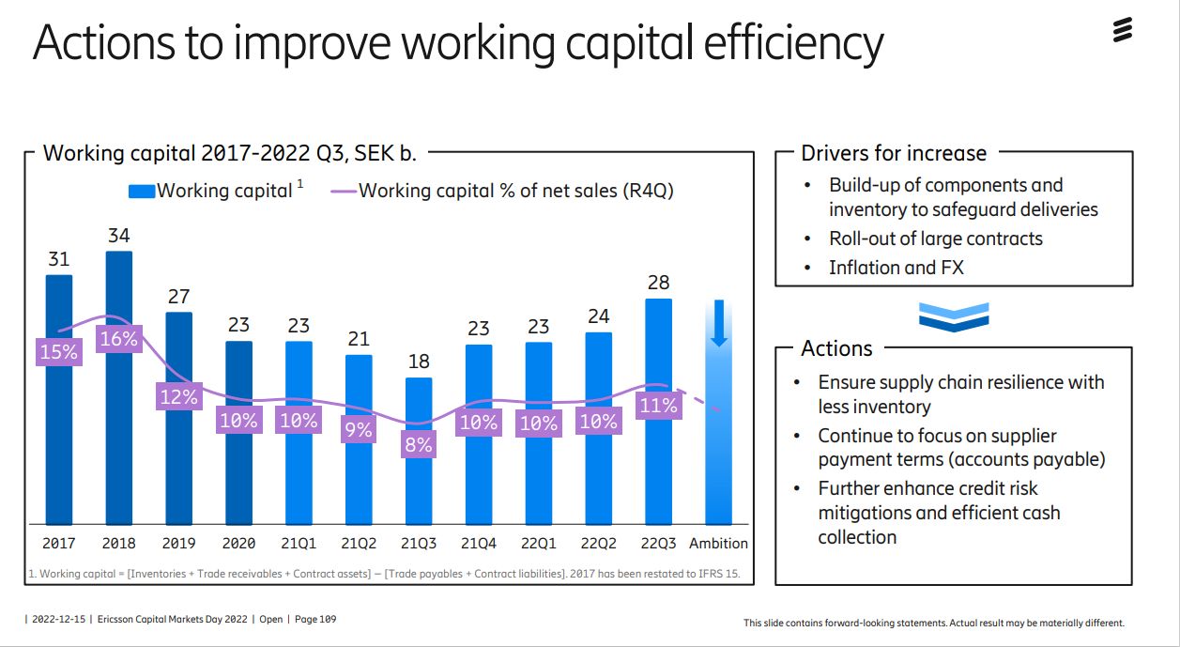
Capital Efficiency

