Slide 1
The Role and Tools &Techniques of a CFO/Controller
Lecture 3. Focus on ACTIVE OWNERS: PE (EQT) & HEDGE FONDS (CEVIAN) & MANAGEMENT PRACTICE.
Jan Lindvall
January 18, 2023

Slide 2
Cevian ”on” Board!

Slide 3
Agenda
Introduction to PE and activist funds (Hedge funds).
Intellectual roots and research related to PE
PE – how it works. Example EQT.
PE – do they have better management?
Hedge funds – how it works. Example Cevian

Slide 4
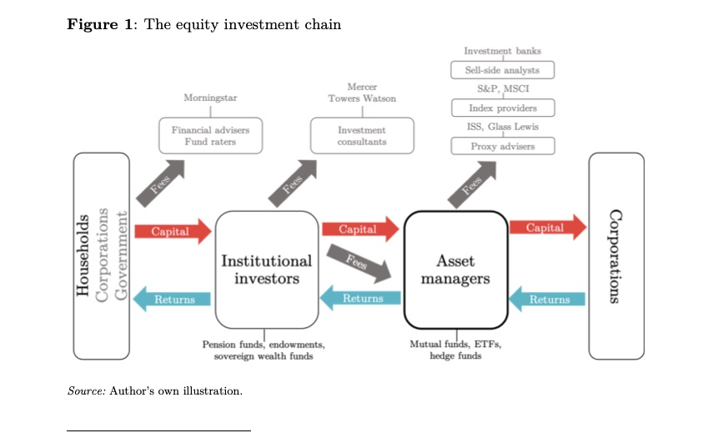
The Map: Braun: The Equity investment in general

Slide 5
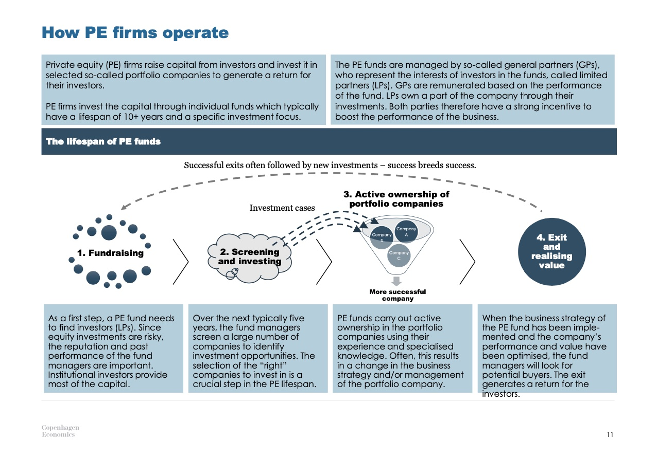
How PE operate : The importance of GP (General Partner) and LP (Limited Partners)

Slide 6
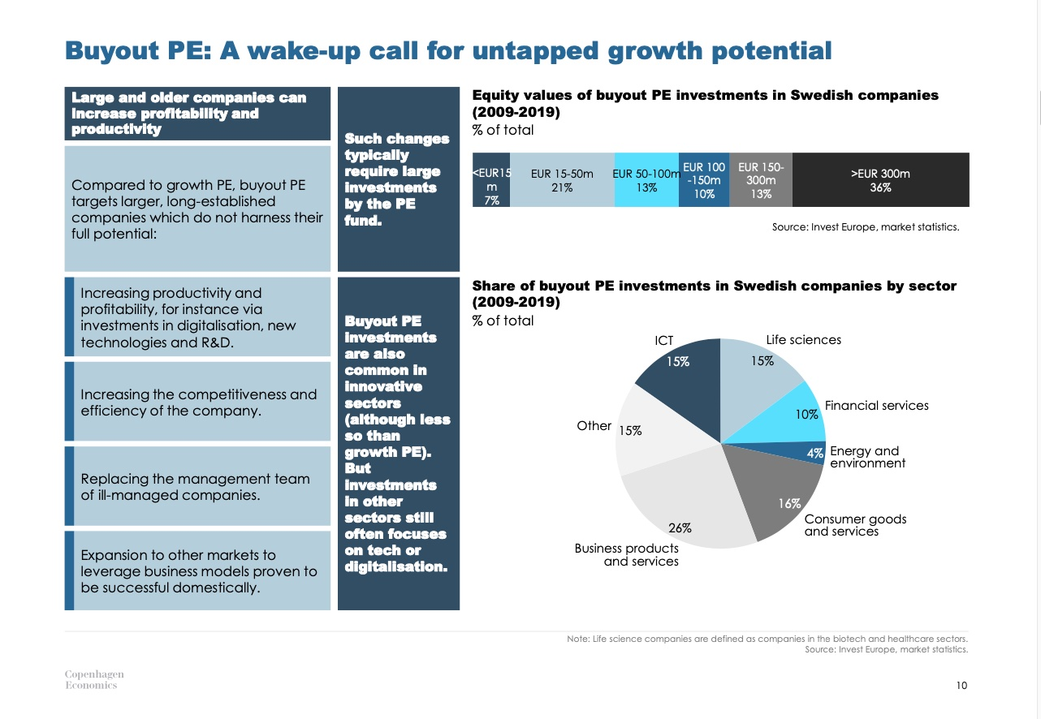
Buyout PE

Slide 7
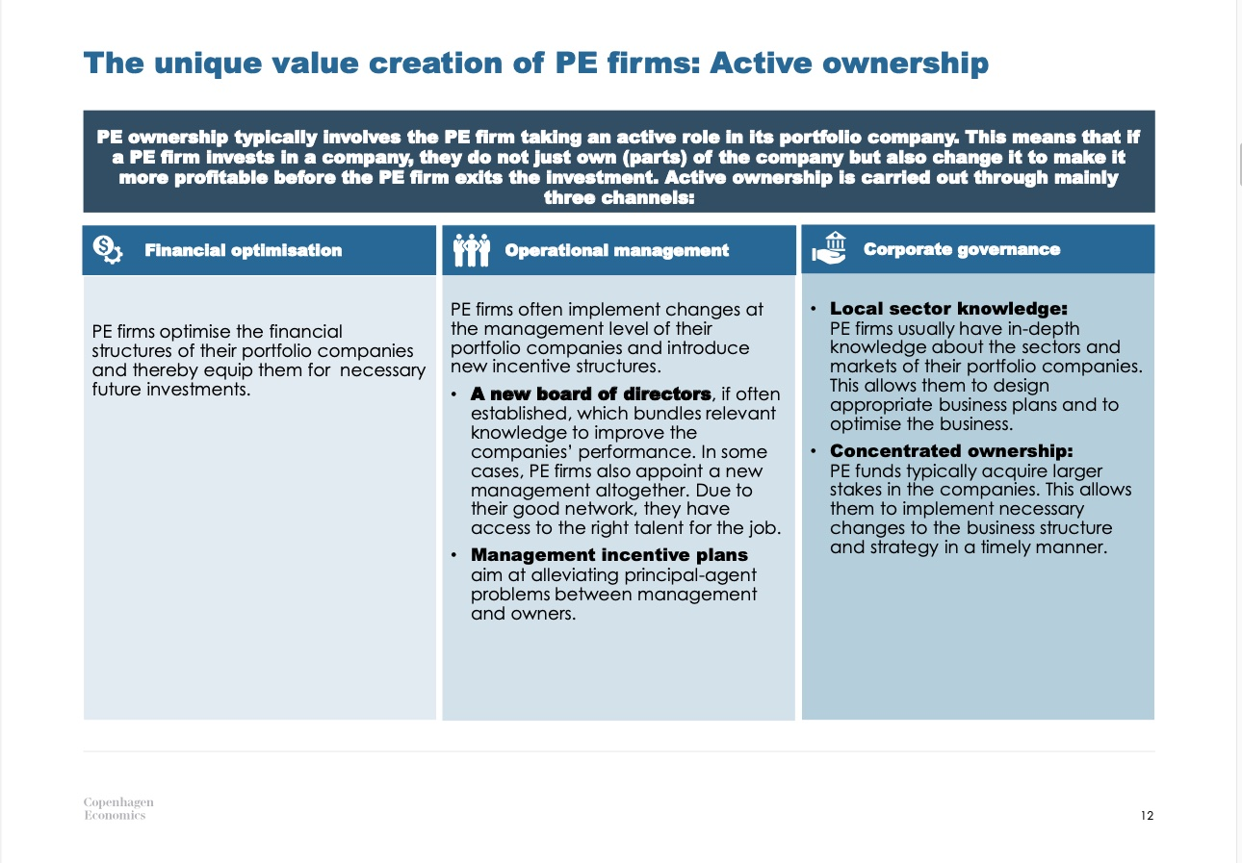
PE & Active Ownership. HOW?

Slide 8
Shareholder Revolution/Private Equity: Intellectual – Academic roots
Brown et al, 2020, p 9
Jensen & Meckling : “Theory of the Firm: Manage- rial Behavior, Agency Costs, and Ownership Structure.”4
That paper revolutionized the theory of corporate finance by identifying and analyzing conflicts of interests and incentives between the management and share holders of large public companies.
In a 1986 “The Agency Costs of Free Cash Flow: Corporate Finance and Takeovers,”
Jensen extended this analysis to the shareholder activism of the ’80s by documenting the tendency of managers of companies in mature industries to reduce their efficiency and value by hoarding excess cash and capital—or, with even worse consequences, reinvesting it in low-return businesses, including diversifying acquisitions—instead of returning it to shareholders.

Slide 9
Good with debts… LEVERAGE - increased monotoring?
”Jensen also viewed the heavy use of debt financing as providing what amounts to an automatic internal monitoring-and-control system. That is, if problems were developing, top management would be forced by the pressure of the debt service to intervene quickly and decisively.”

Slide 10
OE: ”Buyouts” & ”Growth Equity”/Venture Cap
Brown p 11
”Much, of course, has changed since Jensen identified the main features of this “new organizational form” with its “better model of corporate governance.” The term “LBO” is rarely heard these days, having been absorbed into a broader class called “private equity”—a category which includes traditional buyouts and “growth equity” (investing in companies that are established but still growing strongly).
And the financial structures and kinds of companies involved in such transac tions have also changed somewhat over the years.

Slide 11
Four common question related to PE…
1. How have PE buyout companies performed relative to their public counterparts? And to the extent there have been improvements in operating performance and productivity gains, how have such gains been achieved? What role have PE firms played in this process?
2. Especially in light of the large fees and profit shares paid to the PE firms, or GPs, and the significant “control” premiums over market paid to the selling companies, how have the returns to the LPs that provide the bulk of the funding for PE funds compared to the returns earned by the shareholders of otherwise comparable public companies?

Slide 12
Four questions cont.
3. Why is PE so controversial? Beyond their effects on productivity and benefits for investors, what are the employ ment and other social effects of buyouts and PE?
4. What are the prospects for future PE returns to their LPs, especially in light of the volume of capital commitments and high purchase multiples that were being paid, at least until the onset of the COVID pandemic? And what role, if any, should PE activity be expected to play in the recovery from the pandemic?

Slide 13
Learning from experience (1990s)? P 13
”But the industry collectively appears to have learned from this experience and responded with at least two important adjustments.
The first was a reduction of leverage ratios and other increases in financial flexibility.
The second, and perhaps even more important, adjustment was the PE firms’ growing recognition of the value of operational engineering, and their efforts to develop or acquire this capability. PE firms have done this in an increasing number of ways.

Slide 14
Some results – conclusions about PE -investors
… expect to provide strong equity incentives to their management teams and believe those incentives are very important.
• …regularly replace top management, both before and after they invest.
• … structure smaller boards of directors with a mix of insiders, PE investors, and outsiders.
•…the sources of that added value, in order of importance, increasing revenue, improving incentives and governance, facilitating a high-value exit or sale, making additional acquisi- tions, replacing management, and reducing costs.
• … commit meaningful resources to add value, using a considerable variety of different ways and approaches.

Slide 15
The possibilities and problems with the standard ”2 and 20” compensation
”Critics argue that the standard “2 and 20” private equity contract allows GPs to earn excessive compensation while doing too little to discipline underperforming GPs or provide them with effective incentives to maximize LP returns. Some critics claim that there is too much “fixed” compensation in the form of management fees versus carry, while others have suggested that the sheer complexity of some management contracts has effectively allowed GPs to charge high fees for mediocre or even substandard performance.”

Slide 16
What are the major charges against private equity?
The most common is that the high leverage used in many deals puts pressure on the portfolio companies themselves to cut productive investment and forgo even profitable growth. And in their relentless quest for efficiency, PE is regularly chastised for “gutting companies,” selling off valuable assets, and cutting jobs and reducing overall employment.
But perhaps a bigger source of controversy surrounding the PE industry is the amount of money made by the top PE firms and their partners. This controversy echoes much of the public debate about high wealth and income inequality across society. And large fortunes have been built in the PE business, as they have in other sectors.

Slide 17
The Future for PE? From QE to QT: higher interest
”The greatest internal challenge facing the industry collectively—and this was true well before the coronavirus showed up—is likely to be the boom-and-bust cycle that appears to have become an established feature of the industry. Such cycles appear to be driven by the amounts of new capital flowing into the industry, and the competition for deals that such capital flows create. High returns tend to attract new capital commitments. And because returns tend to be highest when interest rates are low relative to stock prices, the high returns and abundance of capital in turn tend to lead to more deals at higher prices.”

Slide 18
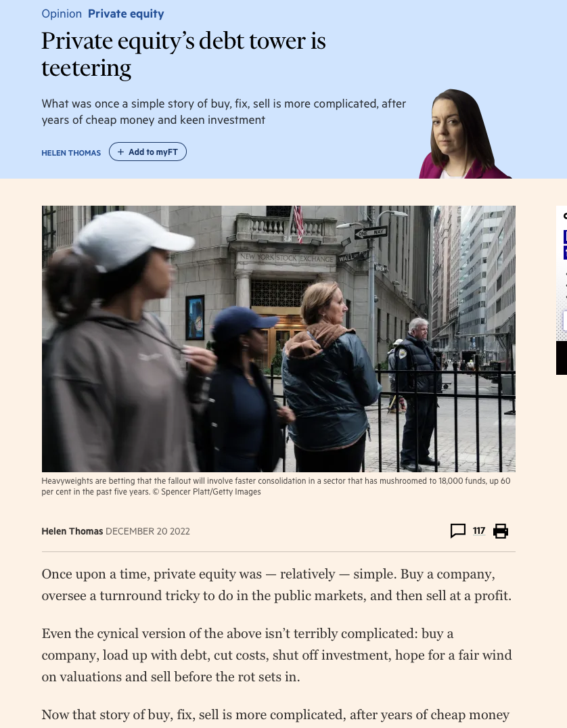
The situation today 1

Slide 19
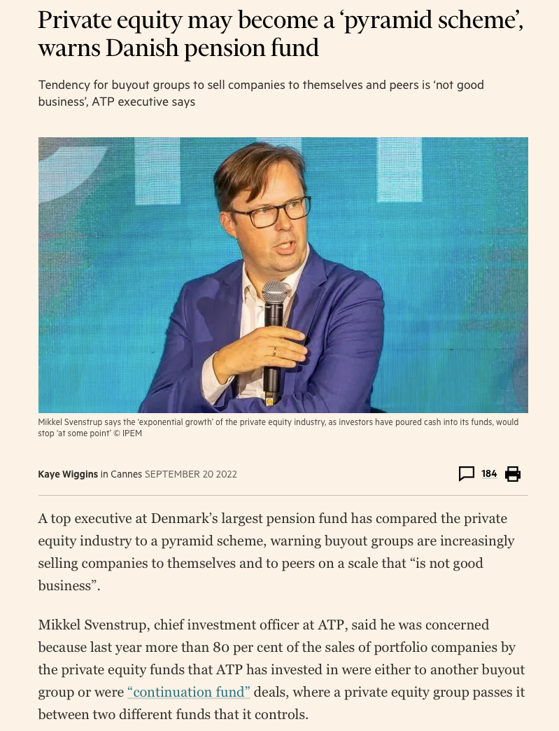
The Situation Today 2

Slide 20
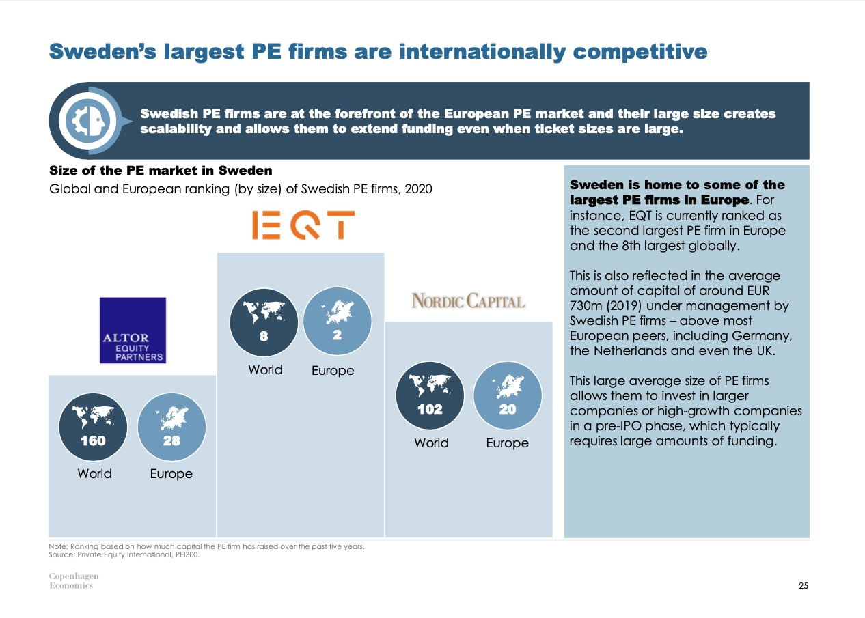
Sweden – Large PE firms. EQT the only public!

Slide 21
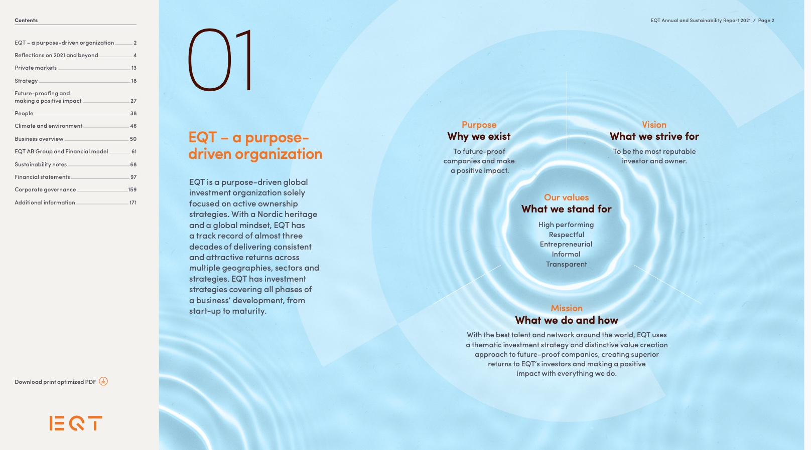
EQT – also ”Purpose Driven!”

Slide 22
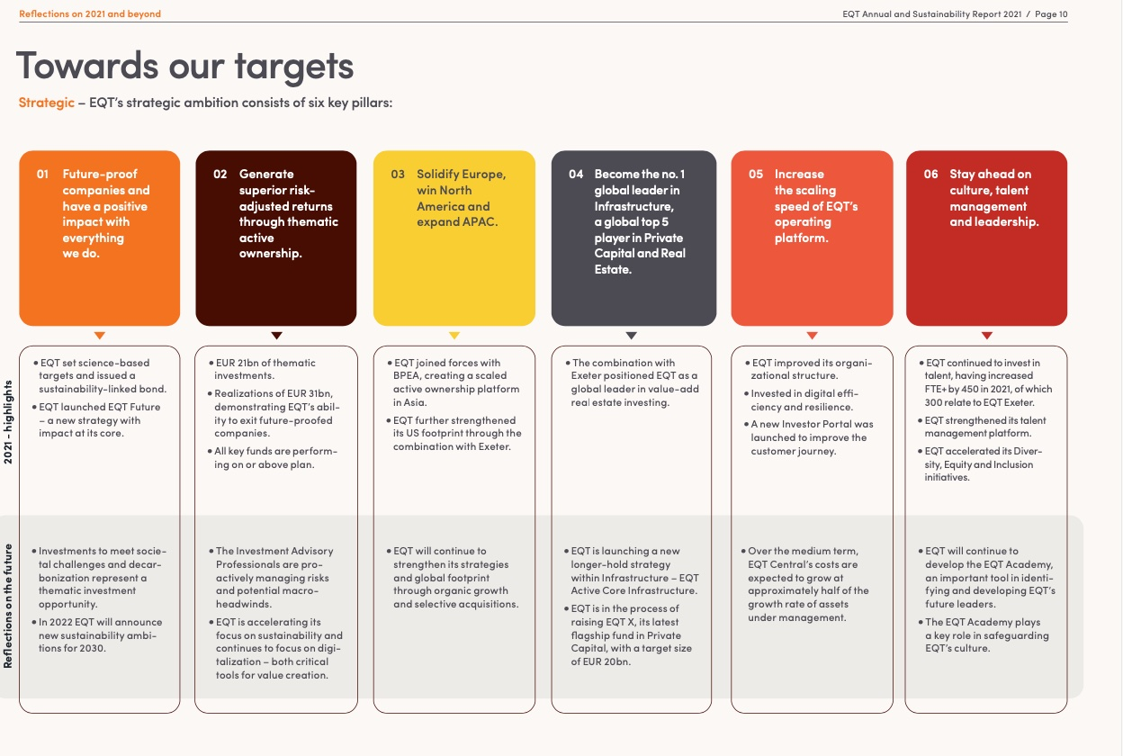
EQT: Strategic Target – Six Pillars

Slide 23
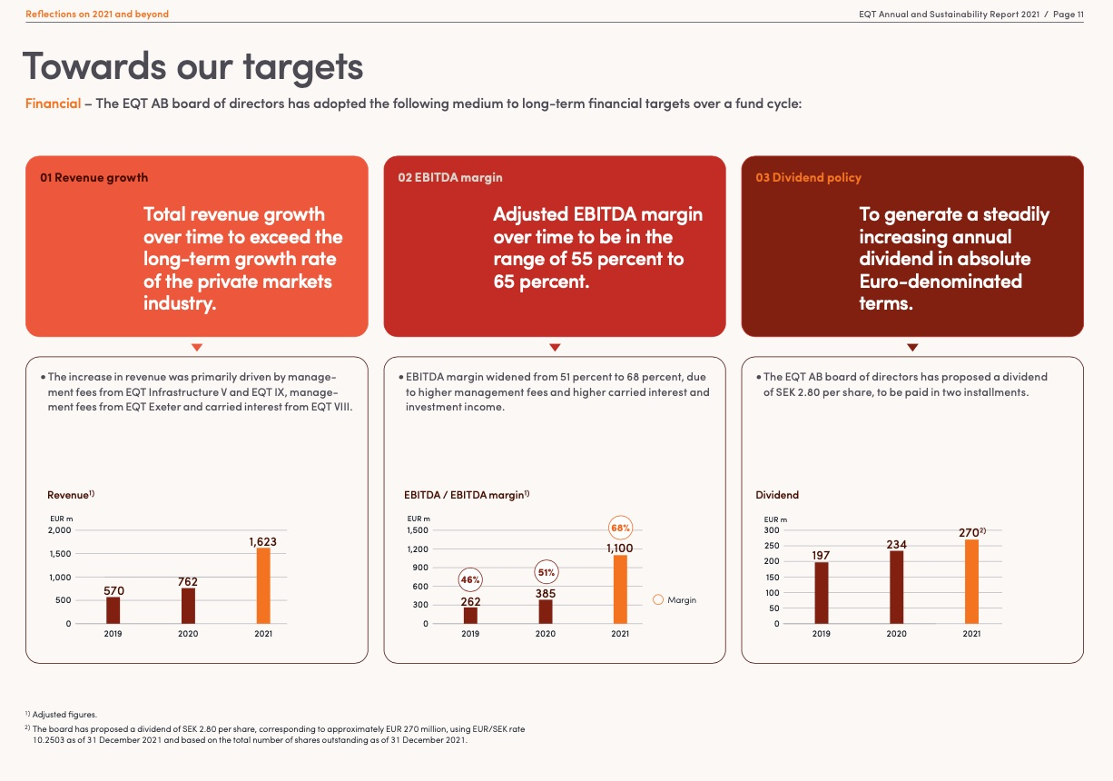
EQT . Financial Targets

Slide 24
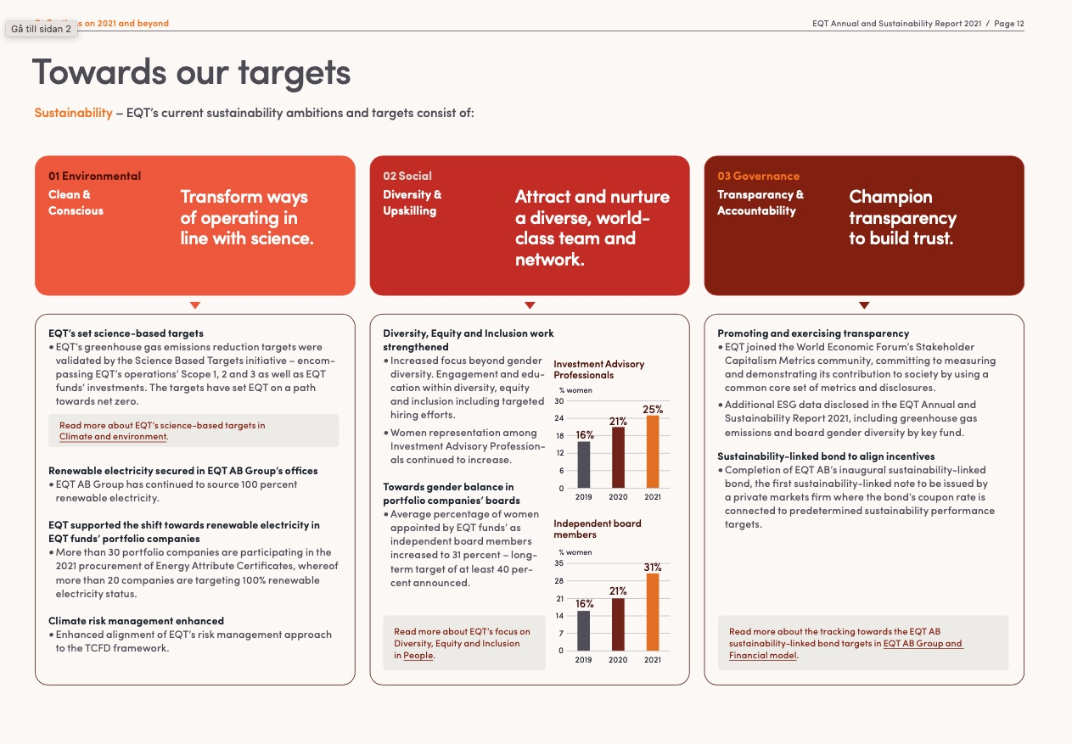
EQT – Targets Sustainability

Slide 25
PE & Management Practice: Monitoring, Targets, Incentives. Bloom et al
We find that PE firms appear to have a particularly large gap in monitoring practices. These are the type of “Lean” manufacturing practices around continuous performance measurement, improvement, and feedback that originates in world-class firms like Toyota.
PE firms are also relatively strong at setting effective targets, which involves setting stretching but realistic targets across the whole firm, with these targets matching up in the short and long run.
Finally, while unconditionally PE firms do have better incentives over linking pay, promotion, and continued employment to the effort and ability, when we include a full set of country, firm, industry, and noise controls, the difference with other ownership becomes insignificant.

Slide 26
PE & Management Practice cont
In the last two columns of Table 3 we examine whether PE firms also differ in terms of the decision making authority allocated to the plant manager.
This decentralization index records the extent to which the plant manager can make autonomous decisions in terms of hiring and investment, sales and marketing, and product introduction initiatives. We find that PE firms appear to be more decentralized relative to other ownership types in terms of decisions related to sales/marketing and product introduction (column 5), while the difference is insignificant with respect to hiring and capital decisions (column 4).2

Slide 27
Hedge Funds (Ahn & Wiersema p 98)
”Hedge funds are considered to be an institutional investor but they differ significantly from pension funds, mutual funds, endowment funds, banks, and insurance companies. The SEC defines a “hedge fund” as a pooled, privately organized investment vehicle that is administered by professional investment managers who have significant investment in the fund
… hedge funds, like private equity, are not open to the public and can only be invested in by accredited investors (e.g., financially sophisti- cated investors such as high-net-worth individuals, mutual funds, pension funds, or insurance companies).

Slide 28
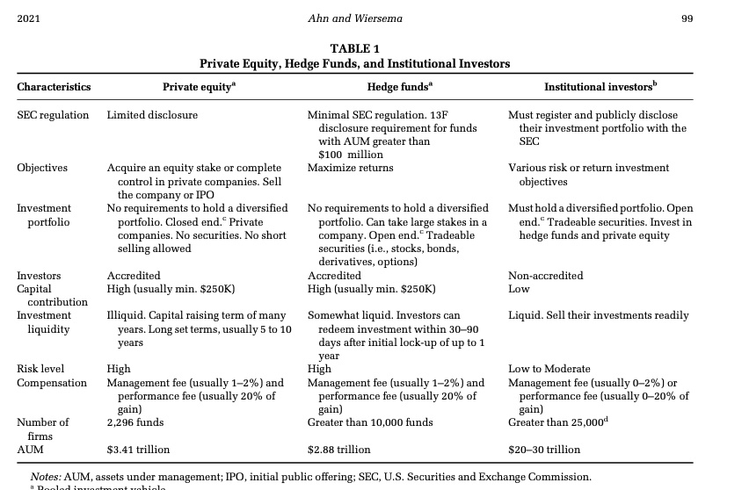
Differences

Slide 29
A difference..
”Unlike other institutional investors, hedge funds, like private equity, can take large stakes in a company, since they are not required to hold a diversified portfolio. Like other investment vehicles, hedge funds collect a 1–2% fee based on assets under management, but also earn 20% of the gain in value of the investment portfolio. Given this compensation structure and since the principals of these funds have their own wealth invested, hedge funds have strong incentives to generate positive returns, which ac-counts for their aggressive behavior and investment strategies.”

Slide 30
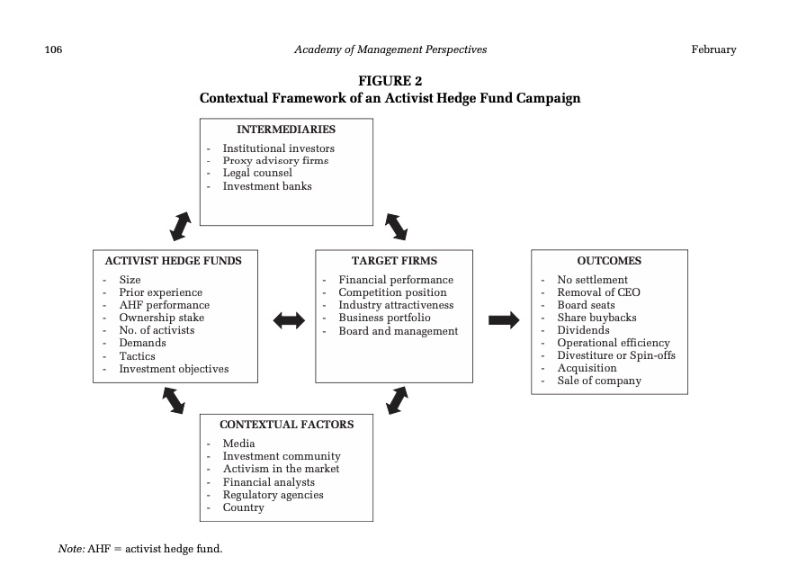
Hedge Funds – mechanisms

Slide 31
The Importance of ISS p 103 See Ericsson
”Finally, proxy advisory firms such as Institutional Shareholders Services (ISS) have “become enormously influential and have also helped weaken corporate defenses” (Briggs, 2007, p. 692). ISS strongly supports shareholder activism, opposing takeover defenses such as poi- son pills and staggered boards, which has resulted in most public companies complying with their guidelines (Coffee & Palia, 2016). As a result, companies can face the prospect that their entire board could be removed in a proxy fight. ”

Slide 32
Cevian: Ericsson, Nordea, SKF, ABB…
”In contrast, Cevian Capital, the largest European activist, pursues a completely different approach by conducting private negotiations with management and the board, without issuing letters or public statements about its campaigns. What motivates and determines the nature of an activist’s campaign and the resulting impact on the various parties are questions that deserve to be explored in order to better understand the impact of hedge fund activism.”

Slide 33
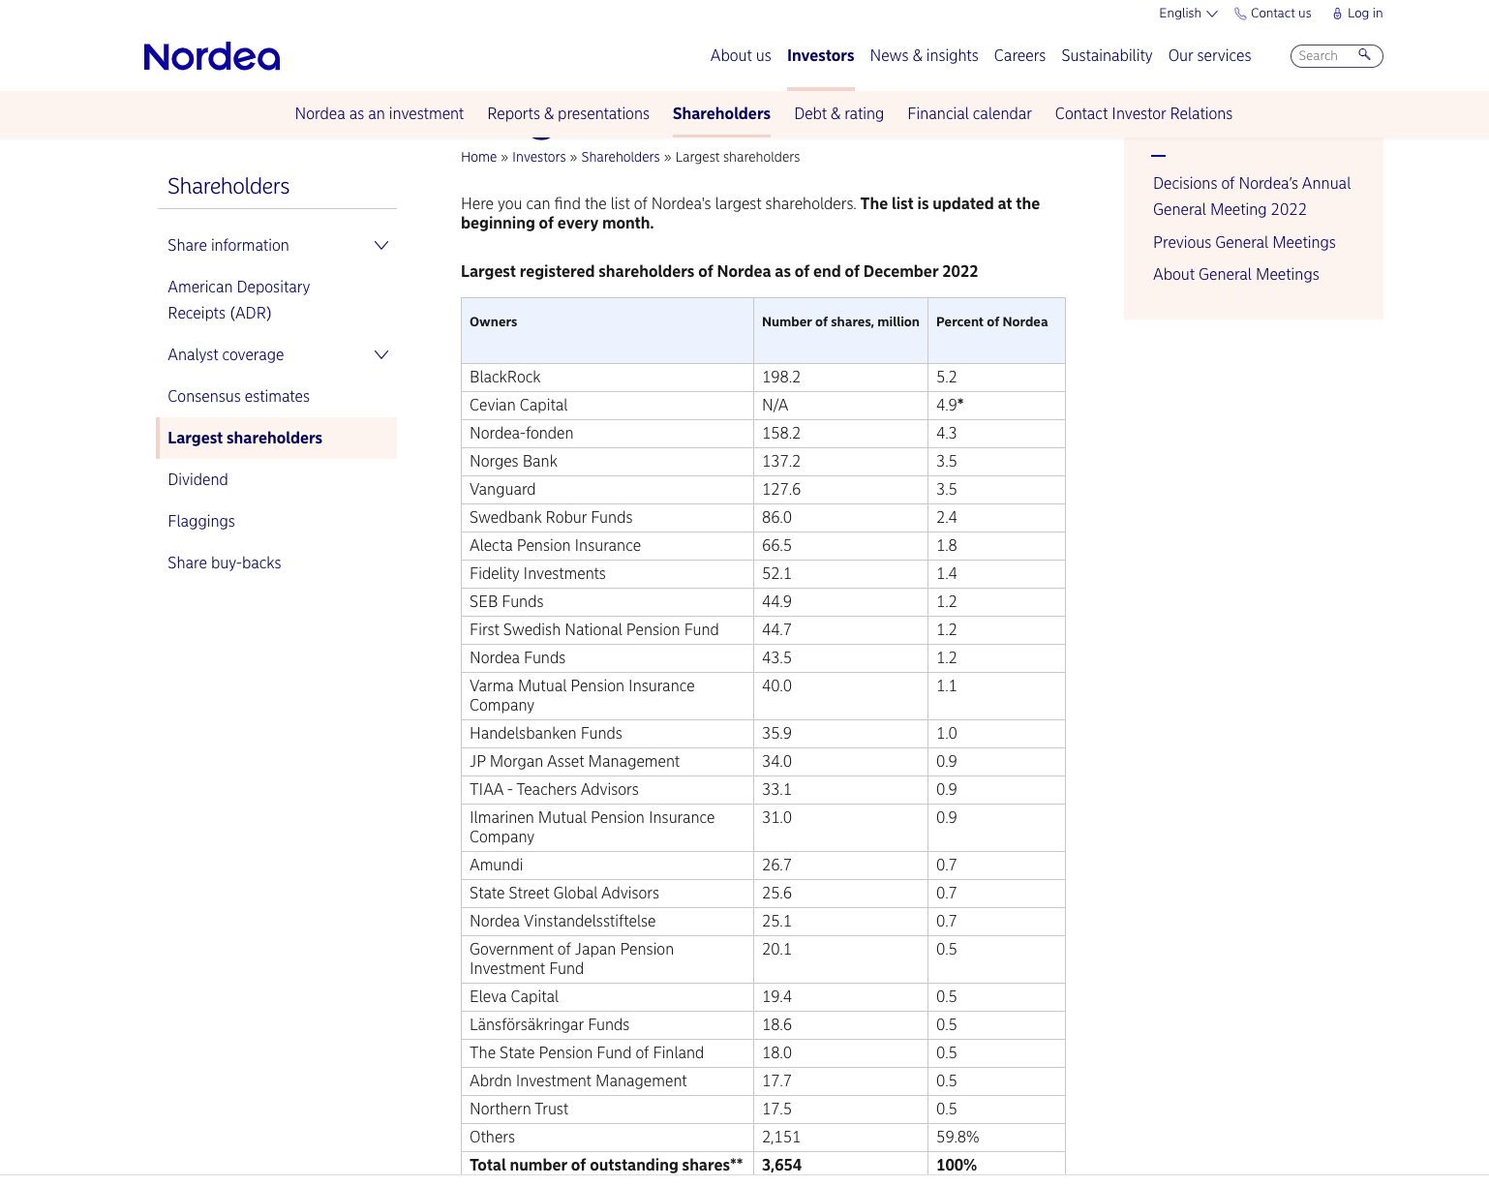
Who owns Nordea?

Slide 34
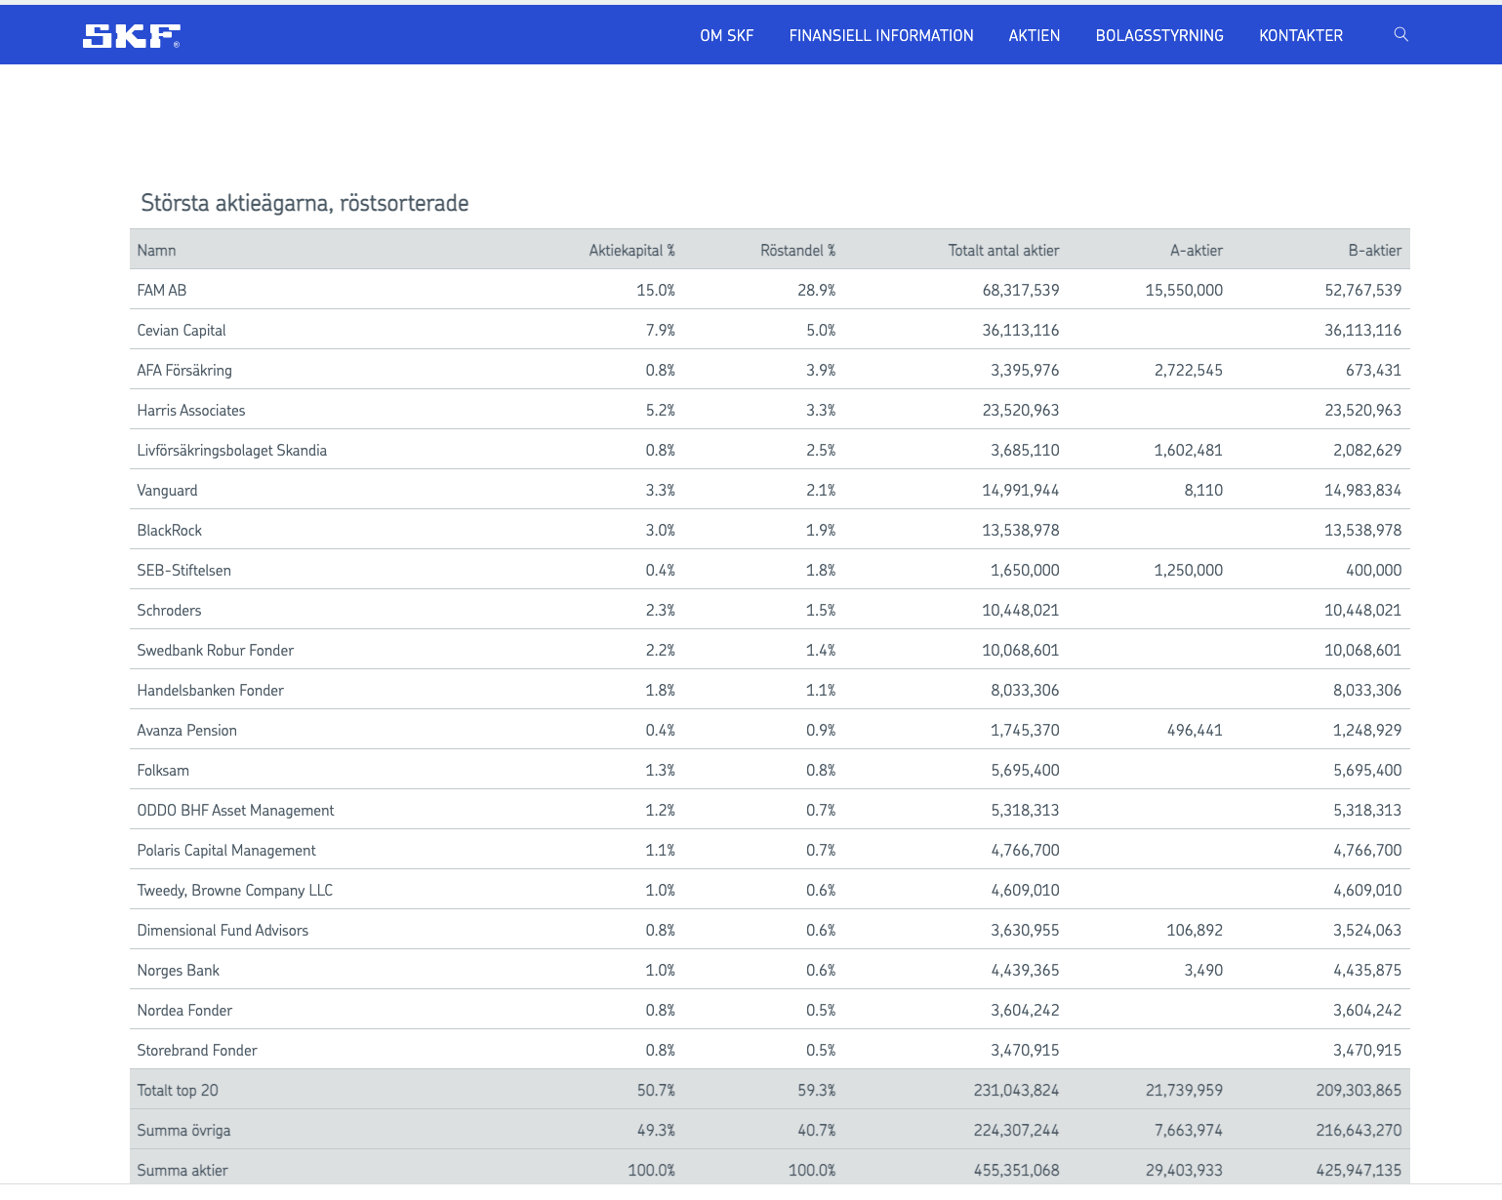
Who owns SKF?

Slide 35
Cevian Executive Pay and Sustainability Targets

