Slide 1
The Role,Tools &Techniques CFO/Controller
Lecture 4. Capital allocation: important but difficult!
Jan Lindvall
January 23, 2023

Slide 2
Disposition
1. ABB & Capital Allocation: Active Porfolio Management
2. Models - models for reduce complexity & create action
3. Results from Graham, CFO-study.
4. Results/comments about Capital Allocation, Credit Suiesse

Slide 3

Case ABB

Slide 4
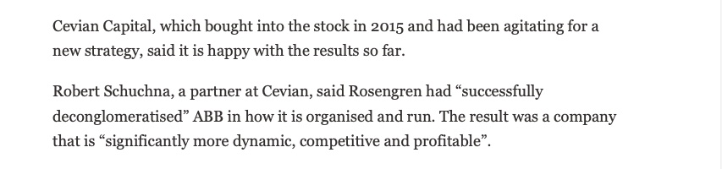
Cevian – active owner: ”deconglomeratisation”!

Slide 5

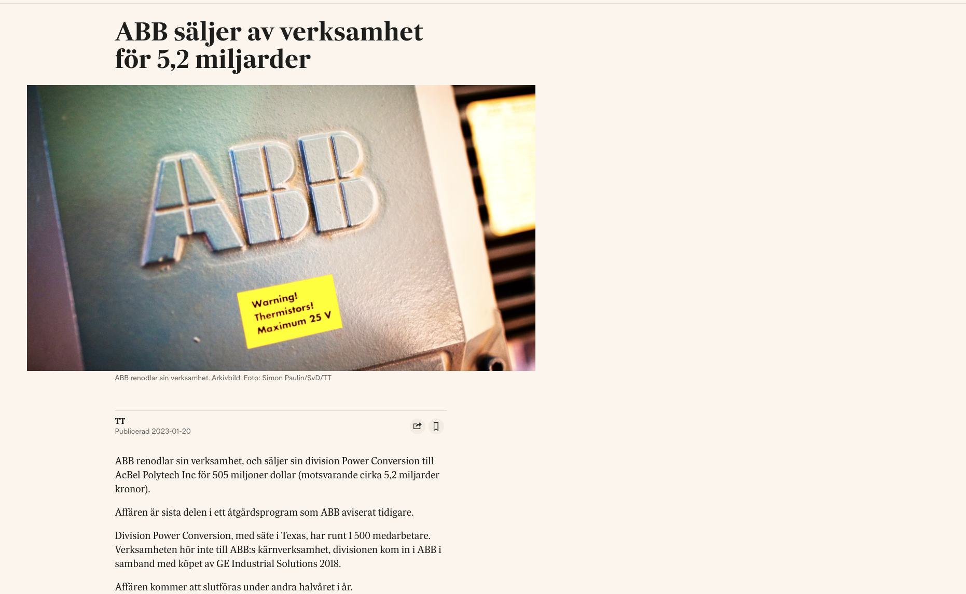
ABB Portfolio Management in Practice

Slide 6

Portfolio Management

Slide 7
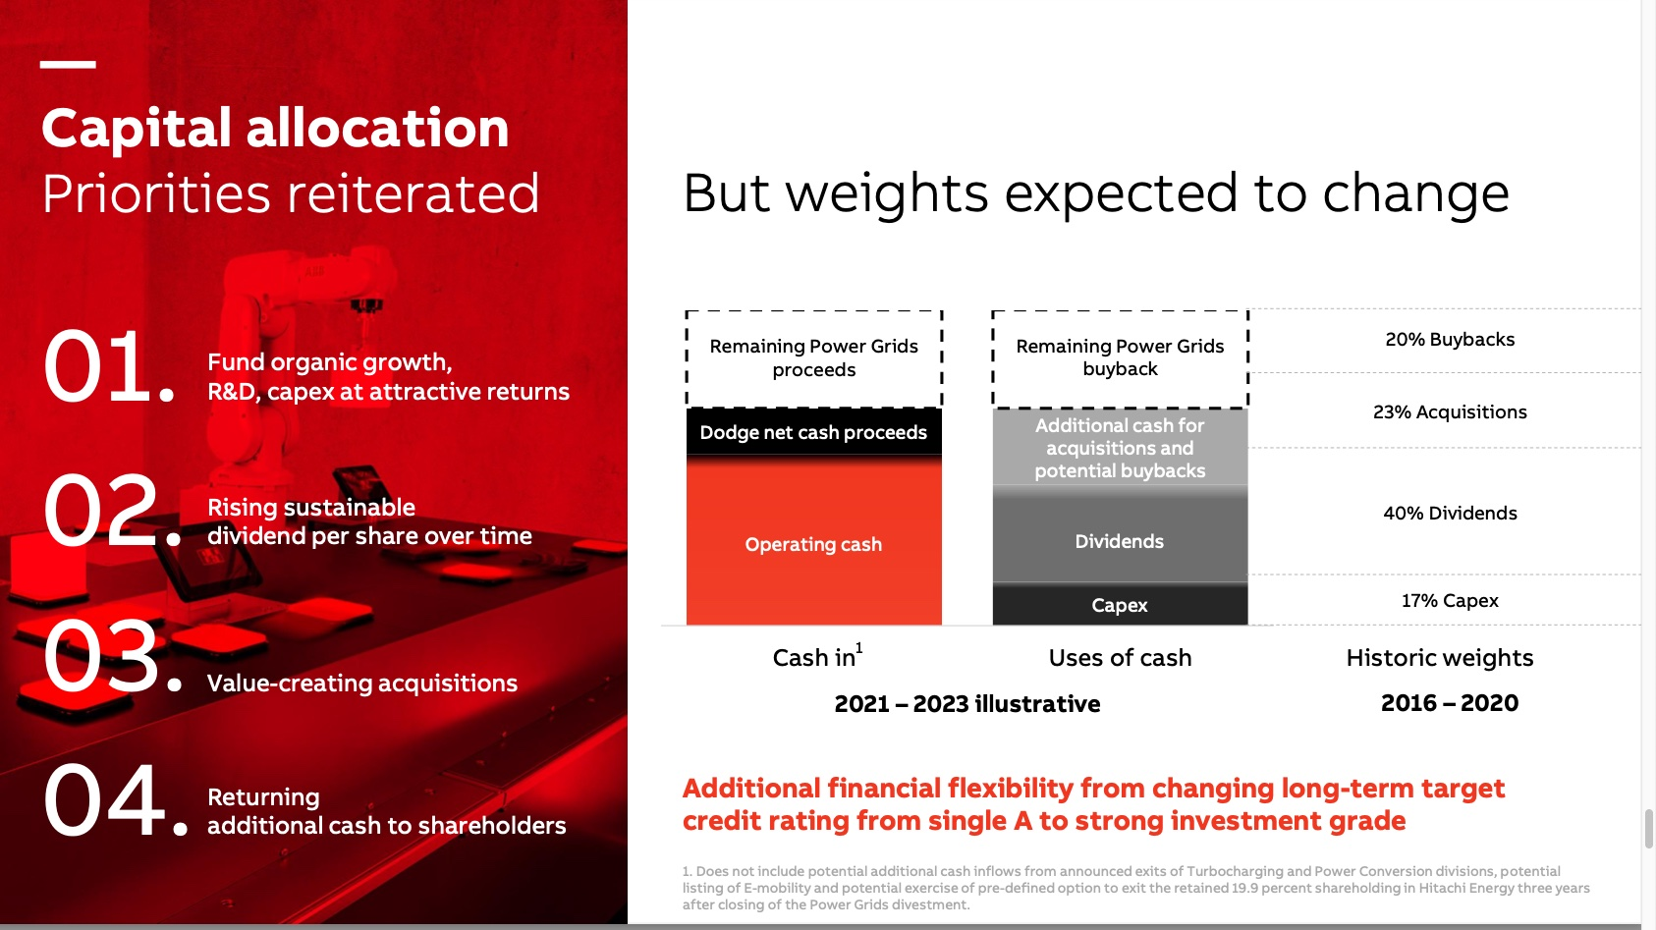
What to do? Inflow and outflow of cash

Slide 8
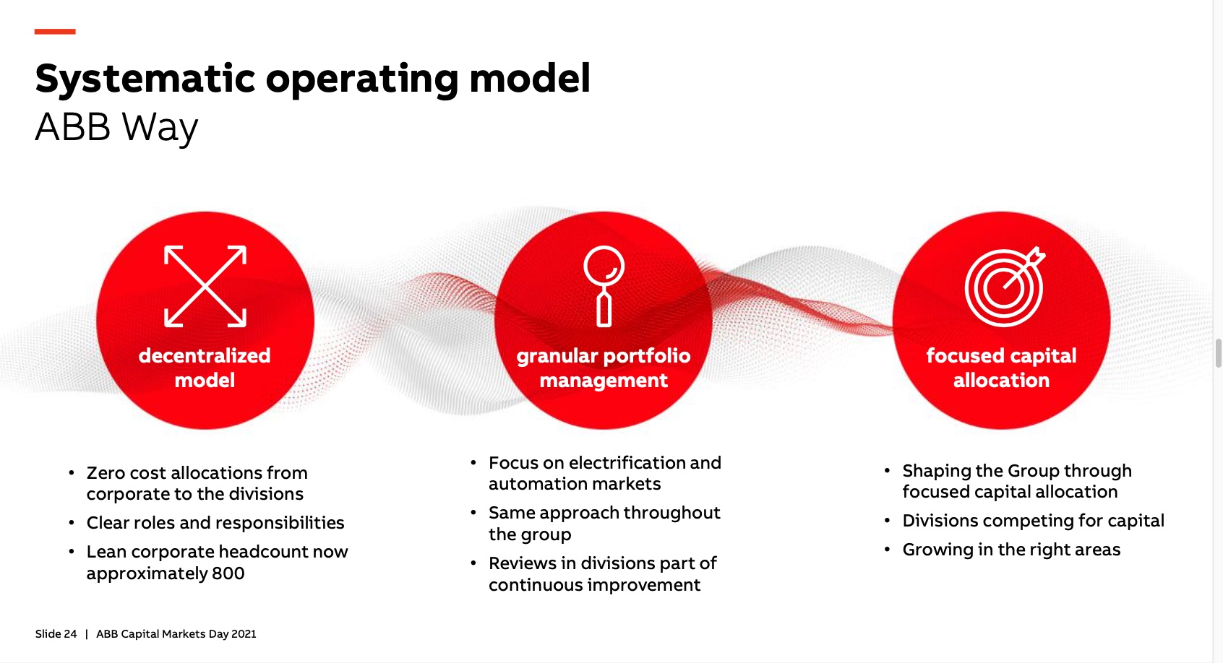
How to do it? Portfolio management and focused capital allocation in a decentralised model

Slide 9
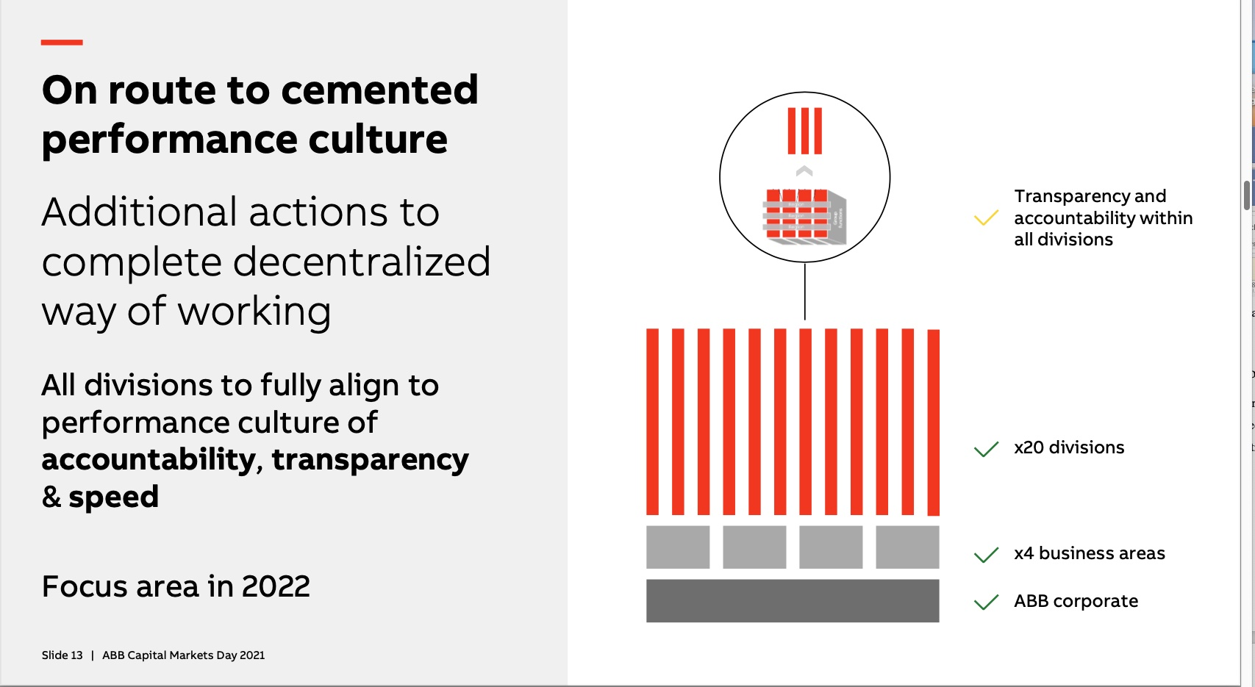
Decentralization & Performance: Accountability, Transparency & Speed!

Slide 10
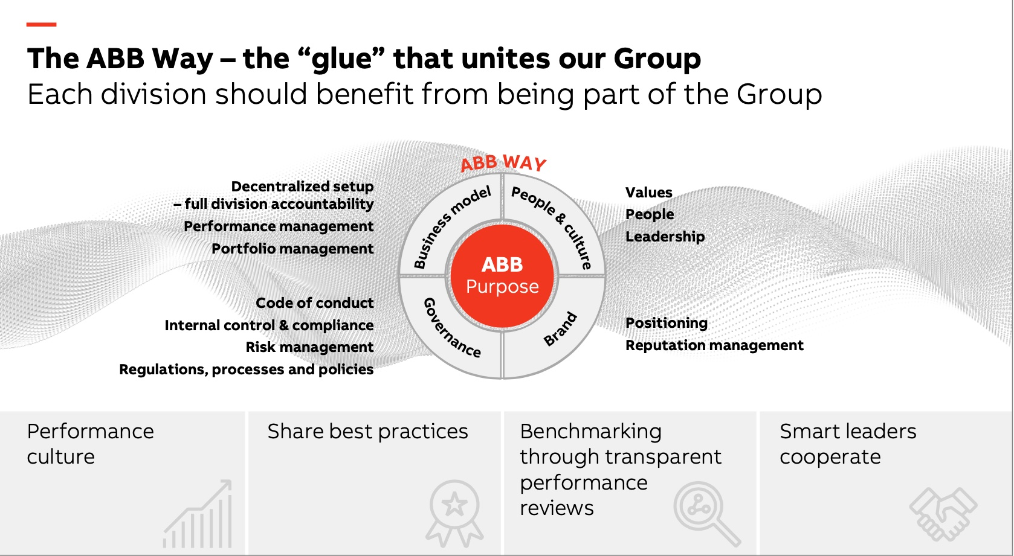
The ABB Way: the ’glue’

Slide 11
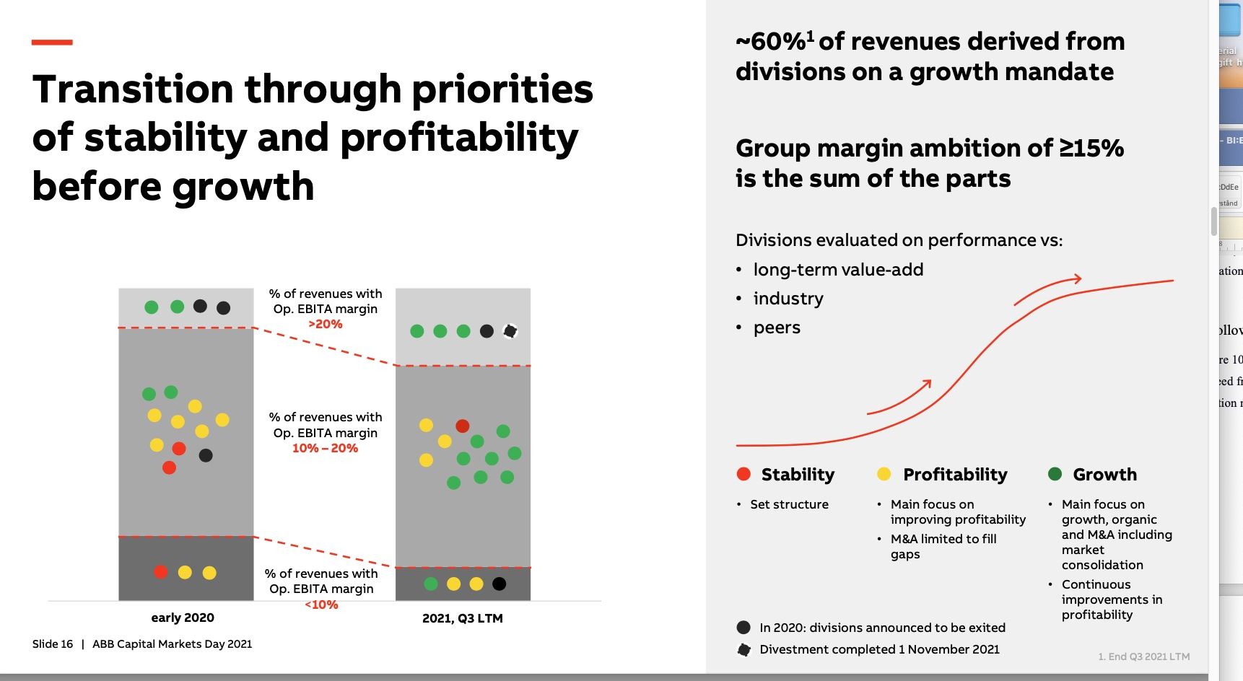
Management Control – a dynamic process

Slide 12
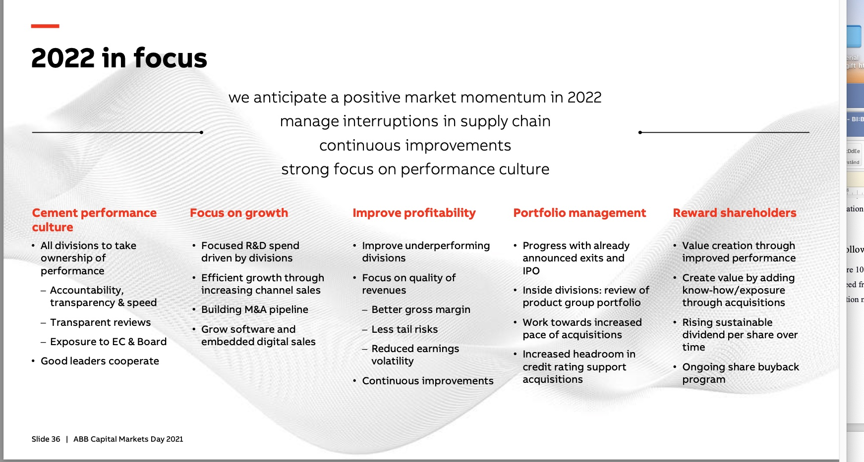
Looking forward…

Slide 13

Model 1. Discounted Cash Flow – important financial model!

Slide 14
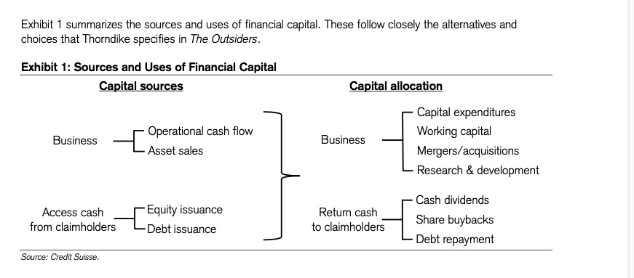
Model 2: Financial Capital: Sources and uses

Slide 15
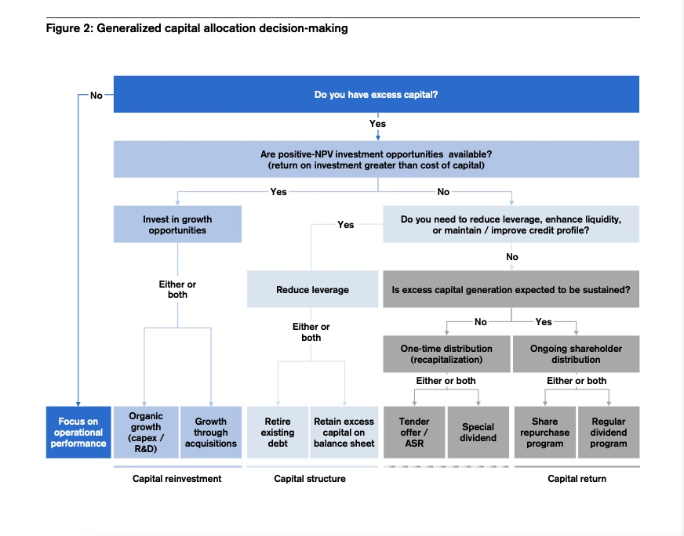
Model 3: Capital Allocation decision-making. A rational view.

Slide 16
Difference between Accounting (”history”) and Finance (”future”)
”IN A TRADITIONAL CORPORATE FINANCE framework, rational managers optimize to maximize shareholder value. A substantial body of research based on this framework assumes among other things that managers form rational expectations, optimize corporate investment intertemporally, and invest in positive net present value (NPV) projects.
However, these principles only partially align with real-world decision-making. Moreover, a gap between academic research and the practice of finance is reflected in the modest statistical fit of most corporate finance models and the even more modest ability to predict outcomes out of sample or provide quantitative guidance for specific companies.”
Graham, 2022, p 1976

Slide 17
Graham CFO- study: Important topics: investment (flow), capital structure (stock), payout, expectations/planning.
The CFO surveys explore topics including corporate investment, capital structure, payout, and corporate expectations and planning.
Some of this analysis is new to finance, such as that corresponding to the corporate planning process, even though planning is the foundation of many financial decisions and underlies the cash flow forecasts that are a staple of finance teaching and research.
Graham 1976

Slide 18
Result 1. Near term focus – two years!
One common practice of finance theme is that in many instances, companies focus on the near term. For instance, CFOs indicate that, on average, the information in their corporate plans is reliable for a horizon of only two years— and that this horizon has decreased over time.
Other evidence of a near-term focus includes extensive use of the payback method for capital budgeting; emphasis on current profits when changing investment plans; and benchmarking debt against current cash flows rather than long-term value.

Slide 19
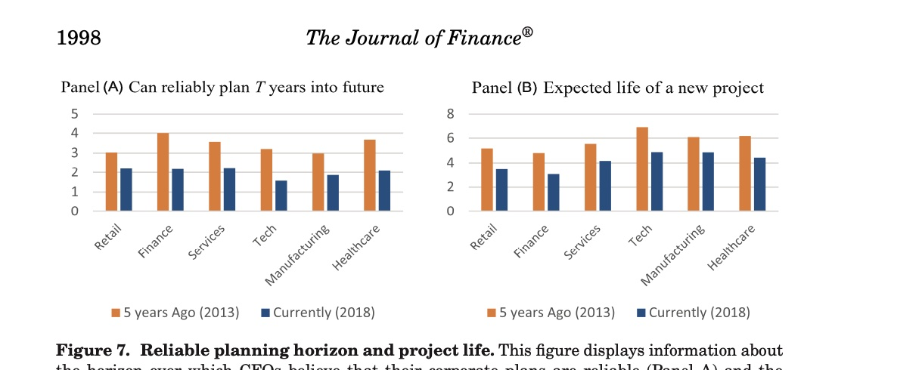
Short planning horizon

Slide 20
Result 2. Managerial forecast - not soo good!
”… in reality, managerial forecasts produce an unusual number of positive and negative surprises, that is, managerial forecasts are miscalibrated (or overprecise), with the second moment of the distribution too tight. ”

Slide 21
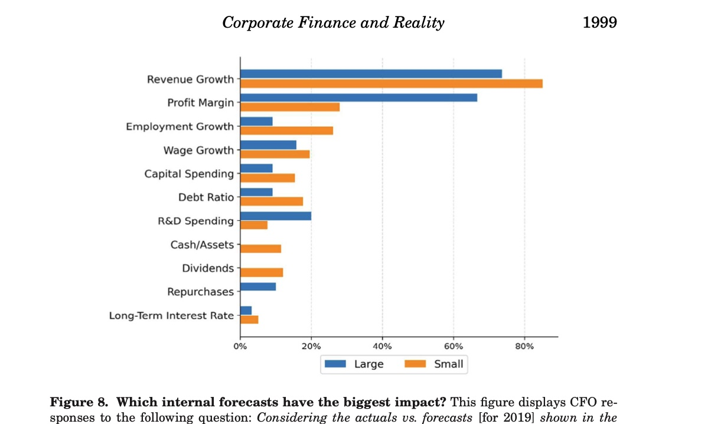
Most important forecasts?

Slide 22
Excuses: Self-attribution biases
”The CFO surveys provide evidence consistent with self-attribution bias in that executives are more likely to “blame the market” if revenues miss on the downside (relative to forecast) but take credit if revenues overperform...”

Slide 23
Result 3. Conservative policies
”Companies adopt what appear to be conservative policies (the third theme), perhaps in an effort to provide slack in the event downside surprises occur. Conservative policies are common. Capital budgeting policies are conservative in that companies set investment hurdle rates far above their cost of capital, which leads them to choose projects that ex ante they believe will have large NPV (NPV>>0).
”The CFOs also indicate that dividend payout increases tend to be conservative, allowing a firm to maintain its dividend even if future profits disappoint. In sum, decision rules are often conservative, to some extent offsetting near-focused and miscalibrated managerial forecasts”

Slide 24
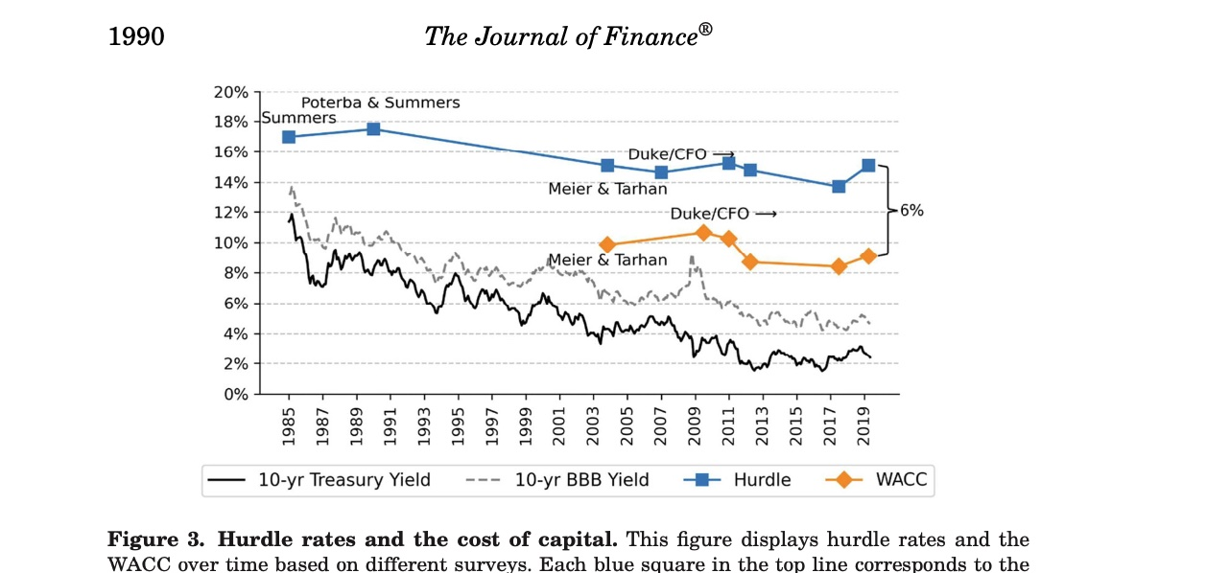
Conservatism: Hurdle rate ”much” higher than cost of capital

Slide 25
Result 4. Corporate decision- making is sticky!
”The CFO surveys, however, indicate that corporate decision-making is sticky. For example, the factors that drive debt decisions are ranked similarly in 2022 and 2001. In addition, the popularity of using the capital asset pricing model (CAPM) to estimate the cost of capital has persisted over the past 20 years, despite many advances in asset pricing theory and evidence that the CAPM does not well explain the cross-section of returns. Moreover, investment hurdle rates are very sticky, with only minor changes over the past 35 years even as market interest rates fell substantially. CFOs further indicate that target debt ratios do not change often.”
Graham, 2021, p 1979

Slide 26
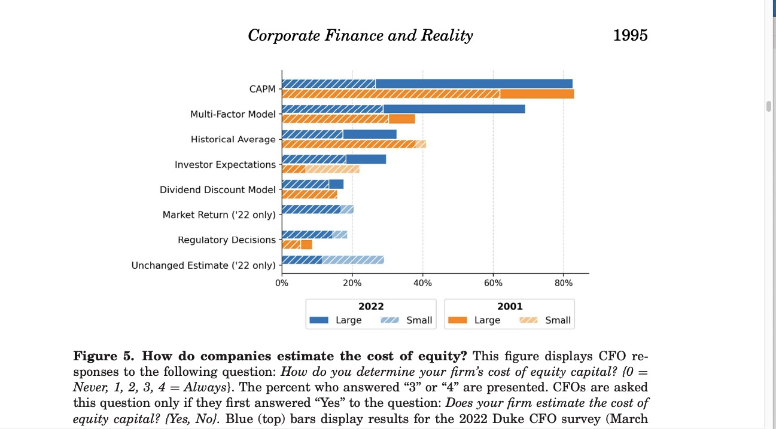
How they estimate ”cost of equity”?

Slide 27
Result 5. Simple decision rules!
”A fifth theme relates to the commonly held assumption that managers use decision processes that account for multiple dimensions of complex circumstances. The CFO surveys suggest that companies use simple decision rules. For example, even after decades of business education highlighting the deficiencies of the payback rule, many (especially small) firms rely more heavily on payback than on NPV in capital allocation, possibly due to implementation challenges. Moreover, NPV often plays a supporting role in corporate investment choices.”

Slide 28
Result 6. Shareholder vs Stakeholder: multiple goals!
”Finally, the surveys provide evidence about the objects over which companies attempt to optimize. Somewhat at odds with the traditional objective of maximizing shareholder value, the survey evidence suggests that companies have shifted toward a more balanced shareholder-stakeholder focus. As discussed below, this potentially has implications for discount rates and employee welfare. In addition, corporate objectives appear to focus more on the valuation numerator (revenues or cash flows) than on the denominator (discount rates), more on debt/EBITDA or credit ratings than on debt/value or debt/assets, and more on maintaining dividend payouts than on the classic objective of first choosing investment projects and then paying out excess profits to investors.
Graham, 2022, p 1980

Slide 29
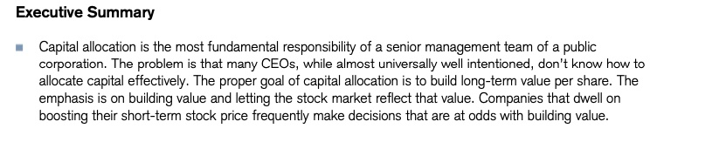
Credit Suisse: Capital Allocation: important but often lack of competence!

Slide 30
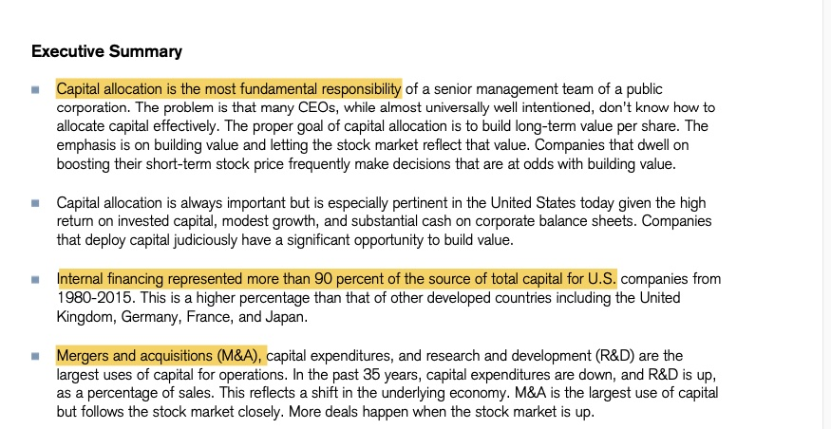
Results/comments: Capital Allocation. Credit Suisse 1

Slide 31
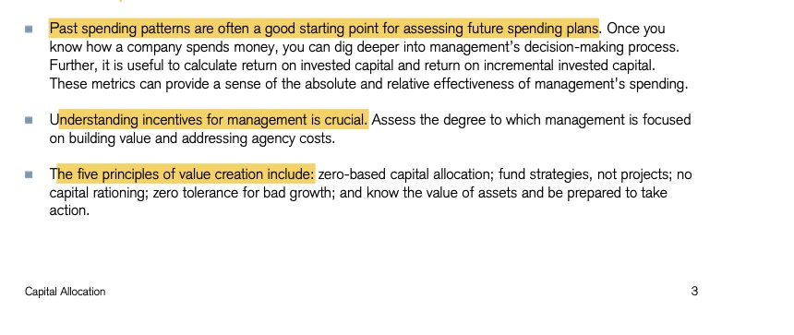
Results/comments: Capital Allocation. Credit Suisse 2

Slide 32
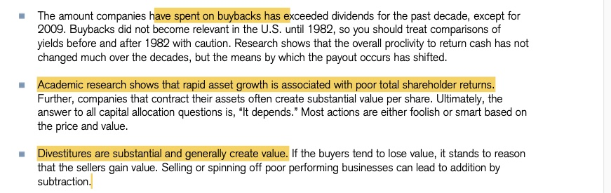
Results/comments: Capital Allocation. Credit Suisse 3

Slide 33
Strategy is important!
CFO!
”The process of making inputs more valuable has a number of aspects. A logical starting point is a strategy. Properly conceived, a strategy requires a company to specify the trade-offs it will make to establish a position in the marketplace that creates value. A strategy also requires a company to align its activities with its positioning and to execute effectively.”
Credit Suisse, Capital Allocation, 2016

