Slide 1
Lecture 4: Debt Policy: From Leveraging to Deleveraging Balance Sheet
230124
Jan Lindvall

Slide 2
Daniel Ek, Spotify 230123: strategy is important: Speed, Efficiency, Control Costs
”As we say in our Band Manifesto, change is the only constant. For this reason, I continue to reiterate that speed is the most defensible strategy a business can have. But speed alone is not enough. We must also operate with efficiency. It’s these two things together that will fuel our long-term success. With this in mind, I have some important news to share today.
”While we have made great progress in improving speed in the last few years, we haven’t focused as much on improving efficiency. We still spend far too much time syncing on slightly different strategies, which slows us down. And in a challenging economic environment, efficiency takes on greater importance. So, in an effort to drive more efficiency, control costs, and speed up decision-making, I have decided to restructure our organization. ”

Slide 3
The need to become more efficient: layoffs!
That brings me to the second update. As part of this effort, and to bring our costs more in line, we’ve made the difficult but necessary decision to reduce our number of employees.
”Over the next several hours, one-on-one conversations will take place with all impacted employees. And while I believe this decision is right for Spotify, I understand that with our historic focus on growth, many of you will view this as a shift in our culture. But as we evolve and grow as a business, so must our way of working while still staying true to our core values.
”To offer some perspective on why we are making this decision, in 2022, the growth of Spotify’s OPEX outpaced our revenue growth by 2X. That would have been unsustainable long-term in any climate, but with a challenging macro environment, it would be even more difficult to close the gap.

Slide 4
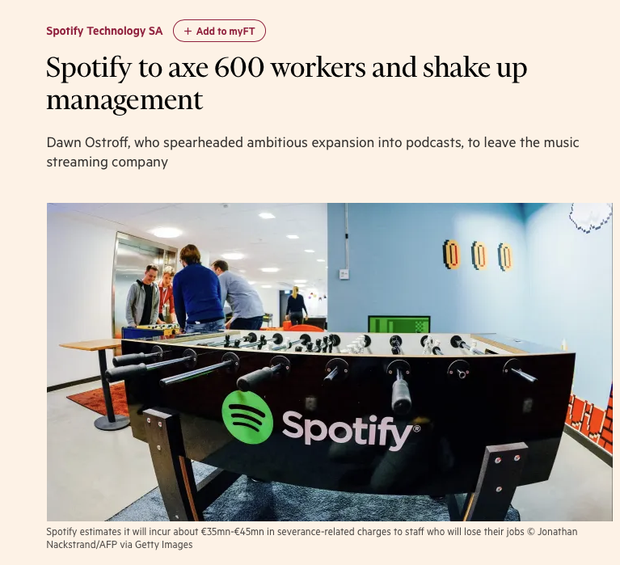
…and Stock Markets reaction…
…went on an acquisition spree, spending billions of dollars to buy podcasting companies and striking deals with stars…
Wall Street initially cheered Spotify’s podcast gamble, but later lost patience as the company continued to invest heavily at the expense of profits.
Now: Spotify shares closed up 2 per cent in New York. The stock has dropped more than 70 per cent from its pandemic highs, valuing the world’s largest music streaming company at less than $19bn.

Slide 5
Disposition
Change of concepts – change of perceptions – change of metrics
Example. Sandvik
Corporate Finance – some comments
S & P rating model
Example – DCF, Growth & CF

Slide 6
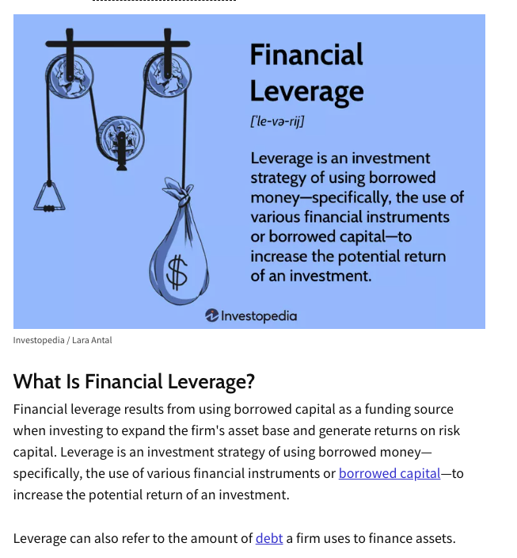
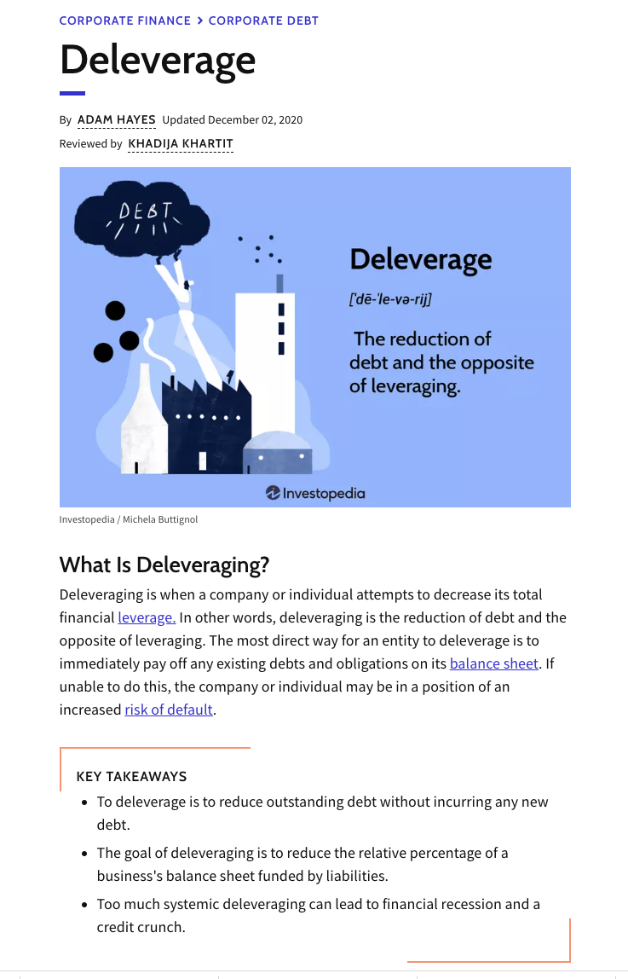
From Leverage to Deleverage (Investopia)

Slide 7
New concepts
Equity- to –assets: Solidity. Accounting
Debt-to- equity: Financial gearing. Finance
Net debt – to – EBITDA. Financial Risks/Ratings

Slide 8
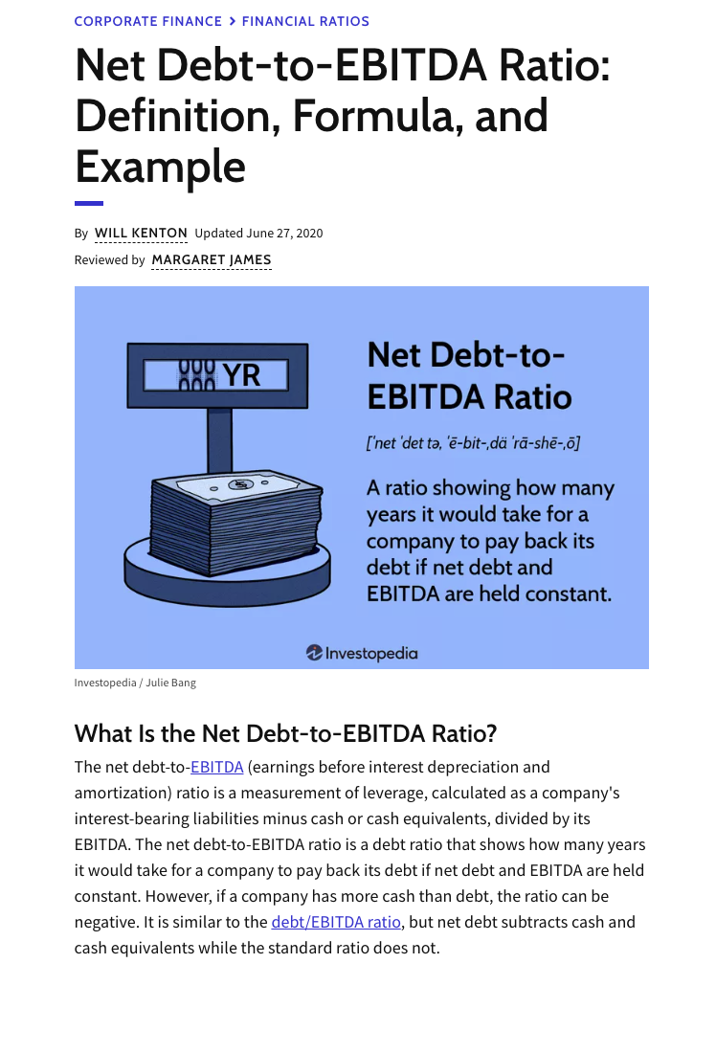
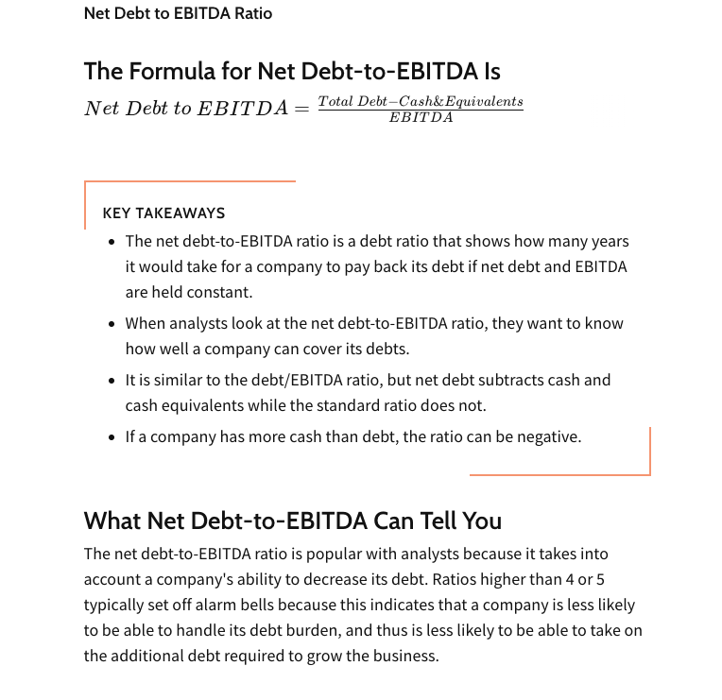
New Concept – New Perception/Attention – New Metrics

Slide 9
The Case of Sandvik. Christner, 2015. ”The Valuable Organisation”
….the management introduced a new set of financial targets in the year 2000. These targets included a new target for the company’s capital structure, which was the first time that the company had publicly communicated a balance sheet target.
Specifically, this new target was articulated in terms of the debt-to-equity ratio. Hence, this new target marked a shift in how the balance sheet was valued.
…the balance sheet had previously primarily been discussed in terms of the equity- to-assets ratio.
In contrast with the equity-to-assets ratio, which compared the company’s equity to the total assets (i.e. both interest-bearing and non- interest bearing liabilities), the debt-to-equity ratio focused specifically on the company’s debt (i.e. interest-bearing liabilities). This new target thus promoted a focus on different things.

Slide 10
Christner, ”The Valuable Organisation”, pp 116-117
Whereas the equity-to-assets ratio had often been linked to the question of ‘solidity’, i.e. the company’s ability to withstand a downturn in the economy, the debt-to-equity ratio was more often linked to the question of ‘financial gearing’, i.e. the leverage that the company could get from its debt financing. In practice, the debt-to-equity ratio was also often known as the gearing ratio. Following the introduction of this new target, the company’s capital structure, and in particular the level of the company’s debt, thus came to be in the focus.

Slide 11
Continue…
”In particular, the new target was that the company should have a debt- to-equity ratio of 0.6 – 0.8, i.e. that the debt should be 60 to 80 percent of the equity (Annual Report 2000). At the time when this target was introduced, the company’s debt-to-equity ratio was 0.3, i.e. the debt was 30 percent of the equity (ibid.). This new target thus entailed a significant re- balancing of the balance sheet: the company needed to take on substantially more debt to reach the target.
”The management explained that this new target was intend “to achieve a better balance between equity capital and debt”, and to create a more valuable capital structure (ibid.). Thus, debt had now become more valuable than before.

Slide 12
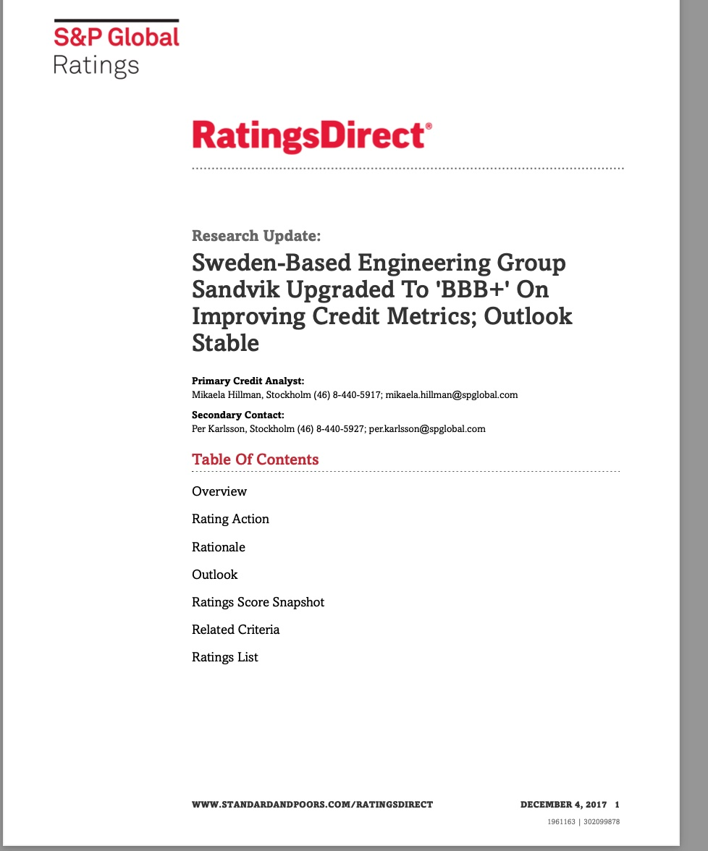
Sandvik New Rating S&P, 2017

Slide 13
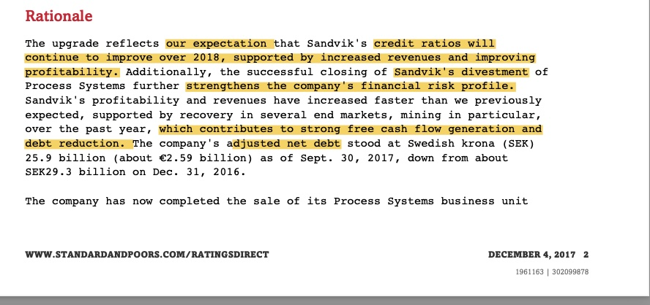
Arguments- rationale for upgrading: improved revenues & profitability

Slide 14
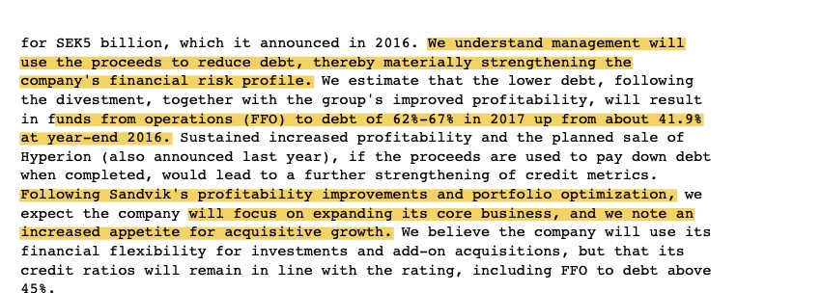
Cont, FFO – funds from operations vs Ebitda?

Slide 15
According to internet (not ChatGPT!)
Q: Difference between Profitability and Free Cash Flow?
”FFO and EBITDA are similar in that both metrics are used as an alternative to net income, and both adjust-out depreciation and amortization. The main difference between FFO vs EBITDA is that FFO is used to measure free cash flow from operations while EBITDA attempts to measure profitability from operations.”

Slide 16
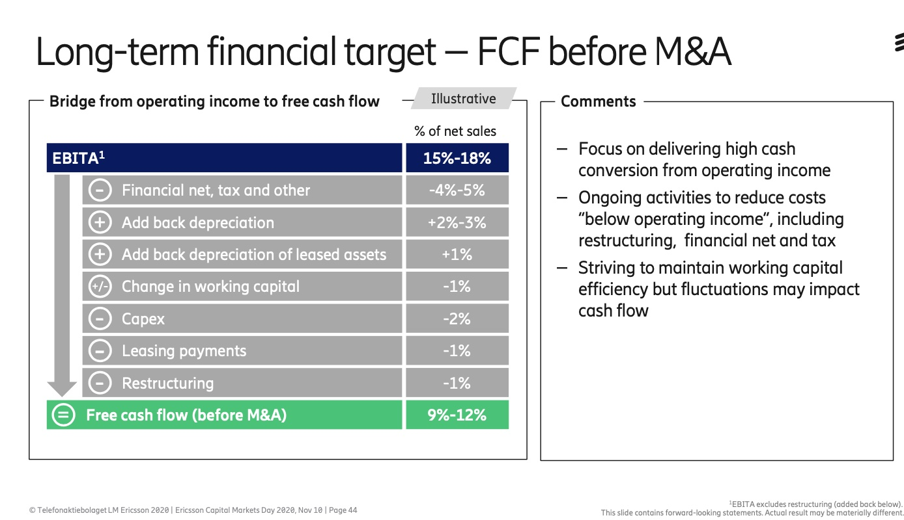
Answer: exampel Ericsson!

Slide 17
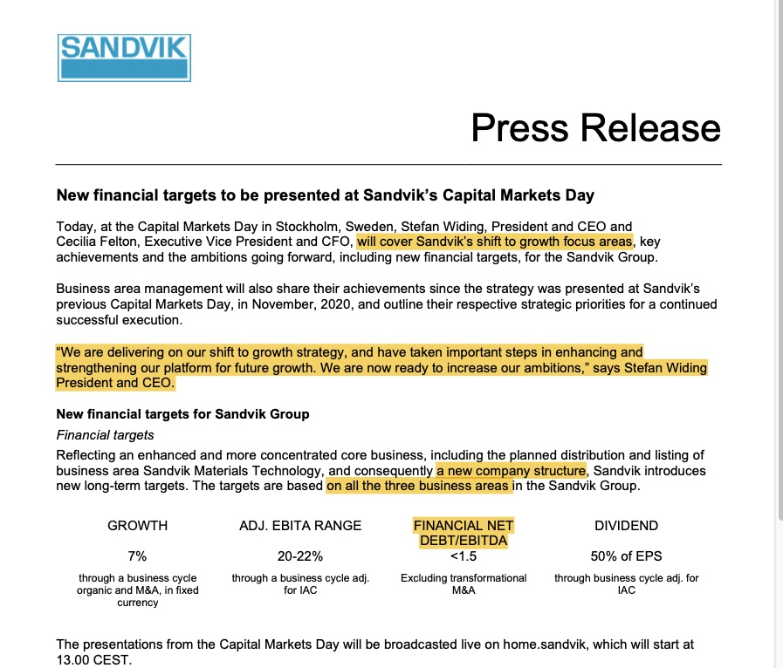
New Financial Goals, Sandvik May 2022

Slide 18
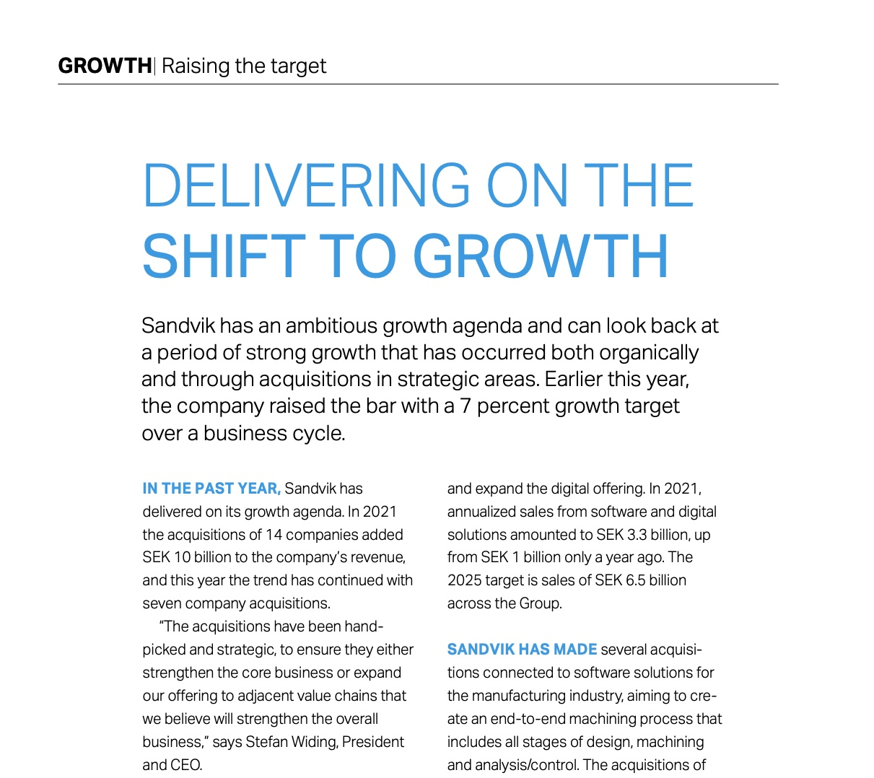
Strategy Shift: Growth!

Slide 19
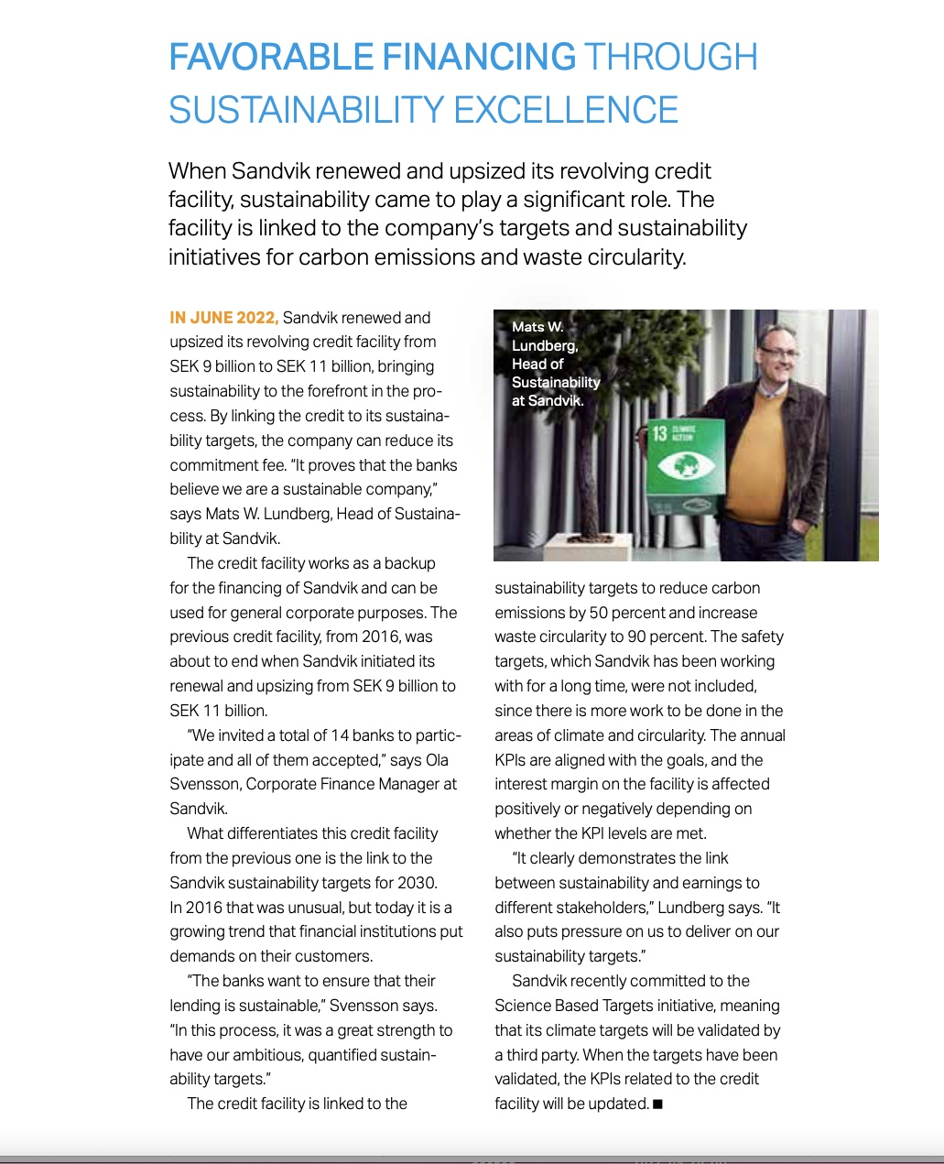
Growth needs Finance. Meet Sandvik 2022:2

Slide 20
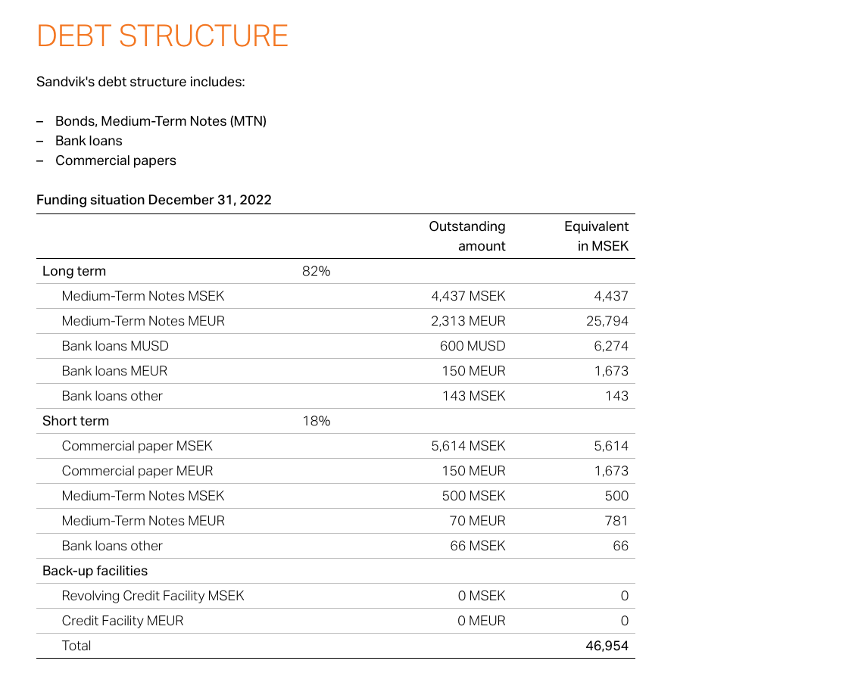
Sandvik Debt Structure, December 2022

Slide 21
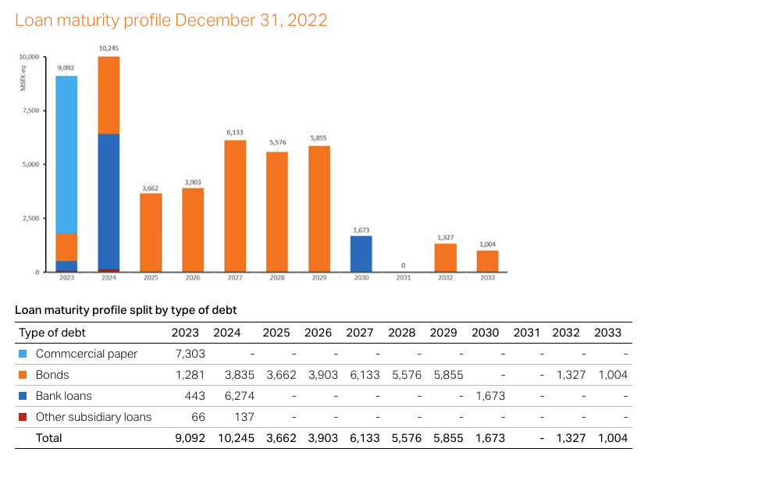
Time Perspective – Maturity Profile

Slide 22
Corporate Finance: Three major decisions
Choosing projects in which to invest – capital budgeting
Choosing how to finance the firm´s investements and operations – capital structure/ financing policy
Choosing how much and in what form (dividends or share repurchases) to distribute to the firm´s shareholders - payout policy.

Slide 23
Five major building blocks Brickely & Smith, p 2
Efficient Markets Theory: Eugene Fama Nobel Prize 2013.
Portfolio Theory. Harry Makowitz, Nobel Price 1990.
Capital Asset Prising Theory. Bill Sharpe, Nobel Price 1990,
Option Pricing Theory. Black-Scholes (1973)
Agency Theory. Michael Jensen & William Meckling (1976)

Slide 24
The most importan one: Modigliani & Miller (1958/1961) Brickely & Smith, p 30
”The M&M Capital Structure and Dividend Irrelevance Propositions are arguably the most important ideas in all corporate finance”.
..within perfect markets an given the firm´s investment policy, the financing choice does not affect current firm value.

Slide 25
Capital Structure: Brickely & Smith, p 86
At the most general level , there are at least two primary theoris of how firm manage their capital structures: The Tradeoff Theory and The Pecking Order Theory”.
The Tradeoff Theory argues that firms have target capital structures that depend on the specific incremental costs and benefits they face from employing debt.
The Pecking Order Theory argues that managers have a strict preference for internal over external financing and debt over equity financing when the firm has to raise funds externally.

Slide 26
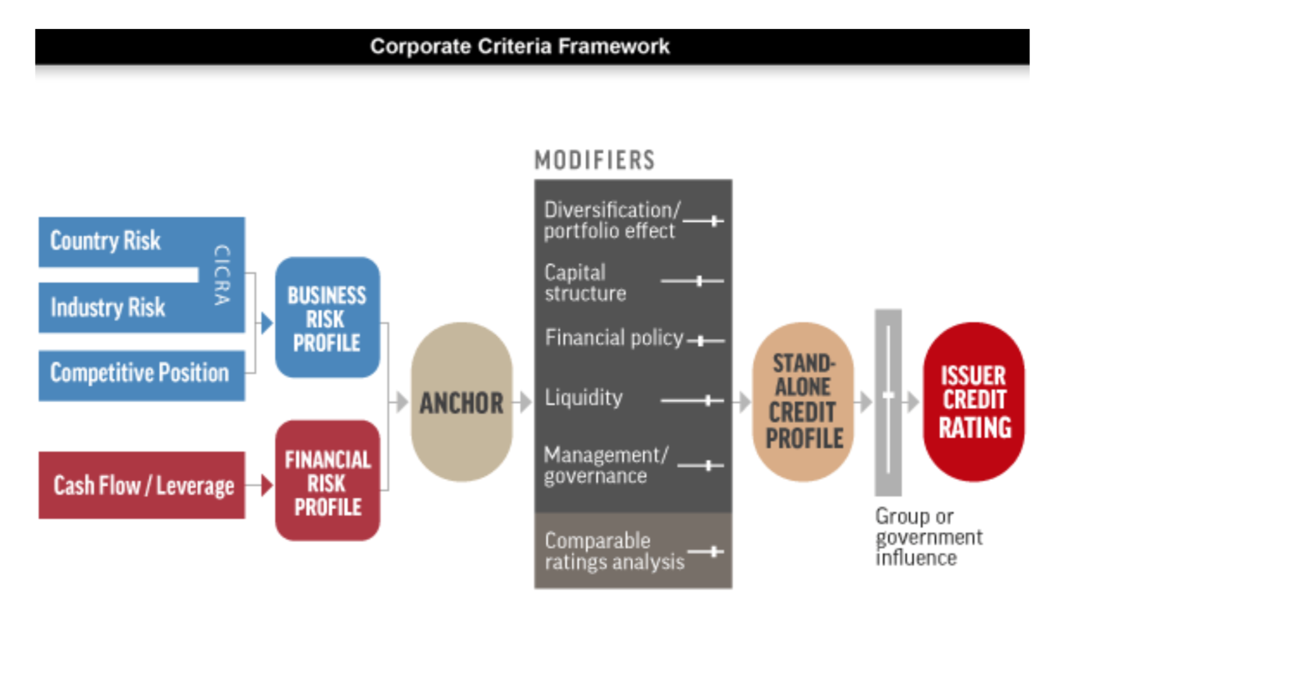
S&P model

Slide 27
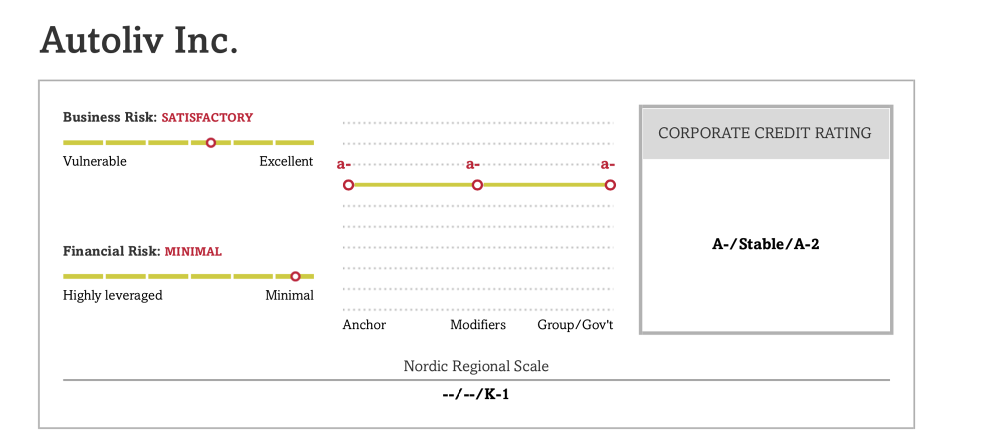
Autoliv

Slide 28
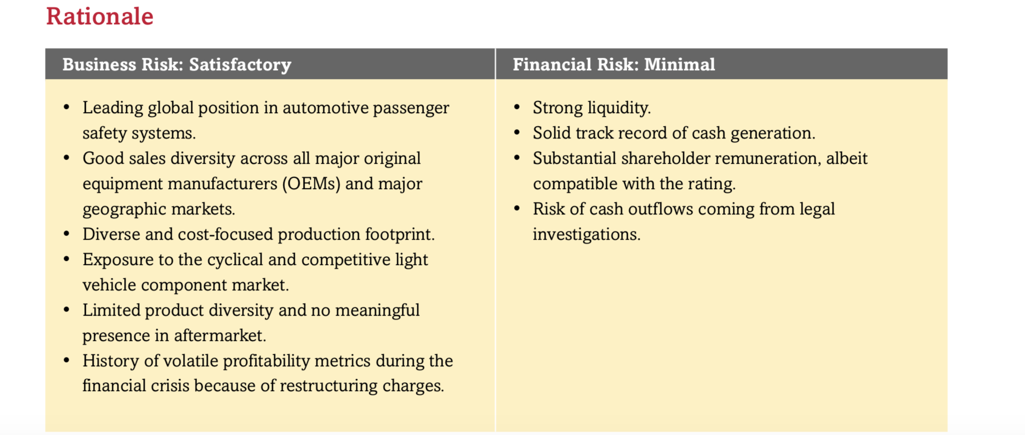
Arguments- Rationale

Slide 29
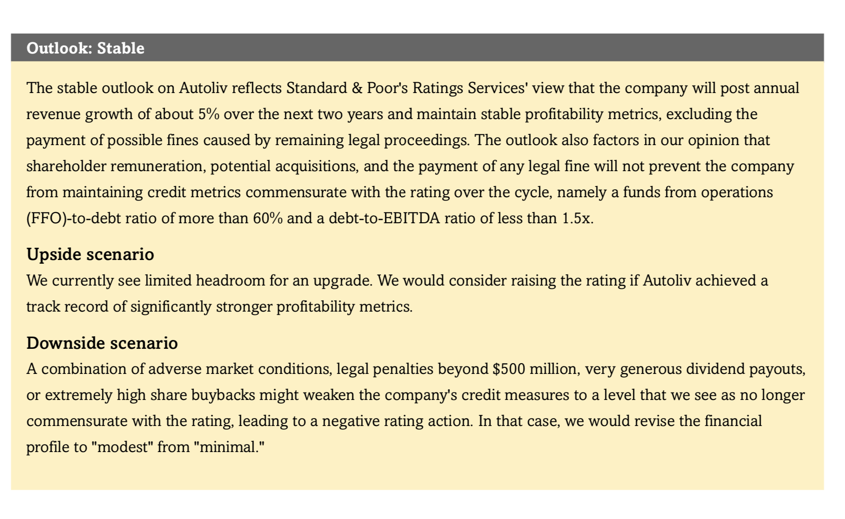
Outlook: Scenarios

Slide 30
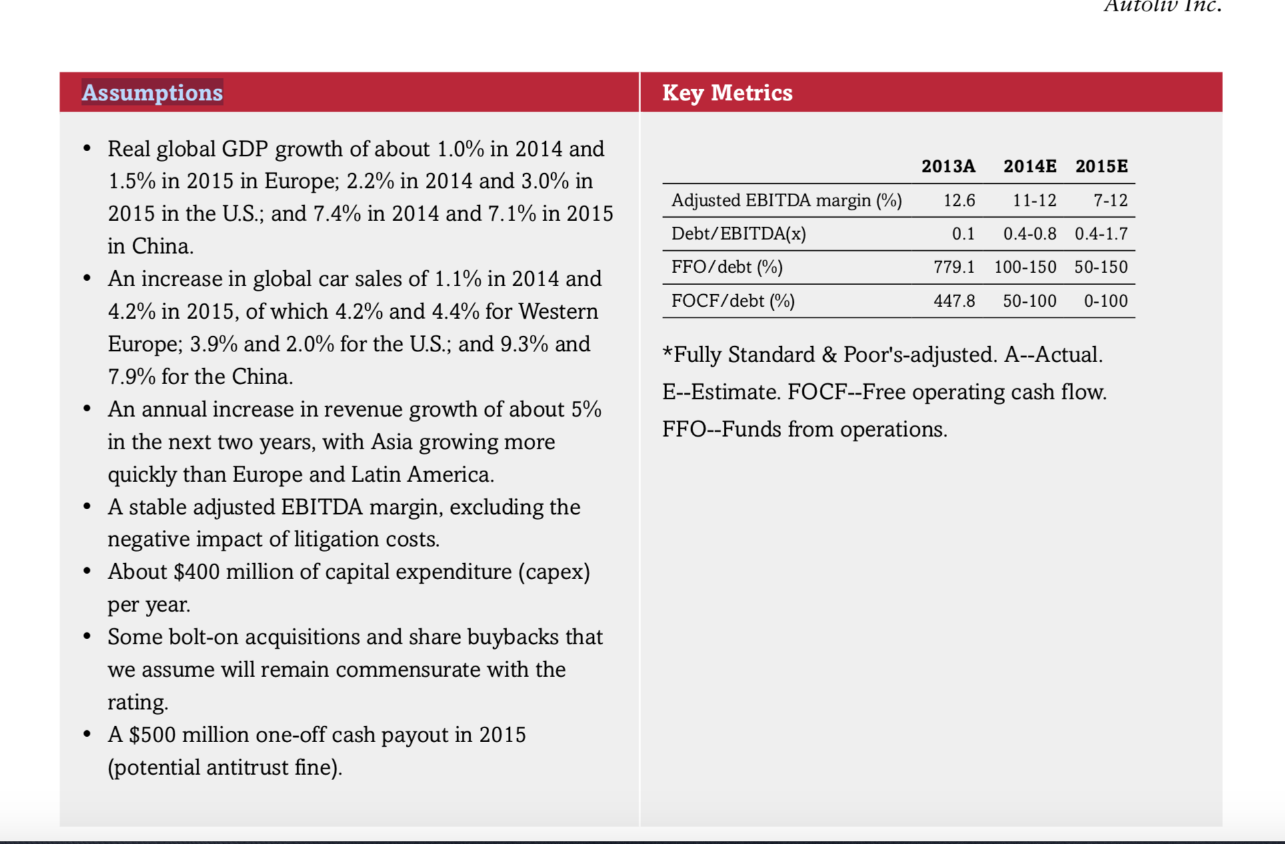
Scenario: Assumptions & Key Metrics

Slide 31
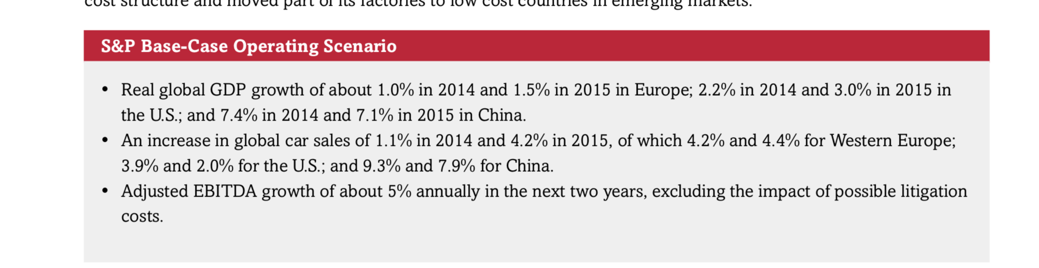
Assumptions

Slide 32
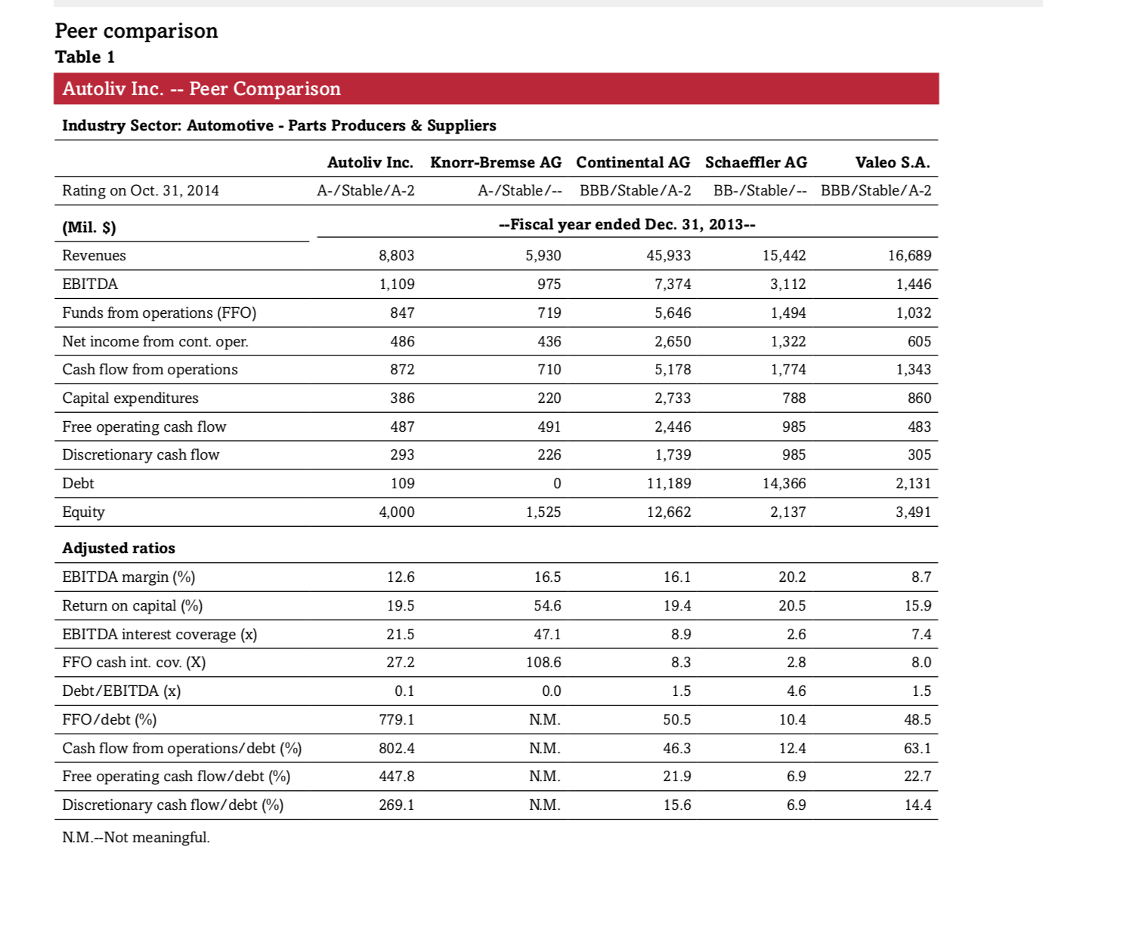
Peer comparison

Slide 33
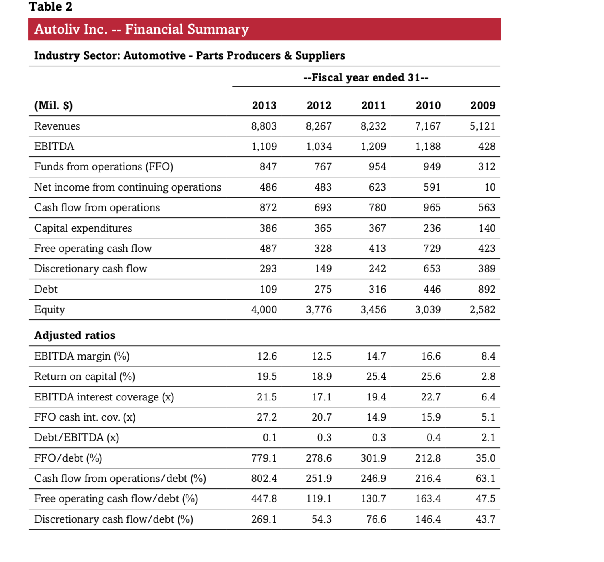
Financial Summary

Slide 34
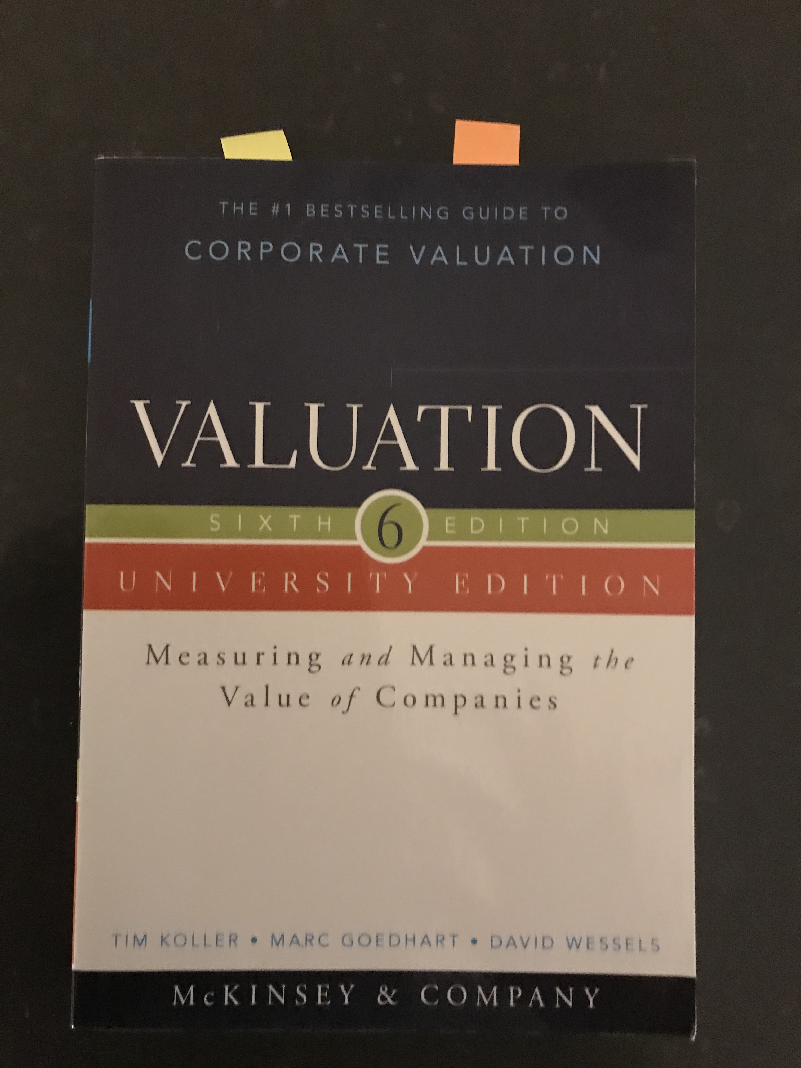
Value & Valuation

Slide 35
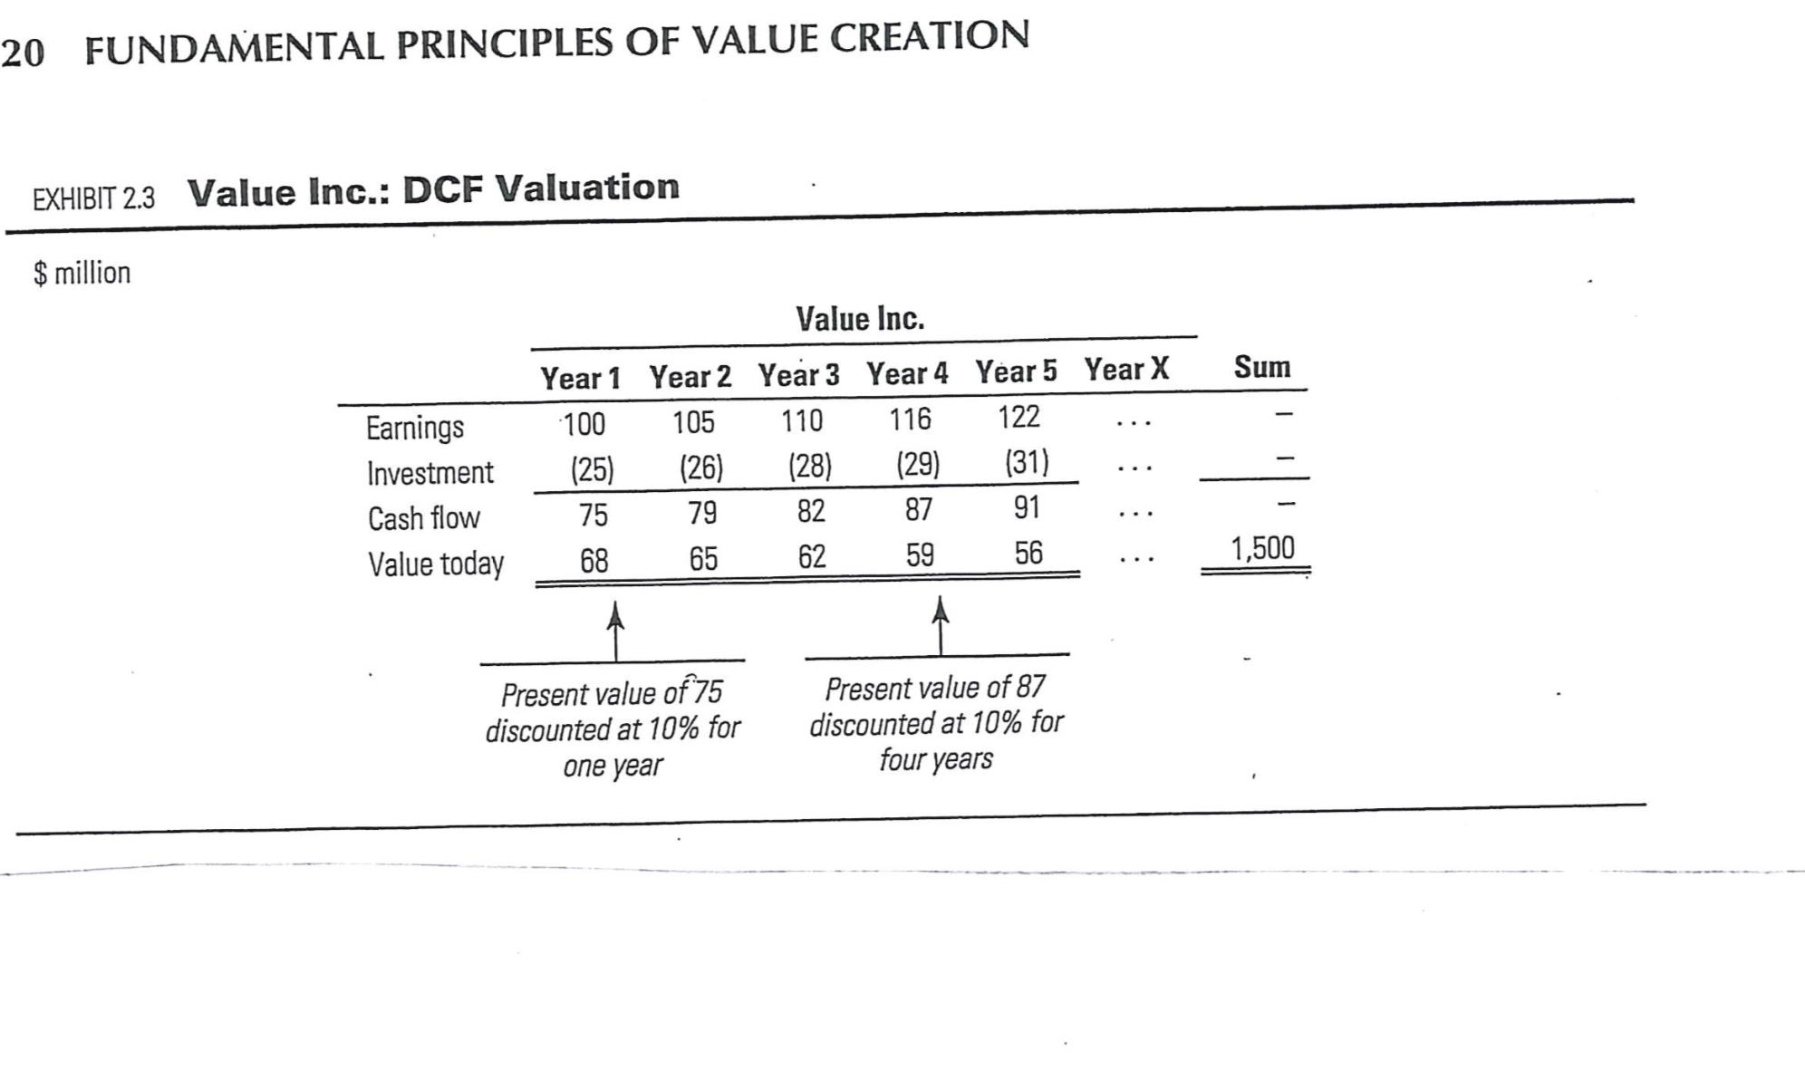
Time Frames and Hurdle Rates

Slide 36
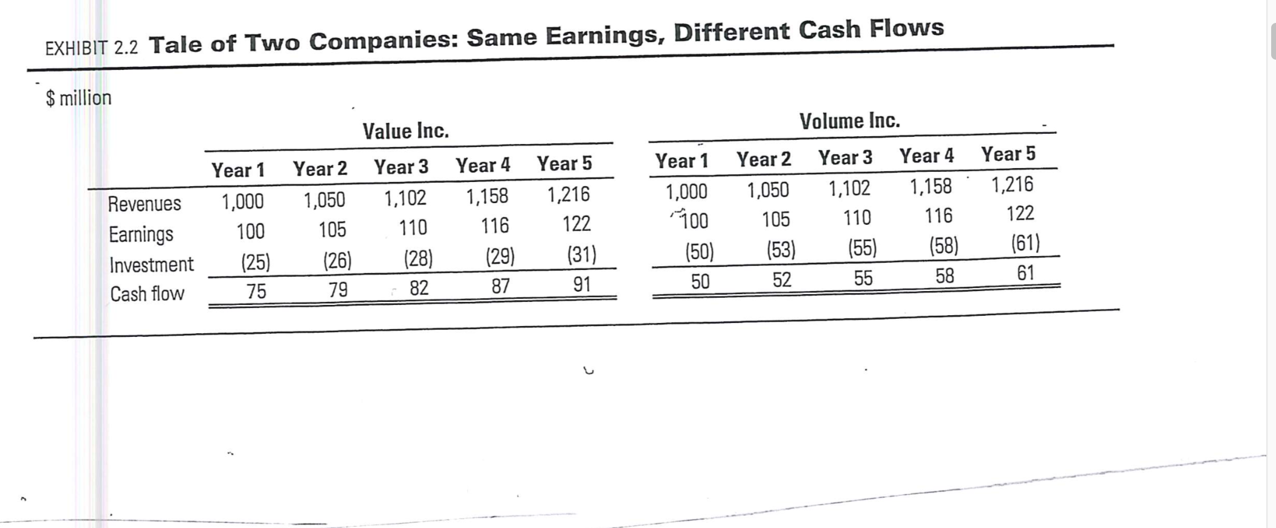
Growth good – but not always! Capex!

Slide 37
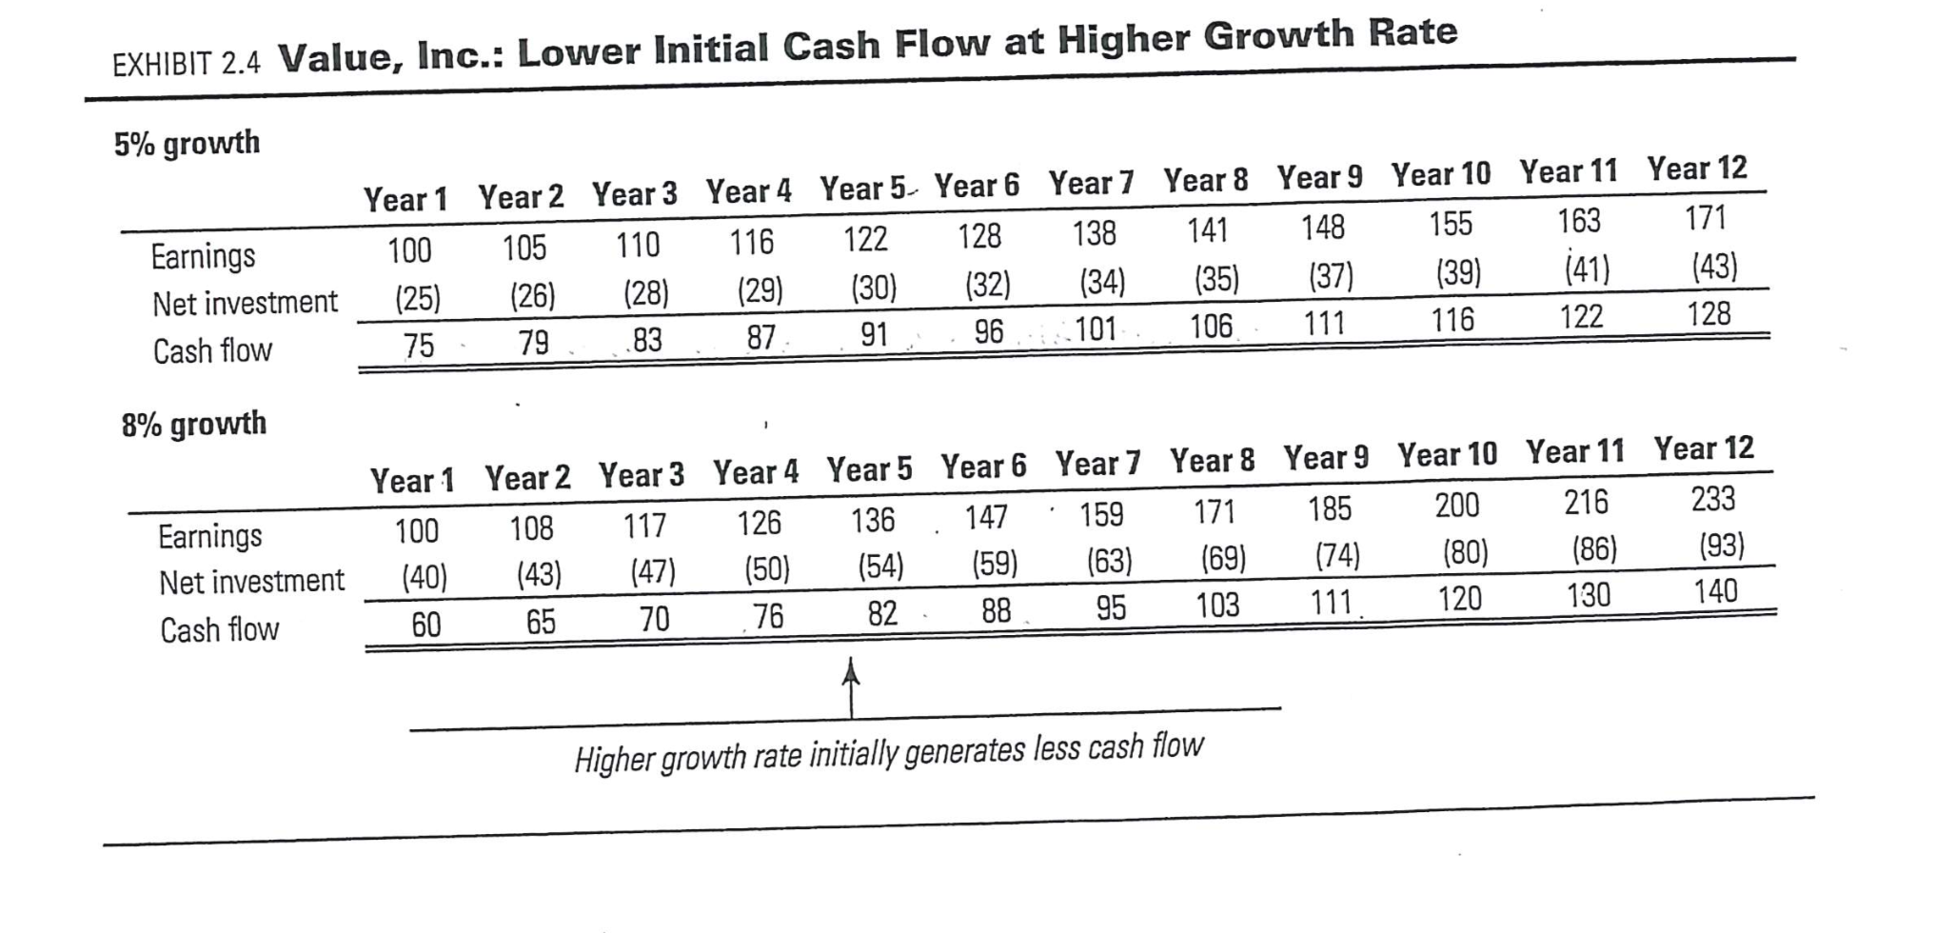
Different Growth Rates – different Time Frames. Different FLOWS

Slide 38
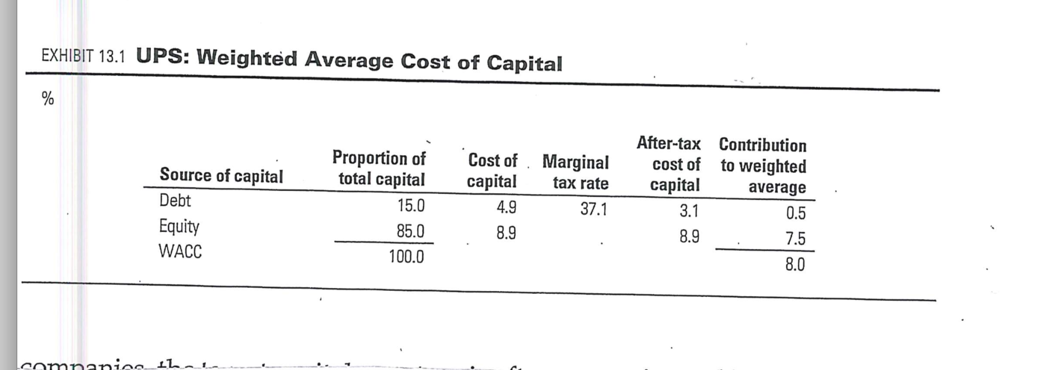
WACC

