Slide 1
Lecture 6 Strategic Pillars (Strategy) & Metrics
January 26, 2023
Jan Lindvall

Slide 2
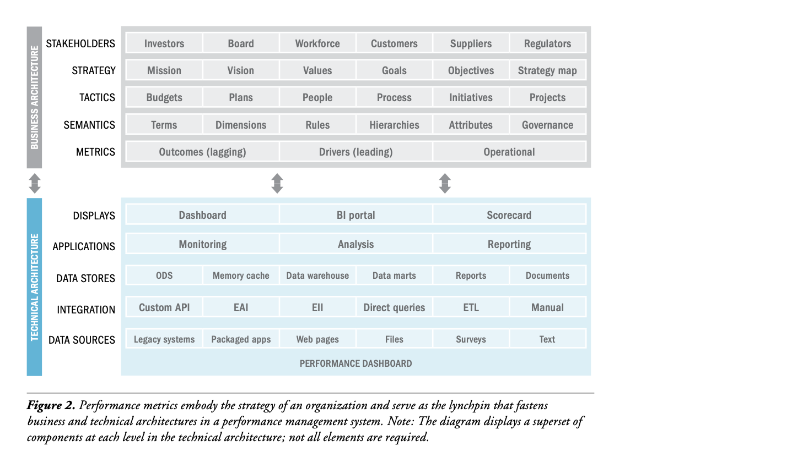
Connection Metrics and Information Systems (Eckerson, TDWI, 2009)

Slide 3
Disposition
0. Background: Why CFO & Strategy ?
1. Megatrends – macro & micro: resileince & agility
2. Strategy: Why & What?
3. A Need of Metrics. KPIs
4. Business Model & Platform Companies
5. Strategic Pillars & Strategic Questions
  5.1 Outsourcing
  5.2 Modularisation: need of standards
  5.3 Number 1 or 2? PRICING: Segmentation & Segments
  5.4 Service
  5.5 Total Cost of Ownership (TCO) & Life Cycle Cost
  5.6 Circular Business Model: Scientific Based Targets: Scope 1-3

Slide 4
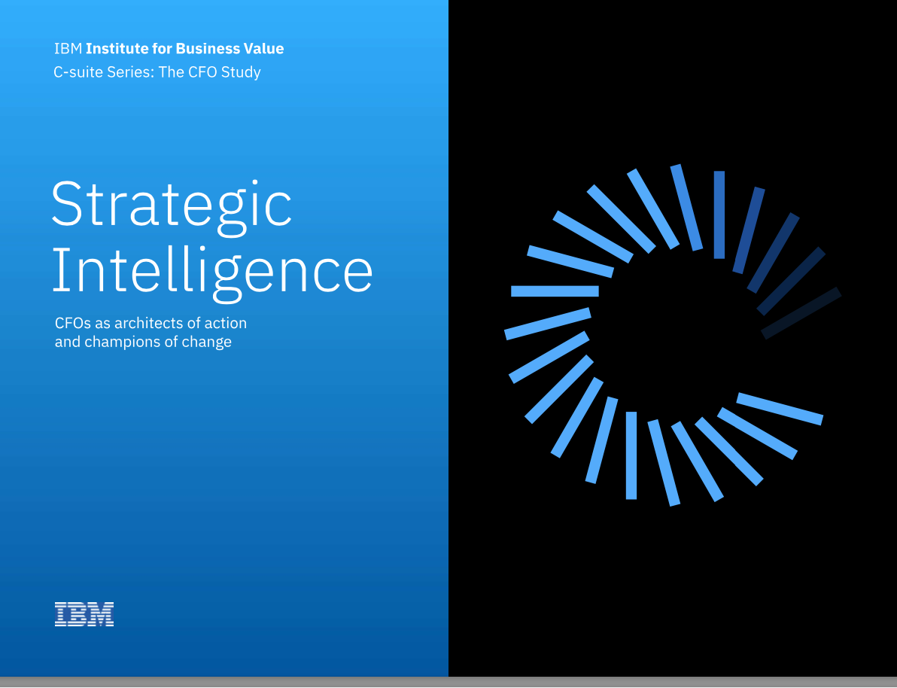
0. IBM: Strategic Intelligence

Slide 5
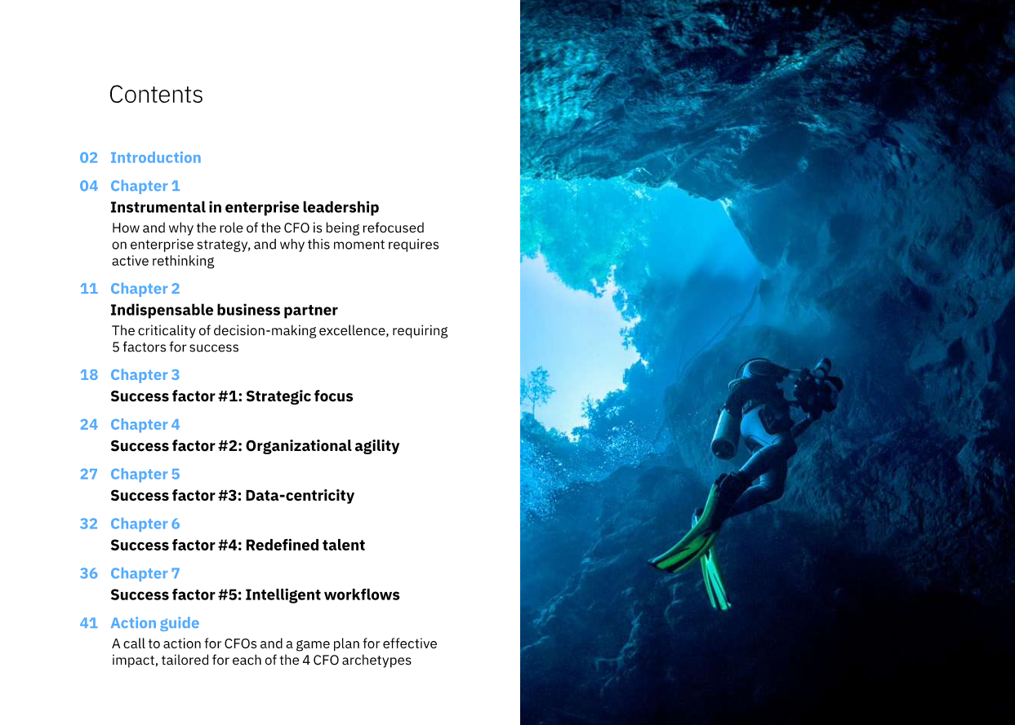
0. The CFO Agenda

Slide 6
2. Megatrends
Demography
Geography
Climate - Environment
Digitalisation
Financialisation

Slide 7
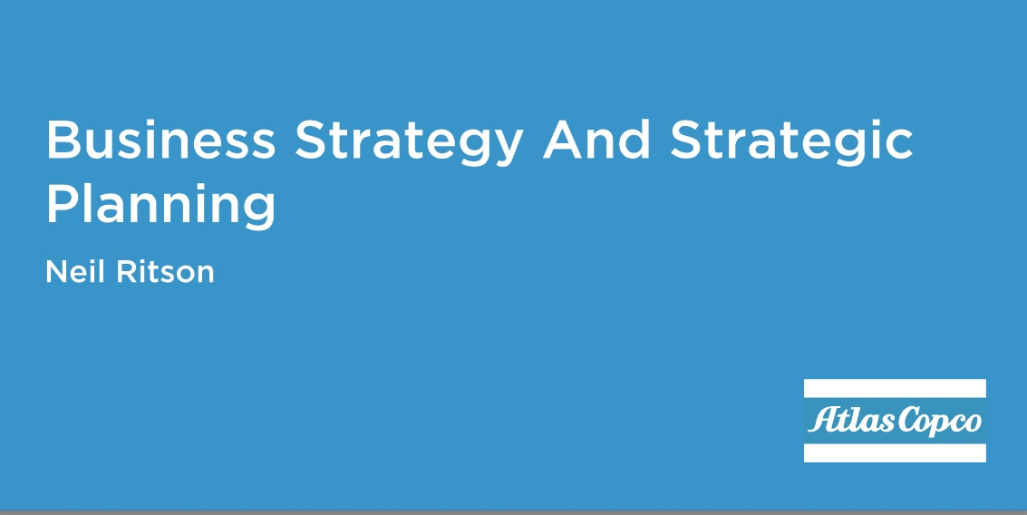
2. Strategy – an overview of thoughts

Slide 8
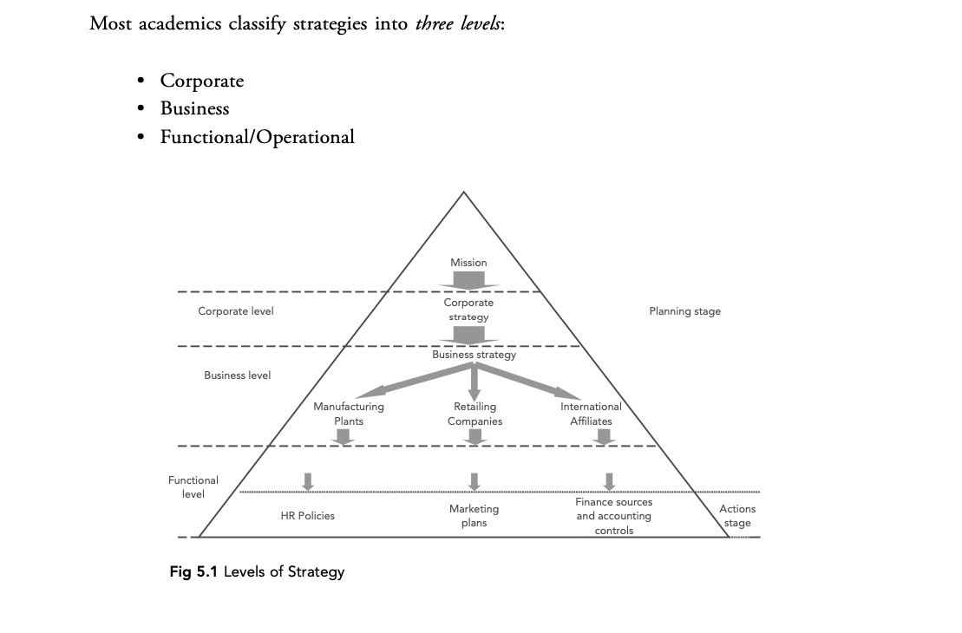
2. Strategy at Different Levels

Slide 9
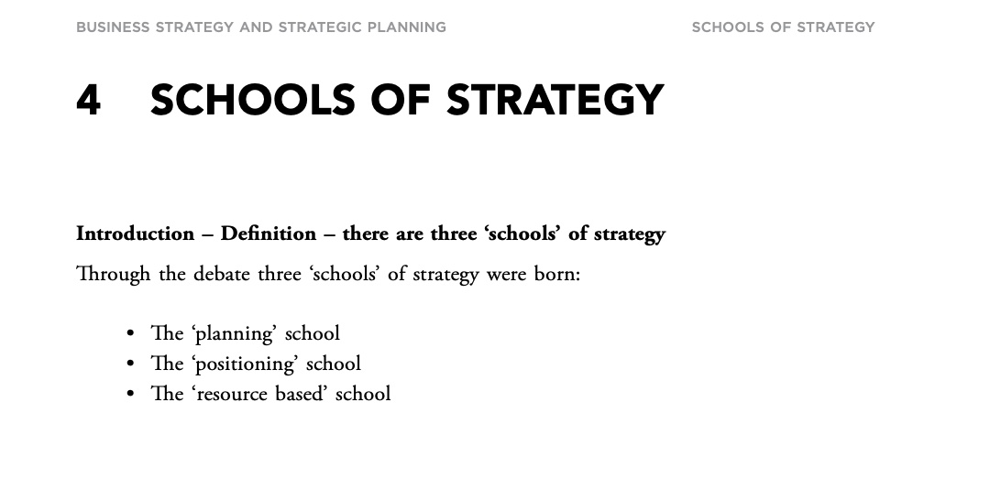
2. Different Schools – different perspectives

Slide 10
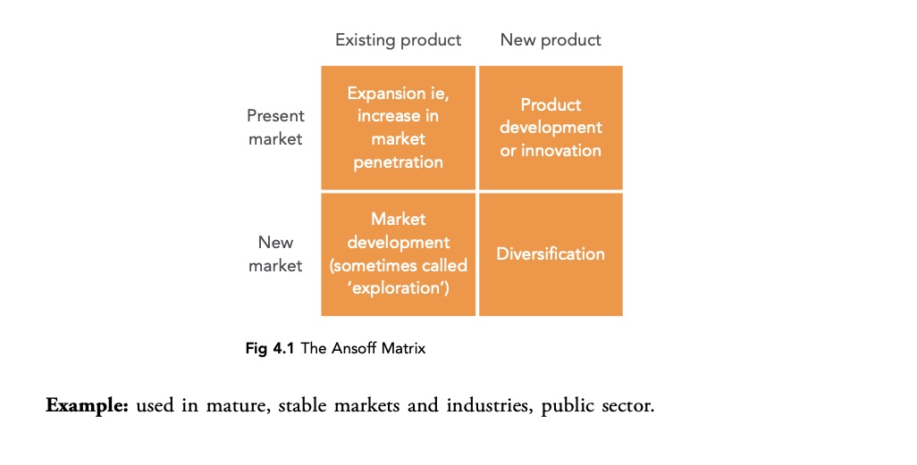
2. The Classic: Product & Market

Slide 11
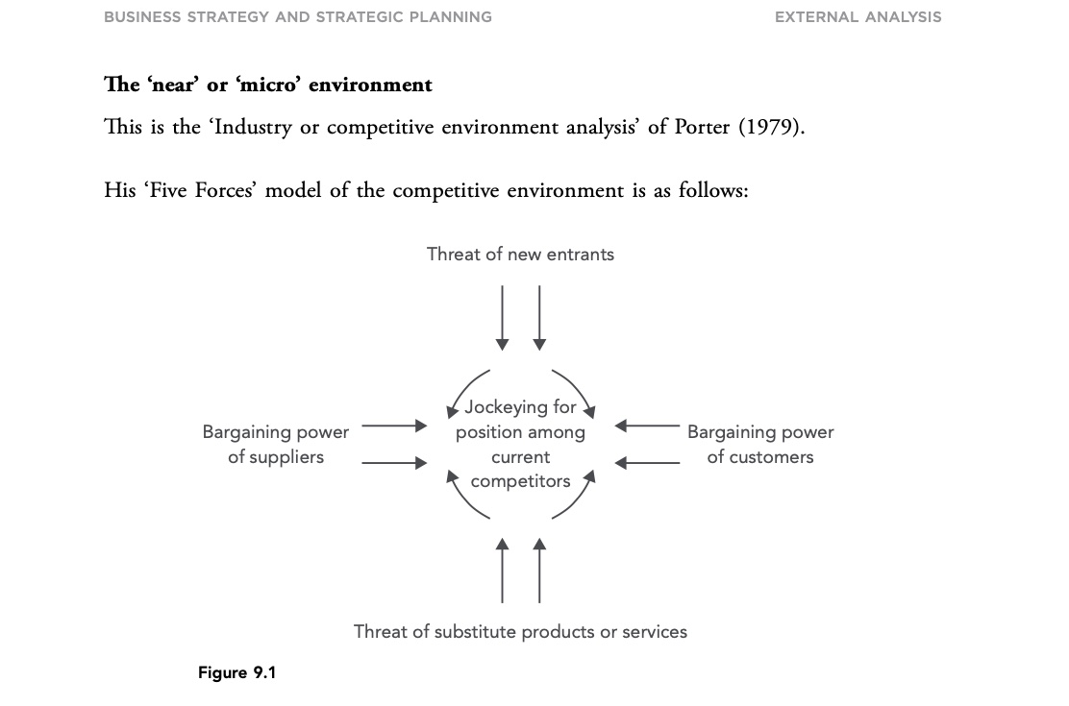
2. Porter : Industry Structure

Slide 12
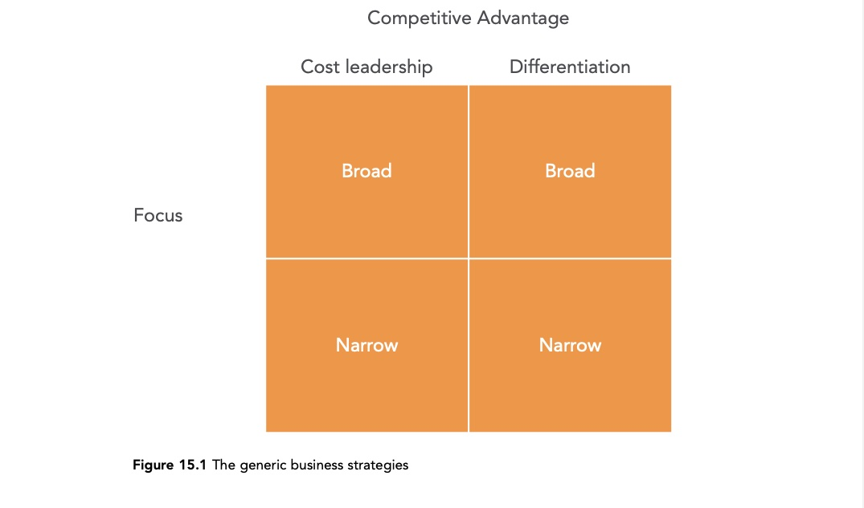
2. Porter Three Generic Strategies

Slide 13
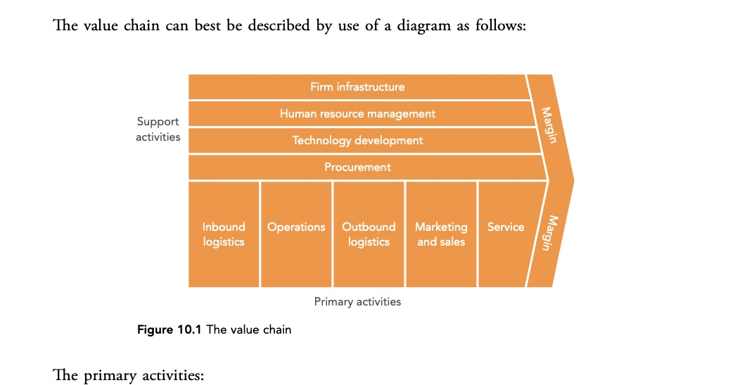
2. Porter Value Chain & Value Ssystems

Slide 14
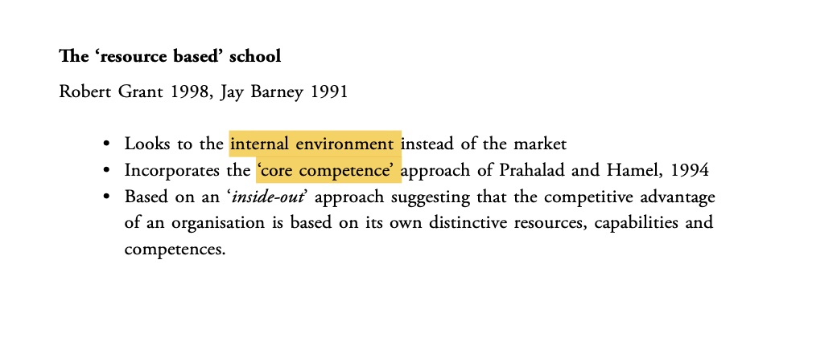
2 Resource Based view: Core Competence

Slide 15
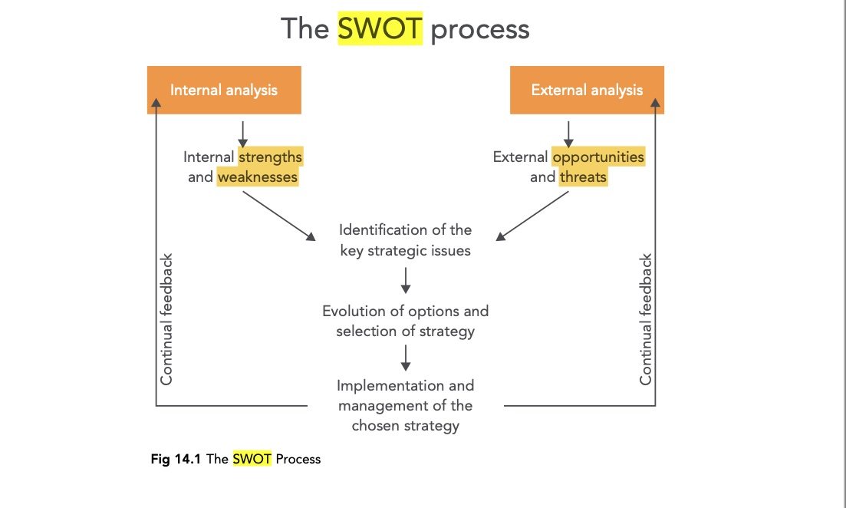
SWOT – the most common tool!

Slide 16

3. Even if ”Accounting is the language of business”…
The entity’s business model, corporate performance and the intentions of management cannot be understood by simply focusing on financial information and financial statements.
Integrated commentary could include text, tables, graphs and other visual aids and even dynamic ones, showing changes in reported amounts over time, differences in amounts from one period to the next, or additional breakdowns of aggregated amounts.

Slide 17
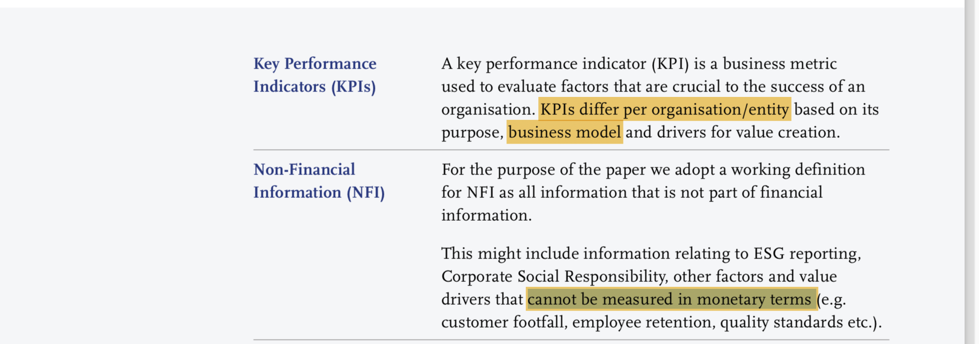
3. Need of different types of data.
(FEE, 2015)

Slide 18
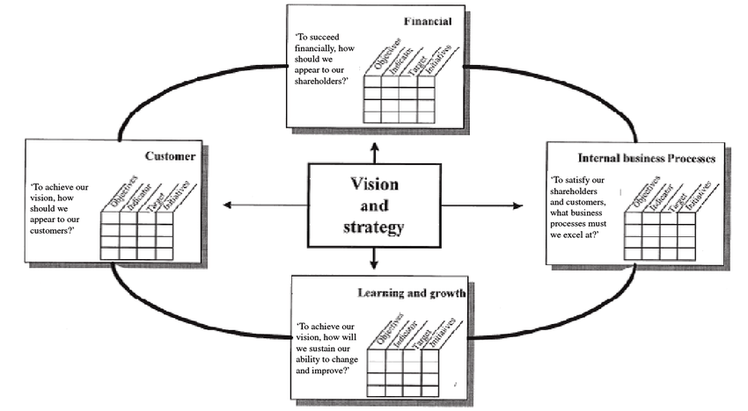
From(?) Balanced Scorecard to KPI:s (Key Performance Indicators).
Relation strategy – measurements (metrics).
From one-dimension to multi-dimensional.
Metrics identified and defined by humans, processed and stored by and ”informationsystems and machines”.
Dashboards: Key Performance Indicators (KPI:s)

Slide 19
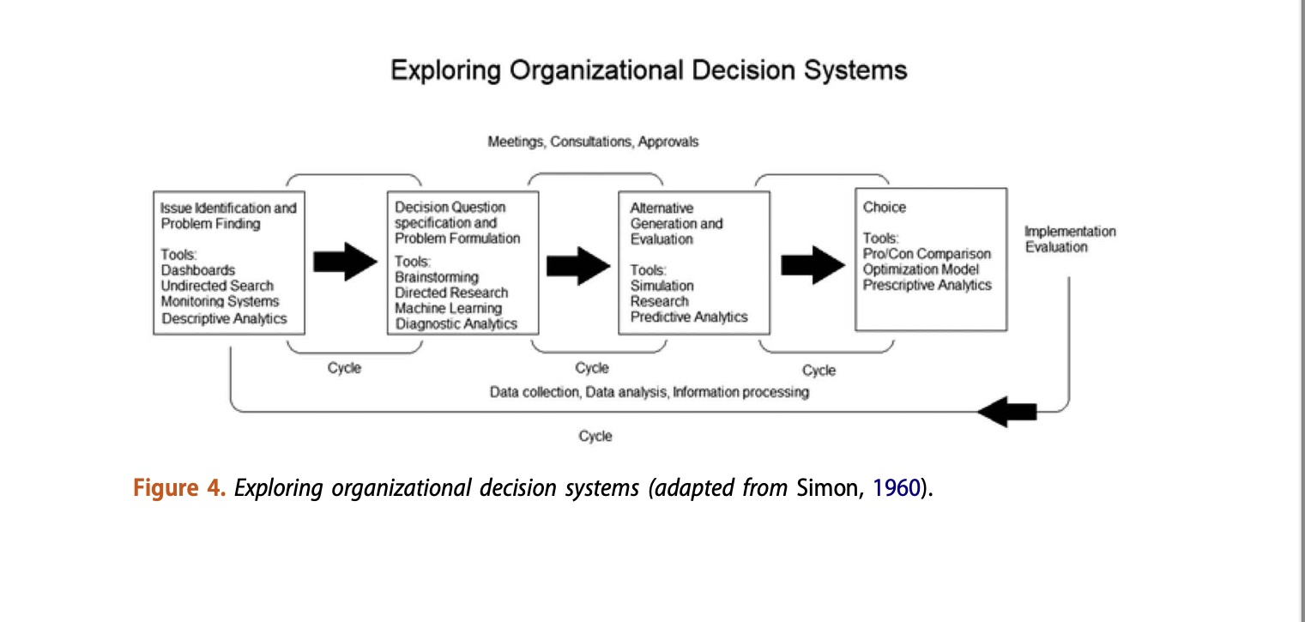
3. Metrics

Slide 20
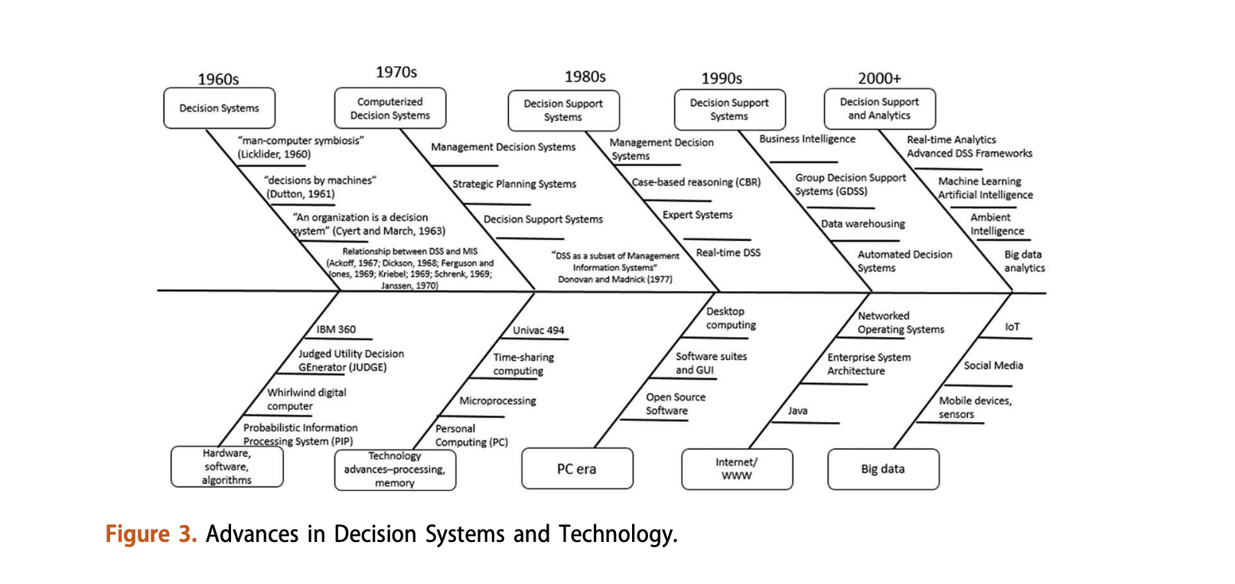
3. Decision systems

Slide 21
4. Business Models – stories about VALUE
”Business models, though, are anything but arcane. They are, at heart, stories – stories that explain how enterprises work. A good business model answers Peter Drucker’s age-old questions: Who is the customer? And what does the customer value? It also answers the fundamental questions every manager must ask: How do we make money in this business? What is the underlying economic logic that explains how we can deliver value to customers at an appropriate cost?

Slide 22
4. Business Models
”…all new business models are variations on the generic value chain underlying all businesses. Broadly speaking, this chain has two parts. Part one includes all the activities associated with making something: designing it, purchasing raw materials, manufacturing, and so on. Part two includes all the activities associated with selling something: finding and reaching customers, transacting a sale, distributing the product or delivering the service.
Magretta 2002, Why Business Models Matter

Slide 23
4. A tool for Business Model development: Canvas Osterwalder

Slide 24
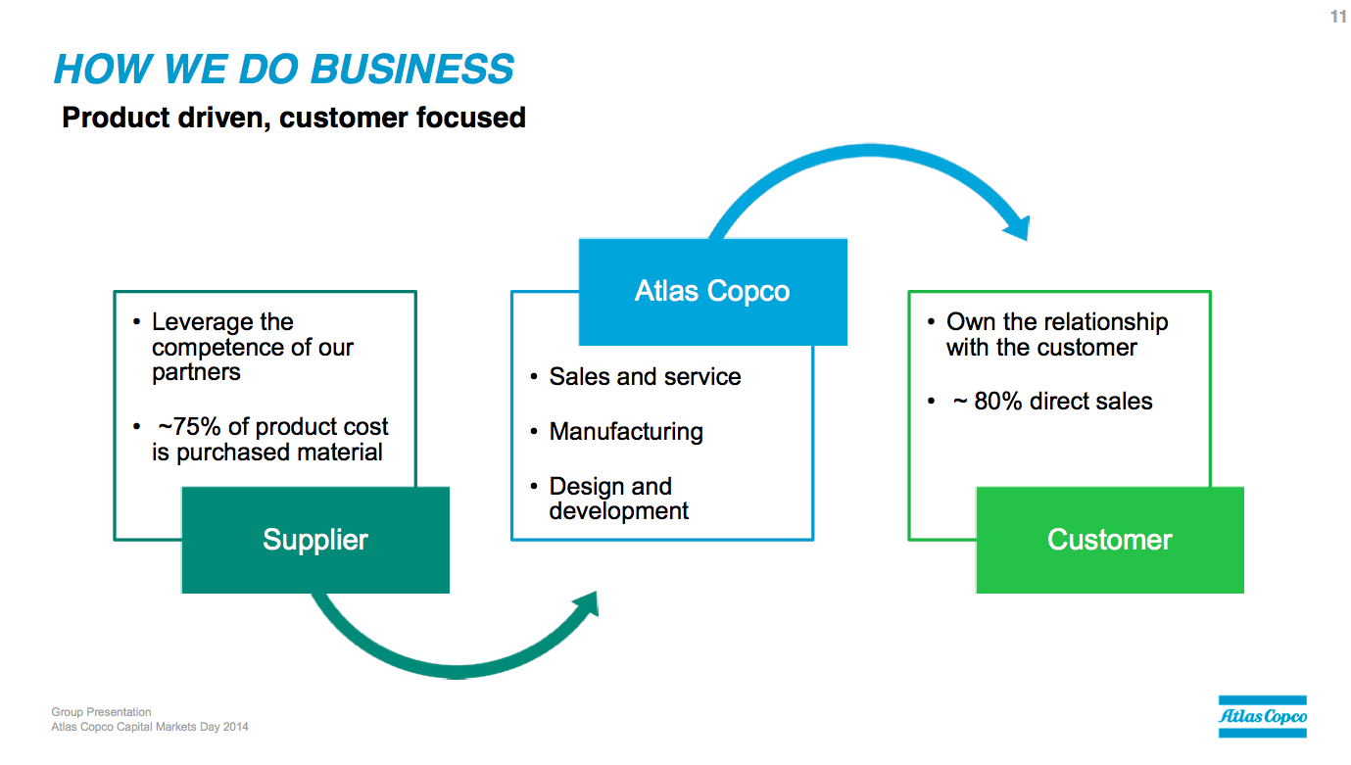
One way to communicate BM

Slide 25
4. What is a Platform Company?
Cusumano, et al, 2019, The Business of Platforms
”More importantly, they bring together individuals and organizations so the can innovate or interact in ways not otherwise possible, withe the potential for nonlinear increases in utility and value”
Nonlinear
Network effects: positive feedback loops. Economies of Scale!

Slide 26
4. Platform business models: two basic types
Innovation platforms usually consist of common technological building blocks that the owner and ecosystem partners can share in order to create new complementary products and services. E.g Google, IBM Watson, Amazon AWS.
Transaction platforms. Largely intermediaries or online marketplaces that make it possible to share information or to buy, sell or access a variety of goods and services. E.g. Facebook, Uber, Airbnb.
Hybrids: emphasize a combination of product and platform businesses. E.g Apple, Oracle

Slide 27
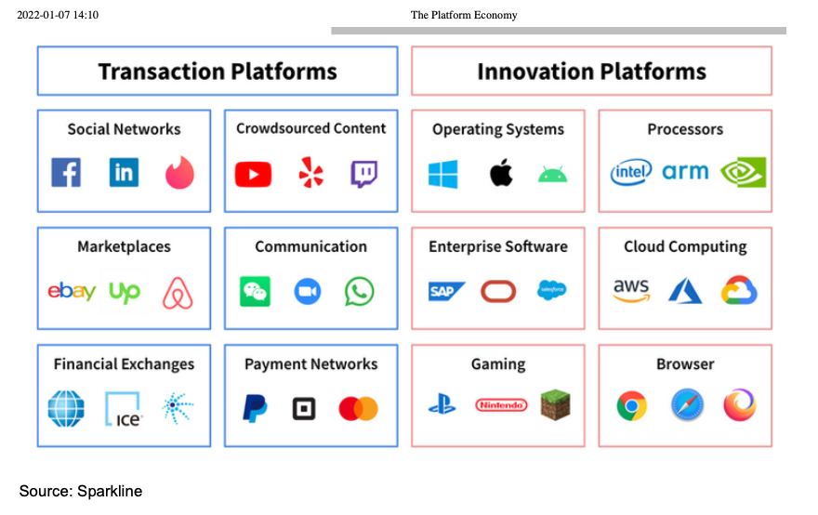
4. Examples Platform Companies

Slide 28
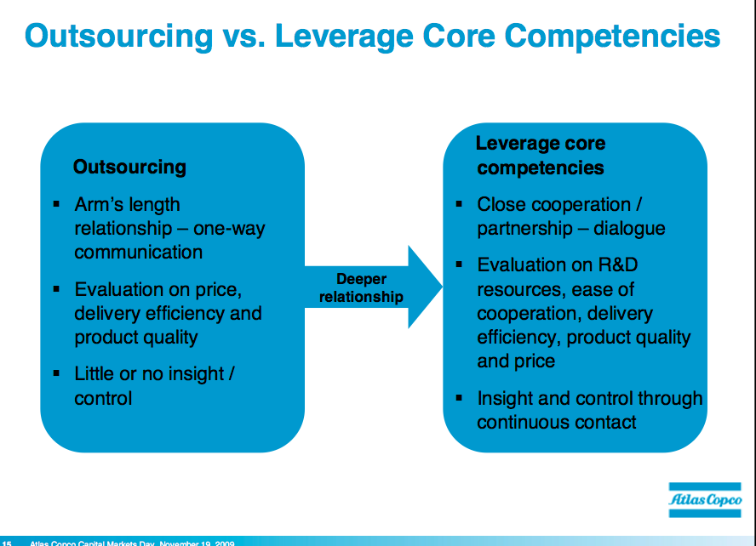
5.1 Scope – different views on outsourcing

Slide 29
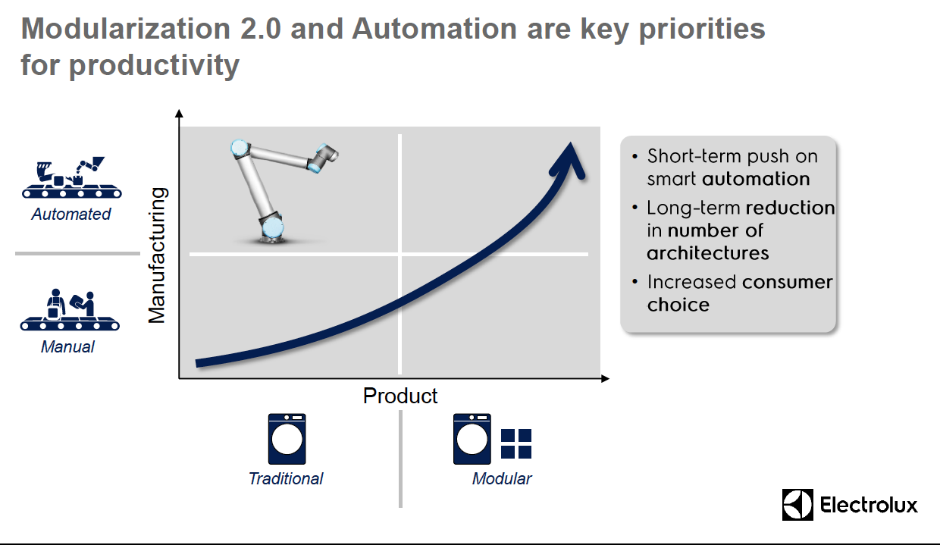
5.2 Modularization 1

Slide 30
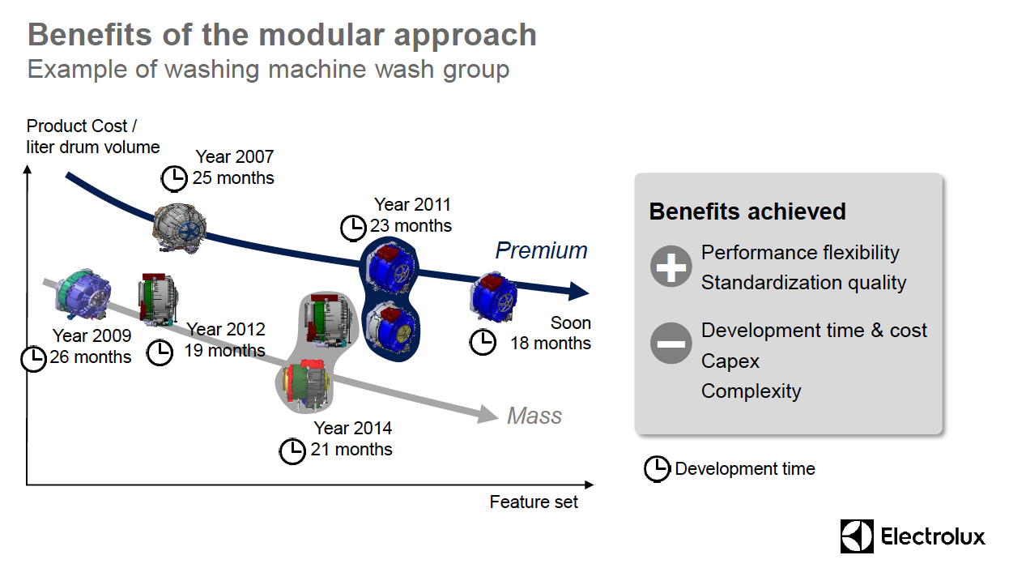
5. 2 Modularisation 2

Slide 31
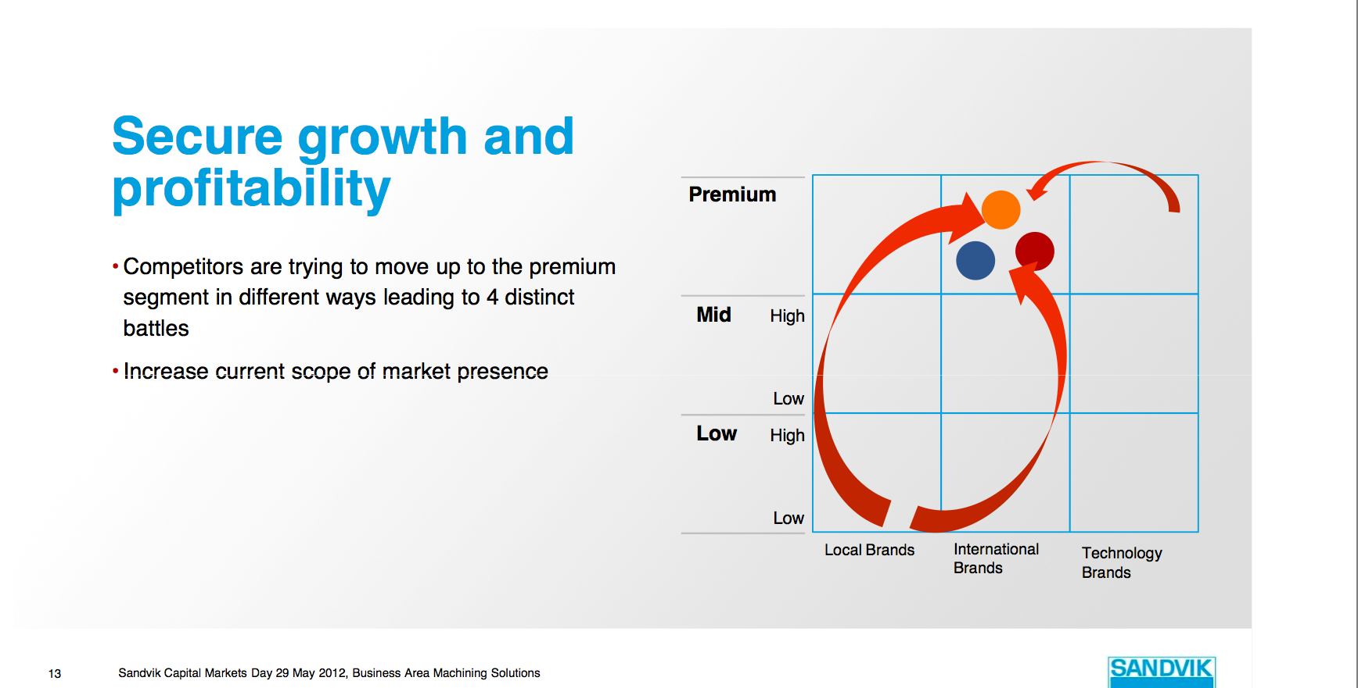
5.3 Growth, Revenues & Profitability in a Global context.

Slide 32
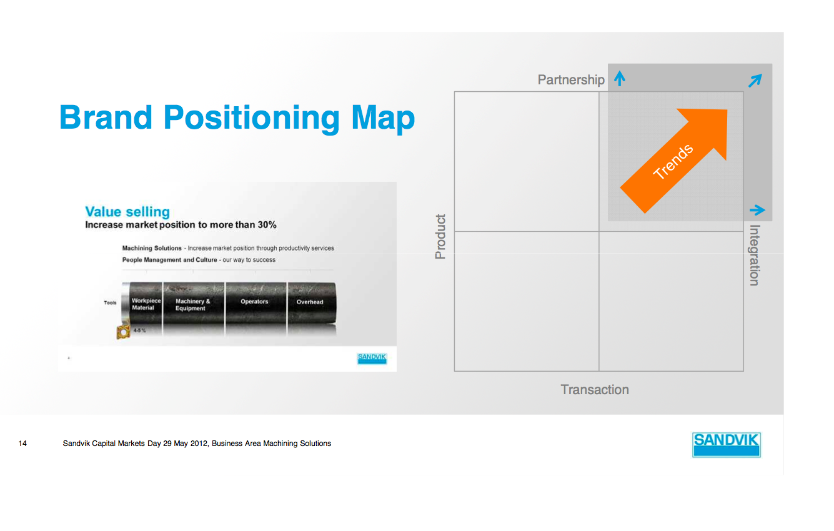
5.3 Pricing Strategy Important! Connection to Strategy

Slide 33
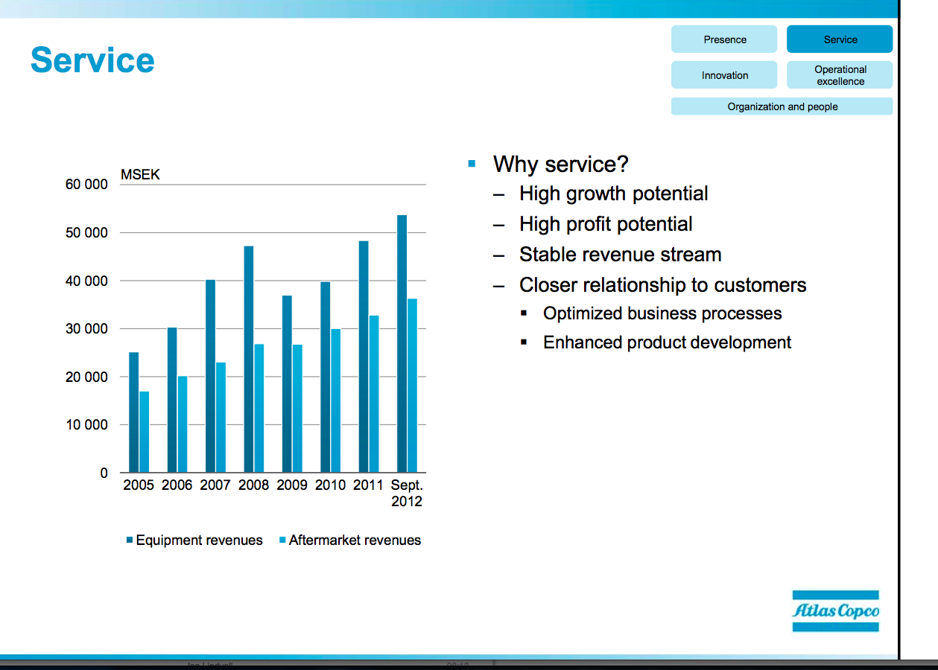
5. 4 Scope: The Advantages with Service

Slide 34
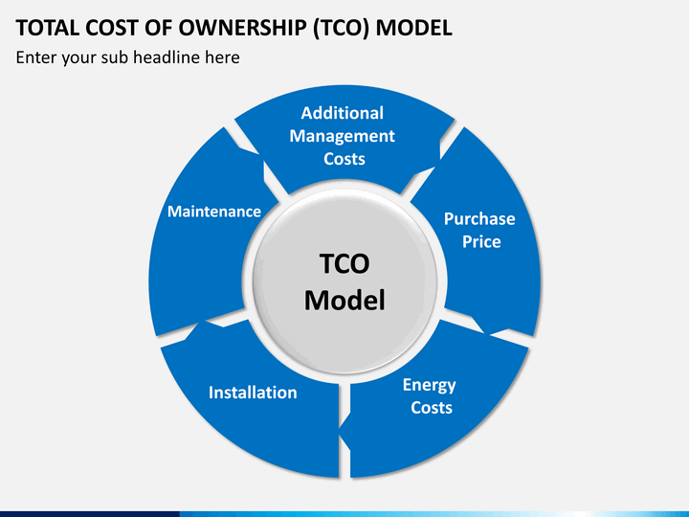
5.5 Total Cost of Ownership (TCO) Model

Slide 35
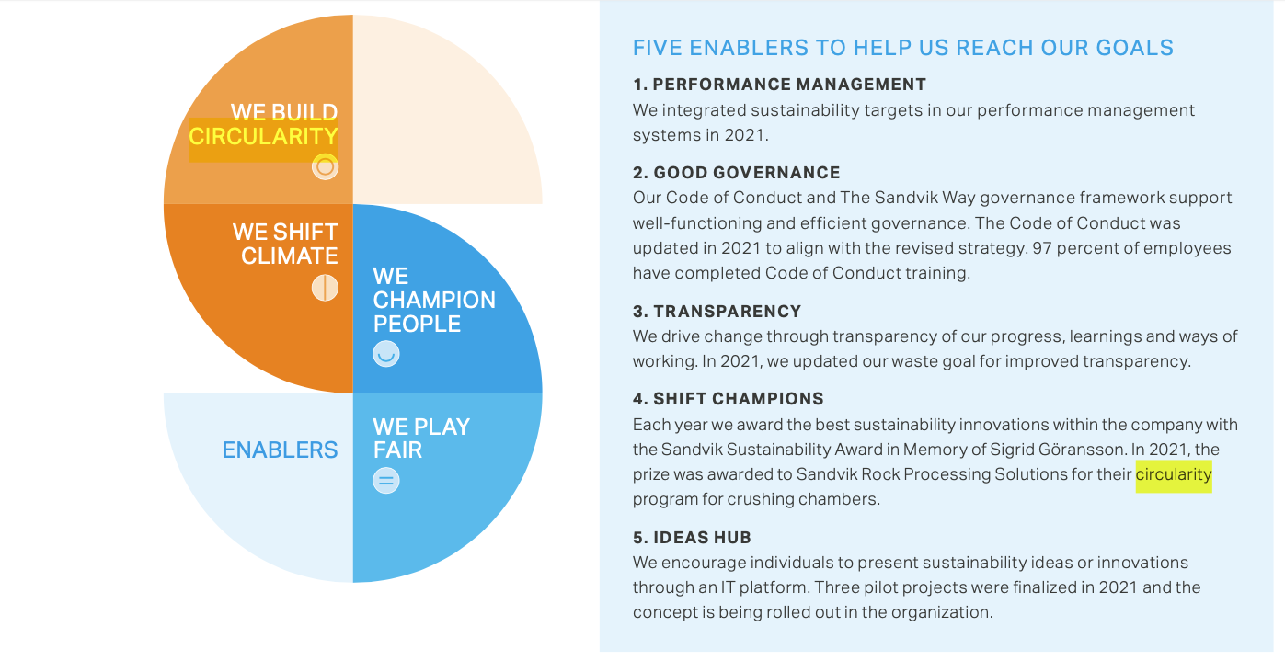
5.6 Strategic Shift- change of footprints

Slide 36
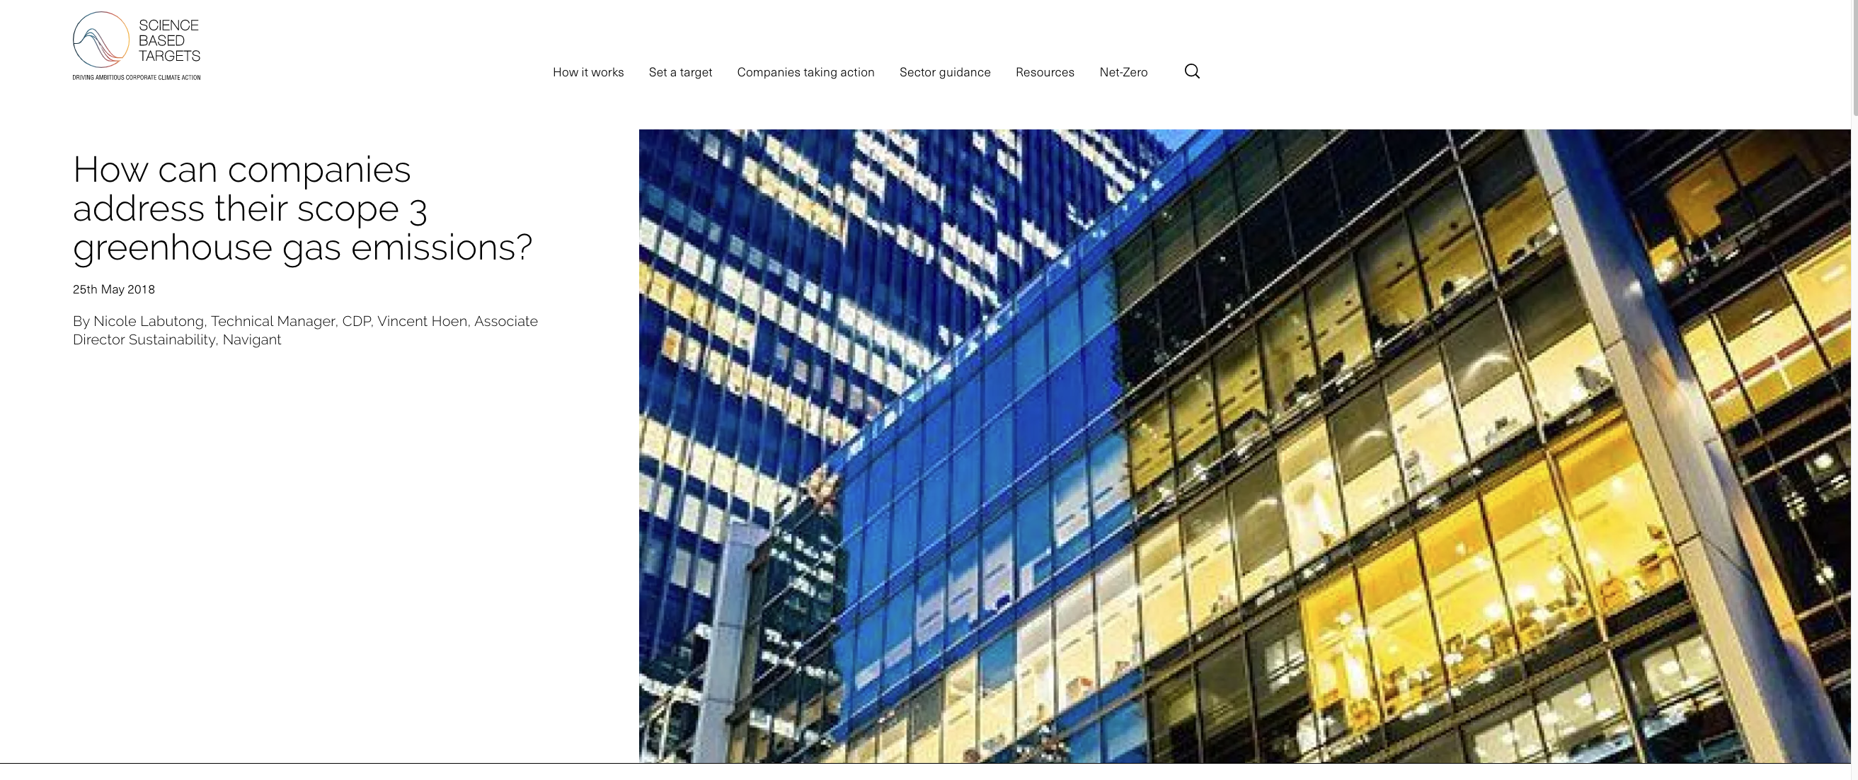
5.6 Scientific Based Targets

Slide 37
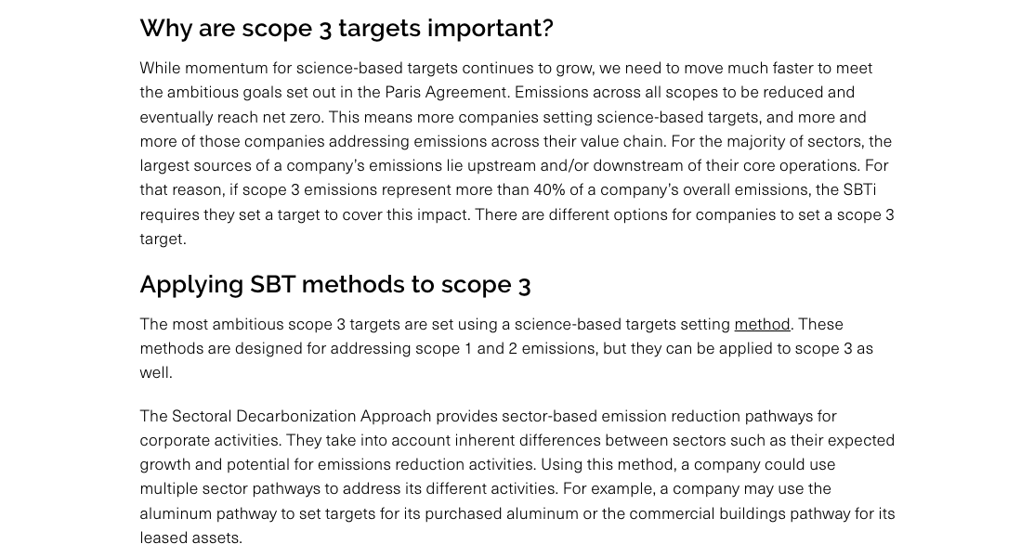
5. 6 Scientific Based Targets: Scope 1-3

Slide 38
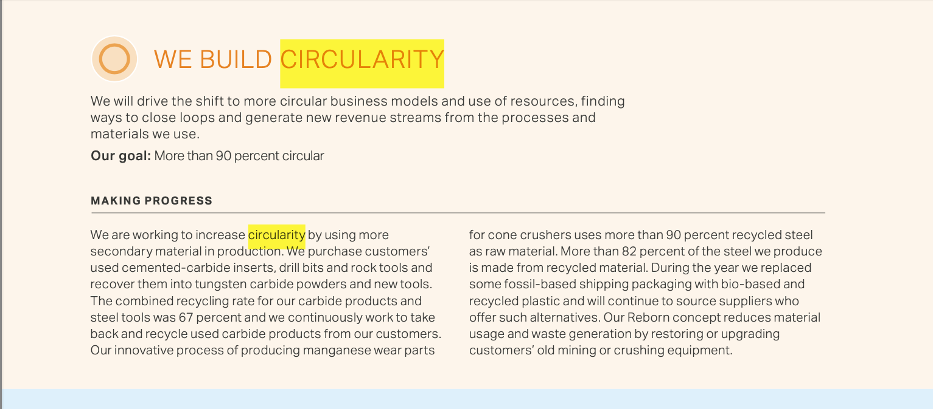
5.6 Circular Business Models

Slide 39
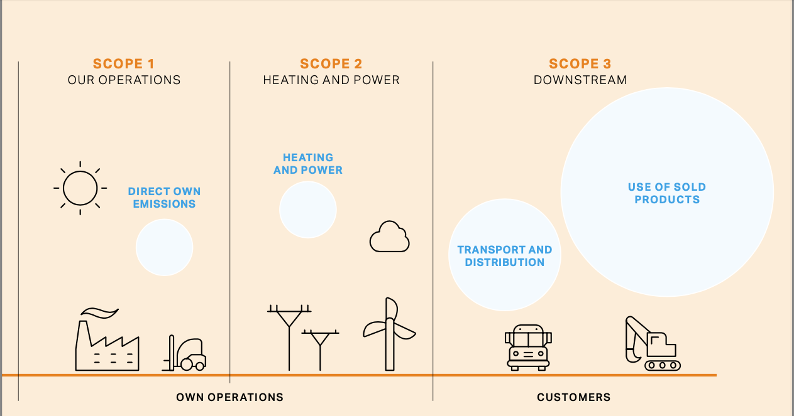
5. 6 Scope 1-3

Slide 40
Atlas Copco

Slide 41
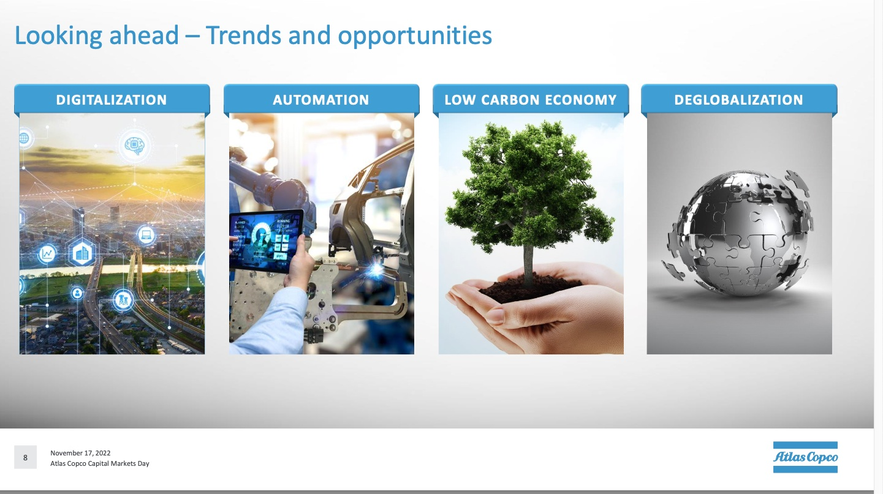

Slide 42
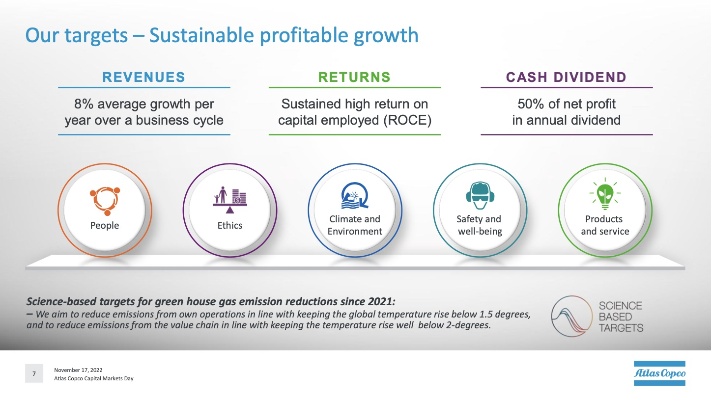
6. Example Atlas Copco

Slide 43
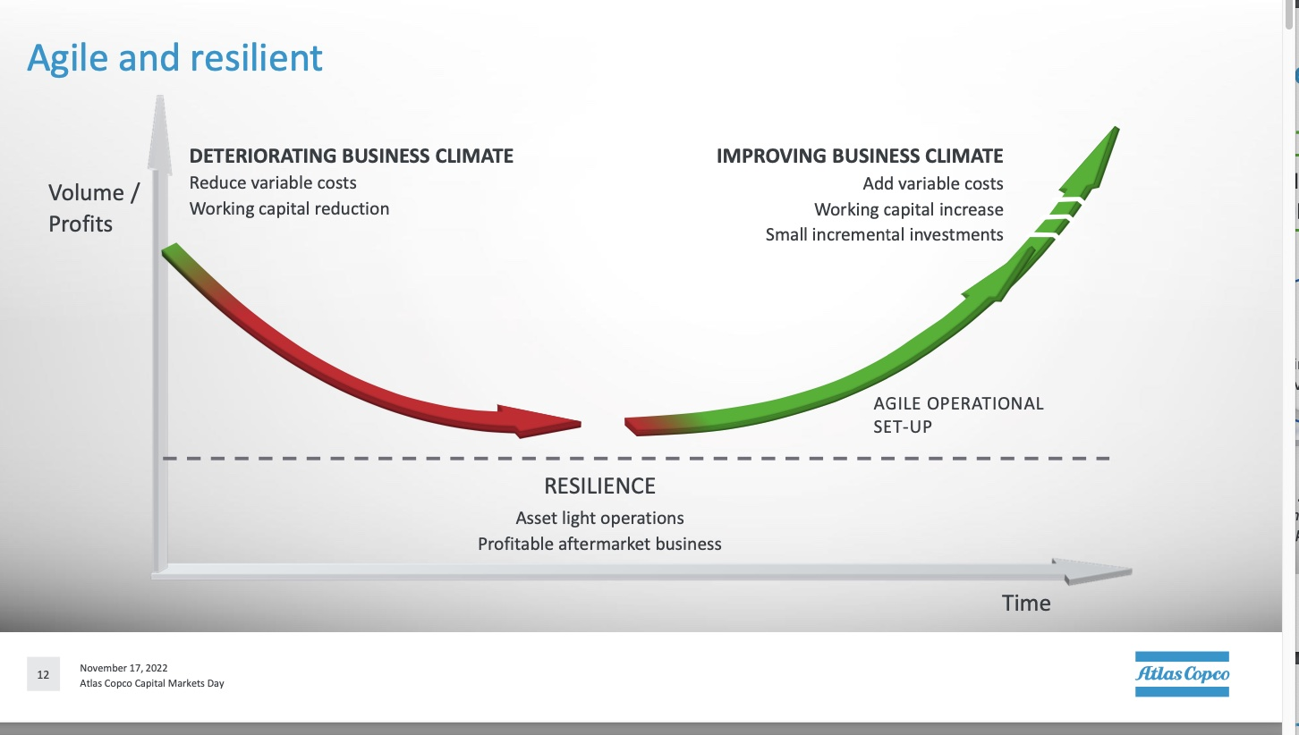
6. AC Business Model

Slide 44
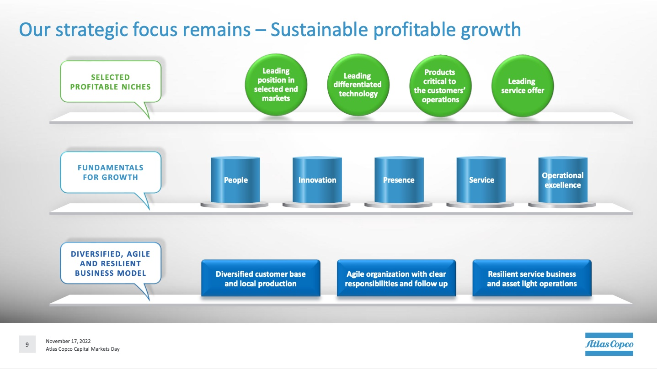
6. AC

Slide 45
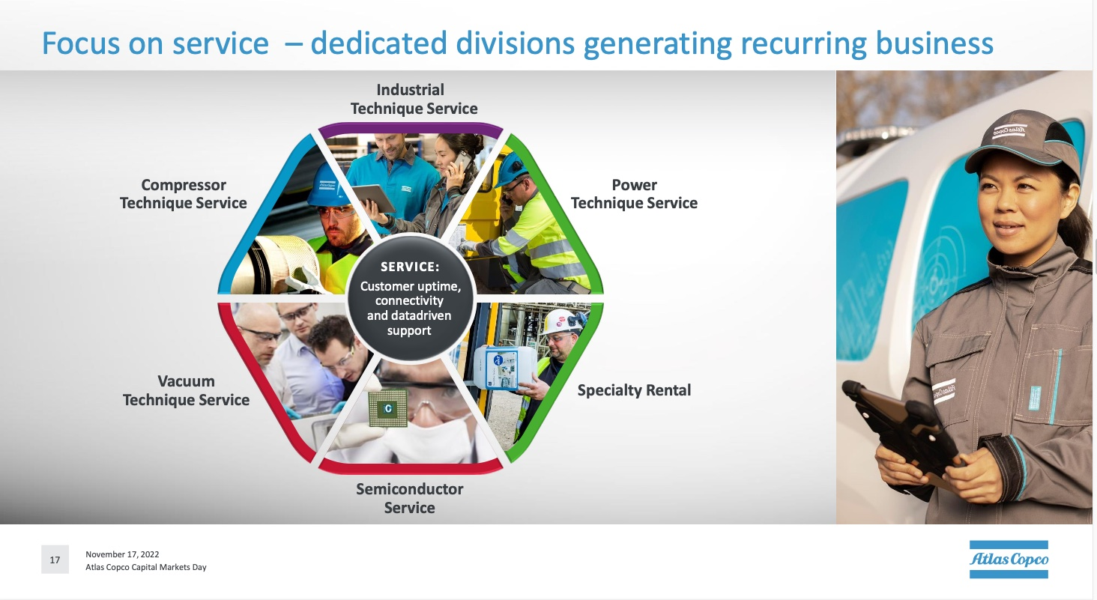
6. Service

Slide 46
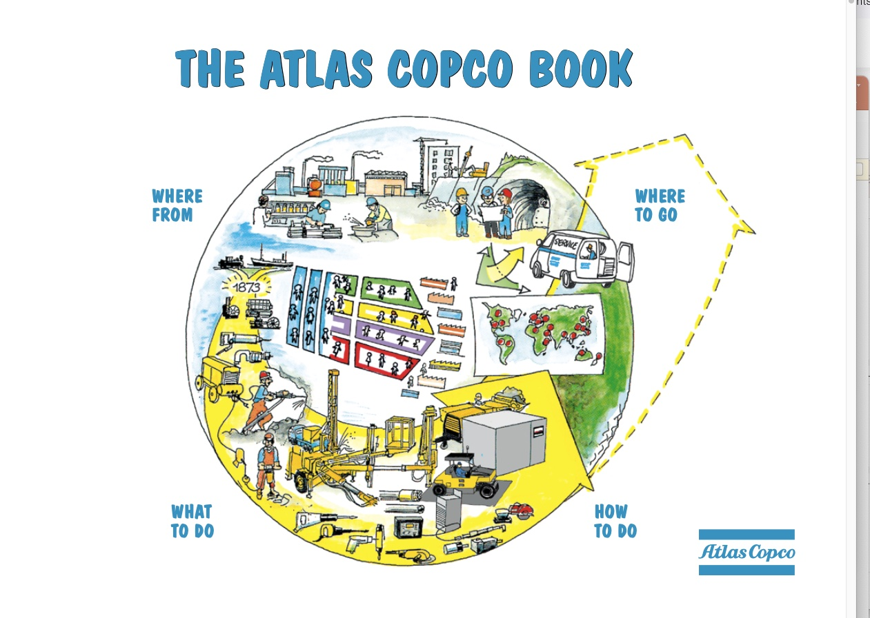
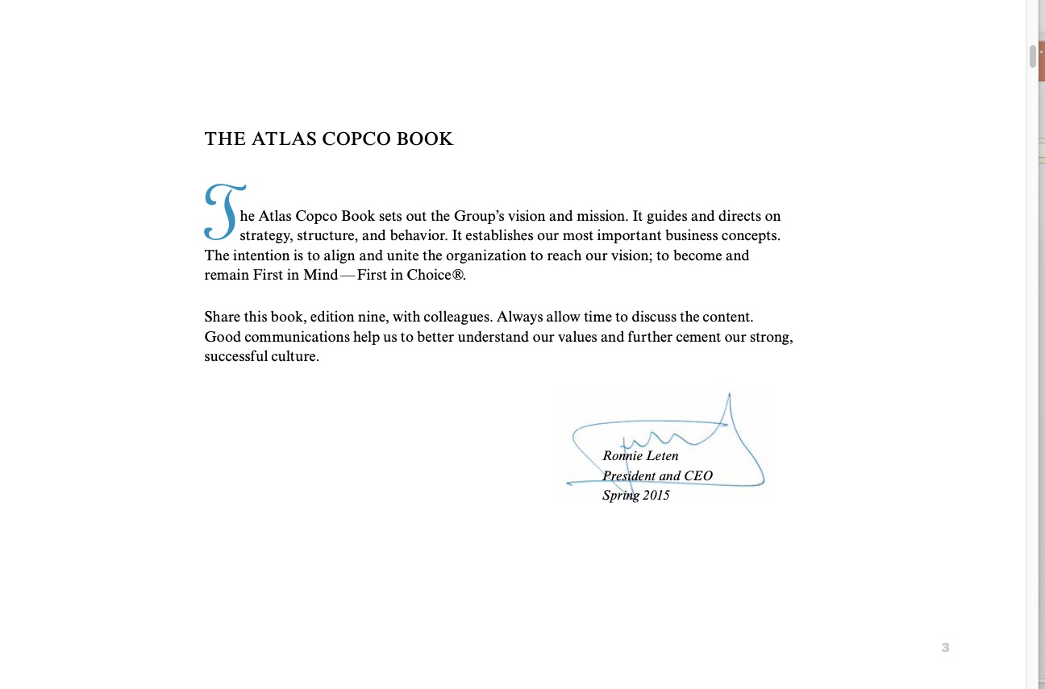
6. A Specific Tool: Atlas Copco Book

Slide 47
Purpose with the Book

Slide 48
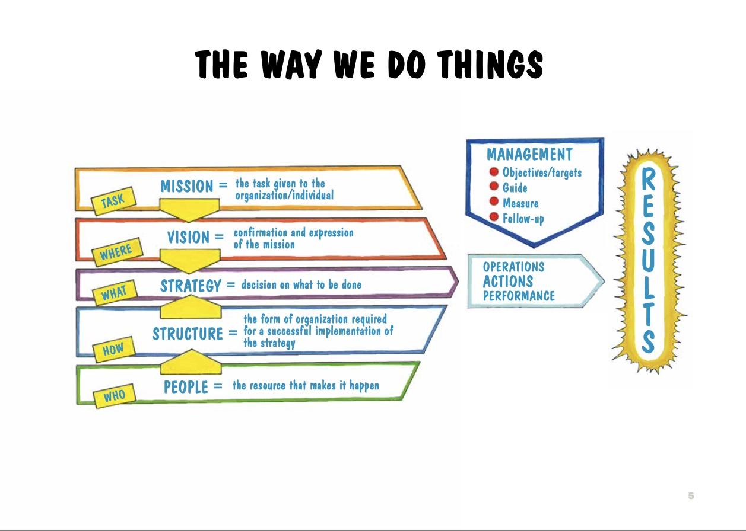
The Way We Do Things

Slide 49
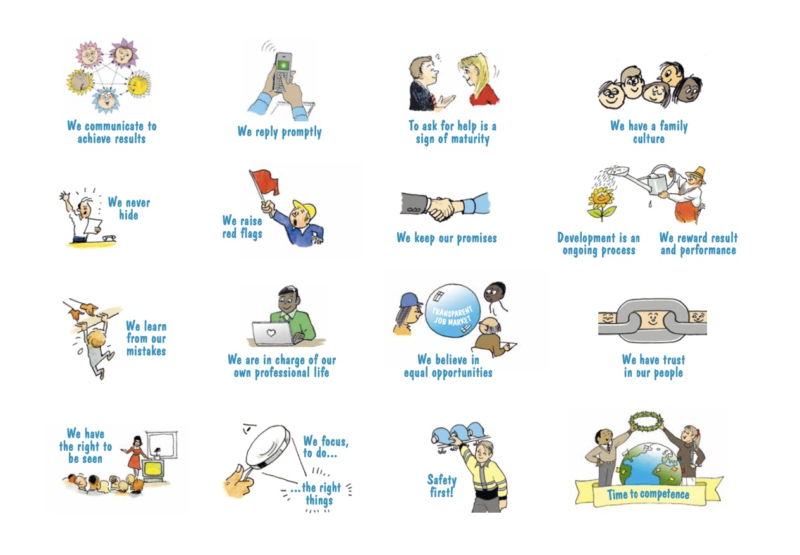
6. Ideas and Principles

Slide 50
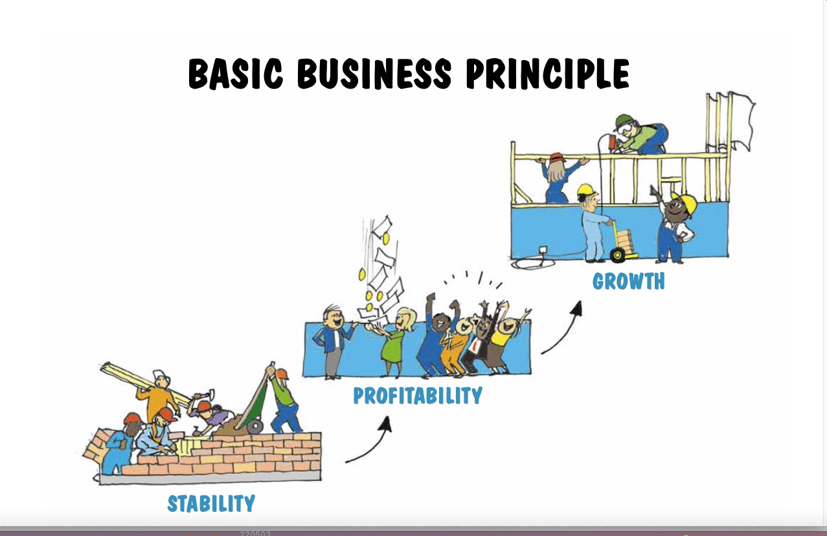
6. The Basics

Slide 51
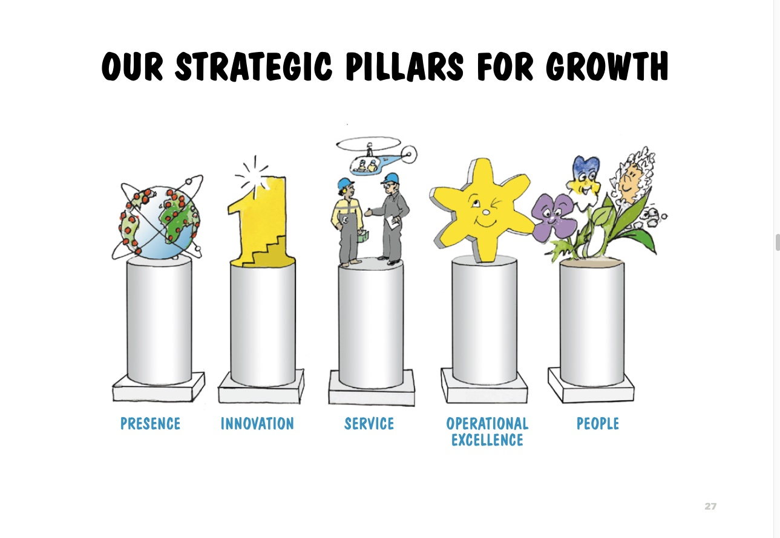
6. Strategic Pillars

Slide 52
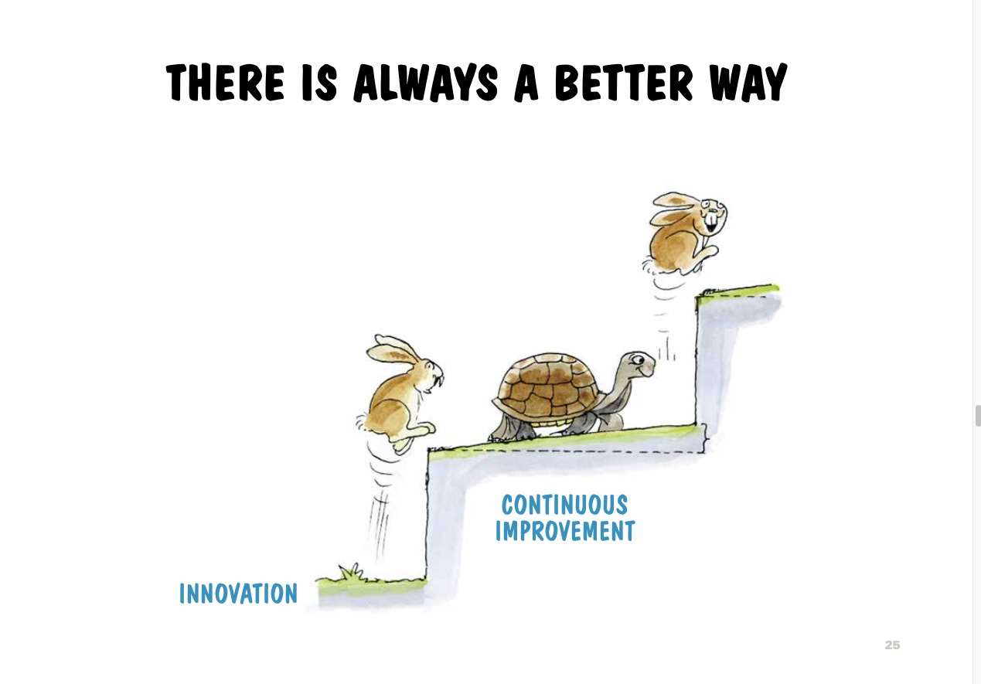
6. A Better Way

Slide 53
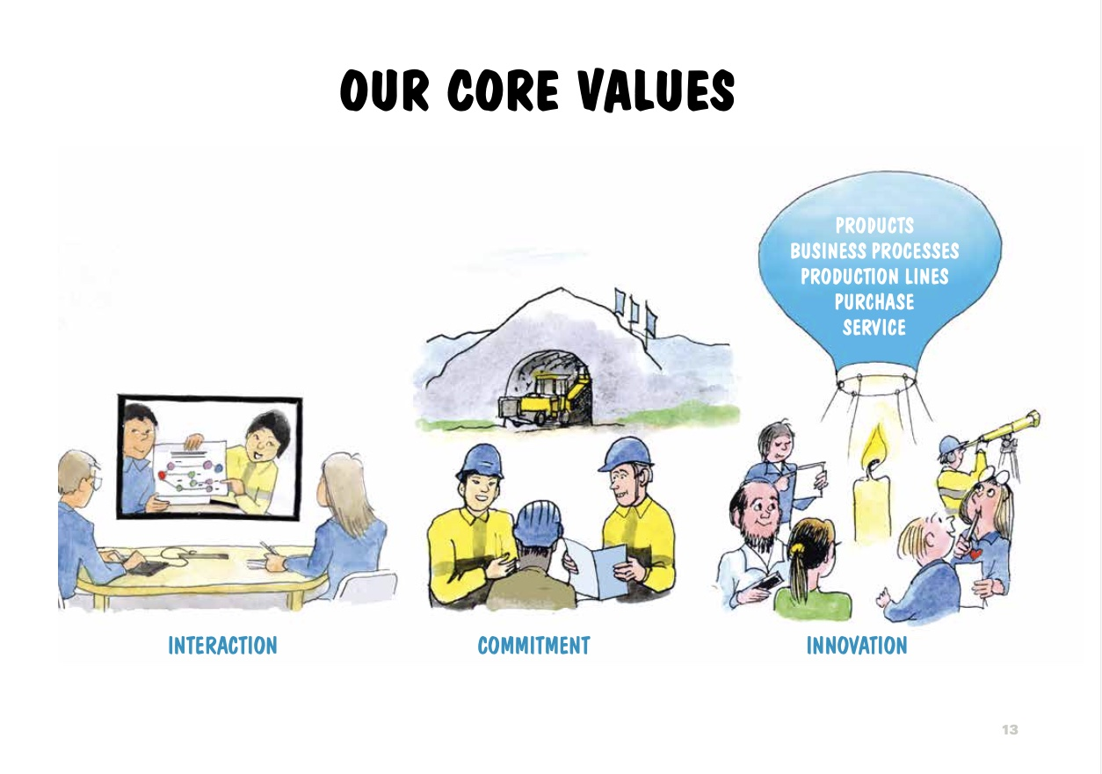
6. The importance of Value

