Slide 1
Lecture 9. ERP Systems
230202
Jan Lindvall

Slide 2
Disposition
ERP – system: ”The BACKBONE”: Transactions
Visualisation – Business Process: Activities: How/Verb
General Ledger – Start and End for financial information
(REVENUE CYCLE): INCOME STATEMENT. ”First Line”
Expediture Cycle: WHAT and HOW WE BUY AND PAY: INCOME STATEMENT (mostly), but also BALANCE SHEET (inventory;WIP).
Production Cycle: HOW WE PRODUCE; DISTRIBUTE AND GET MONEY. INCOME STATEMENT (mostly: COGS), but also BALANCE SHEET (inventory;WIP).

Slide 3
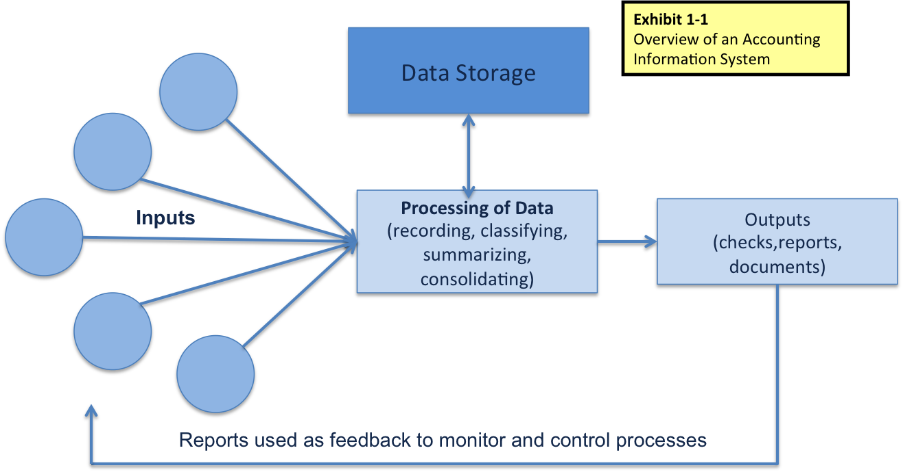
The Process
Various Business Processes
SO 2 An overview of an accounting information system

Slide 4
ERP - Development

Slide 5
ERP – old and new?

Slide 6
The Information Backbone – Enterprise Resource Planning

Slide 7
3.5 ERP – Modules – Based on modules and Integration

Slide 8
Enterprise Resource Planning (E R P) Systems
Integrates activities from the entire organization
Revenue Cycle
Expenditure Cycle
Production Cycle
H/R Payroll Cycle
General Ledger and Reporting System
Notes:
This is a good place to emphasize that good internal controls are necessary, as an integrated database has the benefit of inputting data once in the system; if that input is inaccurate, it will be useless. That is why most people only have access to certain portions of the system and that good data entry controls are necessary.

Slide 9
Remember: Data Storage!
Important to understand how data is organized
Chart of accounts
Coding schemas that are well thought out to anticipate management needs are most efficient and effective
Transaction journals (e.g., Sales)
Subsidiary ledgers (e.g., Accounts receivable)
General ledger
Note: With the above, one can trace the path of the transaction (audit trail)
Notes:
Figure 2.2 on page 37 is a great example of showing students how to follow a transaction to the various subledgers and the general ledger. This helps them visualize the structure of how data is stored in an AIS.

Slide 10
Business Process Diagrams
Is a visual way to represent the activities in a business process.
Intent is that all business users can easily understand the process from a standard notation (B P M N: Business Process Modeling Notation).
Can show the organizational unit performing the activity.

Slide 11
Types of Flowcharts
Document: shows the flow of documents and data for a process, useful in evaluating internal controls
System: depicts the data processing cycle for a process
Program: illustrates the sequence of logic in the system process

Slide 12
Example: Figure 3.1 Business Process Diagram Symbols
Notes:
Long Description:
The table shows the six different symbols used in drawing a business process diagram as follows:
Symbol
Name
Explanation
Circle with thin outline
Start/Begin
The start or beginning of a process is represented by a small circle.
Circle with thick outline
End
The end of a process is represented by a small bolded circle.
Rounded rectangle
Activity in a process
An activity in a process is represented by a rounded-edge rectangle. An explanation of the activity is placed inside the rectangle.
Rhombus
Decision
A decision made during the process is represented by a diamond. An explanation of the decision is placed inside the symbol.
Solid arrow
Flow
The flow of data or information is indicated by an arrow.
Dotted arrow
Annotation information
Information that helps explain a business process is entered in the BPD and, if needed, a bolded dashed arrow is drawn from the explanation to the symbol.

Slide 13
Figure 3.2 Business Process Diagram of Payroll Processing at S&S. ACTIVITIE: VERB!
Notes:
Note that a major difference between the data flow diagrams and flowcharts compared to the business process diagram is that the business process diagram can distinguish the department or location that the activity takes place. These rows—such as New Employee, Human Resources, Payroll, and so on—in the above figure are called swim lanes.
Long Description:
The table shows the activities performed in the case of each employee flowing from one row to the next row starting from new employee in the first row as follows:
Employee
Activities Performed
New Employee
Complete new employee form (arrow flowing to third row via second row)
Human Resources
Complete employee change form (arrow flowing to third row)
Payroll
From Departments
Receive employee timecards
Prepare employee paychecks, payroll summary (arrow flowing to fifth row)
Prepare payroll register, tax report
Update employee/payroll files
Accounts Payable
Prepare tax check, total payroll check, and disbursement voucher (arrow flowing to fifth row)
Susan
Approve and sign paychecks, tax check, and payroll check
Disburse checks and reports to employees, bank, and government
Forward cash disbursement vouchers (arrow flowing to sixth row)
Ashton
Update general ledger, cancel journal vouchers

Slide 14
Figure 3.3 Common Flowcharts Symbols
Notes:
Long Description:
The table with common flowcharting symbols for input/output, processing, and storage appears as follows:
Symbol
Name
Explanation
Input/Output Symbols
A rectangle with a wave-like base
Document
An electronic or paper document or report
Three rectangles numbered 1, 2, and 3, each with a wave-like base
Multiple copies of one paper document
Illustrated by overlapping the document symbol and printing the document number on the face of the document in the upper right corner
A pentagon with one curved side
Electronic output
Information displayed by an electronic output device such as a terminal, monitor, or screen
A trapezoid with non-parallel sides much longer than the parallel sides
Electronic data entry
Electronic data entry device such as a computer, terminal, tablet, or phone
Symbol for electronic output connected to symbol for electronic data entry
Electronic input and output device
The electronic data entry and output symbols are used together to show a device used for both
Processing Symbols
Rectangle
Computer processing
A computer-performed processing function; usually results in a change in data or information
Trapezoid
Manual operation
A processing operation performed manually
Storage Symbols
Cylinder
Database
Data stored electronically in a database
A circle with a terminal point at the bottom
Magnetic tape
Data stored on a magnetic tape; tapes are popular back-up storage mediums
An inverted triangle with letter N inside it
Paper document file
File of paper documents; letters indicate file-ordering sequence: N: numerically, A: alphabetically, D: by date
Parallelogram
Journal/ledger
Paper-based accounting journals and ledgers
Long Description:
The table with common flow and miscellaneous symbols appears as follows:
Symbol
Name
Explanation
Flow and Miscellaneous Symbols
Right arrow
Document or processing flow
Direction of processing or document flow; normal flow is down and to the right
Right arrow with a zig-zag tail
Communication link
Transmission of data from one geographic location to another via communication lines
Circle
On-page connector
Connects the processing flow on the same page; its usage avoids lines crisscrossing a page
Pentagon
Off-page connector
An entry from, or an exit to, another page
Rounded rectangle
Terminal
A beginning, end, or point of interruption in a process; also used to indicate an external party
Rhombus
Decision
A decision-making step
A line connected to a square open on the right
Annotation
Addition of descriptive comments or explanatory notes as clarification

Slide 15
General Ledger
Integrates and summaries
Central master file
OUTPUT: FINANCIAL STATEMENTS AND MANAGERIAL REPORTS

Slide 16
General Ledger & Reporting System

Slide 17
ONLINE GL & Reports

Slide 18
Exampel: Expenditure Cycle
Definition
Activities: what & how we doing work
Ordering mtrl
Receiving mtrl
Approving invoices
Paying invoices

Slide 19
Revenue (”Accounts Receivable”) & Expenditure (”Accounts Payable”).

Slide 20
Context Diagram Expenditure Cycle: SUPPLIERS/VENDORS

Slide 21
ERP support EXP Cycle

Slide 22
DATA FLOW:Ordering,Receiving, Approving, Paying

Slide 23
MORE DETAILED VIEW. STEP 1. Ordering materials – How?

Slide 24
STEP 2. Receiving materials

Slide 25
Production Cycle

Slide 26
Fundamental: Models : (Product)Calcualtion,

Slide 27
Figure 16.1 Context Diagram of the Production Cycle
Notes:
Long Description:
The diagram shows that the production cycle includes:
Providing purchase requisitions to expenditure cycle
Receiving overhead and raw materials from expenditure cycle
Providing labor needs to human resources management/payroll cycle
Receiving labor costs from human resources management/payroll cycle
Providing reports to management
Providing cost of goods manufactured to general ledger and reporting system
Providing finished goods to revenue cycle
Receiving sales forecasts and customer orders from revenue cycle

Slide 28
Production: 1.Product Design; 2. Planning & Scheduling, 3. Production Operations, 4. Cost Accounting

Slide 29
Documents! Many…

Slide 30
ERP & Production Cycle

Slide 31
ERP: Integrating Production Cycle & Other Cycles (cf. ”first ERP -slide”

Slide 32
1. Product Design: OUTPUT: Materials (”Bill of Materials”) & ”Steps to Follow”(”Operational List”) Example: Bills of Materials

Slide 33
Example: Operation List

Slide 34
2. Planning & Scheduling: Master Production Schedule

Slide 35
2. Planning and Scheduling
Two types of production planning
Manufacturing resource planning (M R P-II)
Lean manufacturing
Documents from Planning and Scheduling
Production order
Materials requisition
Move tickets
Notes:
MRP-II is thought of as “push” manufacturing because goods are produced in expectation of customer demand.
Lean manufacturing is thought of as “pull” manufacturing because goods are produced in response to customer demand.

Slide 36
3. Start: Production Order

Slide 37
Material Requisition

Slide 38
Inventory Transfer

Slide 39
4. Cost Accounting Systems
Provide information for planning, controlling, and evaluating the performance of production operations
Provide accurate cost data about products for use in pricing and product mix decisions
Collect and process the information used to calculate the inventory and cost of goods sold values that appear in organization’s financials
Notes:
Cost accounting systems can help organizations achieve their manufacturing goals by these three principal objectives.
Accomplishing the first objective requires that an organization’s cost accounting system collects real-time data about the performance and production activities for management to make timely decisions.
Accomplishing the last two objectives requires organizations to classify and assign costs. Types of costs that are collected and classified are:
Raw materials usage data
Direct labor costs
Machinery and equipment usage
Manufacturing overhead costs
Assigning costs can be done in one of several ways:
Job-order costing: costs assigned to a specific production job or batch
Process costing: costs assigned to each process in the production cycle and averages costs for all units produced
Activity-based costing: tracing costs to the activities.

