Slide 1
Lecture 11. Project
February 7, 2023
Jan Lindvall

Slide 2
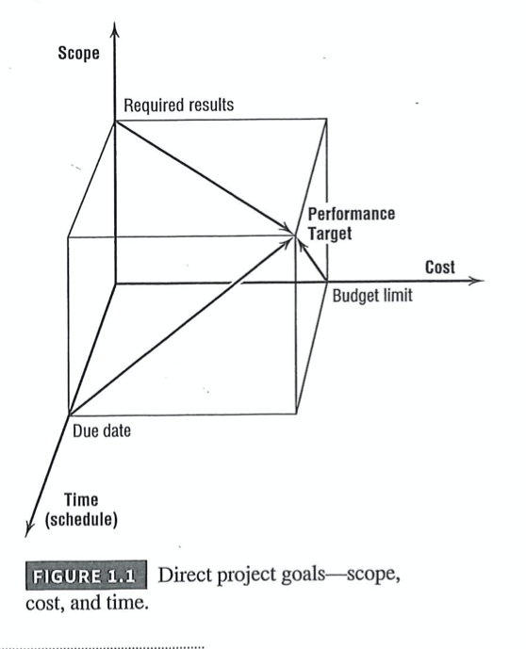
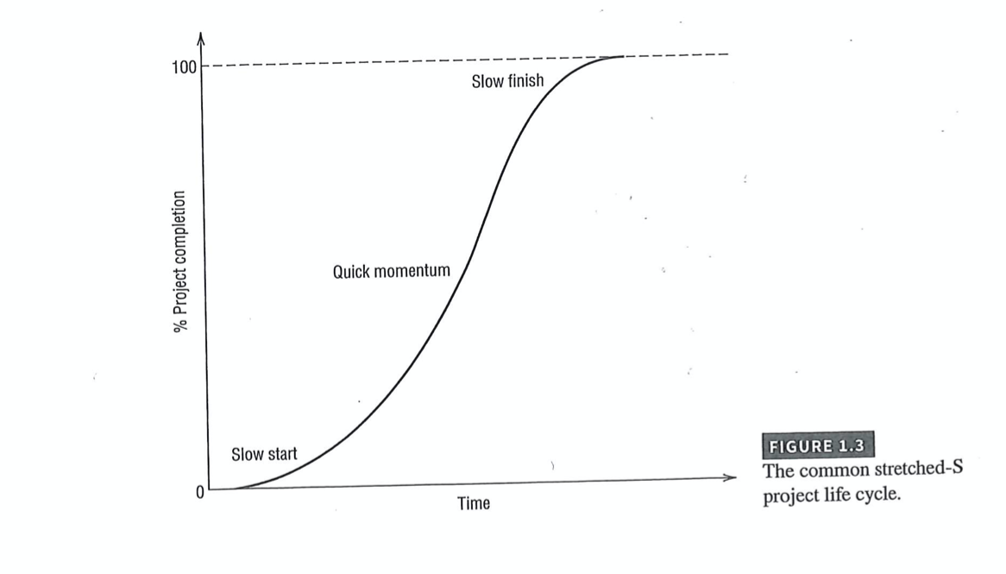
Projects! Time, Cost, Quality and Risk!

Slide 3
AN example: ERP/ES: Many stakeholders – different expectations
Success viewed in technical terms.
Success viewed in economic, financial or strategic business terms.
Success viewed in terms of the smooth running of business operations.
Success as viewed by the ERP-adopting organization’s managers and employees.
Success as viewed by the ERP-adopting organization’s customers, suppliers, and investors.
Markus, et al, 2000, Learning from Adopters

Slide 4
ERP – projects: Three different phases
Markus, et al, 2000
(1) the project phase during which ERP software is configured and rolled out to the organization,
(2) the shakedown phase during which the company makes the transition from ‘go live’ to ‘normal operations’
(3) the onward and upward phase during which the company captures the majority of business benefits (if any) from the ERP system and plans the next steps for technology implementation and business improvement.

Slide 5
1. Success in Project Phase
Project cost relative to budget.
Project completion time relative to schedule.
Completed and installed system functionality relative to original project scope.

Slide 6
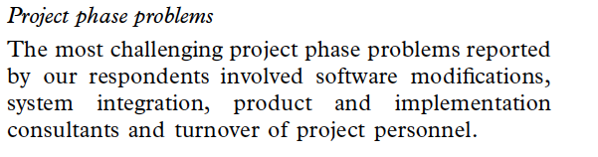
1.1 Problems in Project Phase

Slide 7
2. Success in the shakedown phase
Short-term changes occurring after system ‘go- live’ in key business performance indicators such as operating labour costs.
Length of time before key performance indicators achieve ‘normal’ or expected levels.
Short-term impacts on the organization’s adopters, suppliers and customers such as average time on hold when placing a telephone order.

Slide 8
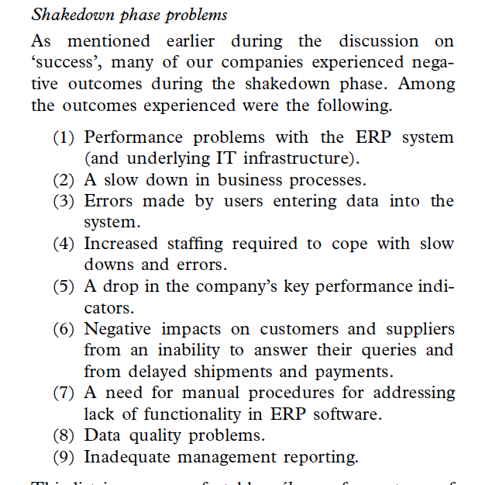
2.1 Problems in Shakedown phase

Slide 9
3. Success in the onward and upward phase
Achievement of business results expected for the ERP project, such as reduced IT operating costs and reduced inventory carrying costs.
Ongoing improvements in business results after the expected results have been achieved.
Ease in adopting new ERP releases, other new ITs, improved business practices, improved decision making, etc., after the ERP system has achieved stable operations.

Slide 10
3.1 Problems in Onward and upward phase
Unknown business results
Disappointing business results
Fragile human capital
Migration phase problems

Slide 11
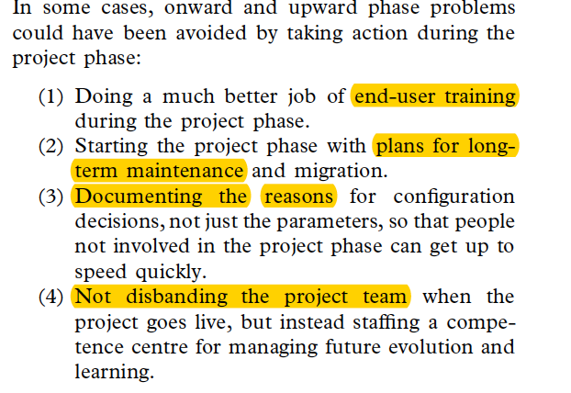
What to do?How to reduce/solve? Problems?

Slide 12
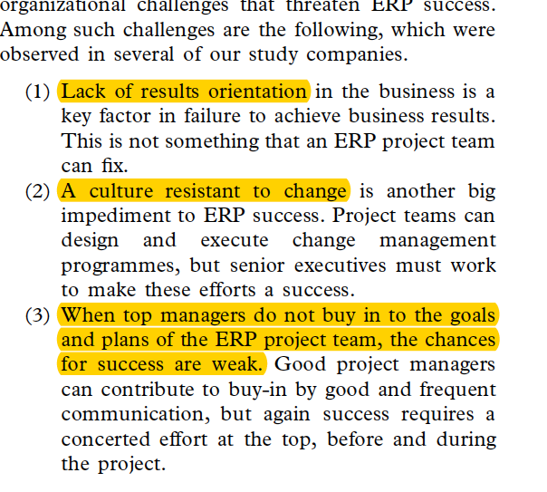
Organizational Challenges

Slide 13
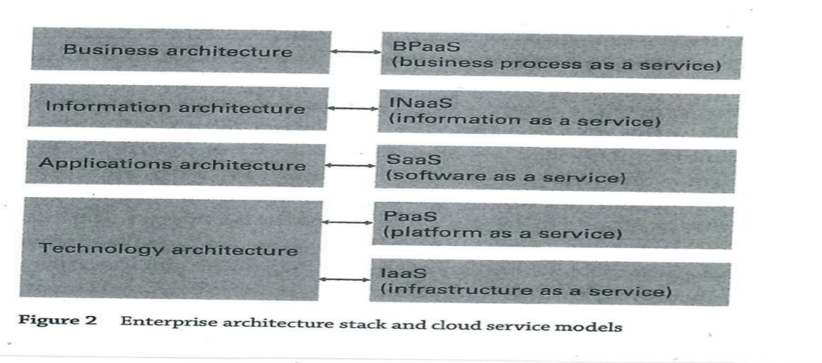
Cloud

Slide 14
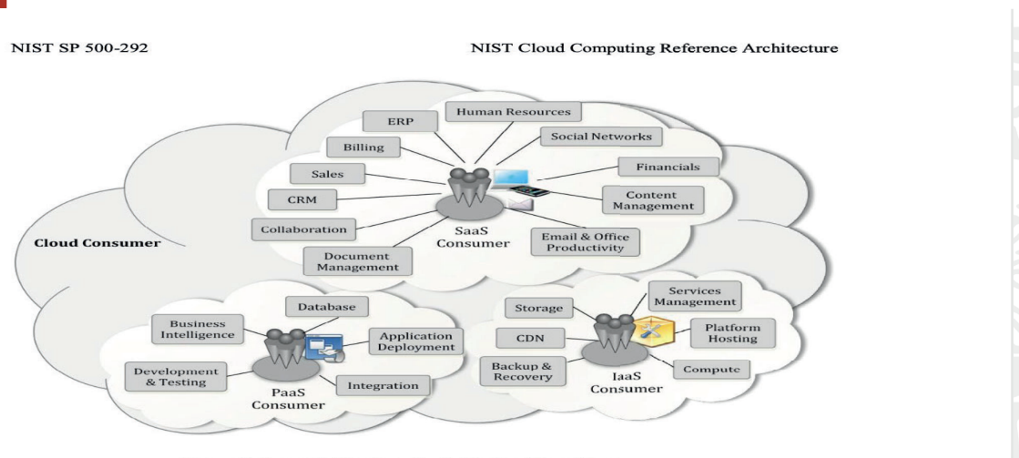

Slide 15
Cloud
From CAPEX to OPEX: fixed cost to variable cost
Scaling – Flexibility
Access

Slide 16
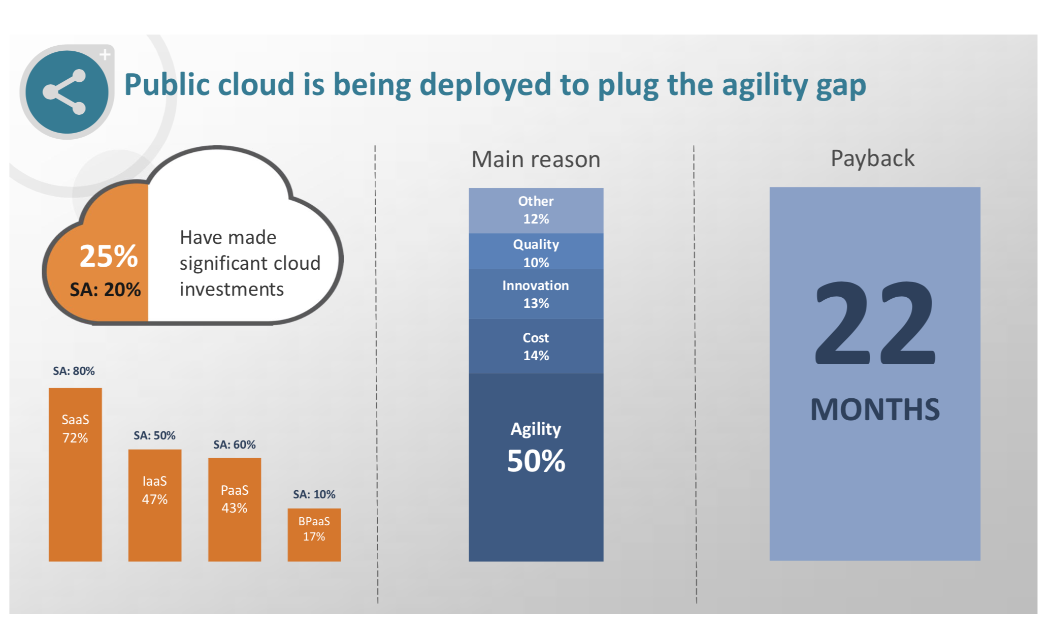
Cloud

