Slide 1
Lecture 15. The Role and Technique. Summary
230213
Jan Lindvall

Slide 2
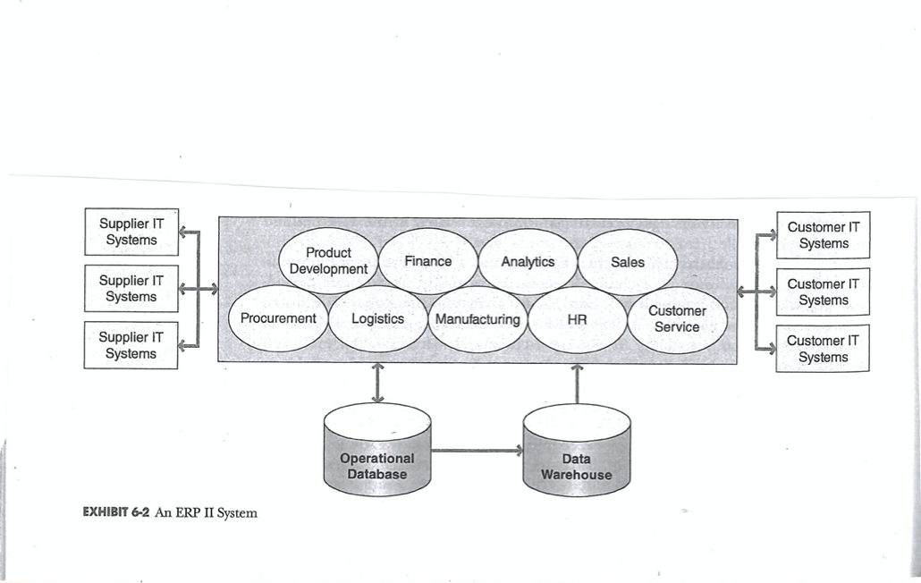
1. What is - "An ERP System"? Discuss - shortly - two crucial aspects of this system!
The Information Backbone – Enterprise Resource Planning

Slide 3
2. What is a Data Warehouse? Compared with an "Operational database," what is the crucial difference?
Data Warehouse
”A centralized respository containing data from a range of sources across an organization. The data are structured to support summary reports from the aggregated data. Online analytcal processing (OLAP) is the term used to describe the typical operations on a data warehouse”.
Glossary, Data Science

Slide 4
Four characteristics for a data warehouse 2
Data warehouses offer the overarching and unique benefit of allowing organizations to analyze large amounts of variant data and extract significant value from it, as well as to keep a historical record.
Subject-oriented. They can analyze data about a particular subject or functional area (such as sales).
Integrated. Data warehouses create consistency among different data types from disparate sources.
Nonvolatile. Once data is in a data warehouse, it’s stable and doesn’t change.
Time-variant. Data warehouse analysis looks at change over time.

Slide 5
3. What is a company´s “Charts of Accounts”? Why is it so important?

Slide 6
Accounting – Charts of Accounts
”… it also represents a landmark in the evolution of the use of data. It enabled information to be recorded in the form of ’categories’ that linked accounts. It worked by means of a set of rules about how to record data – one of the earliest examples of standardized recording of information”.
Mayer-Schönberger & Cukier, 2013, Big Data, s.81.

Slide 7
4. OLAP (Online Analytical Processing) – and how to use it?
”OLAP operations generate summaries of historical data and aggregate data from multiple sources. OLAP operations are designed to generate report-type summaries and enable users to slice, dice, and pivot data in a dta warehouse using a predefined set of dimensions of the data, such as sales by stores, sale by quarter, and so on.”
Glossary, Data Science

Slide 8
OLAP (Online Analytical Processing) – and how to use it?
”OLAP operations generate summaries of historical data and aggregate data from multiple sources. OLAP operations are designed to generate report-type summaries and enable users to slice, dice, and pivot data in a dta warehouse using a predefined set of dimensions of the data, such as sales by stores, sale by quarter, and so on.”
Glossary, Data Science

Slide 9
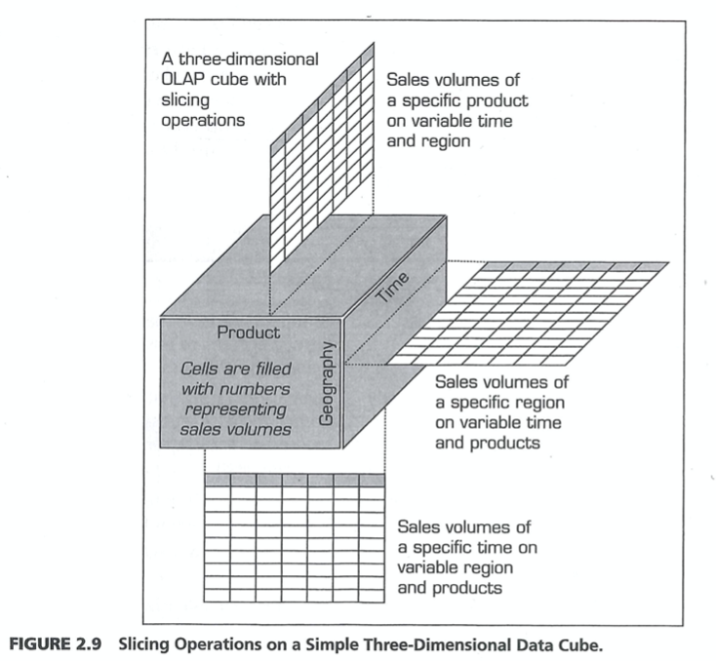
4. What is OLAP? Discuss two possibilities/activities, "with OLAP can we…". Relate your answer, your two examples, to "Customer Profitability."
OLAP & Data Cube

Slide 10
5. What is ETL, in a Data Warehouse milieu?

Slide 11
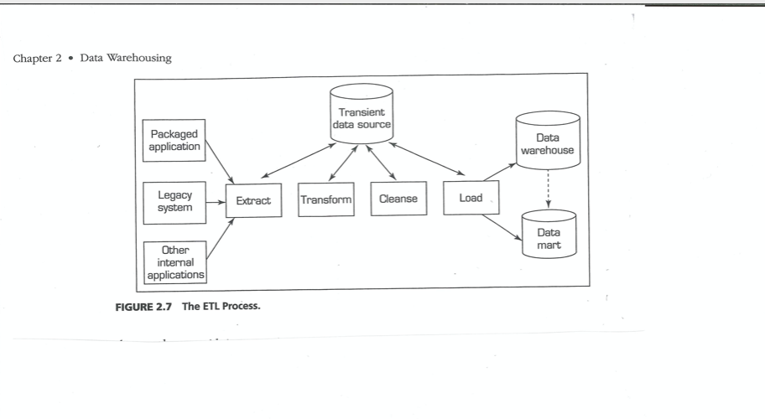
5. ETL - Extract Transform Load.
ETL Visualisation
ETL definition
”… describes the typical processes and tools used to support the mapping, merging, and movement of data between databases”
Glossary, Data Science

Slide 12
6. What is a "Business Process"? Why is the concept important when we discuss information sytems?

Slide 13
Information Needs and Business Processes
Business organizations use business processes to get things done. A business process is a set of related, coordinated, and structured activities and tasks performed by people, machines, or both to achieve a specific organizational goal.
Key decisions and information needed often come from these business processes.
Notes:
A good example to walk through with students would be a local restaurant near campus (e.g., a pizza restaurant).
Ask students to put themselves in the shoes of the restaurant owner; what decisions would the owner need to make to run the business successfully?
The students may have many answers that could include decisions about what products (pizzas to sell), what resources are needed to make the pizza (labor, equipment, and ingredients), whom to buy the ingredients from. How many people are needed to work at the restaurant, and what skills are required from employees (pizza maker, waiter, delivery person), and so on.
In essence, all of these decisions can be mapped to a series of business processes and from these decisions identify information that is needed to measure performance.
For example, if the key decision is what types of pizzas should I sell, the processes that may impact this decision would be sales and market information. In addition, vendor information on ingredient costs may play a role here as well (especially if it’s an exotic ingredient, expensive ingredient, or hard to source, e.g., cheese imported from Italy).
At the end of this class exercise, many of these can be mapped to Table 1-2 found on page 6.

Slide 14
7. What is a database?
What is a database?

Slide 15
7. Database
Database: A central repository of data.
”Relational databases store data in collection of tables where each table has a structure of one row per instance and one columne per attribute. Links between tables can be created by having key attributes appear in multiple tables. This structure is suited for SQL queries which define operations on the data in the tables.”
Glossary, Data Science

Slide 16
2. Advantages of Databases
Data is integrated
Data sharing
Minimize data redundancy and inconsistencies
Data is independent of the programs that use the data
Data is easily accessed for reporting and cross-functional analysis
Notes:
The advantages of a database (as compared to a file-based legacy system where there is no integration of files) is shown in the following example:
An organization that has a file-based legacy system that has one file for its customers and a separate file for sales. The separate file would have to also contain customer information causing data redundancy and possible data inconsistencies. For example, one file may have the customer name ABC Co. and the other file may have the same customer but it shows ABC Company. It’s the same customer, but the spelling is inconsistent. This can lead to problems of accuracy later on.
Because of the advantages and the easy integration, sharing, and use of the data in a database, it is extremely important that the data is accurate as many users rely on this data to make various decisions.

Slide 17
8. Discuss the three related concepts "field, record, and file".

Slide 18
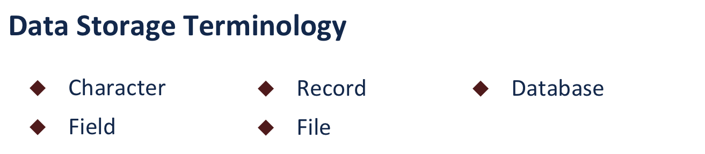
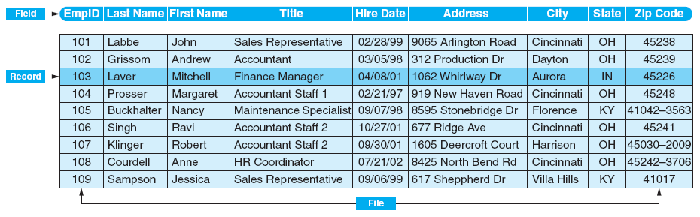
8. Discuss the three related concepts "field, record, and file". Storing and Accessing Data: Structure of a Data Set
Exhibit 13-1
Data Hierarchy

Slide 19
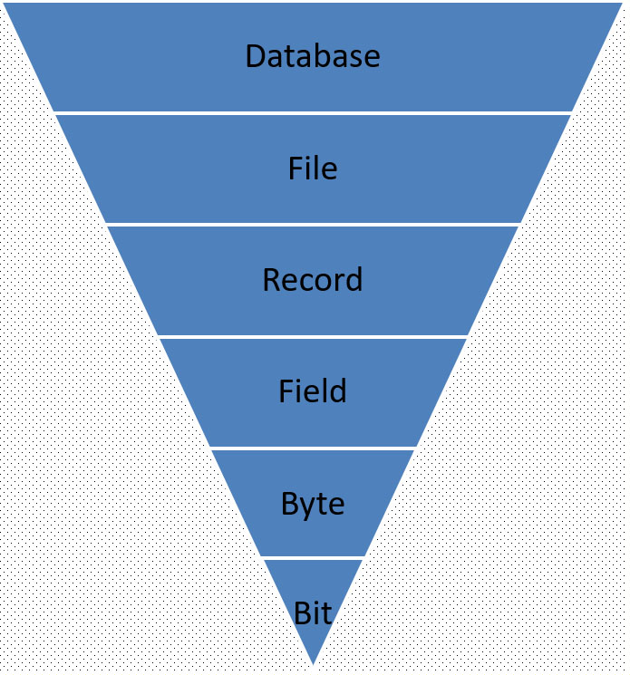
Data Set; File; Table: Basic Computer and I T Concepts
Collection of data stored on the computer; allows data to be easily accessed, retrieved, manipulated and stored
Entire set of related records Ex.) Payroll file
Set of related fields for the same entity Ex.) payroll record is composed of many fields
One item within a record. Ex.) Last name
Unit of storage represents one character. One byte is made up of 8 bits. Ex.) letter “A”
Smallest unit of information in a computer system; can only have one of two values: 0 or 1
S O 5 Basic computer and I T concepts

Slide 20
9 Discuss the concepts "Transaction work" and "Analytical work" related to a CFO department and the "digital tools" they use/can use related to this type of work.

Slide 21
10. Discuss "The Iron Triangle" of projects!

Slide 22
11 During the course, you read a presentation from Qlik, "The Associative Difference." In two points: what's the difference with this solution compared to a "traditional solution"?

Slide 23
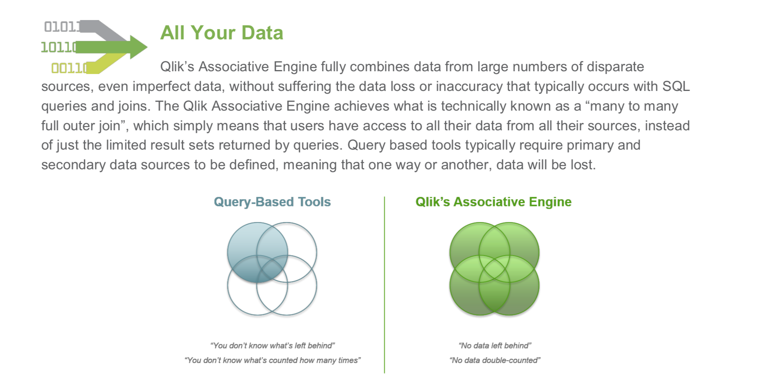
11. Differences!

Slide 24
12 Explain communicatively, what Dallemulle & Davenport presents as "The Elements of Data Strategy"?

Slide 25
Data Strategy & Data architecture – a definition
”A company’s data architecture describes how data is collected, stored, transformed, distributed, and consumed. It includes the rules governing structured formats, such as databases and file systems, and the systems for connecting data with the business processes that consume it. Information architecture governs the processes and rules that convert data into useful information.
Dallemulle & Davenport, 2017, What´s your Data Strategy?

Slide 26
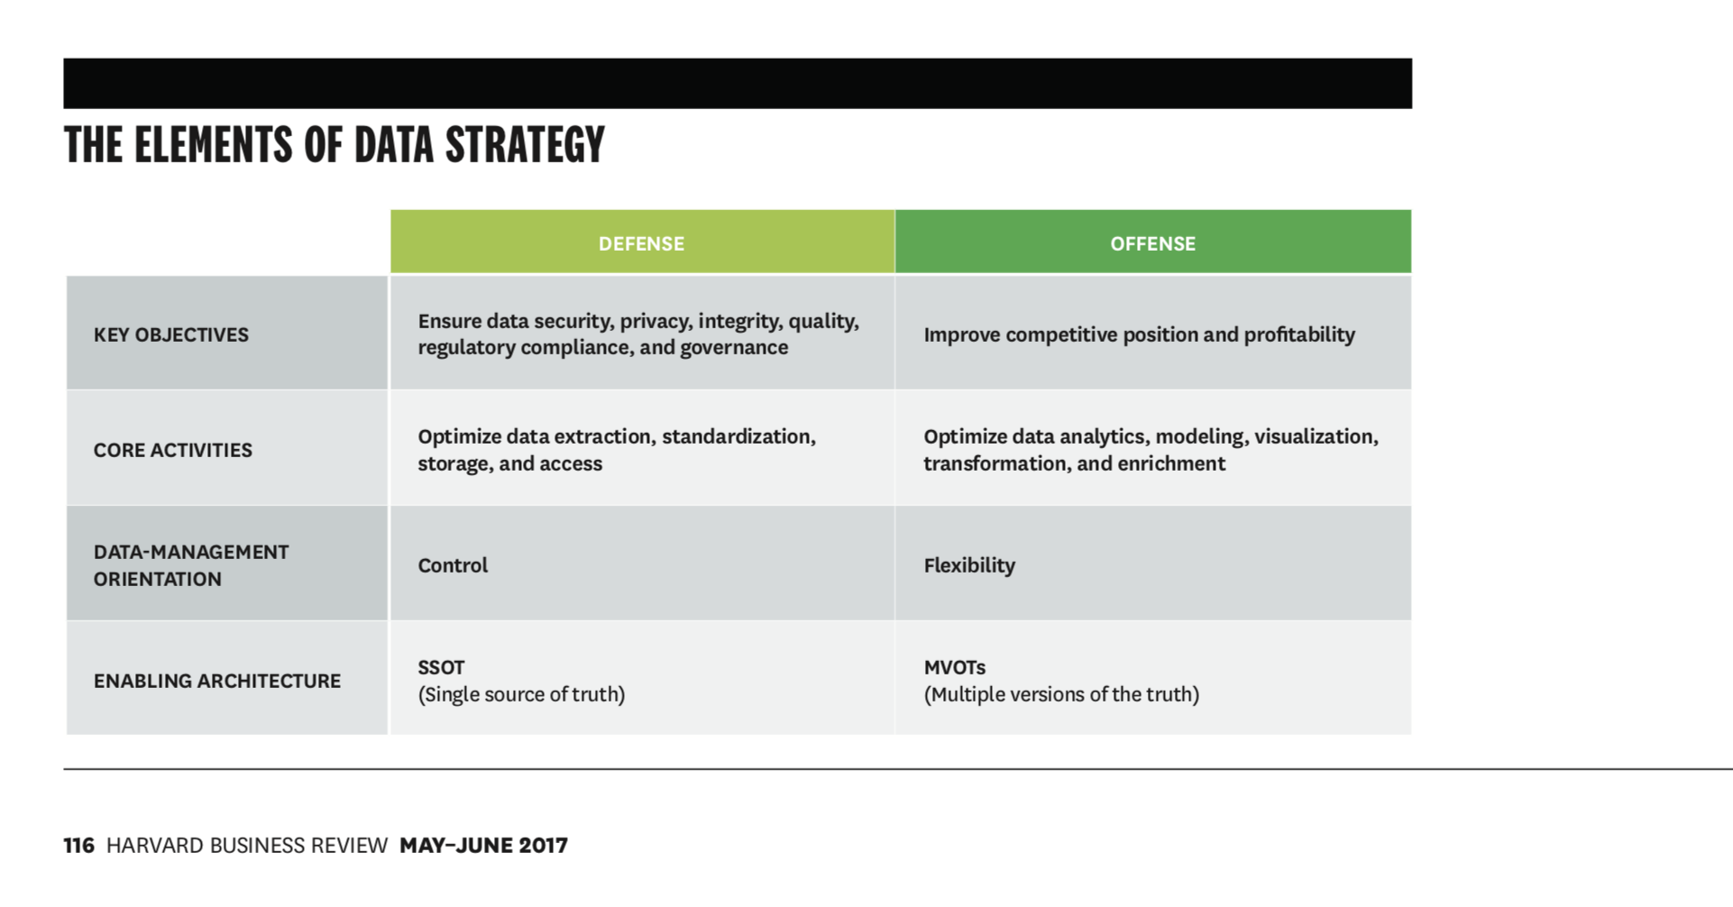
12. Elements of Data Strategy

Slide 27
13 What is a "Legacy system"? Present also two advantages with legacy systems?

Slide 28
14 First – give a short definition of "Batch" and "Online/Real-Time Processing." Then – give one advantage and one disadvantage for each concept!

Slide 29
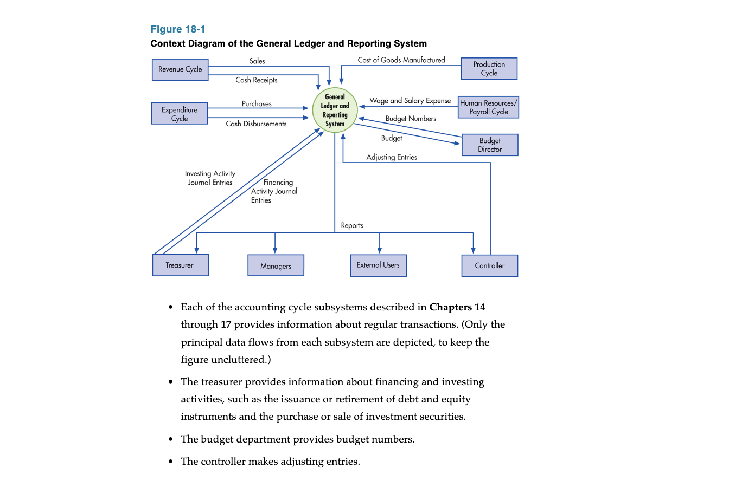
15. General Ledger & Reporting System

Slide 30
15 What is "General Ledger"?
What is "General Ledger"?

