Slide 1
The Magic of Technology: The Machine as a Transformation of Slavery
Alf Hornborg

Slide 2
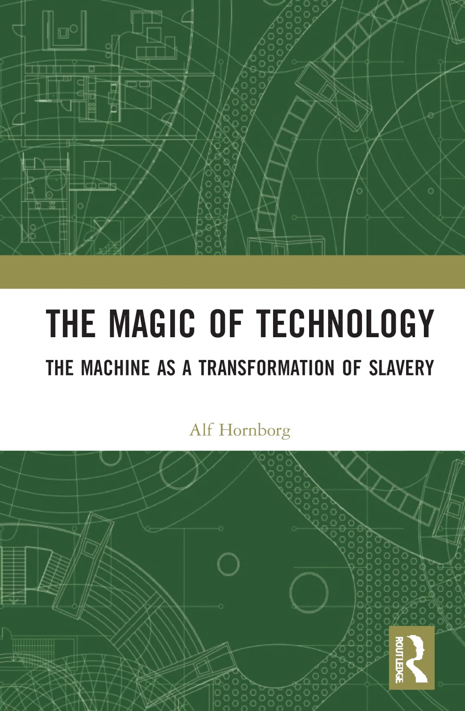

Slide 3
James Watt’s steam engine in 1788

Slide 4
The global context of the steam engine: cotton harvest in a slave plantation

Slide 5
Immanuel Wallerstein: The Modern World-System

Slide 6
Globalized technologies as magic
Magic is to get something done while concealing how it is contingent on human perceptions
Modern (globalized) technologies are contingent on socially constructed exchange rates (prices)
Exchange rates (prices) are contingent on the perceptions and aspirations of market actors – they thus represent magical conversions (as in alchemy)
Conclusion: Modern technologies are contingent on human perceptions

Slide 7
The Industrial Revolution as time-space appropriation
Commodity | Volume for £1000 in 1850 | Embodied labor | Embodied land
Raw cotton | 11.84 tons | 20,874 h | 58.6 ha
Cotton cloth | 3.41 tons | 14,233 h | - 1 ha

Slide 8
19th-century British appropriation of space
Land-saving imports and technologies | 1815 | 1830 | 1900
Food energy in sugar as replacement of British crops |  | 1 m ha | 6 m ha
Textile fiber in cotton as replacement of British wool |  | 9 m ha | 100 m ha
Baltic and American timber as replacement of British timber | 0,6 m ha |  | 5 m ha
Coal as substitution for firewood and charcoal | 6 m ha |  | 84 m ha
Grain, beef, coffee, tea, tobacco, etc. |  |  | ?
TOTAL (cf. land mass of Great Britain = 24 m ha) |  |  | 195 m ha +

Slide 9
Technological progress as the appropriation of time and space

Slide 10
Per capita net imports of biophysical resources to the EU, Japan and USA in 2007 (diagrams compiled by C. Dorninger)

Slide 11
The global technomass relies on physically unequal exchange
High-order matter-energy
Market prices
Low-order matter-energy (entropy)

Slide 12
’Technological progress’ and unequal exchange are two sides of the same coin
We know that the Industrial Revolution required vast extractive areas, including colonial cotton plantations, but why doesn’t it affect our image of technology?
Without the triangular Atlantic trade, the conditions for British industralization would have been very different
Why is technology perceived as pure ingenuity, distinct from unequal relations of exchange?

Slide 13
Technology as our magic: comparing bronze and steam
Bronze metallurgy in the 2nd millennium BC was contingent on a world-system of trade ranging from Cornwall to Afghanistan
Steam technology in the 19th century was contingent on a world-system of trade ranging from Alabama to India
Both technologies were products of specialized and esoteric knowledge, but this was not a sufficient condition for their existence
Both also required asymmetric, social transfers of embodied labour, land, and other biophysical resources
To acknowledge only the first condition is an example of fetishism

Slide 14
Technological fetishism is a product of our dualistic thinking about nature versus society
’Nature’ is conventionally understood as the material and inexorable causality of the physical universe
’Society’ is a domain of constructed and negotiable social relations
The machine is classified as nature, although it is also profoundly social
As Bruno Latour has alerted us, the ’purification’ of hybrid phenomena as either nature or society is misleading
The purification of technology as revealed nature is as misleading as the purification of the economy as having nothing to do with nature

Slide 15
’Nature’ versus ’society’ as a modern idea (Latour 1993)

Slide 16
The dualistic modern classification of ’technology’ as Nature and ’economy’ as Society
NATURE | SOCIETY
THE MATERIAL | THE RELATIONAL
MARKET
MACHINE
TECHNOLOGY | ECONOMY

Slide 17
The unequal exchange of labour time

Slide 18
We consume the life-energy of others

Slide 19
Modern mobility as parasitism
‘As societies put price tags on time, equity and vehicular speed correlate inversely. … Beyond a certain velocity, passengers become consumers of other people’s time, and accelerating vehicles become the means for effecting a net transfer of life-time.’
Ivan Illich (1973)

Slide 20
Conclusions
By obscuring asymmetric material transfers, the fetishised idea of monetary value propels ecologically unequal exchange
Global exploitation has been delegated to (seemingly neutral arrangements like) the market and technology

