Slide 1


Green growth, degrowth & green new deal
Rikard hjorth warlenius, Associate professor,
School of global studies, University Of Gothenburg

Slide 2
Four theses on climate & growtH
CO₂ => Climate change

Slide 3
Four theses on climate & growtH
CO₂ => Climate change
Economic growth => + CO₂

Slide 4
Four theses on climate & growtH
CO₂ => Climate change
Economic growth => + CO₂
Capitalism <=> Economic growth

Slide 5
Four theses on climate & growtH
CO₂ => Climate change
Economic growth => + CO₂
Capitalism <=> Economic growth
Capitalism is not likely to fall within the time frame we have
at our disposal to cut CO₂ emissions to avoid disastrous climate change

Slide 6
Four theses on climate & growtH
CO₂ => Climate change
Economic growth => + CO₂
Capitalism <=> Economic growth
Capitalism is not likely to fall within the time frame we have
at our disposal to cut CO₂ emissions to avoid disastrous climate change
One must go

Slide 7
Four theses on climate & growtH
CO₂ => Climate change climate deniers/delayers
Economic growth => + CO₂
Capitalism <=> Economic growth
Capitalism is not likely to fall within the time frame we have
at our disposal to cut CO₂ emissions to avoid disastrous climate change
One must go

Slide 8
Four theses on climate & growtH
CO₂ => Climate change climate deniers/delayers
Economic growth => + CO₂ green growth
Capitalism <=> Economic growth
Capitalism is not likely to fall within the time frame we have
at our disposal to cut CO₂ emissions to avoid disastrous climate change
One must go

Slide 9
Four theses on climate & growtH
CO₂ => Climate change climate deniers/delayers
Economic growth => + CO₂ green growth
Capitalism <=> Economic growth Steady state economics
Capitalism is not likely to fall within the time frame we have
at our disposal to cut CO₂ emissions to avoid disastrous climate change
One must go

Slide 10
Four theses on climate & growtH
CO₂ => Climate change climate deniers/delayers
Economic growth => + CO₂ green growth
Capitalism <=> Economic growth Steady state economics
Capitalism is not likely to fall within the time frame we have degrowth/Ecoleninism
at our disposal to cut CO₂ emissions to avoid disastrous climate change
One must go

Slide 11


Varieties of green growth
Spontaneous development, ”environmental kuznetz curve”
Forced development through regulation, mobilizations

Slide 12
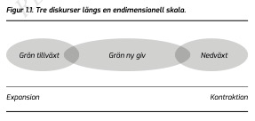
three discourses
Green growth
degrowth
Green new deal

Slide 13
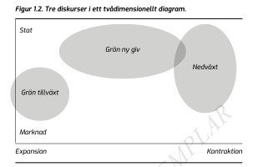
three discourses
Green growth
degrowth
Green new deal

Slide 14
What’s The root cause?
Market failures!☞Green growth
Economic growth! ☞ degrowth
Capitalism! ☞ Green new deal

Slide 15
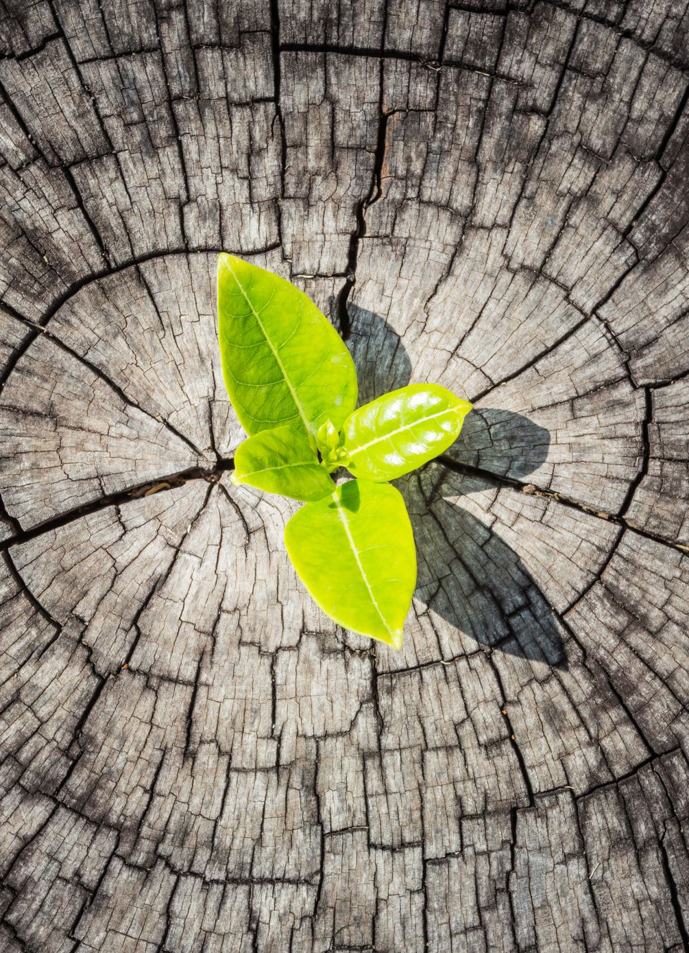
Green growth
Core ideas:
The system can be fixed
Free markets & technical innovation
Internalize externalities
DEcoupling

Slide 16
Green growth
History of ideas:
Environmental economics
Ecological modernization
Sustainable development
Green growth theory

Slide 17
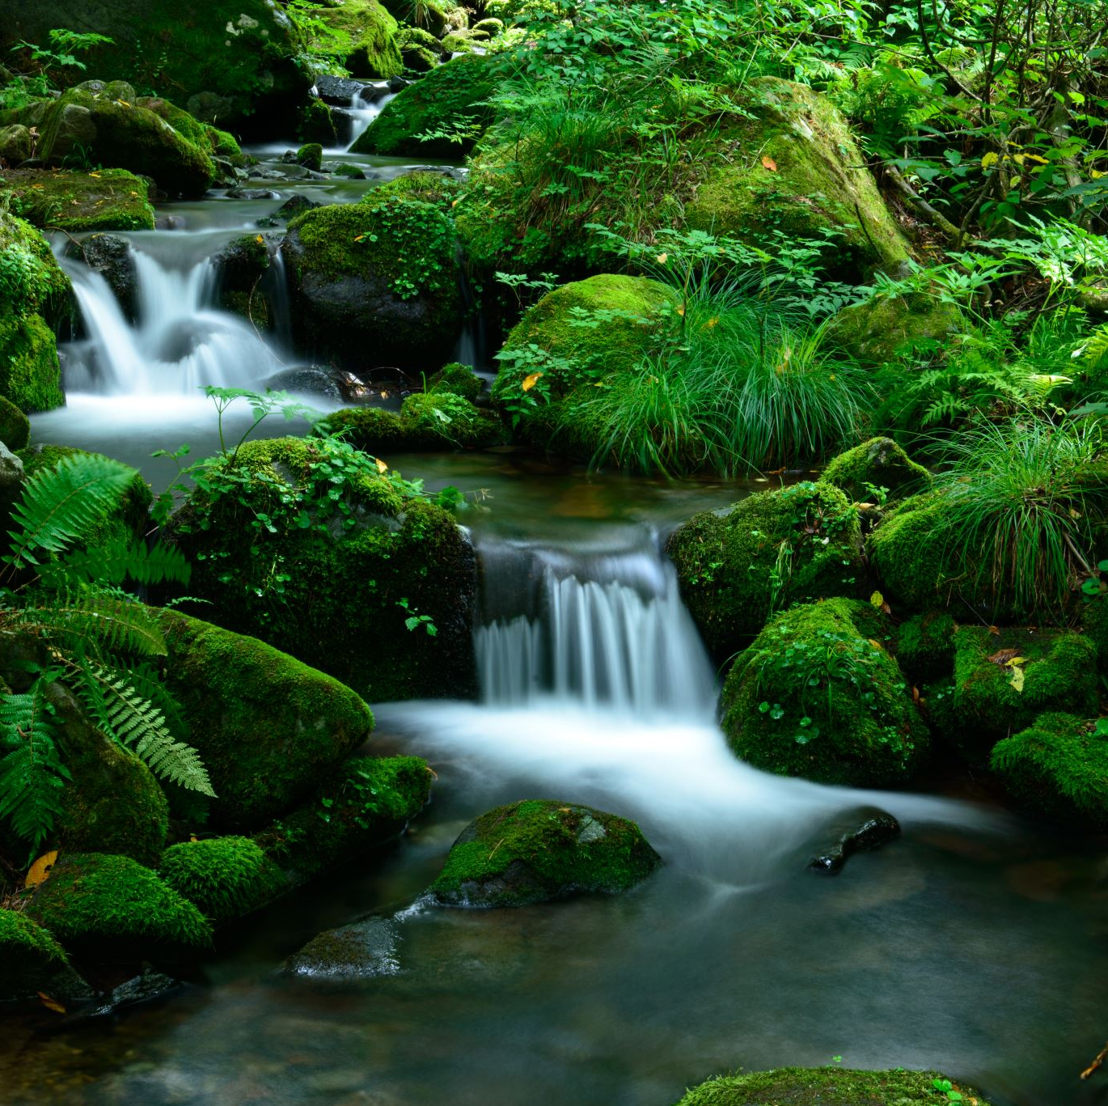
degrowth
Core ideas
GDP Growth requires growth
in material throughput
decoupling pessimists
Positive vision

Slide 18
degrowth
History of ideas
Transatlantic school
  Limits to growth?
  Steady state economics
  T. Jackson & K. Raworth
  [malthusianism]
Mediterranean school
  French political ecology
  Degrowth

Slide 19

Green new deal
Core ideas
Capitalism is crisis-prone
State intervention can stabilize it
Against neoliberal austerity
Green Welfare state

Slide 20
Green new deal
History of ideas
New deal, folkhemmet
Keynesianism
Gröna folkhemmet
Green new deal 1.0 & 2.o

Slide 21
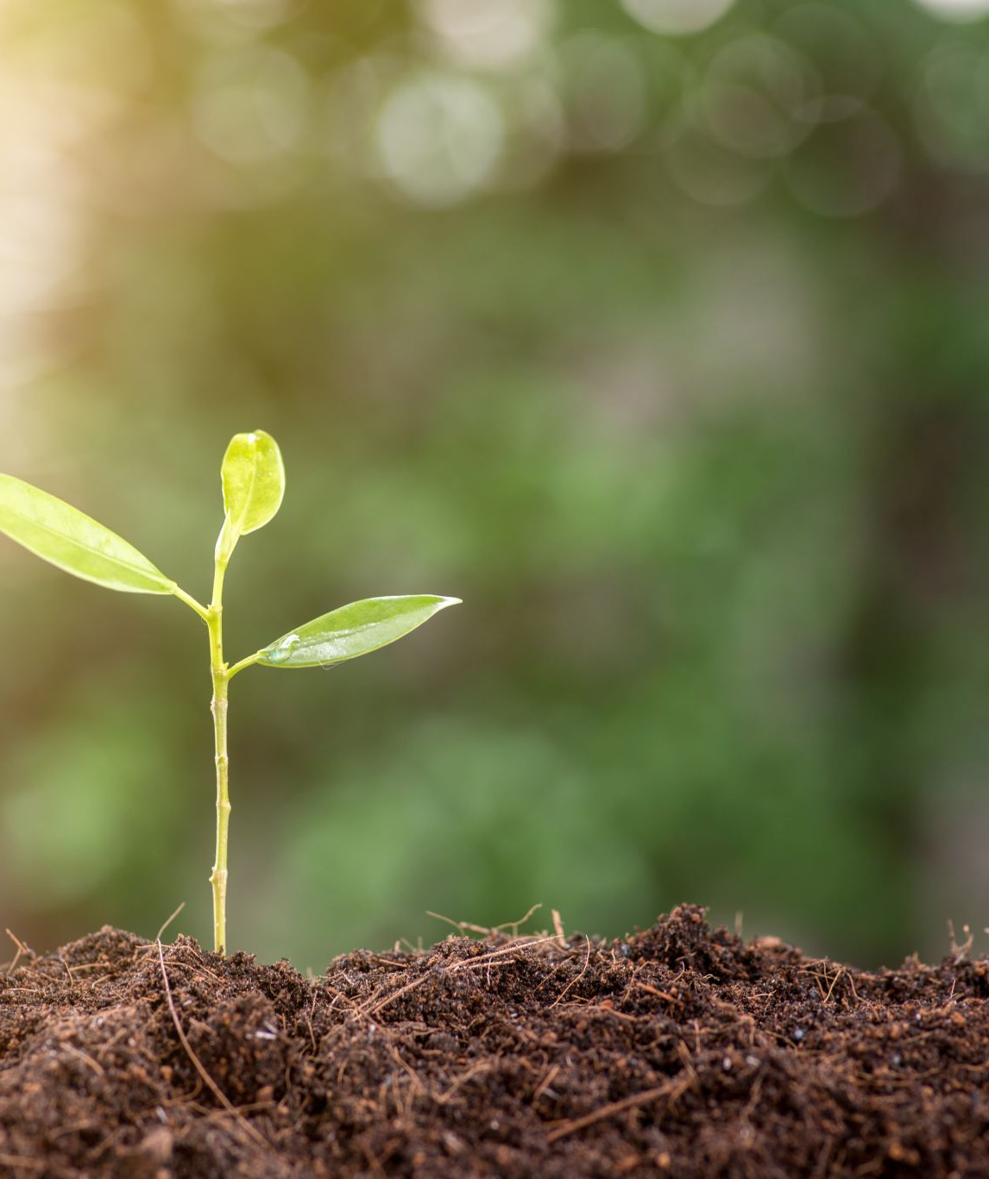
growth
our inability to understand exponential growth

Slide 22
growth
our inability to understand exponential growth
The great
acceleration

Slide 23
decoupling

Slide 24
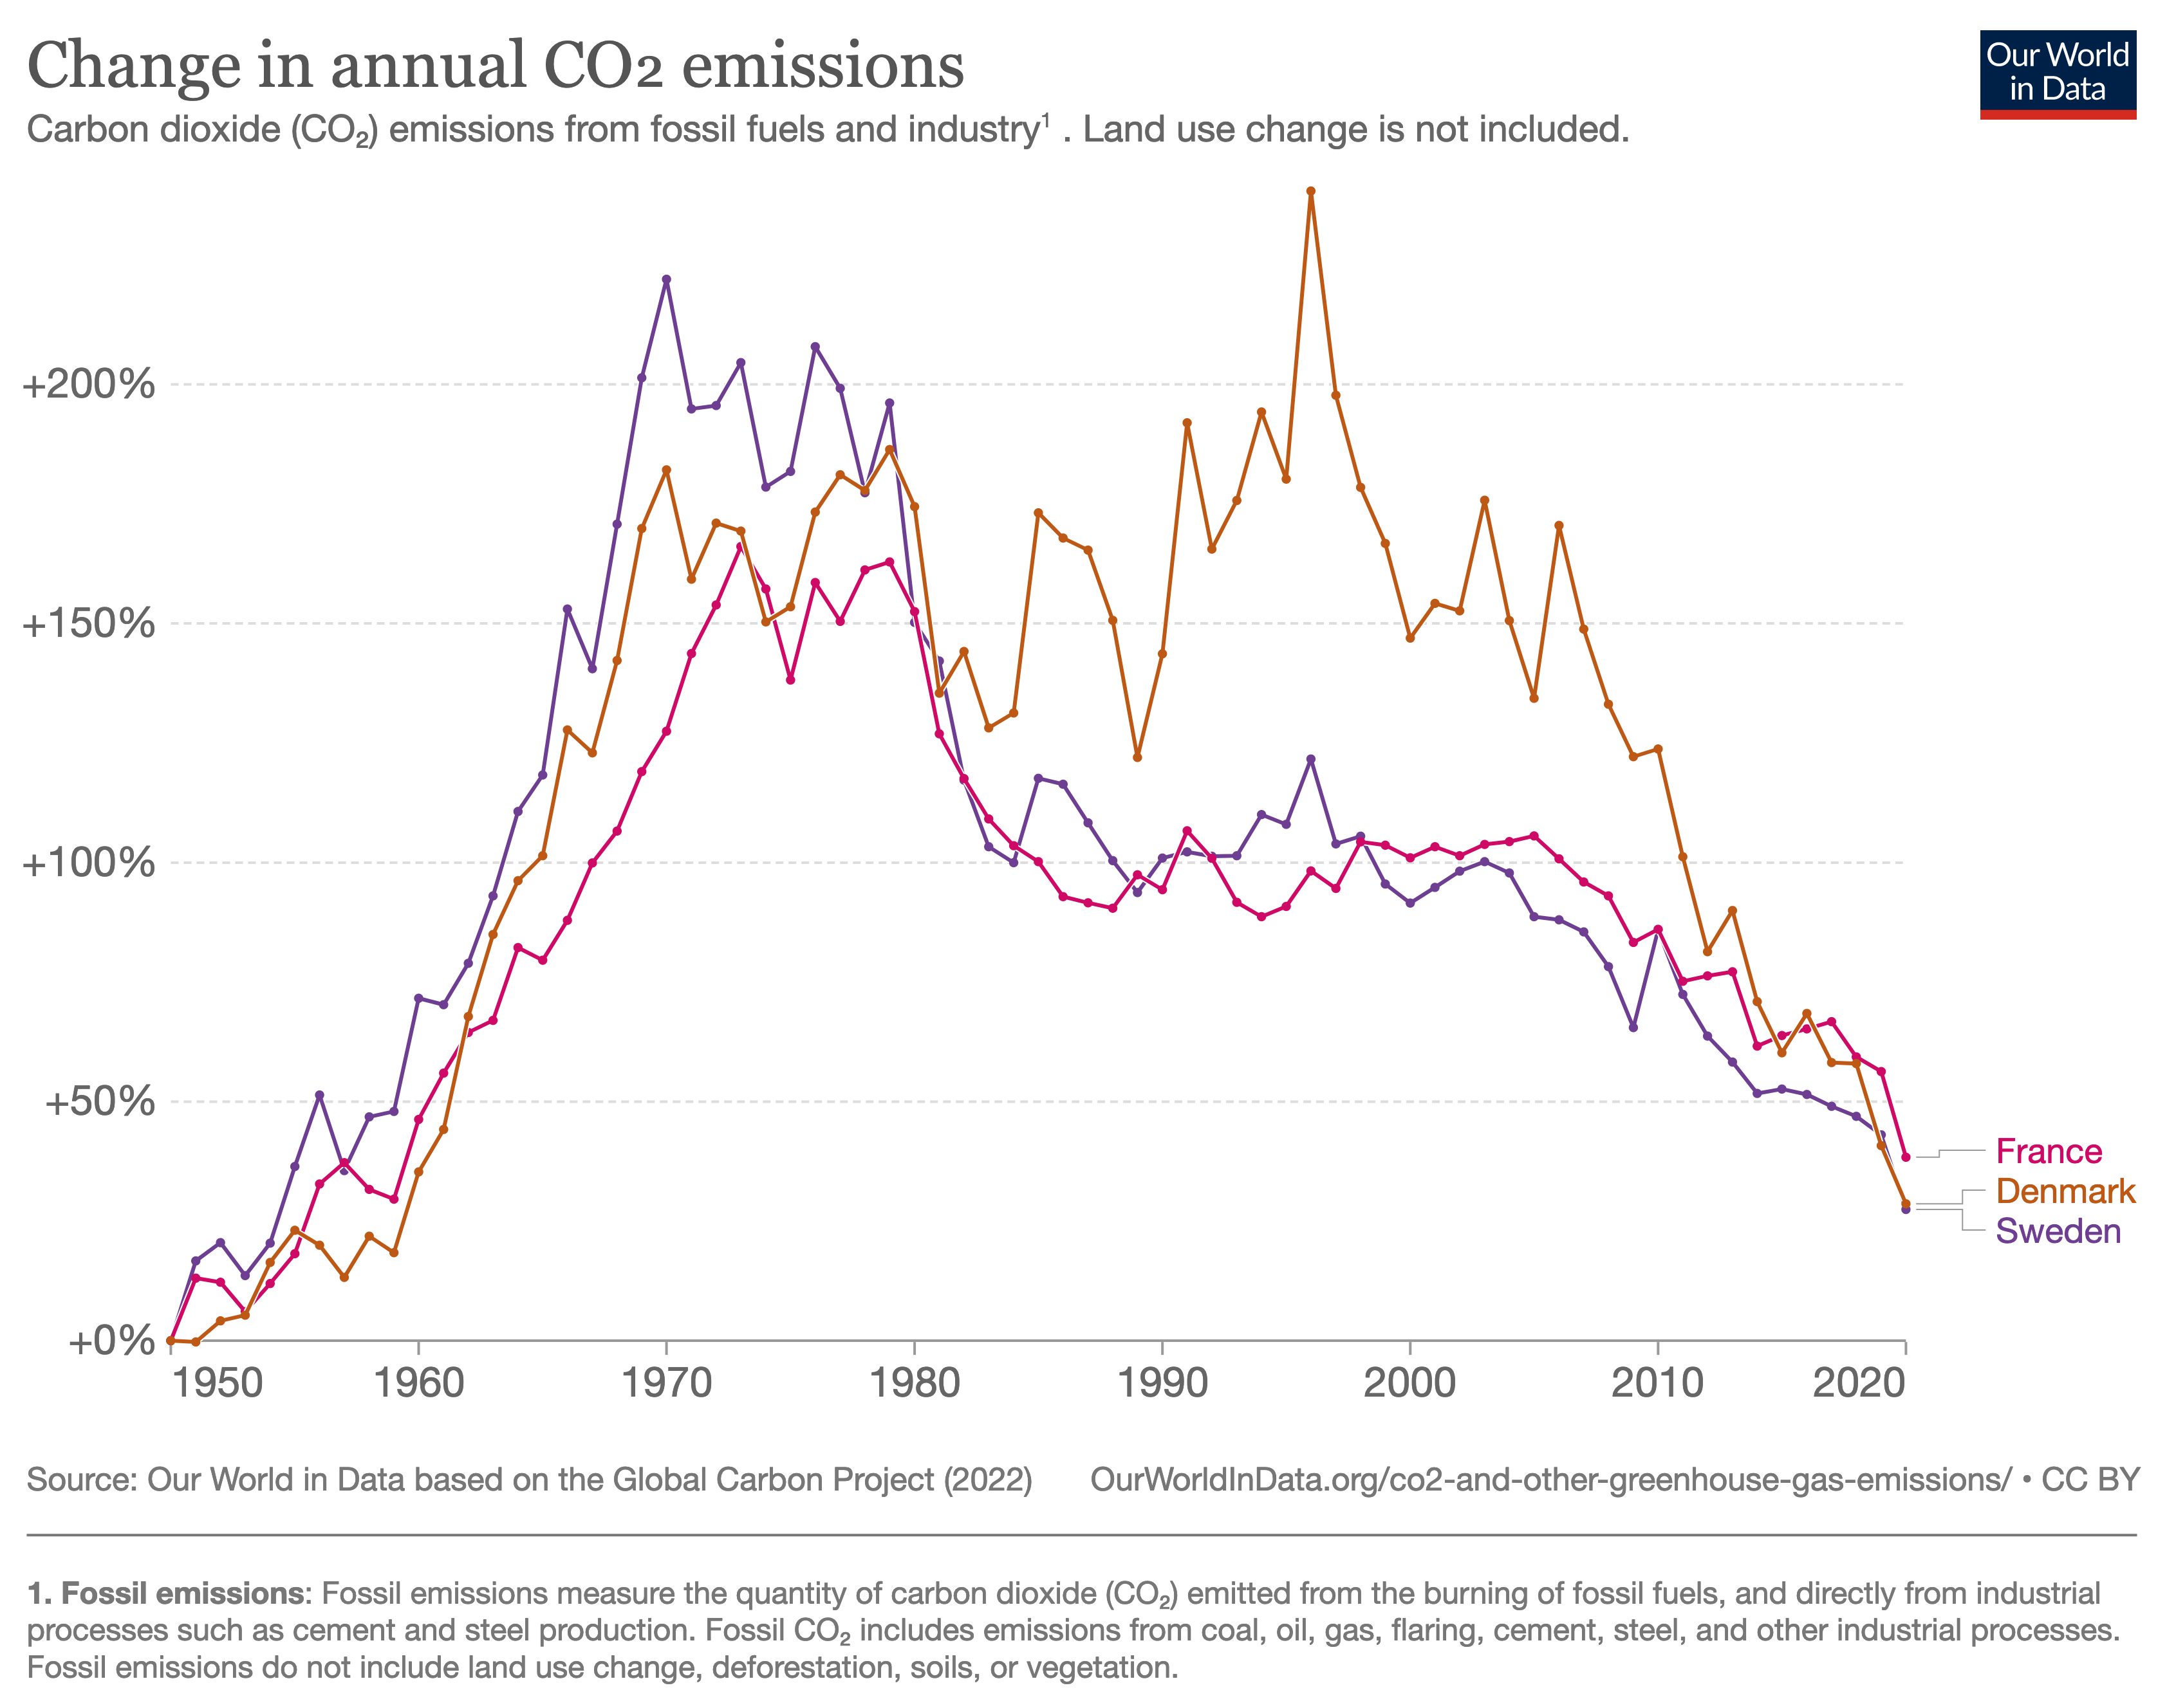
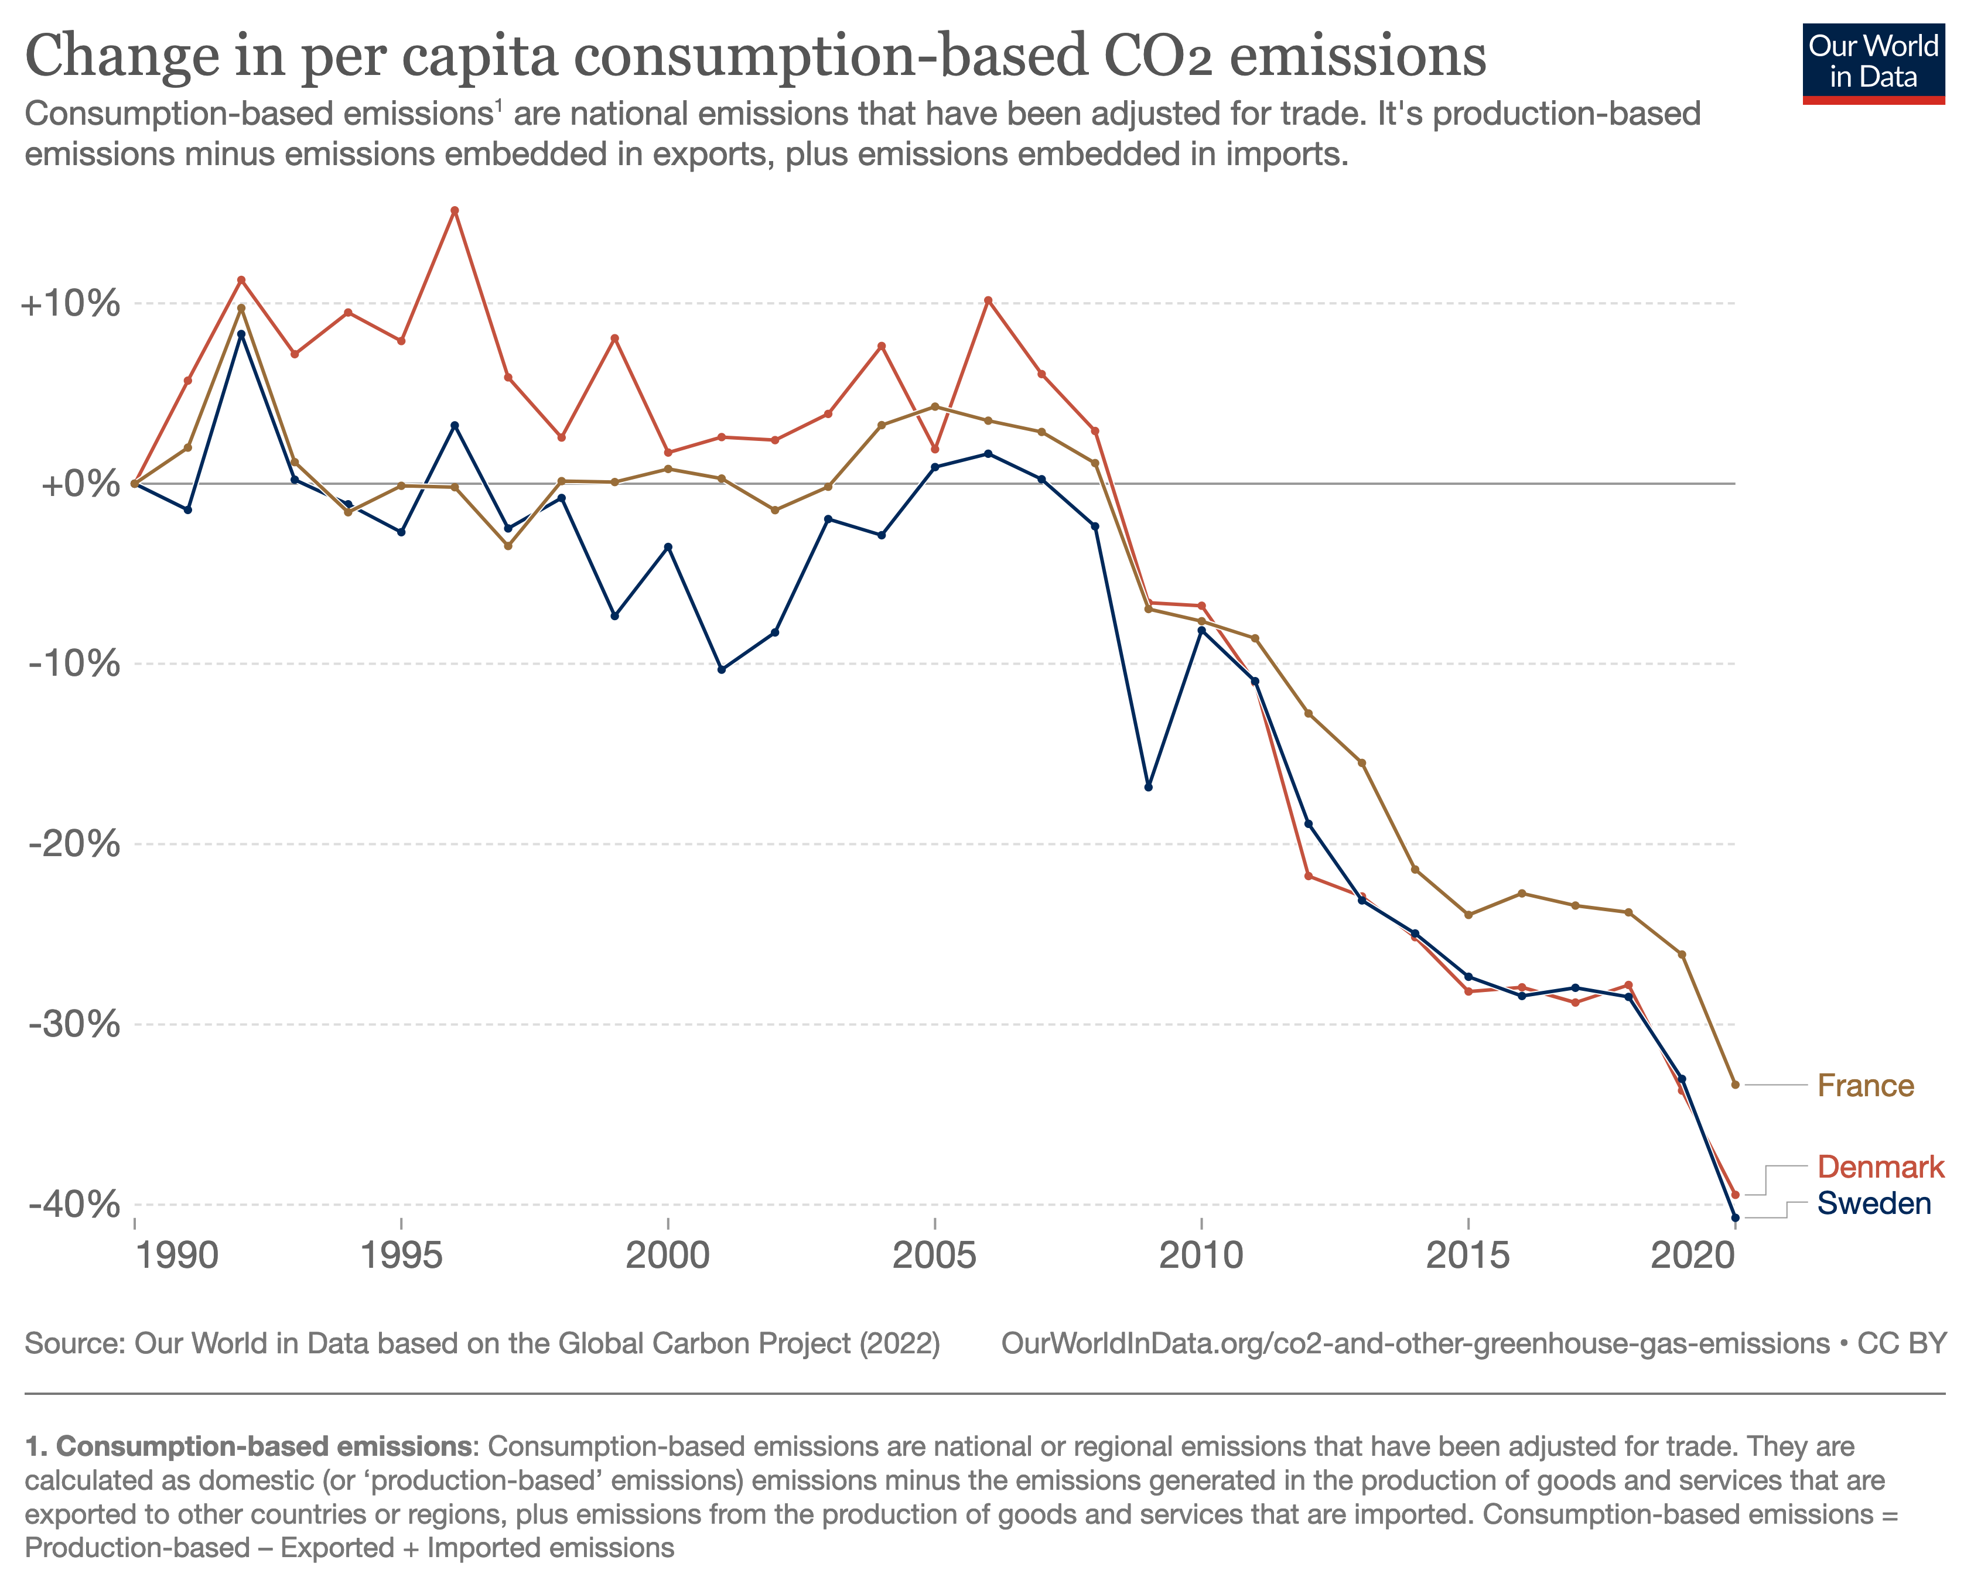
decoupling

Slide 25
decoupling
How much degrowth is needed to reach the emission targets under pessimist assumptions on degrowth?

Slide 26

economic growth and technology
GDP = consumption + investments + public sector + (export – import)
What creates growth?
  More production (e.g. more labour, capital, resources)
  Productivity increases (more production per unit of labour)
  = technological and organizational innovations
Why growth?
  Capitalism driven by profits and accumulation

Slide 27
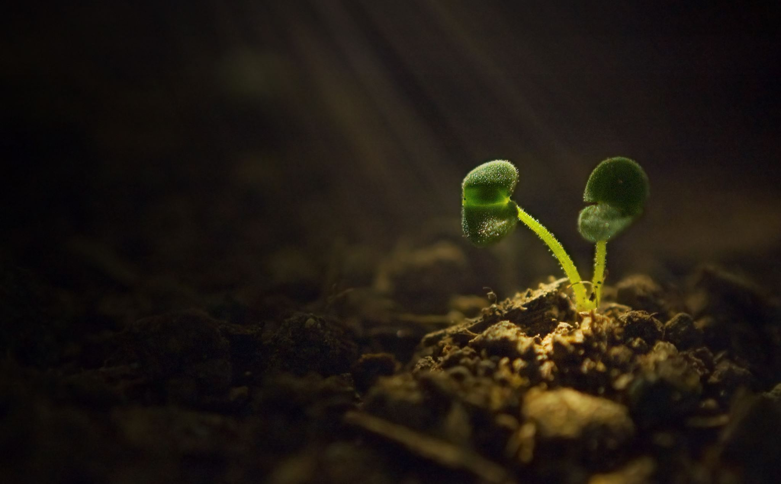
Capitalism and growth
Growth as preference
Growth as imperative

Slide 28
Capital accumulation
Growth drives capitalism (degrowth position)
Capital accumulation and profits drives capitalism and growth is an effect (structuralist position)

Slide 29
Gdp versus profits
GDP = consumption + investments + public sector + (export – import)
Profits = surplus value from labour process

Slide 30
Gdp versus profits
Public sector
Income distribution
Population and employment
Internationalization

Slide 31
Historical examples
Golden era (ca 1945-1975): High growth/decreasing profits
Neoliberalism (ca 1980-2020): Low(er) growth, high profits

Slide 32
conclusions
Capitalism is driven by profits, not growth
”Growth policies” tend to be ”profit policies”
Growth and capital accumulation are contingently related
Capitalism cannot exist without accumulation/growth
Degrowth is revolutionary
Growth is neither good nor bad, nor is it neutral

Slide 33
Essential readings
Green growth
degrowth
Green new deal
OECD resource: https://www.oecd.org/greengrowth/
Kågesson, P. (2016): Grön tillväxt under lupp
Jacobs, M. (2013): Green Growth
Smulders, S., M. Toman, C. Withagen (2014): Growth Theory and ’Green Growth’
Meadows et al. (1972): The limits to growth
Jackson, T. (2009): Prosperity without growth
D’Alisa, G., F. Demario, G. Kallis (2014) Degrowth: A vocabulary for a new era
Hickel, J. (2020): Less is more. How degrowth will save the world
Klein, N. (2019): On Fire. The burning issue for a Green New Deal
Ocasio Cortez, A. & E. Markey (2019): Resolution Recognizing the Duty of the Federal Government to create a Green New Deal
Pollin, R. (2018): De-Growth vs. a Green New Deal

