Slide 2
Agenda – Debate Week!
Introduction to debate
Debate teams
Run-through of climate technologies
Self-organized preparation work

Slide 3
Debate structure – 45 minutes per debate
2 Teams debate, the other 2 teams are spectators/audience and may ask questions
One team starts off the debate with an opening statement on their stance; then the other team gives an opening statement.
Then, with help from a moderator, the two teams will present their arguments, and be able to counter-argue as well.
Preparation:
Opening statement
At least 3 arguments
Closing statement
Think about what the opposing side might say/argue for as well, and prepare counterarguments!
Use references when preparing, and send a list of references (1 per team) after the debate

Slide 4
Climate technologies
NET – Negative emissions technologies
CCS – Carbon capture and storage
BCC – Biomass carbon capture
Re- and afforestation
Geoengineering
SAI – Stratospheric aerosol injection
MCB – Marine cloud brightening
GBAM – Ground-based albedo modification

Slide 5
Debate teams
Team 1: NET-optimists
Arguments FOR the use of NET
Team 2: NET-pessimists
Arguments AGAINST the use of NET
Team 3: Geoengineering-optimists
Arguments FOR the use of geoengineering
Team 4: Geoengineering-pessimists
Arguments AGAINST the use of geoengineering

Slide 6
Climate technologies
NET – Negative emissions technologies
CCS – Carbon capture and storage
BCC – Biomass carbon capture
Re- and afforestation
Geoengineering
SAI – Stratospheric aerosol injection
MCB – Marine cloud brightening
GBAM – Ground-based albedo modification

Slide 7
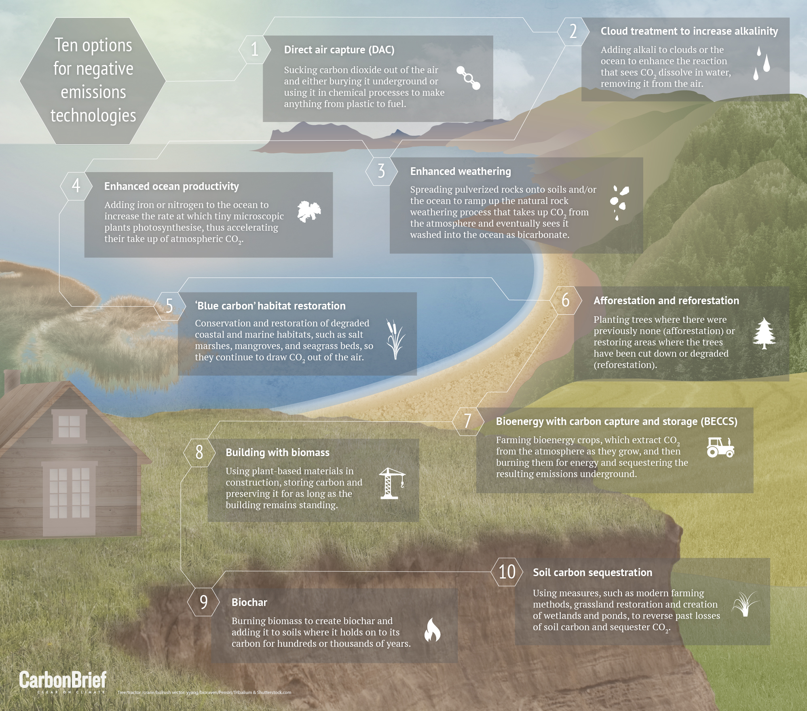
Negative Emissions Technology NET

Slide 8
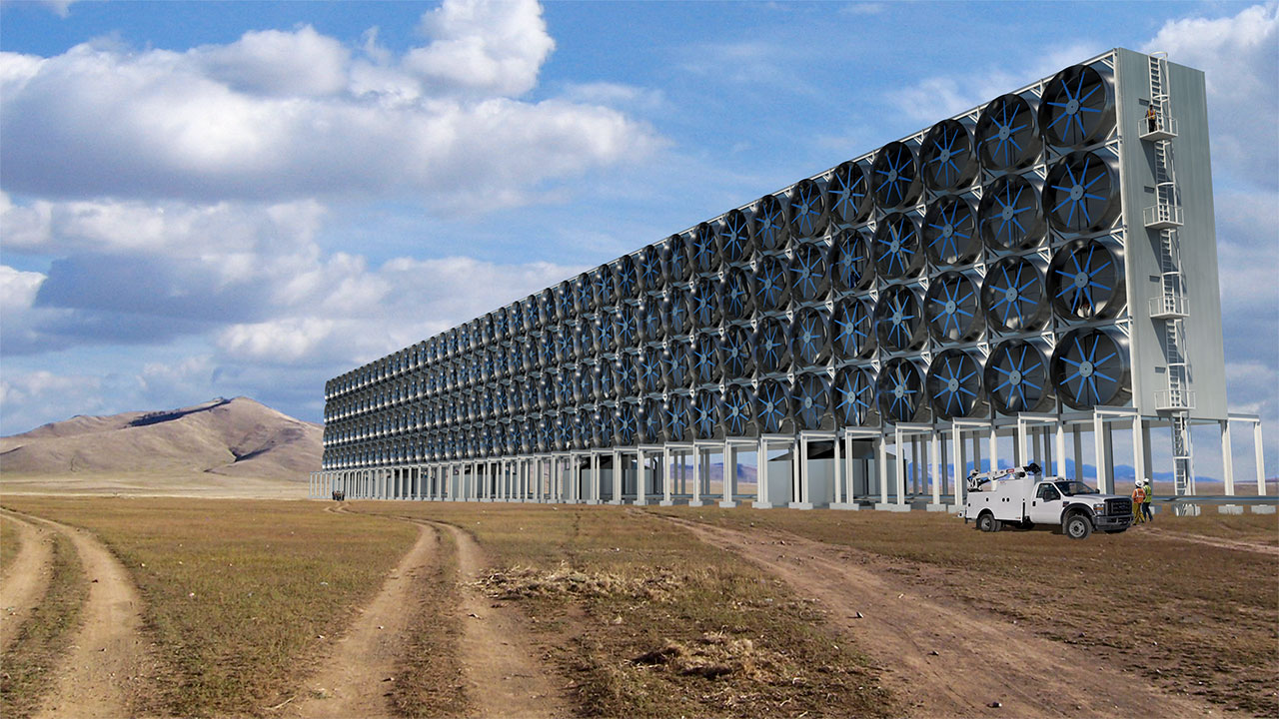
Carbon capture and storage

Slide 9
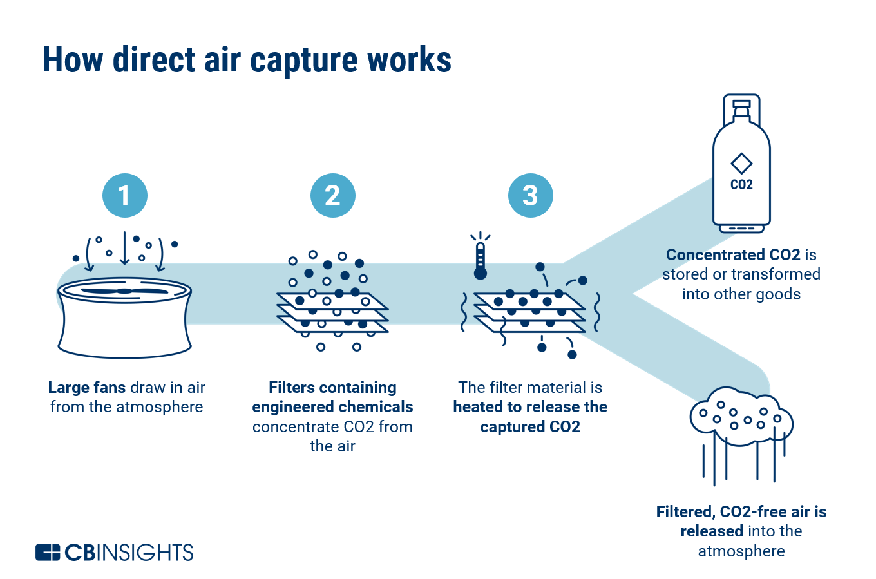
Carbon capture and storage

Slide 10
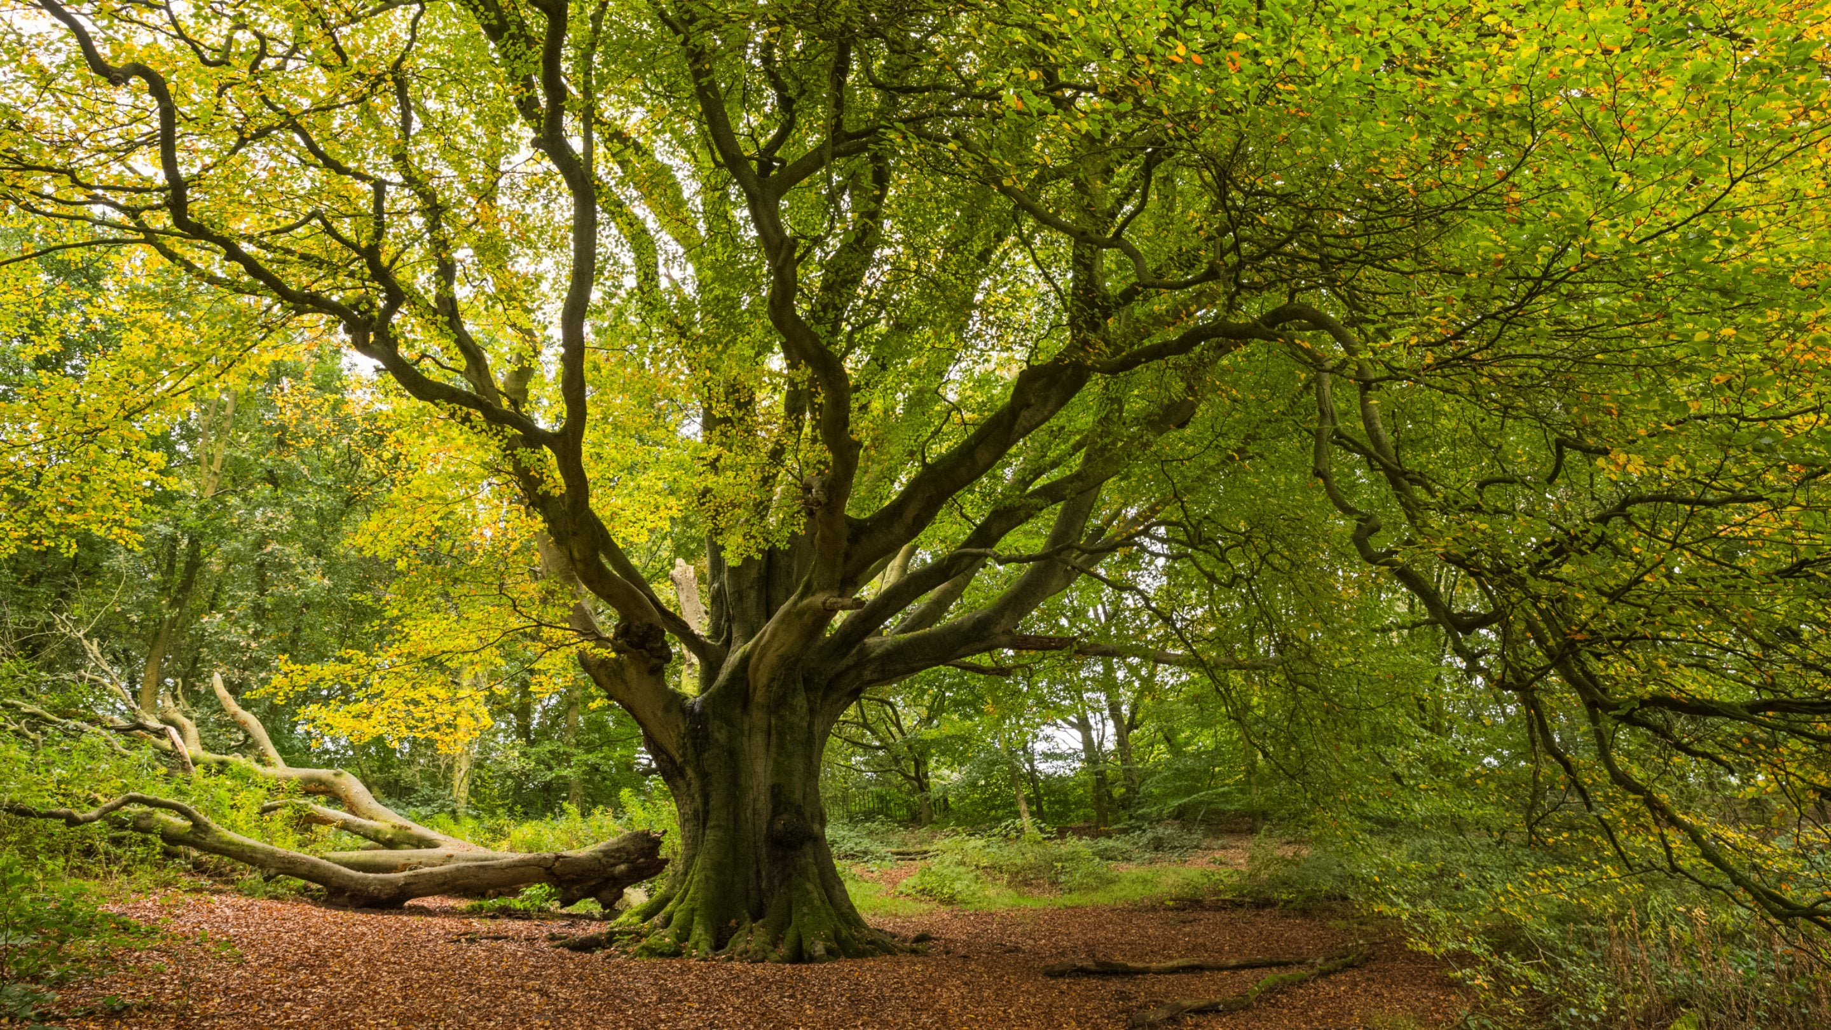
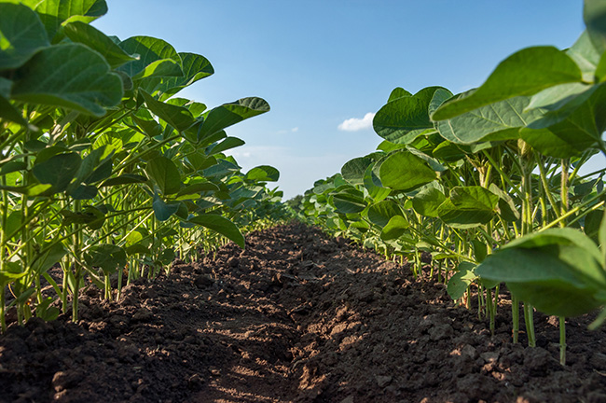
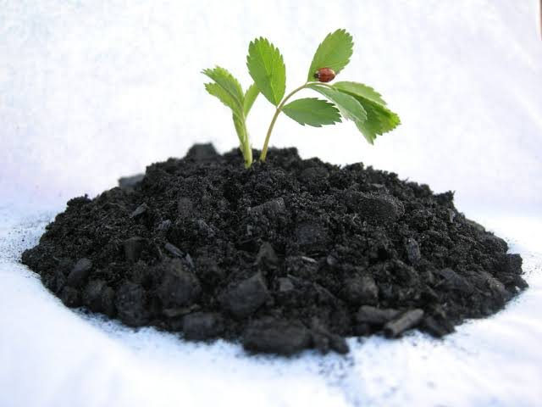
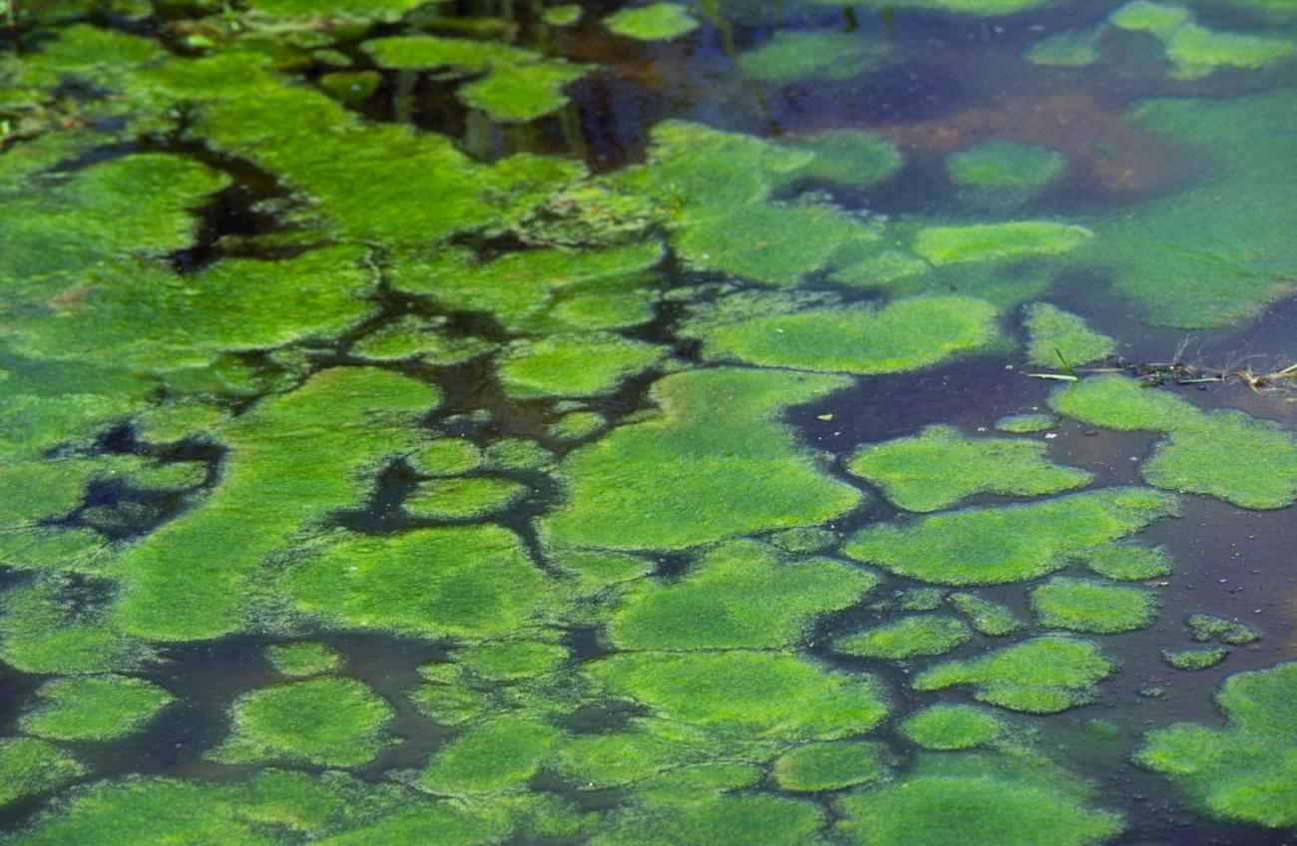
Biomass carbon capture

Slide 11
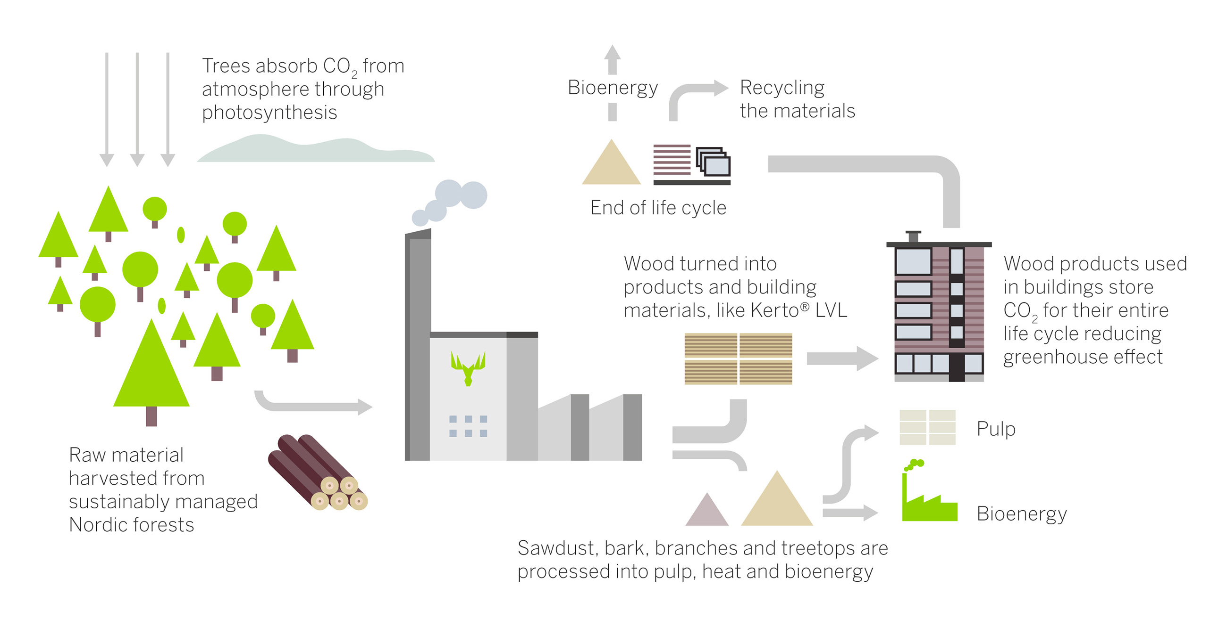
Biomass carbon capture

Slide 12
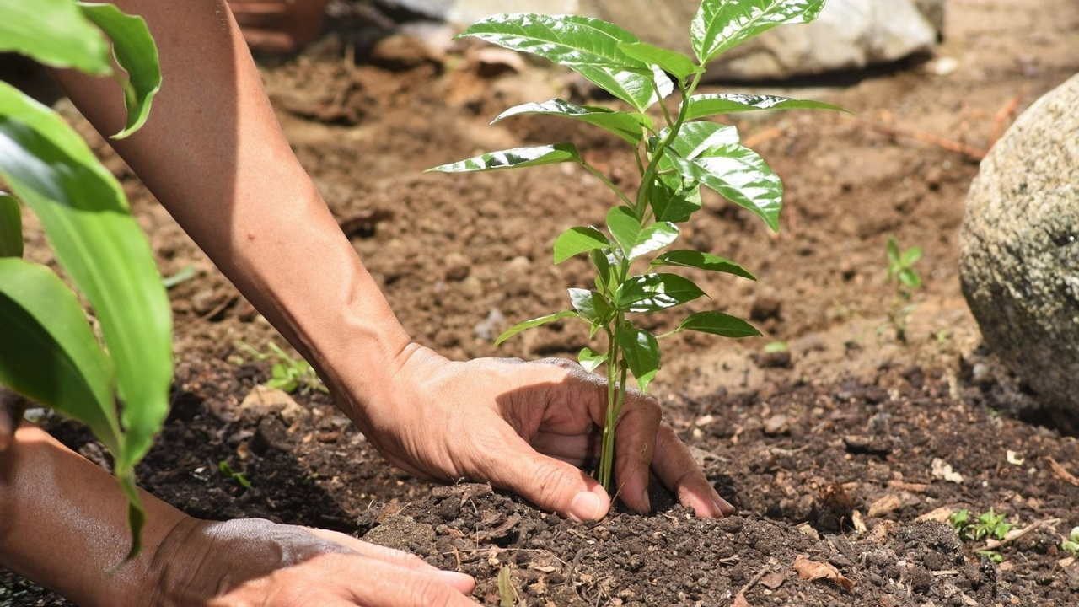
Re- and afforestation

Slide 13
Summary - NET

Slide 14
Climate technologies
NET – Negative emissions technologies
CCS – Carbon capture and storage
BCC – Biomass carbon capture
Re- and afforestation
Geoengineering
SAI – Stratospheric aerosol injection
MCB – Marine cloud brightening
GBAM – Ground-based albedo modification

Slide 15
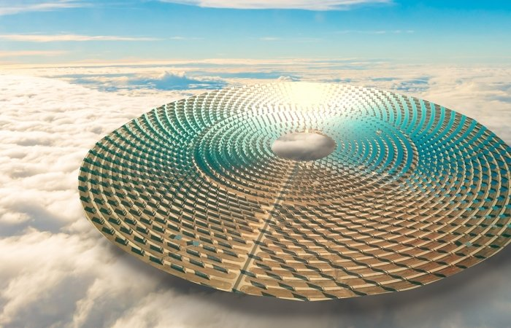
Geo-engineering

Slide 16
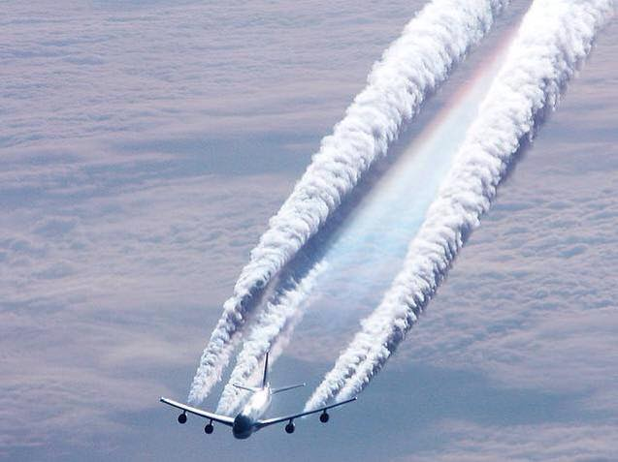
Stratospheric aerosol injection

Slide 17
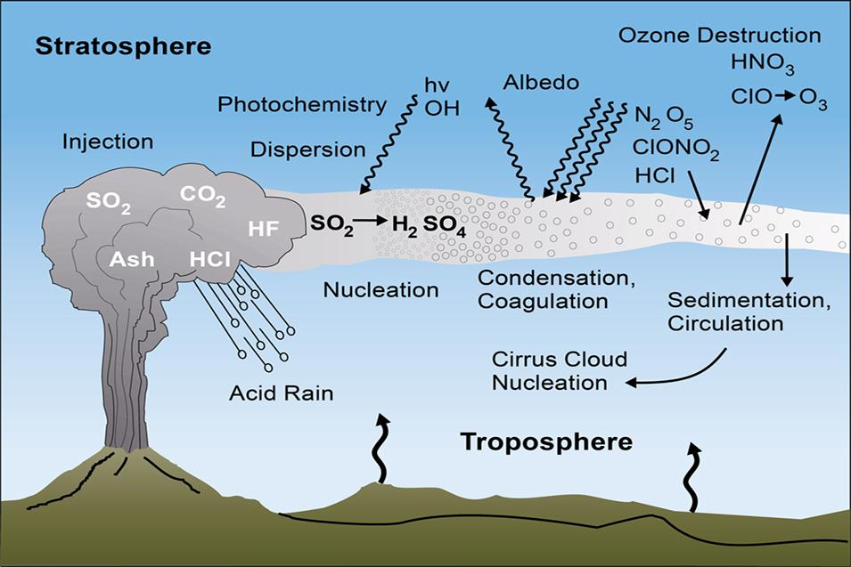
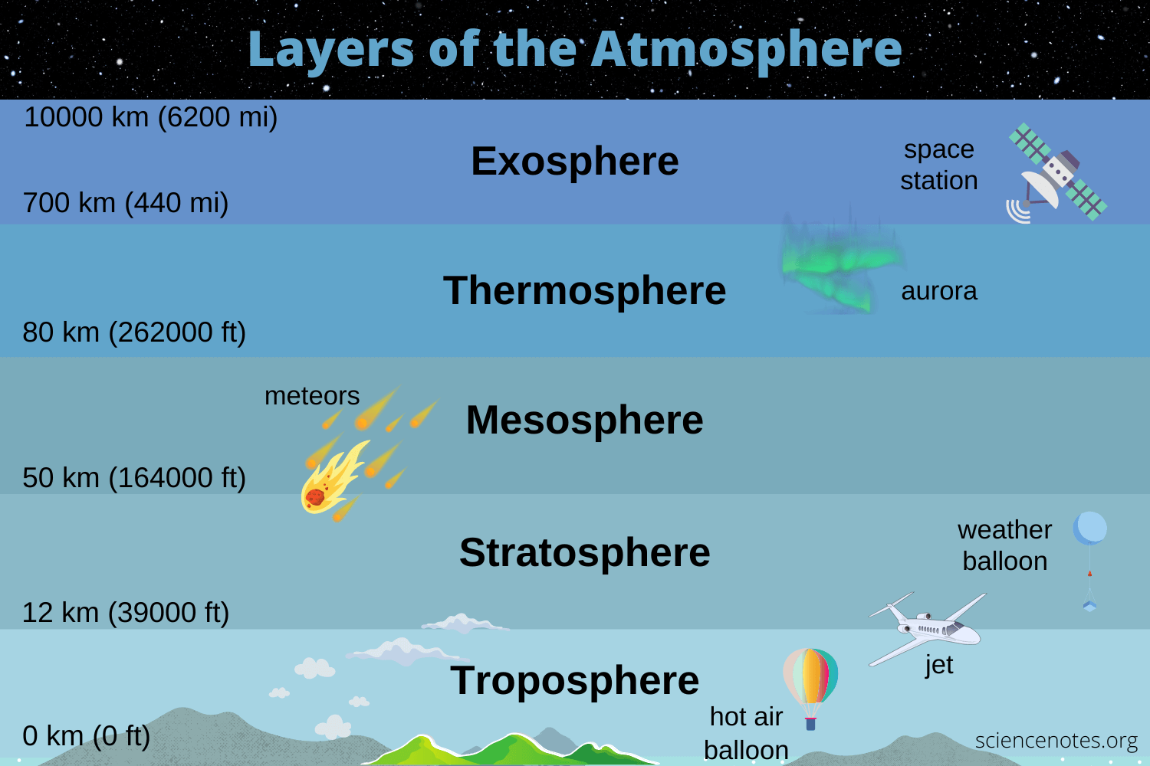
Atmospheric solar radiation management

Slide 18
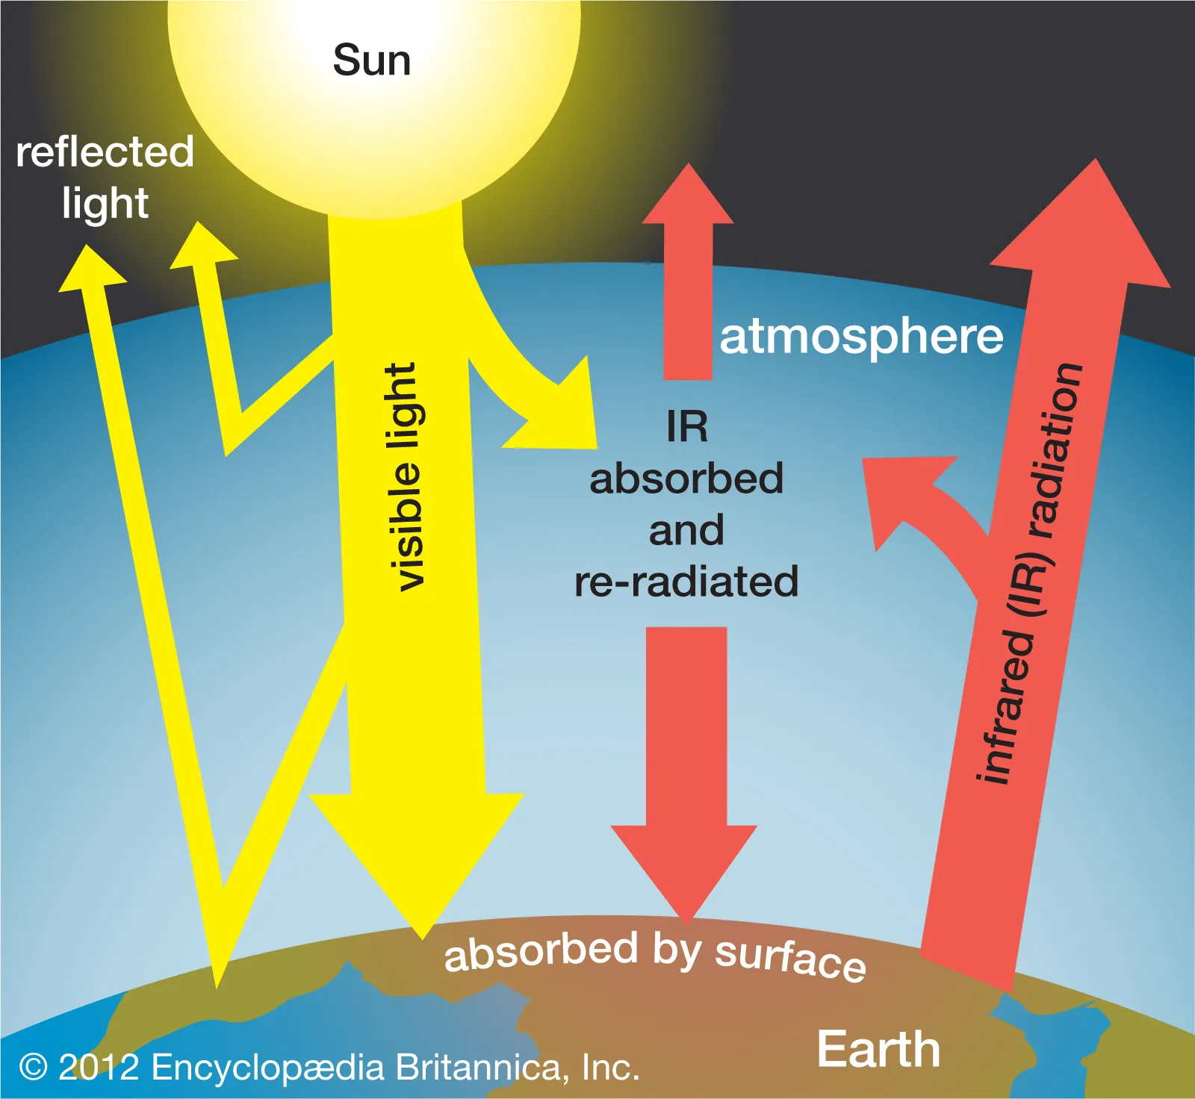
Stratospheric aerosol injection

Slide 19
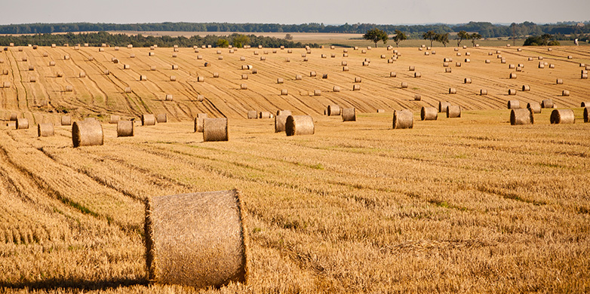
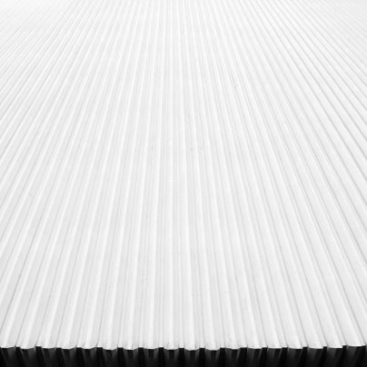
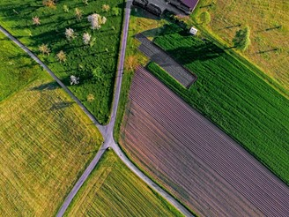
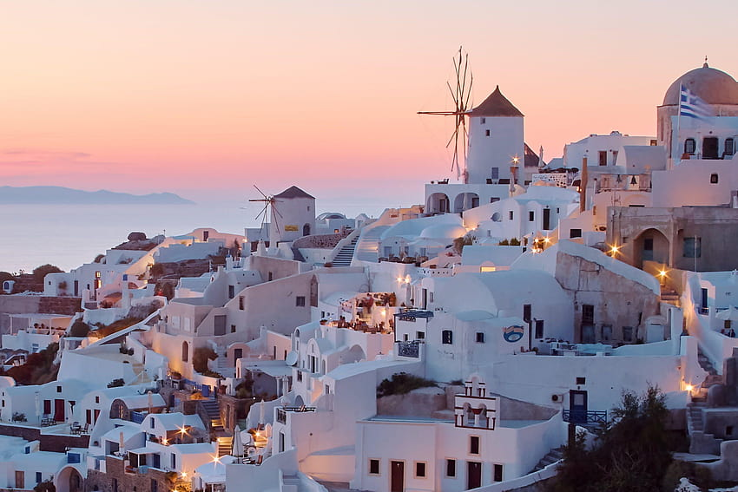
Ground-based albedo modification

Slide 20
Ground-based albedo modification

Slide 21
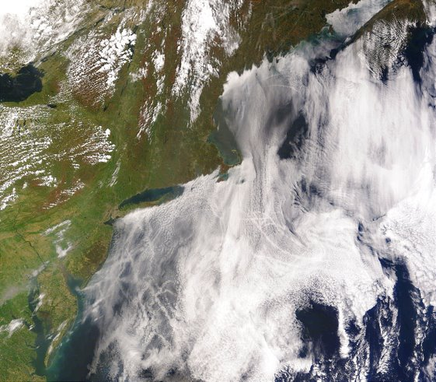
Marine cloud brightening

Slide 22
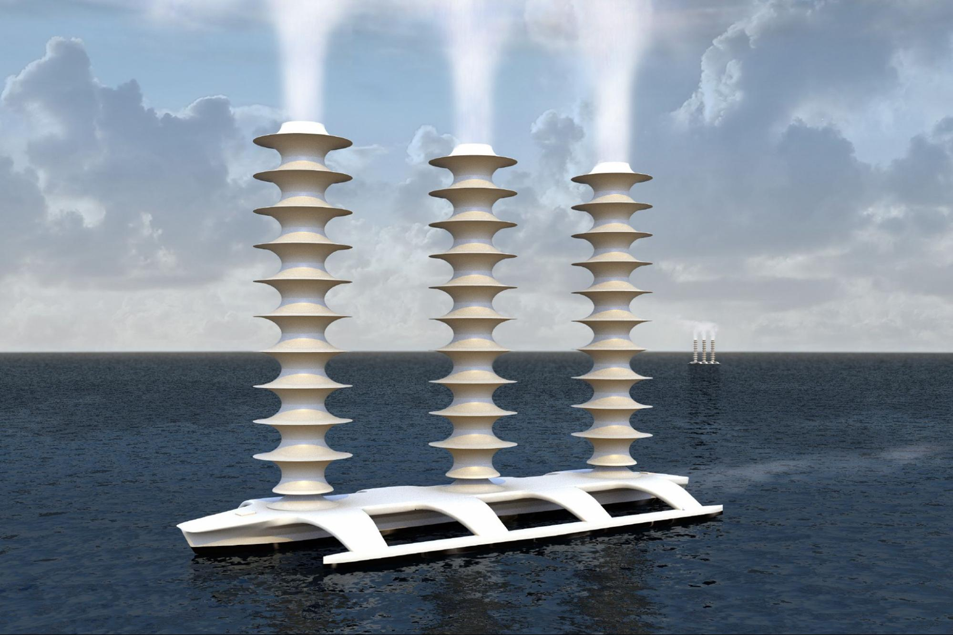
Marine cloud brightening

Slide 23
Marine cloud brightening

Slide 24
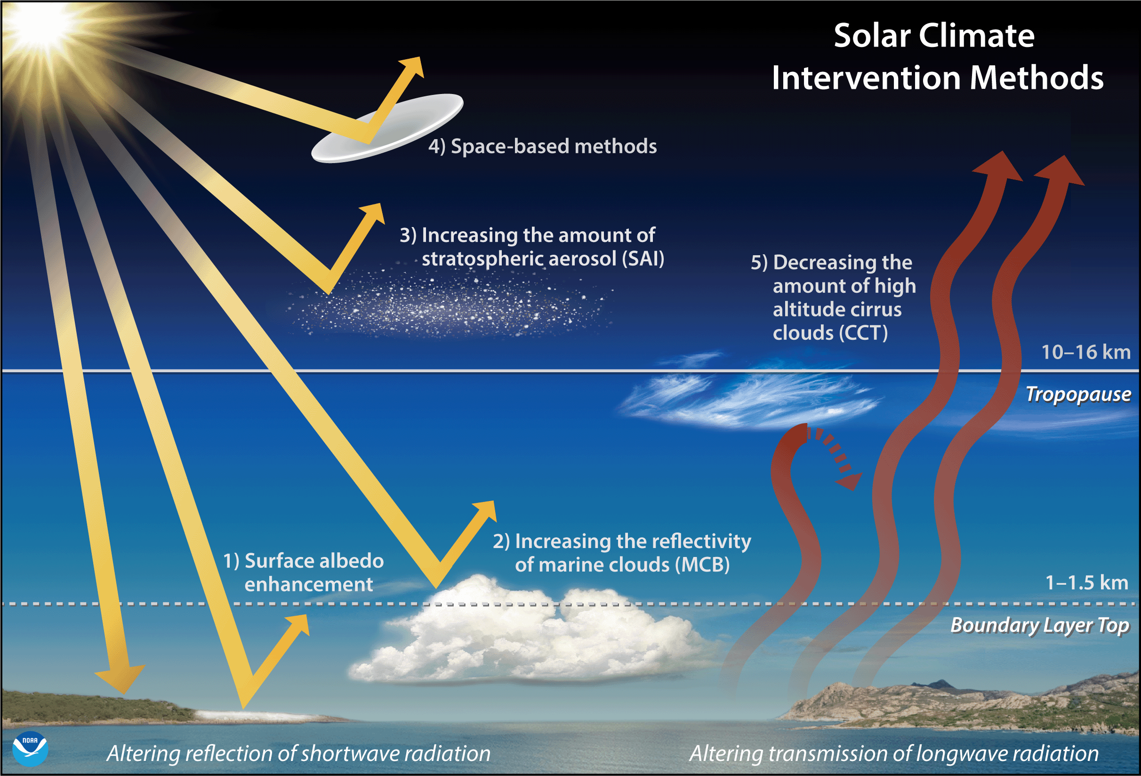
Summary - Geoengineering

Slide 25
Questions?

